Slide 1
Improving Customer Order Fulfillment Reliability
Lean Six Sigma Black Belt — DMAIC Case Study
Customer Order Fulfillment | FMCG-style Supply Chain
Portfolio project using a synthetic dataset
Define → Measure → Analyze → Improve → Control
Lean Six Sigma Black Belt Portfolio | Synthetic FMCG dataset | 1

Slide 2
Executive Summary
What the project set out to improve and what the analysis established
Overall fill rate
Non-cancelled fill rate
Complete order rate
Backorder rate
Eligible shortage
90.3%
92.2%
87.8%
5.2%
174,549
Problem
Analysis
Outcome
Customer orders were not consistently fulfilled in full. The project established a baseline and investigated potential sources of fulfillment variation.
The completed tests did not establish statistically significant associations for product category (p = 0.6179) or warehouse (p = 0.3786), or a statistically significant order-quantity distribution difference (p = 0.3611). Supplier-level rank correlation was very weak.
The project translated baseline observations and process risks into proposed pilot interventions, a corrected FMEA, a future-state process, KPI controls, and a reaction plan.
Evidence boundary: The dataset is synthetic. Descriptive patterns do not establish causal mechanisms, and the project does not claim realized post-improvement benefits or actual operational deployment.
Lean Six Sigma Black Belt Portfolio | Synthetic FMCG dataset | 2

Slide 3
DEFINE — Project Charter & CTQ
Establish the problem, customer requirement, scope, and measurement focus
Business case
Problem statement
Customer order fulfillment is a critical service outcome. The project focuses on understanding variation in ordered-versus-shipped quantity and translating the evidence into process improvements.
Customer demand is not consistently fulfilled in full, while the drivers of variation have not been statistically validated.
Primary CTQ / Y
Scope boundary
Customer Quantity Fill Rate = Total Shipped Quantity ÷ Total Ordered Quantity × 100. The project retains both all-order and non-cancelled views.
Customer Order Created → Order Processing → Inventory Availability Check → Allocation → Replenishment if Required → Fulfillment → Shipment → Customer Order Fulfilled/Unfulfilled.
Lean Six Sigma Black Belt Portfolio | Synthetic FMCG dataset | 3

Slide 4
MEASURE — Baseline & Measurement System
Operational definitions, data quality, and baseline performance
Data quality
• 15,000 sales orders
• 5,000 purchase orders
• 16,425 inventory records
• 150 products, 25 suppliers, 5 warehouses
• No duplicate sales orders; no negative quantities; no shipped quantity above ordered quantity
Measurement definition
Primary Y: Σ Shipped_Qty ÷ Σ Order_Qty × 100. Cancellations are reported separately; partial fulfillment and backorders are tracked as distinct outcomes.
All-order fill rate
Non-cancelled fill rate
Complete order rate
Eligible shortage
90.3%
92.2%
87.8%
174,549
Measurement lesson: the 90.3% and 92.2% figures are different views of the same process, driven by the documented treatment of cancelled orders.
Lean Six Sigma Black Belt Portfolio | Synthetic FMCG dataset | 4

Slide 5
ANALYZE — Where is Variation Concentrated?
Move from baseline performance to evidence-supported factors
Order status
Product/category
Order quantity
Delivered orders dominate the volume, while late, partially fulfilled, backorder, and cancelled outcomes represent distinct failure modes.
Category-level performance varies descriptively, but the chi-square test did not identify a statistically significant association with complete-fulfillment status (p = 0.6179).
The largest order-size band contributed the highest absolute shortage quantity (59,261 units), but its fill rate was approximately 92.57%. The Mann–Whitney test did not identify a statistically significant difference in order-quantity distributions between eligible complete and incomplete orders (p = 0.3611).
Warehouse
Supplier
Evidence boundary
The Minitab chi-square test did not identify a statistically significant association with complete-fulfillment status (p = 0.3786).
Supplier-level Spearman correlation was very weak (ρ = 0.057; reported 95% CI: −0.346 to 0.442). The available Minitab output does not report a p-value.
Inventory linkage was limited; allocation timestamps, workload/capacity, and standardized shortage reasons were unavailable.
Conclusion: Treat order-size and category patterns as descriptive findings, not statistically established drivers. Evaluate selected pilot interventions and collect better operational data before making causal claims.
Lean Six Sigma Black Belt Portfolio | Synthetic FMCG dataset | 5

Slide 6
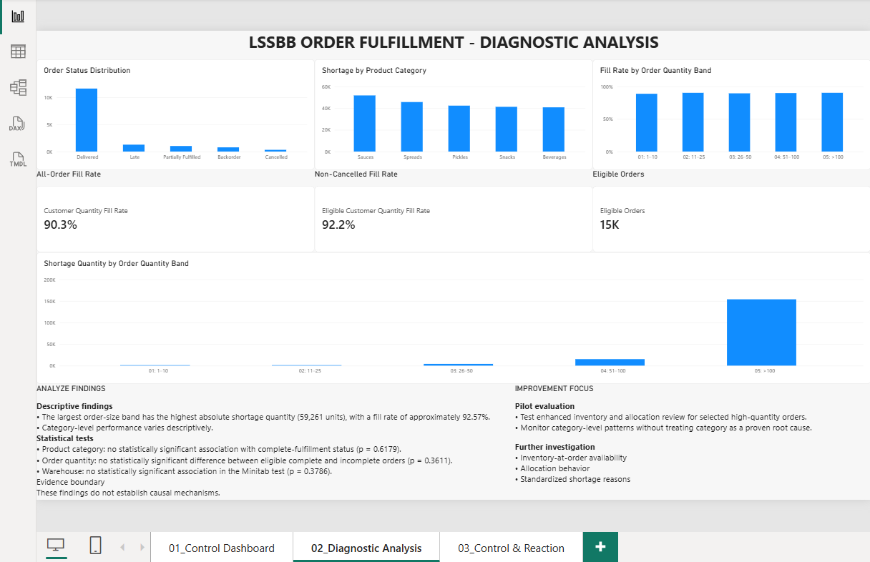
Power BI — Diagnostic Analysis
Portfolio dashboard translating baseline performance and exploratory diagnostic findings into an evidence-aware management view.
Key visual message: Orders above 100 units contribute the highest absolute shortage quantity, while their fill rate is approximately 92.57%.
Category and order-size patterns are descriptive; the completed hypothesis tests did not establish statistically significant effects.
Lean Six Sigma Black Belt Portfolio | Synthetic FMCG dataset | 6

Slide 7
IMPROVE — FMEA & Prioritized Actions
Translate descriptive findings and process risks into practical pilot interventions
1. Order-size risk flag
4. Standardized shortage reason codes
Pilot enhanced inventory availability and allocation review for selected high-quantity orders.
Capture why an order becomes short so future analysis can distinguish potential mechanisms.
2. Category-level monitoring
5. Exception-based allocation review
Monitor category-level patterns without treating category as a proven root cause.
Pilot a defined exception pathway and evaluate outcomes against an appropriate baseline.
3. Inventory-at-order measurement
FMEA prioritization
Highest RPN: large customer order not fully fulfilled (256), followed by category-specific shortage risk (224).
RPN values use provisional Detection ratings and support risk prioritization; they do not establish proven root causes.
Capture inventory position at order time to strengthen future root-cause analysis.
Scenario impact estimates are illustrative assumptions, not measured or realized improvements.
Lean Six Sigma Black Belt Portfolio | Synthetic FMCG dataset | 7

Slide 8
IMPROVE — Future-State Process
Embed the prioritized controls into the fulfillment workflow
1
2
3
4
Order Created
Risk Screening
Inventory Check
Allocation
5
6
7
8
Replenishment Check
Fulfillment
Exception Capture
Control Feedback
Design principle
Risk is identified before allocation, exceptions are captured at the point of failure, and control feedback closes the DMAIC loop.
Lean Six Sigma Black Belt Portfolio | Synthetic FMCG dataset | 8

Slide 9
CONTROL — KPI Monitoring & Reaction
Proposed monitoring and reaction framework using synthetic baseline data; production stability has not been demonstrated.
Fill rate
Complete order
Backorder
Partial
Eligible shortage
90.3%
87.8%
5.2%
6.8%
175K
Reaction plan
Control strategy
Fill-rate deterioration → review affected order-size bands, category performance, and shortage patterns.
Backorder increase → review inventory availability and replenishment.
Partial increase → review allocation and fulfillment exceptions.
Monitor → weekly fulfillment KPIs
Review → exception trends and deterioration
Investigate → order-size/category patterns and inventory availability
React → defined exception response
Standardize → KPI definitions, shortage coding, inventory snapshot completeness
SPC note: The weekly trend is synthetic baseline data. Production control limits and post-improvement stability have not been established.
Lean Six Sigma Black Belt Portfolio | Synthetic FMCG dataset | 9

Slide 10
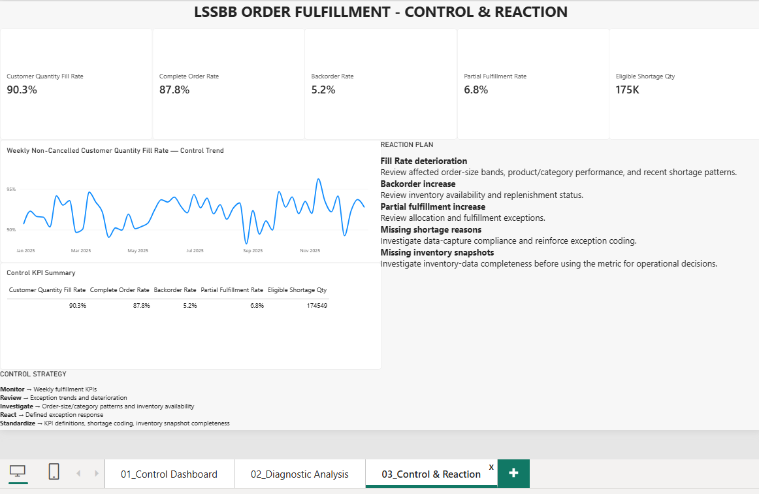
Power BI — Control & Reaction
From KPI monitoring to defined operational response
The dashboard operationalizes the proposed control plan while keeping evidence and causality boundaries explicit.
Lean Six Sigma Black Belt Portfolio | Synthetic FMCG dataset | 10

Slide 11
BLACK BELT TAKEAWAYS
1
Define the CTQ before analyzing causes.
2
Lock operational definitions and separate cancellations, backorders, and partial fulfillment.
3
Use statistical evidence to distinguish supported factors from hypotheses.
4
Translate evidence into FMEA-prioritized actions rather than generic recommendations.
5
Design the control system around measurable KPIs and explicit reaction logic.
Portfolio evidence: DMAIC artifacts + analytical dataset + Power BI control dashboard + improvement/control framework
Lean Six Sigma Black Belt Portfolio | Synthetic FMCG dataset | 11

Slide 12
Evidence Boundary & Portfolio Disclosure
How to present the project accurately in interviews and on GitHub
Dataset
What is demonstrated
Synthetic FMCG-style supply chain data covering sales orders, purchase orders, inventory, products, suppliers, customers, and warehouses. It is used for portfolio demonstration and analytical practice.
DMAIC structure, operational measurement, data-quality review, statistical analysis, FMEA, improvement prioritization, control planning, and Power BI dashboard design.
What is not claimed
Interview positioning
No actual employer performance is claimed. No post-improvement benefit is claimed. Causal mechanisms are not asserted where the available data cannot support them.
Present this as a synthetic-data Lean Six Sigma Black Belt portfolio case study demonstrating DMAIC application, statistical interpretation, FMEA-based prioritization, and control-system design. Be explicit that proposed interventions were not validated through live operational implementation and that no realized improvement benefits are claimed.
Lean Six Sigma Black Belt Portfolio | Synthetic FMCG dataset | 12

