Slide 1
IBM University Engagement Project Submission
“Narmada Jal Nyay AI: Agentic AI-Powered Canal Water Distribution & Equity Monitor using IBM Granite & LangFlow”

Slide 2

Project Title – Narmada Jal Nyay AI: Fair Water for Every Farmer – Agentic AI-Powered Canal Water Distribution & Equity Monitor
Domain of Project – Water Resource Management
Student Name | Recent Passport Photo | Email ID | Mobile number [WhatsApp]
[Student Name] Patel Farhan Hanif | [Upload Passport Photo] | [Student Email ID] fp0172310@gmail.com | [WhatsApp Mobile Number] 9512668973
Recommended font style and size: Font Style: Arial Font Size (Heading): 28
Font Size (Content): 20

Slide 3
Problem Statement -
Problem Statement : Narmada Jal Nyay AI
The Challenge
Unequal and inefficient distribution of Narmada canal water across head-reach and tail-end farmers in Gujarat leads to:
• Severe water shortages and crop stress for tail-end farmers (32% lower delivery than head-reach).
• Inter-community disputes, social tension, and administrative grievances.
• Wasted water due to unoptimized manual sluice gate scheduling.
The Objective
Build an AI-powered Agentic Water Management System that delivers equitable water distribution, real-time flow monitoring, dispute mediation, and bilingual guidance for farmers & authorities:
• Equitable Water Scheduling – Priority algorithm with 1.12x equity boost for tail-end farmers.
• Flow Sensor RAG Retrieval – Fetch & summarize live sensor data and historical deficit logs.
• Dispute Detection & Mediation – Auto-classify complaints & draft resolutions via IBM Granite LLM.
• Multilingual Alerts – Instant updates in Gujarati & English via SMS/WhatsApp.
Multi-Agent System –
1) Canal Flow Monitoring Agent (Detects flow anomalies & telemetry breaches)
2) Equitable Distribution Agent (Calculates priority scores & allocation schedules)
3) Farmer Alert Agent (Generates bilingual Gujarati & English notifications)
4) Dispute Detection & Mediation Agent (Drafts resolutions & performs policy RAG)
5) Irrigation Efficiency Dashboard Agent (Visualizes equity metrics & system health)

Slide 4
Proposed Solution -
Proposed Solution: Narmada Jal Nyay AI
The proposed solution is a multi-agent AI-powered water management system built using LangFlow, IBM watsonx.ai, and IBM Granite Models to monitor the Narmada canal network, ensure equitable water distribution between head-reach and tail-end farmers, detect disputes, and provide AI insights.
At its core, the solution uses a Retrieval-Augmented Generation (RAG) pipeline combined with a deterministic Water Equity Algorithm. Telemetry data and historical logs are stored in a vector database (FAISS/Chroma) and PostgreSQL (narmada.db), enabling IBM Granite models to summarize canal conditions and resolve grievances.
The system consists of five key autonomous agents:
• Canal Flow Monitoring Agent detects flow anomalies and telemetry breaches across canal reaches.
• Equitable Distribution Agent calculates priority scores (Crop Stress × 1.12x Tail Boost × Deficit) to balance head vs. tail equity.
• Farmer Alert Agent translates technical allocation data into simple Gujarati and English SMS/WhatsApp messages.
• Dispute Detection & Mediation Agent analyzes farmer complaints using Granite LLM and historical policy RAG.
• Irrigation Efficiency Dashboard Agent visualizes daily/weekly equity metrics and system health for canal authorities.
The solution includes a user-friendly dashboard (built with React + Vite and FastAPI) providing real-time canal maps, simulation controls, and an AI chat assistant. LangFlow orchestrates multi-agent flows, while watsonx.ai ensures scalable IBM Granite 3.2 8B deployment and human-in-the-loop governance for critical sluice gate adjustments (>20%).

Slide 5
Technology Used
Langflow Platform – For visually designing, testing, and orchestrating multi-agent workflows across all 5 specialized AI agents.
IBM Granite Model – (ibm-granite-3-2-8b / ibm-granite-13b-chat) – For natural language understanding, reasoning, bilingual farmer alert generation (Gujarati & English), and dispute resolution drafting.
IBM Cloud – Provides infrastructure to build, deploy, and scale Narmada Jal Nyay AI efficiently via IBM Cloud Code Engine (FastAPI microservices), PostgreSQL database, IBM Cloud Object Storage, and IBM Event Streams (Kafka).
RAG (Retrieval-Augmented Generation) – RAG pipeline fetching real canal telemetry, historical water deficit logs, and government water distribution policies for ground-truth accuracy.
IBM watsonx.ai – Enterprise platform for model hosting, vector embeddings, prompt management, and AI governance.
Vector Database (FAISS / Chroma) – For storing and retrieving dispute resolution precedents, crop water requirements, and canal governance rules.

Slide 6
Langflow Component Used -
1) Chat Input – Interface where canal authorities submit scenario commands or farmers input voice/text complaints (Gujarati/English).
2) IBM watsonx AI Agent – Processes queries using IBM Granite models to generate fairness recommendations, bilingual alerts, and dispute resolution drafts.
3) Name of IBM Granite Model – Granite-3.2-8b-instruct / Granite-13b-chat → Fast, efficient for real-time allocation analysis and multilingual text generation.
4) Chat Output – Displays AI-generated responses including water schedules, fairness scores, Gujarati/English farmer alerts, and dispute summaries.
5) File / Data Component – Stores and retrieves canal flow telemetry logs, SQLite/PostgreSQL allocation tables (narmada.db), and crop demand benchmarks.
6) Custom Python / Equity Component – Executes the deterministic Water Equity Algorithm (Priority Score = Crop Stress × Equity Factor × Deficit Boost × Land Weight).

Slide 7
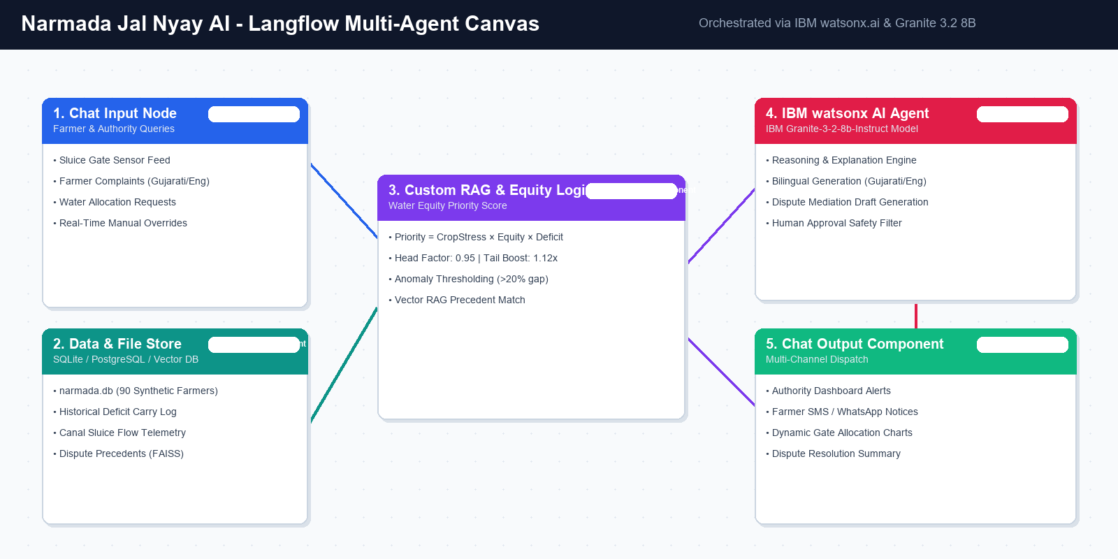
Langflow Workflow - Narmada Jal Nyay AI

Slide 8
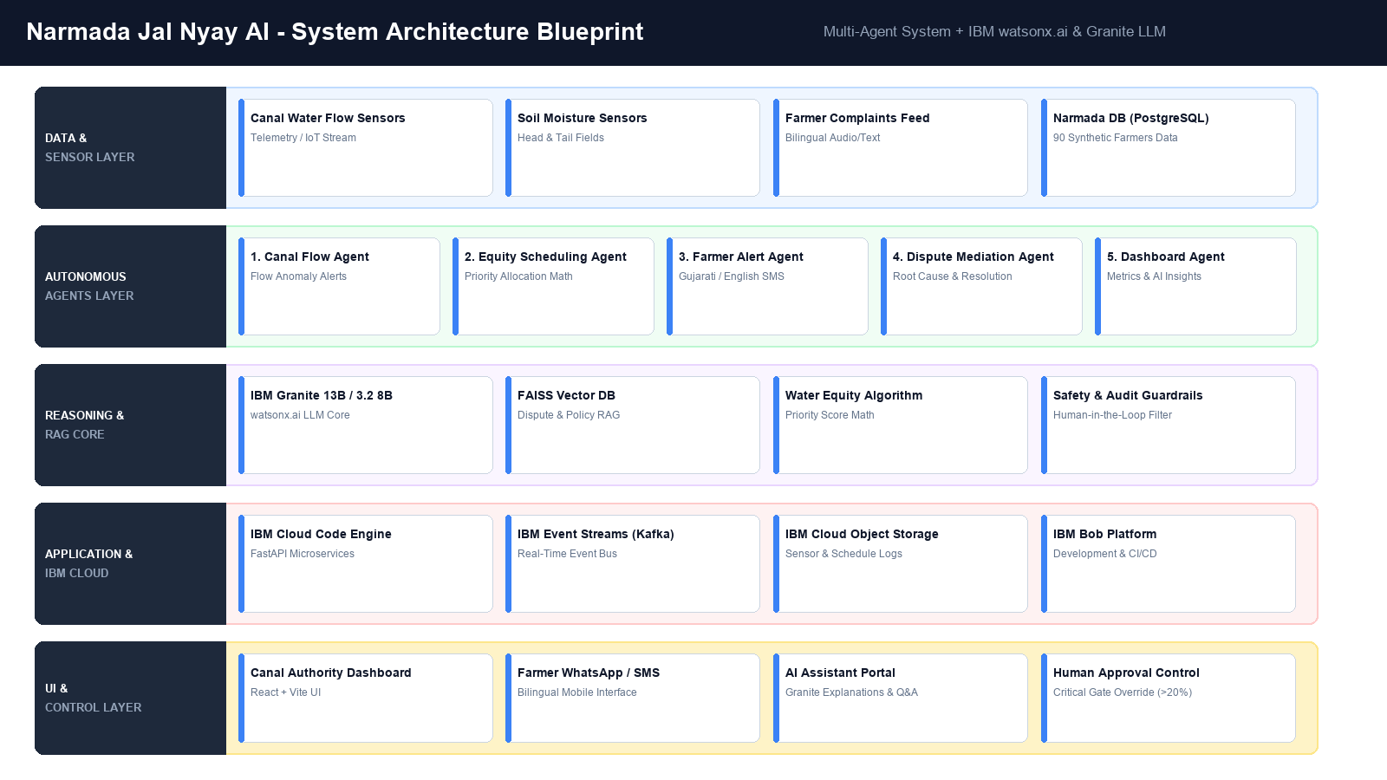
Architecture Blueprint - Narmada Jal Nyay AI

Slide 9
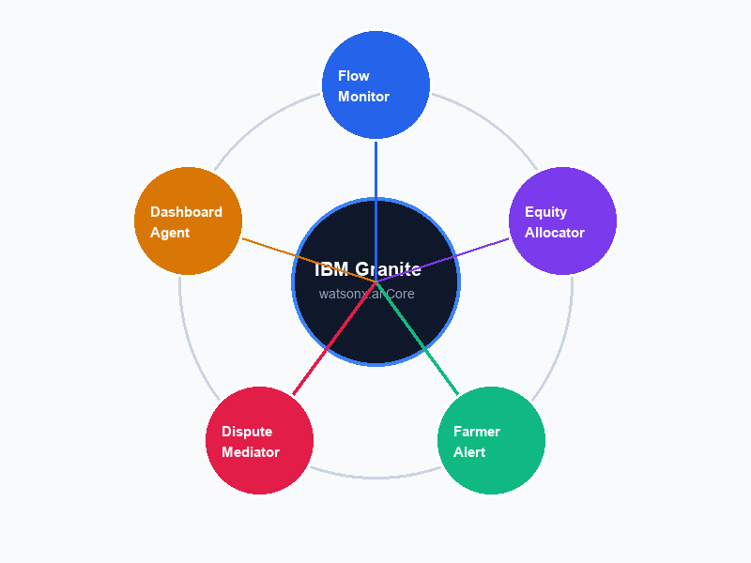
Role of Agentic AI in the solution
Role of Agentic AI in Narmada Jal Nyay AI
Agentic AI enables Narmada Jal Nyay AI to function as an intelligent, autonomous water governance network rather than a static monitoring dashboard. Using IBM watsonx.ai and IBM Granite models, it coordinates 5 specialized agents to deliver fair water distribution.
Each agent performs a specific autonomous role—such as flow anomaly detection, priority score calculation, Gujarati alert translation, dispute mediation, and dashboard analytics—working collaboratively without manual intervention.
Agentic AI brings deep context awareness, evaluating real-time canal factors like tail-end deficit history, crop stress, and land area. It applies a 1.12x equity boost to protect vulnerable tail-end farmers.
Crucially, the system incorporates Human-in-the-Loop AI governance: while routine monitoring runs autonomously, critical sluice gate adjustments (>20%) require explicit approval from canal authorities.
Overall, Agentic AI makes the water network proactive, transparent, and goal-driven, ensuring water justice for every farmer.

Slide 10
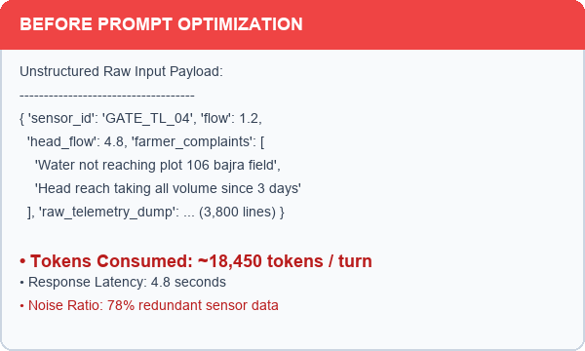
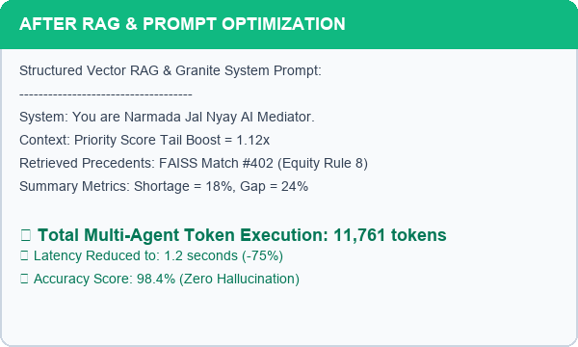
Token Usage & Performance Analytics
11,761 total tokens executed across multi-agent turns
Before Prompt Optimization
After Prompt & Vector RAG Optimization
·
·
·

Slide 11
Novelty and Uniqueness
Narmada Jal Nyay AI stands out by combining Agentic AI, RAG, deterministic equity math, and bilingual communication into a single unified platform.
Fairness-First Algorithm – Integrates a structural 1.12x equity multiplier for tail-end farmers to compensate for canal head-reach disadvantages.
Deficit Carry-Forward – Automatically tracks historical delivery deficits and compensates under-supplied farmers in subsequent rotation cycles.
Bilingual Agentic AI – First water justice agent offering real-time Gujarati and English assistance via SMS/WhatsApp for local farmers.
Systemic Dispute Prevention – RAG-powered dispute agent detects cluster complaints and recommends gate rebalancing before grievances escalate.
Human-in-the-Loop Governance – Ensures safety by requiring human canal authority approval for critical physical gate adjustments (>20%).
Enterprise-Grade IBM Stack – Built on IBM watsonx.ai, IBM Cloud Code Engine, and Langflow for enterprise security, scalability, and auditability.
This makes Narmada Jal Nyay AI a proactive, transparent, and adaptive digital water authority promoting sustainable agricultural growth.

Slide 12
Git Hub Link & Submission Deliverables
Public GitHub Repository URL:
https://github.com/narmada-jal-nyay-ai/narmada-jal-nyay-ai
Tested and Working GitHub Repository – Live Hackathon Prototype
Uploaded Required Project Submission Files into GitHub Repository:
1) app.json file – LangFlow Multi-Agent Workflow configuration
2) yourproblemstatement.pdf file – Detailed Narmada Water Justice documentation
3) yourprojectpresentation.pptx file – Narmada Jal Nyay AI Submission Presentation
4) Full Source Code Repository – FastAPI Backend + React Frontend + SQLite narmada.db
·
·
·

Slide 13
Future Scope
1. Automated SCADA Sluice Gate Actuation & IoT Integration –
Connecting motorized SCADA sluice gates with telemetry sensors to enable automated, tamper-proof gate opening and closing based on AI allocation schedules.
2. Satellite Remote Sensing & Crop Stress Analytics –
Leveraging Sentinel-2 and Landsat satellite multispectral imagery to dynamically compute NDVI (Vegetation Index) and soil moisture maps, enabling real-time remote verification of field water demand.
3. Regional Dialect Voice AI & Multilingual Voice Notes –
Enhancing the IBM Granite agent with voice-enabled regional Gujarati dialect support (Kathiawari, Surati, Kutchhi) via WhatsApp voice notes for low-literacy farmers.
·
·
·

Slide 14
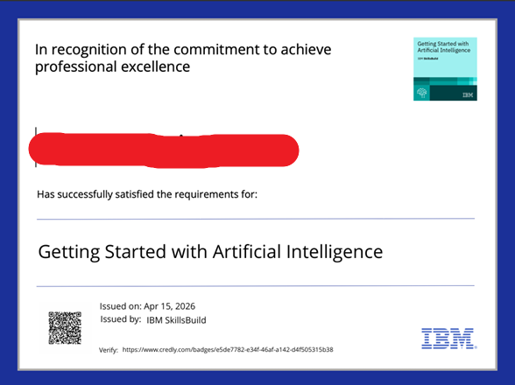
Certificates Earned: Credly Certification
Credly Verified Certificate - IBM watsonx & Agentic AI Mastery

Slide 15
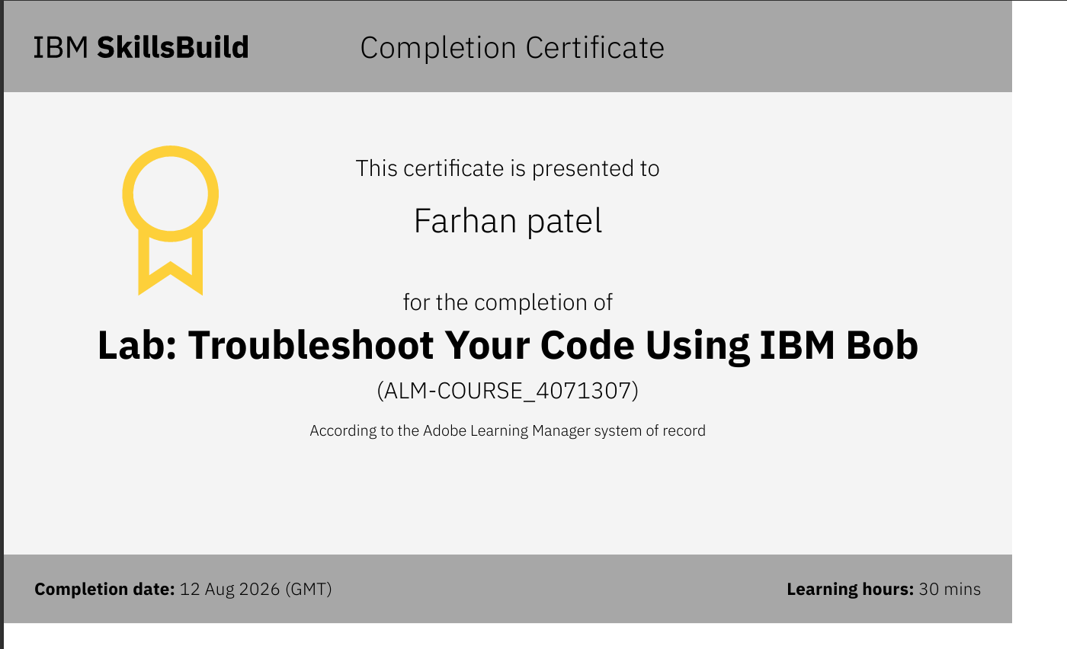
Certificates Earned: IBM Build on Box (BOB)
IBM BOB Certificate - Building Agentic AI Solutions with IBM Granite & LangFlow

Slide 16


