Slide 1
Inspection for Solder Joint Defects in Voltage Regulator ICs of Automotive Charging Applications
2025 IEEE 7th Eurasia Conference on IoT, Communication and Engineering
Presenter: Yi-Hsuan Chiu
Authors: Yi-Hsuan Chiu & Kuang-Chyi Lee
Department of Automation Engineering, National Formosa University
November 14, 2025

Slide 2
CONTENT
Introduction
Dataset Preparation and ROI Extraction
YOLO-Based Solder Joint Classification
Conclusion

Slide 3
Introduction
Background
Solder joint defects reduce reliability and lifespan. Manual checks are slow and subjective, and machines can make mistakes.
Purpose
The purpose of this study is to improve defect detection accuracy, reduce missed and false judgments, and enable early identification and removal of problematic ICs.
Method
Use deep learning to detect solder joint defects by collecting SMT images, extracting ROIs, and classifying joints as normal or defective.

Slide 4
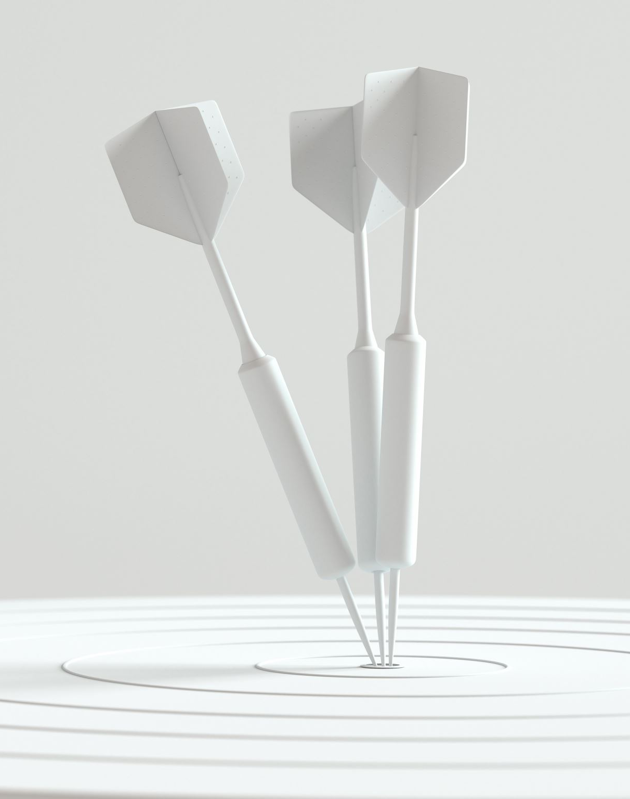
Dataset Preparation and ROI Extraction
Target IC and Image Data Collection
Defect Types
ROI
ROI Annotation

Slide 5
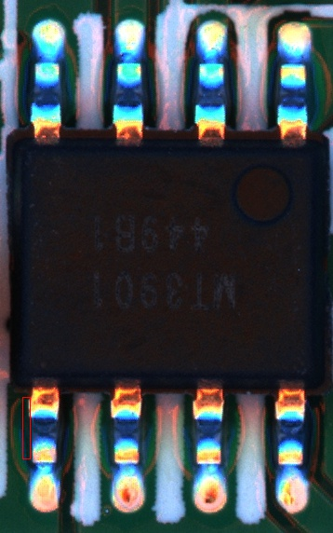
Target IC and Image Data Collection
Target IC：
The target device is an 8-pin 36V/5A buck regulator for car chargers, controlling voltage and protecting the load. As the heart of the charging system, a single pin failure can cause the entire IC to malfunction, potentially affecting vehicle safety.
Image Data Collection：
Images were collected from the SMT line, covering paste printing, reflow, and inspection. Each image shows the full IC and its 8 pins, including solder distribution and alignment, providing a clear basis for YOLO-based classification and defect detection.
Original Image

Slide 6
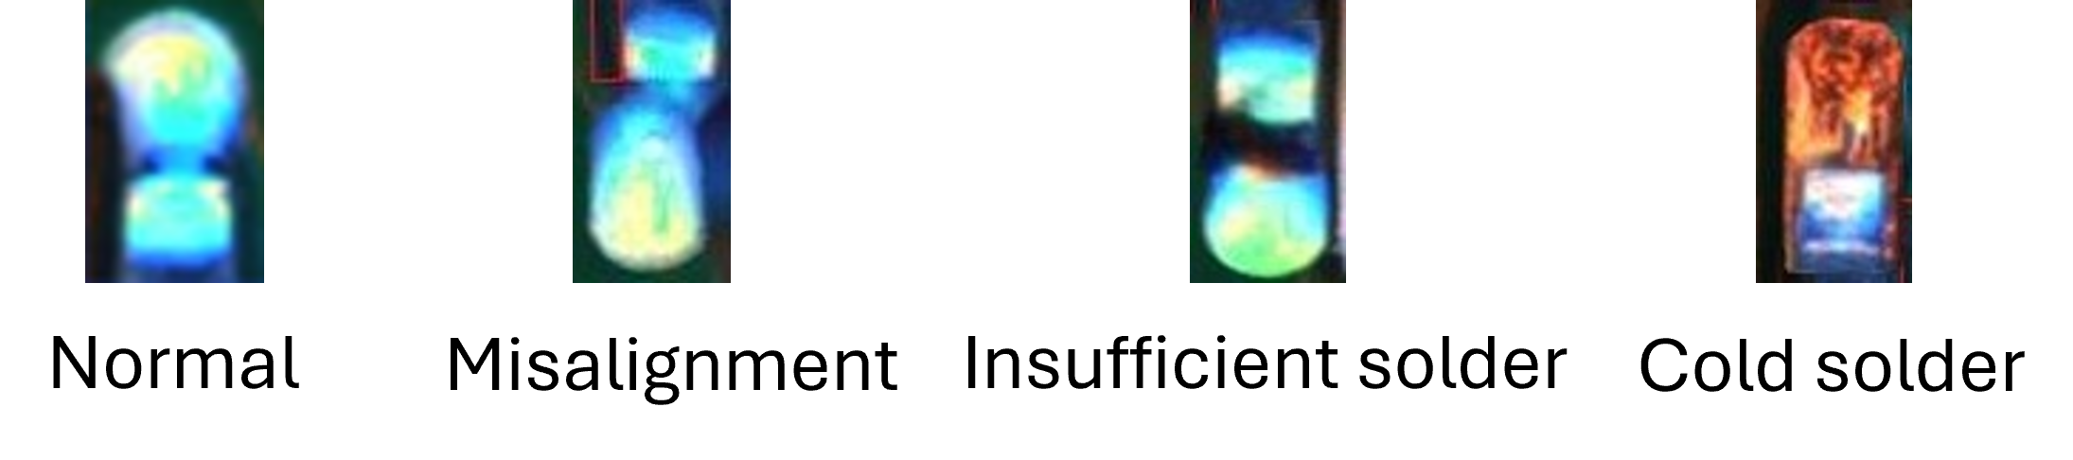
Defect Types
Four Defect Types：
This study focuses on detecting and classifying each solder joint into four types: normal, misalignment, insufficient solder, and cold solder.
Defect Determination Criteria：
Normal: The solder joint is well-aligned with the pad, with sufficient solder amount and a smooth, crack-free surface.
Misalignment: The center of the solder joint deviates from the pad center by more than one-third of the pad width.
Insufficient Solder: The solder coverage area is less than 75%.
Cold Solder: The solder joint surface shows cracks, dull color, or uneven luster.

Slide 7
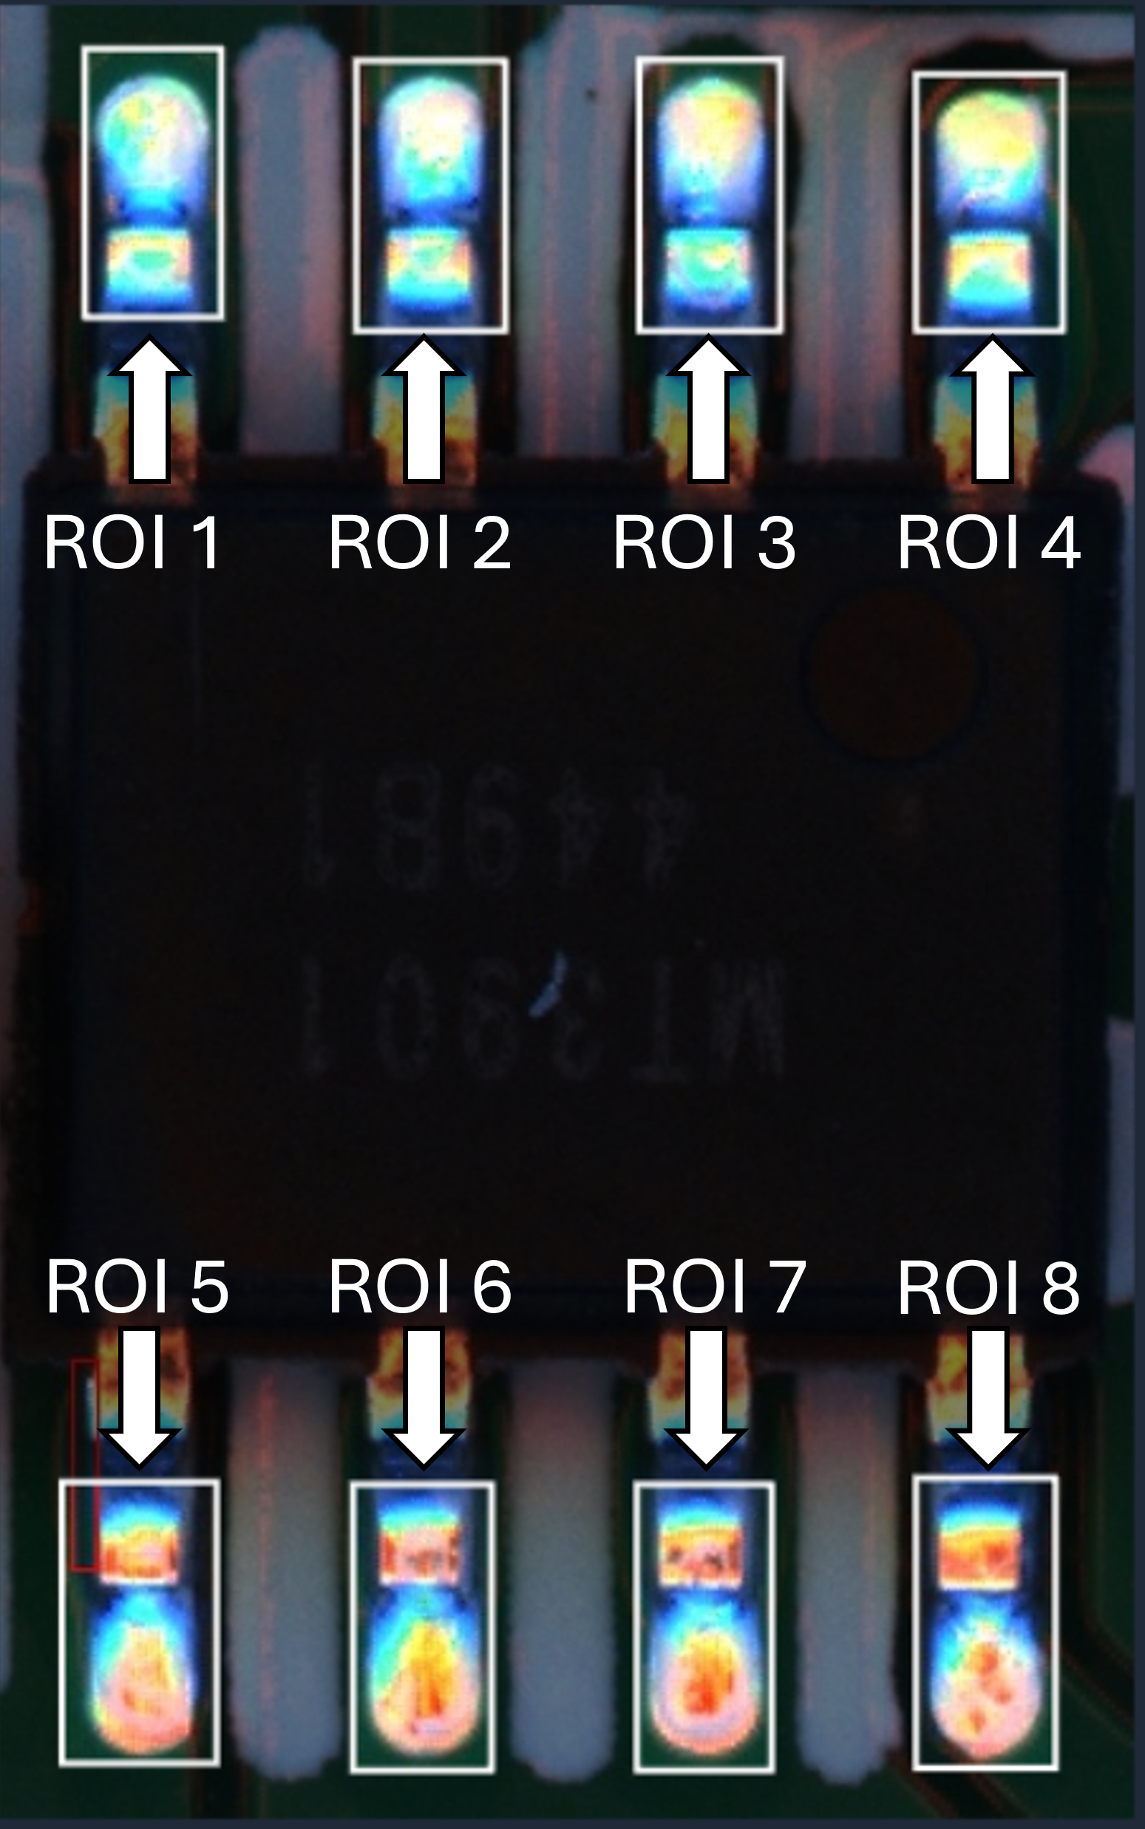
ROI
ROIs are set at the solderable ends of the IC’s 8 pins, where solder sticks to the PCB. The pin bodies mainly provide support and connection but little affect on solder quality. Focusing on the ends lets the model target critical defect areas.
ROI for all 8 pins of the IC

Slide 8
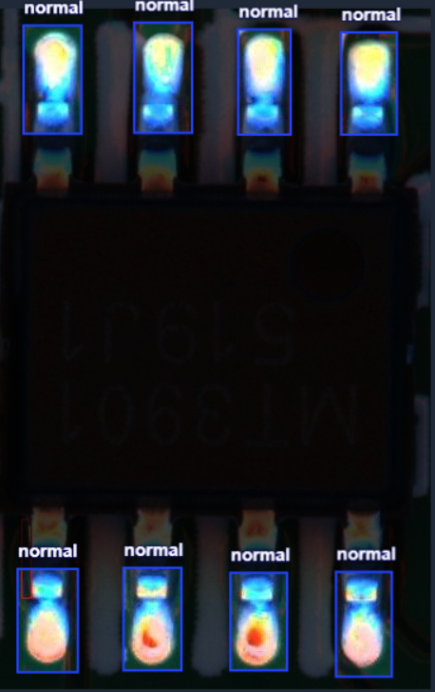
ROI Annotation
The image on the right shows the key ROI areas selected from the original image. Each of the 8 pins of the IC (pins 1–8) corresponds to one ROI.
At the same time, it will label whether the pin is normal or defective.
Regions of interest (ROIs) for all 8 pins of voltage regulator IC.

Slide 9
YOLO-Based Solder Joint Classification
Workflow for Defect Detection
Classification Performance
IC Classification Illustration

Slide 10
Workflow for Defect Detection
Image Collect
ROI Definition & Extraction
Data Annotation
YOLO Model Training
Solder Joint Classification
Performance Evaluation

Slide 11
Classification Performance
True\Pred | Normal | Misalignment | Insufficient solder | Cold solder | Recall
Normal | 3816 | 16 | 0 | 0 | 0.995
Misalignment | 24 | 200 | 56 | 0 | 0.714
Insufficient solder | 8 | 24 | 352 | 0 | 0.916
Cold solder | 0 | 0 | 0 | 304 | 1.000
Precision | 0.991 | 0.833 | 0.862 | 1.000 | Acc = 0.973

Slide 12
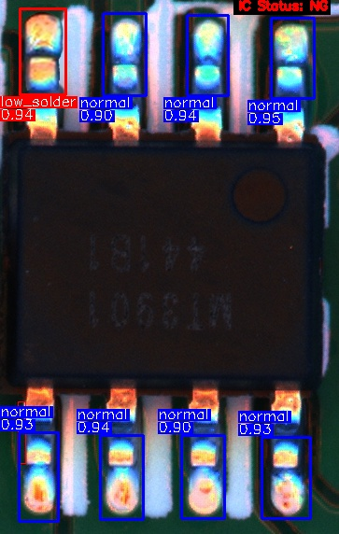
IC Classification Illustration
From the illustration, the defects are labeled, and the ground truth and predicted results for each pin are shown. The IC-level decision rule is displayed in the top-right corner: if any one of the 8 pins is classified as defective, the entire IC is considered NG.
(Note: “Low Solder” in the figure refers to “Insufficient Solder.”)

Slide 13
Conclusion
This study used a deep learning single-pin model for defect detection. It performed reliably at pin and IC levels, with strong results for Normal and Cold Solder, and some confusion in Insufficient Solder and Misalignment. Overall, it shows the method can support inspection and improve quality.

Slide 14
Thank you for your attention

