Slide 1
Gitgame
Group 1
Notes:
1

Slide 2
Agenda
What changed
Goals
Problems
Notes:
2

Slide 3
What changed
Notes:
3

Slide 4
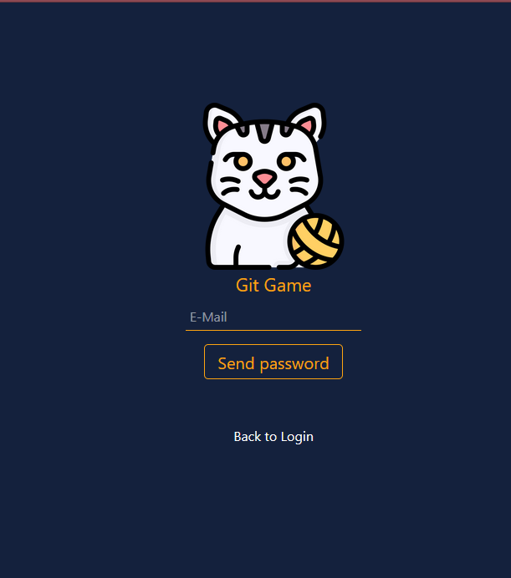
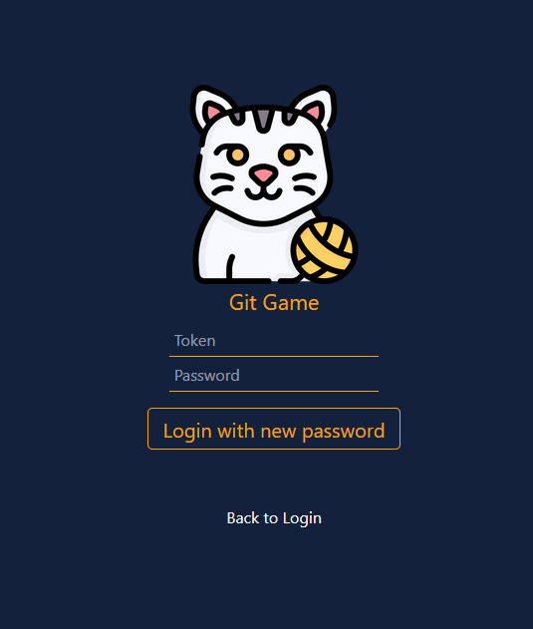
WebDesign
Forgot password
New password

Slide 5
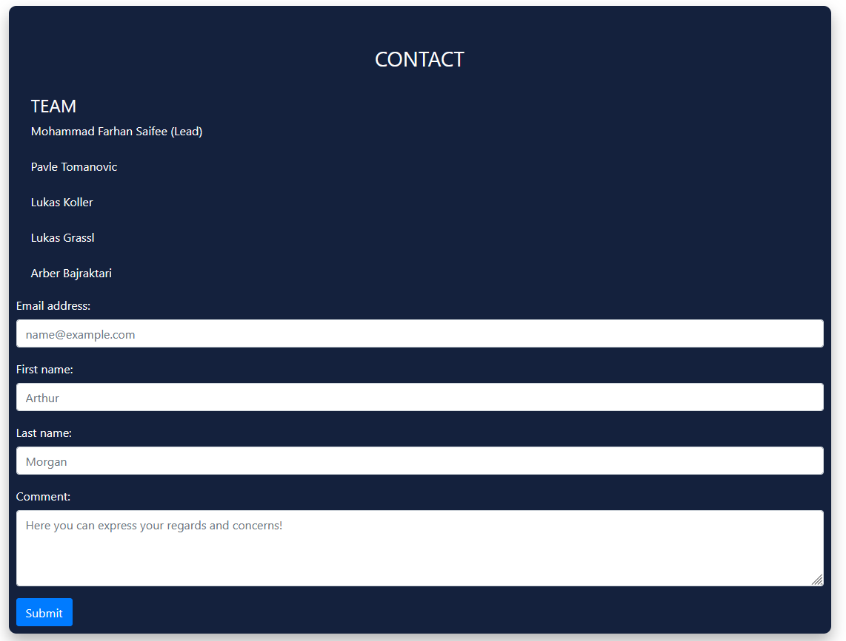
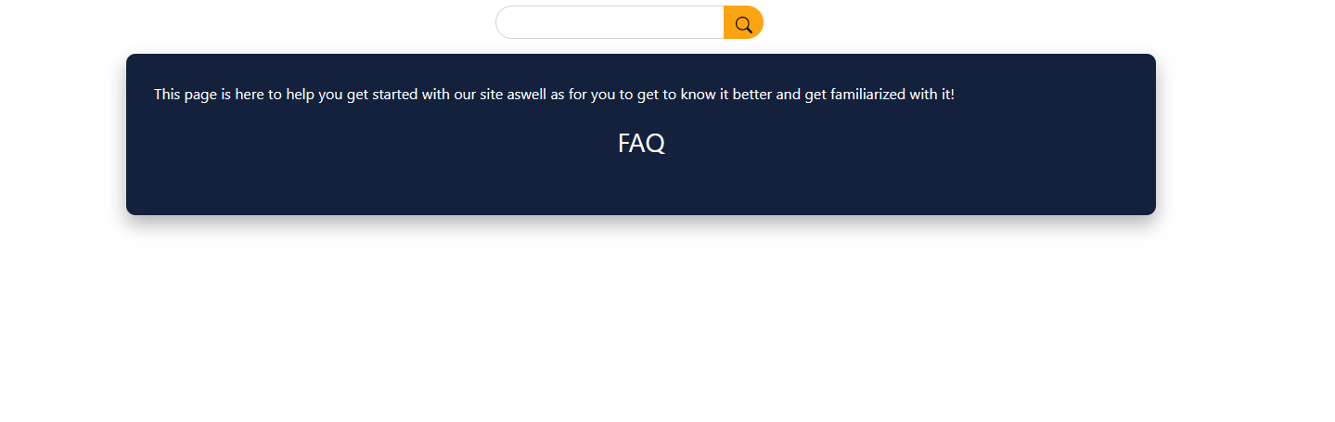
WebDesign
Contact Page
Help Page

Slide 6
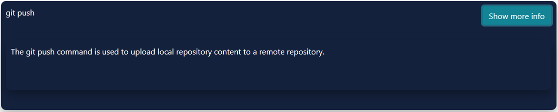
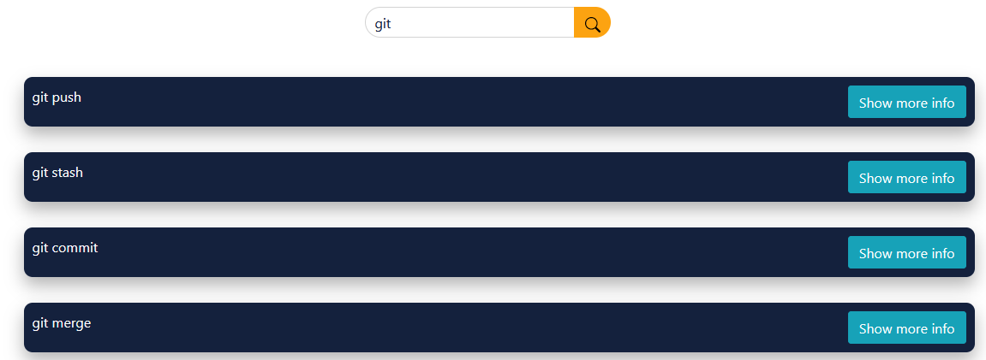
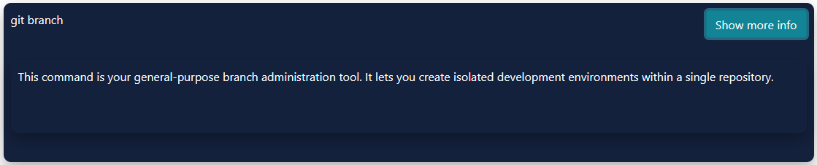
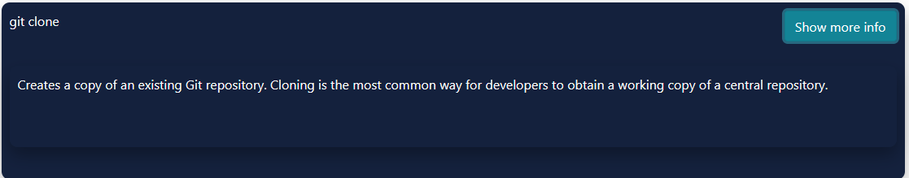
WebDesign
Wiki Page
Searchbar

Slide 7
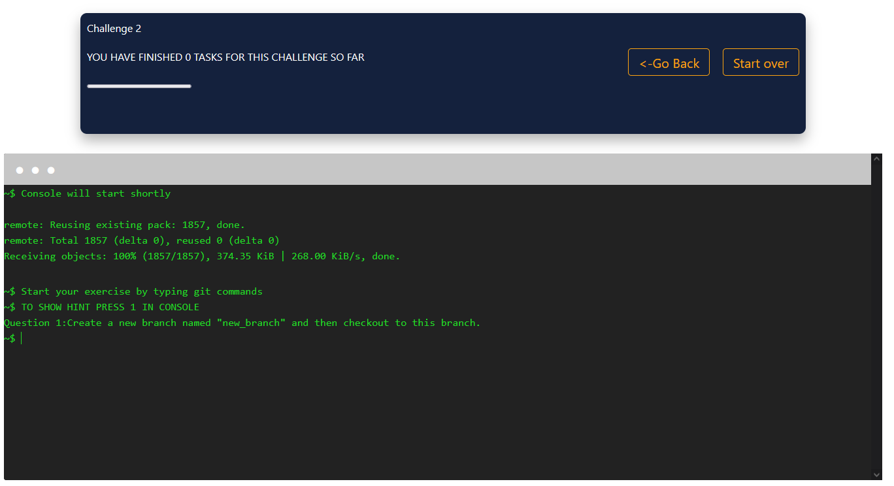
Challanges
7

Slide 8
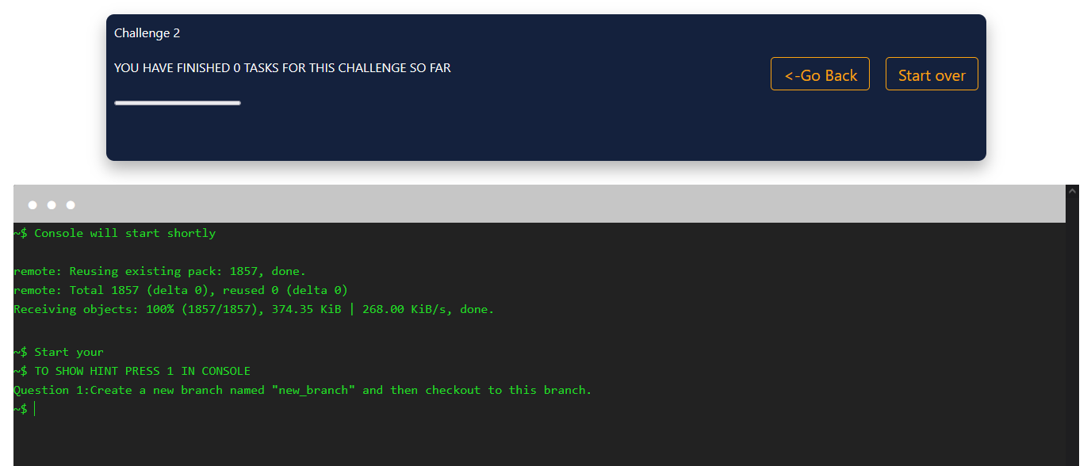
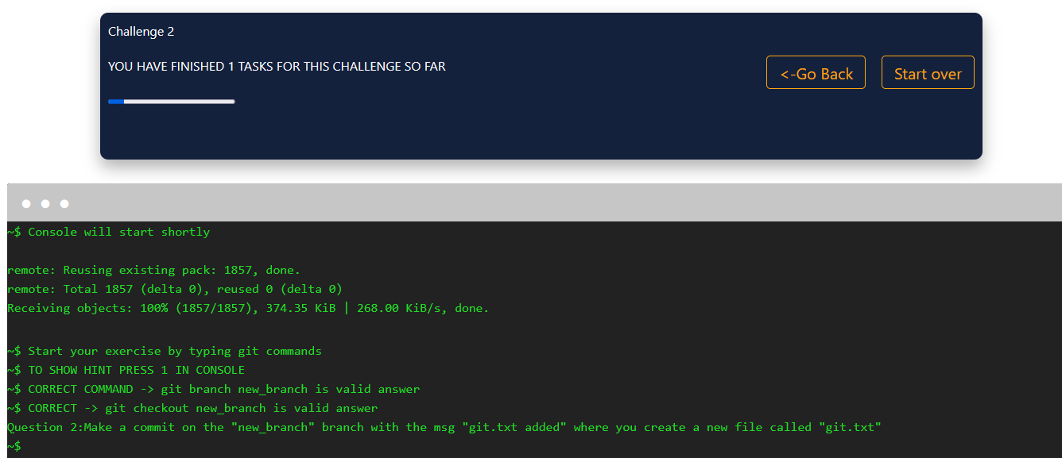
Progress & Highscore
Progressbar
8

Slide 9
Goals
9

Slide 10
Goals
Challanges
Hosting
Add new challanges
Using Webspace
Progress & Highscore
Increase User friendlyness
Track how many hints are needed
Implement Score Page later

Slide 11
Problems
11

Slide 12
Problems from last Semester
Documentation
Organziation
Database FH
Challange script, was not dynamic

Slide 13
Problems this semester
FH Database
Webspace (authorization)

Slide 14
Effort Estimation
14

Slide 15
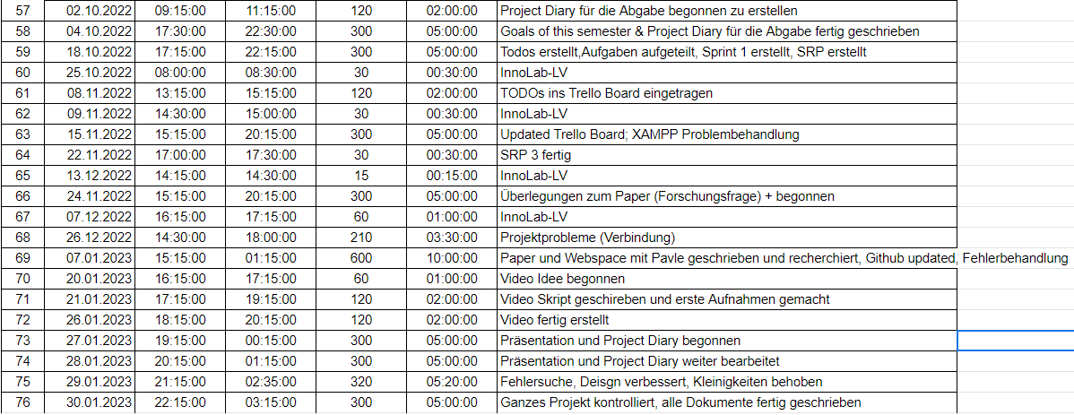
Effort Estimation

Slide 16
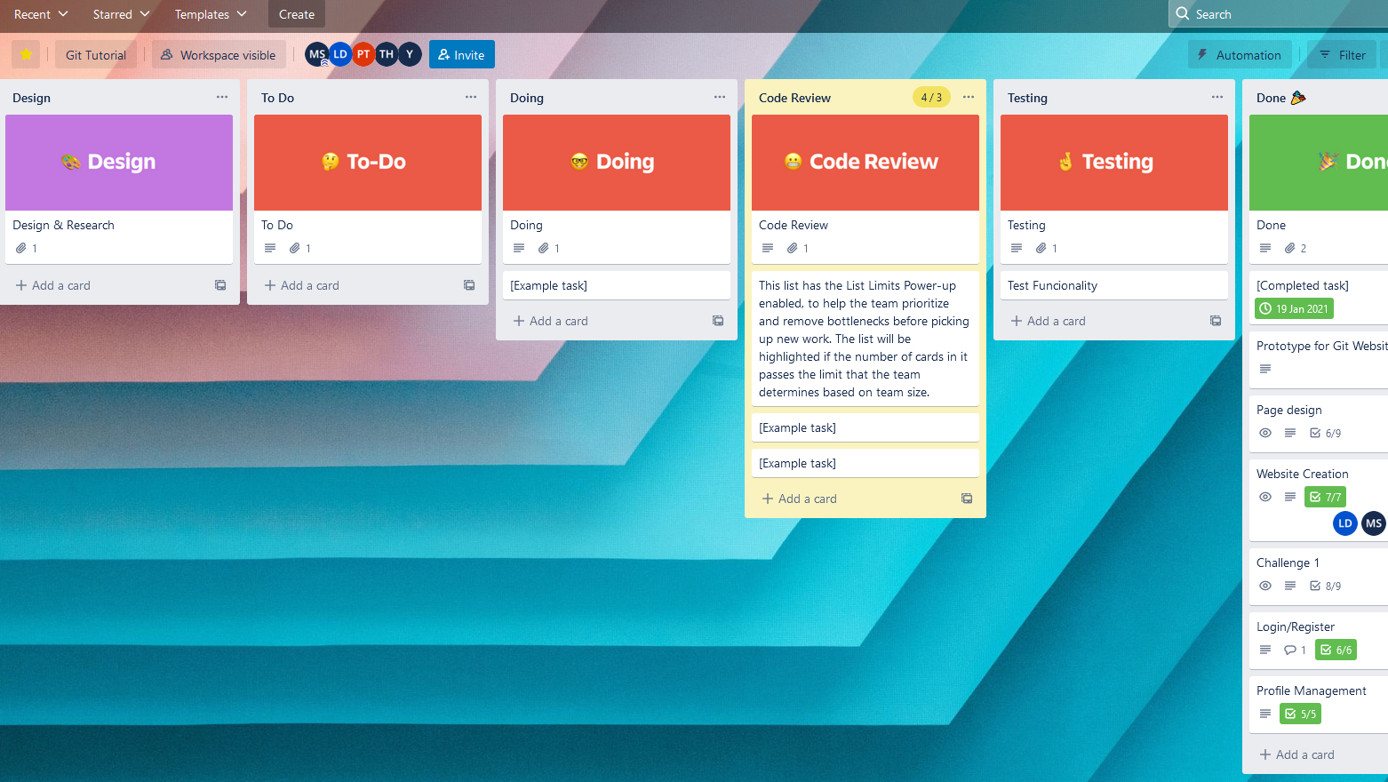
Collaboration & Tooling
Github https://github.com/farhansaifee/Git-Game
Effort Estimation https://docs.google.com/spreadsheets/d/1OMArljF2LpWNn-FKRMXUrwybi12l5OPowxQbWUM-Z8U/edit#gid=0
Trello https://trello.com/b/gF0VGzul/git-kanban

Slide 17
Thank You for your Attention
Notes:
17

