Slide 1
Gitgame
Group 1

Slide 2
Agenda
What changed
Goals
Problems

Slide 3
What changed

Slide 4
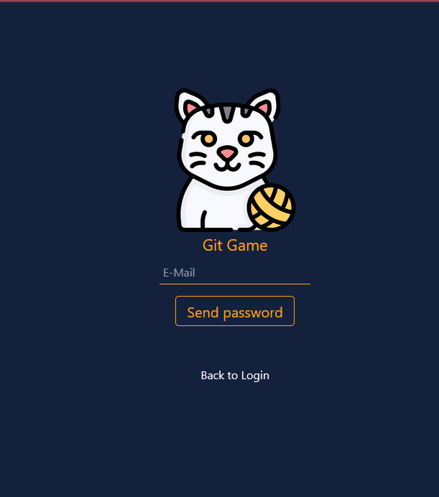
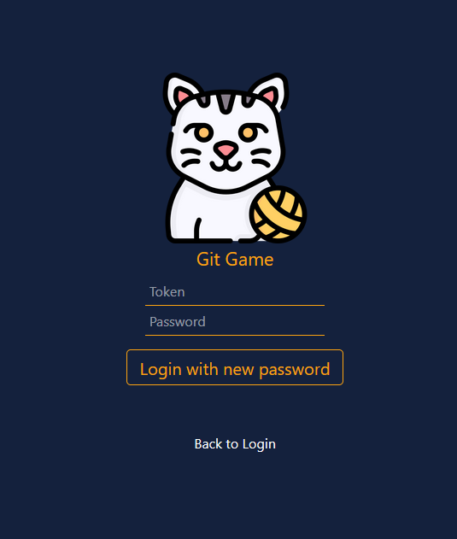
WebDesign
Forgot password
New password

Slide 5
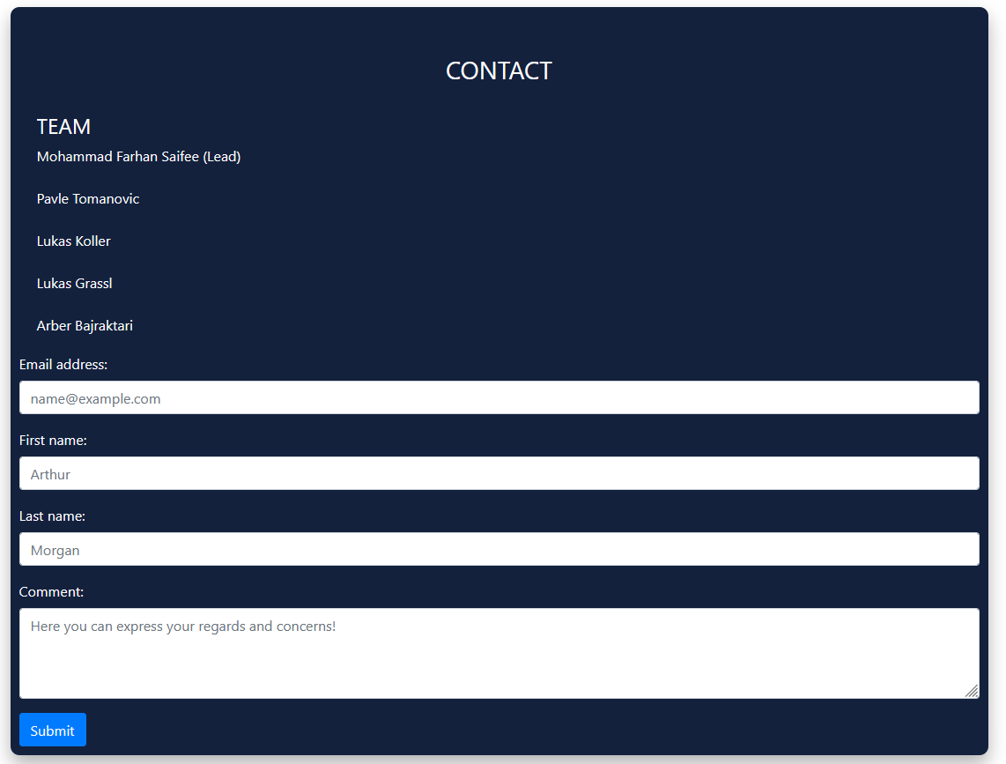
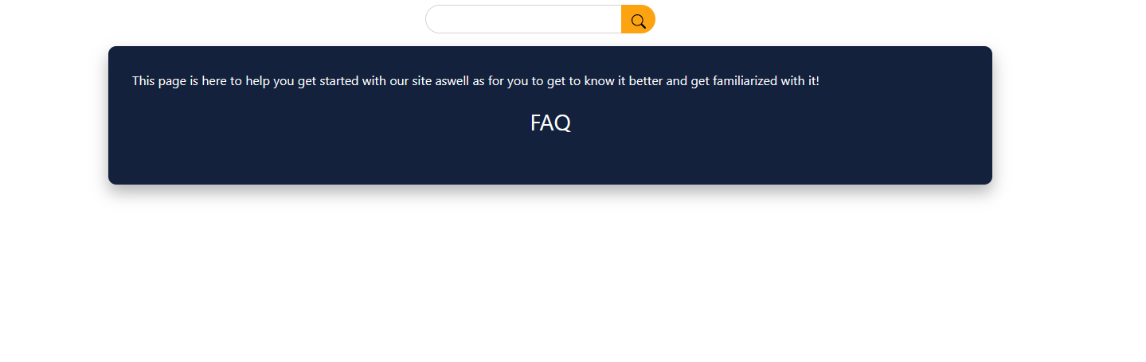
WebDesign
Contact Page
Help Page

Slide 6
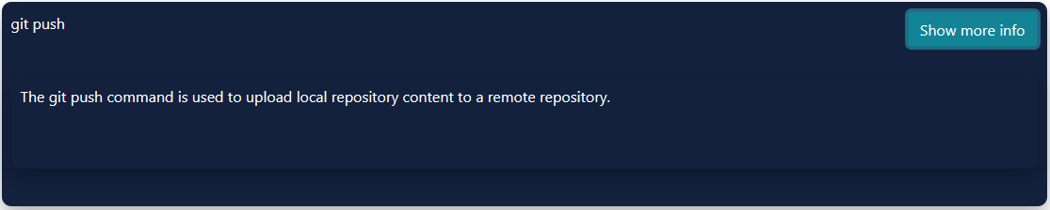
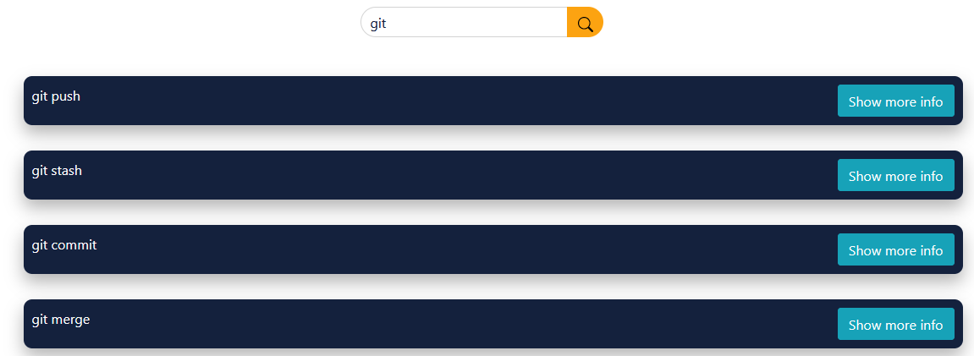
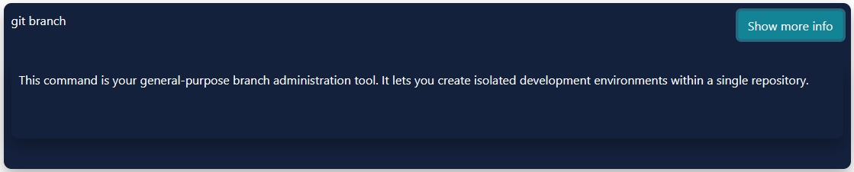
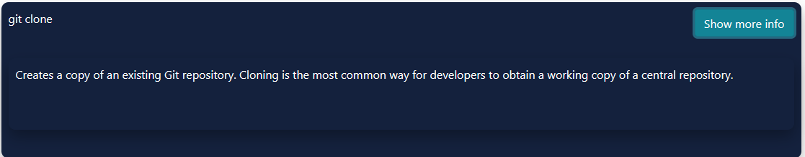
WebDesign
Wiki Page
Searchbar

Slide 7
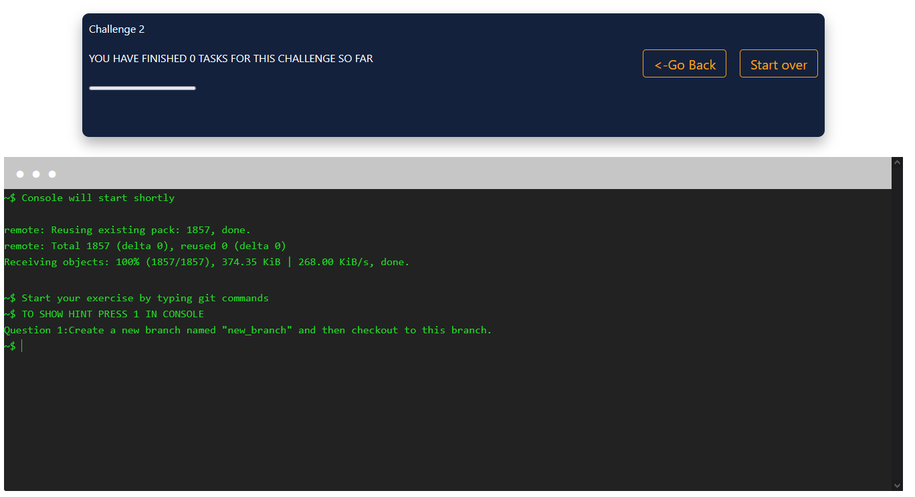
Challanges
3/9/20XX
Präsentationstitel

Slide 8
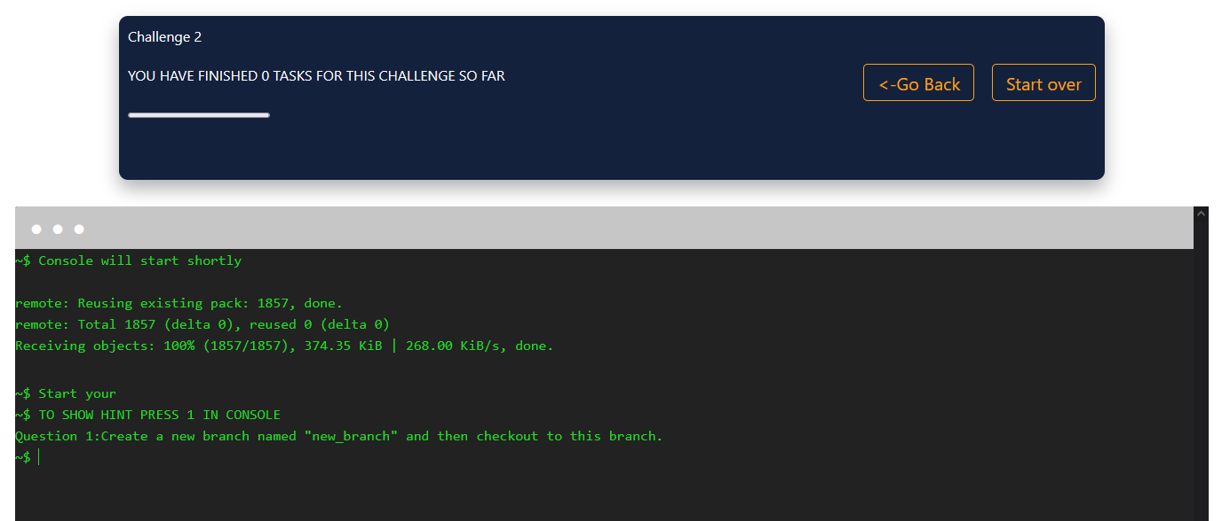
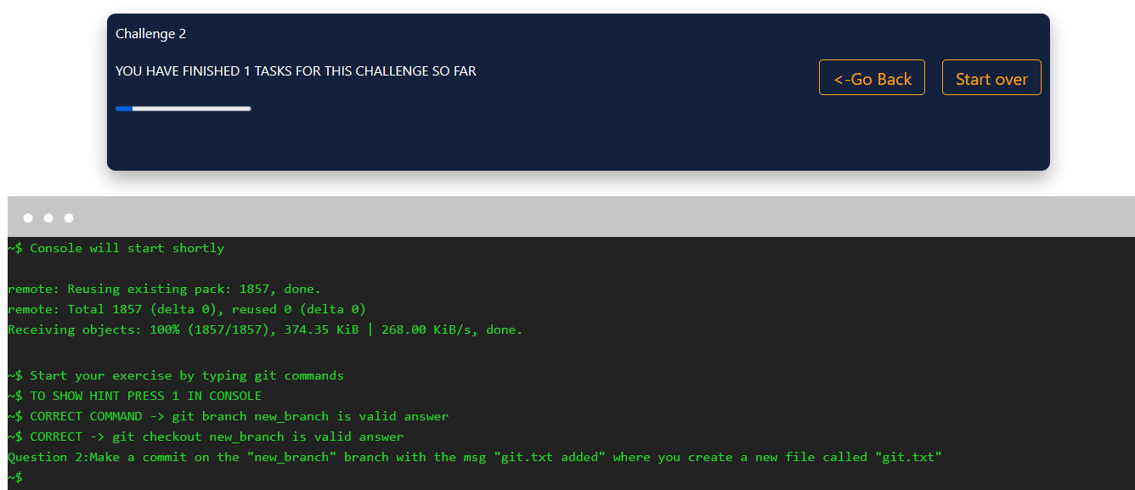
Progress & Highscore
Progressbar
3/9/20XX
Präsentationstitel

Slide 9
Goals
3/9/20XX
Präsentationstitel

Slide 10
Goals
Challanges
Wiki Page & WebDesign
Add new challanges
Searchfunction and learning without doing challagnes
Continuously upgrade Design and Usabilty
Progress & Highscore
Hosting
Increase User friendlyness
Track how many hints are needed
Implement Score Page later

Slide 11
Problems
3/9/20XX
Präsentationstitel

Slide 12
Problems
Documentation
Organziation
Database FH
Challange script, was not dynamic

Slide 13
Thank You for your Attention

