Slide 1

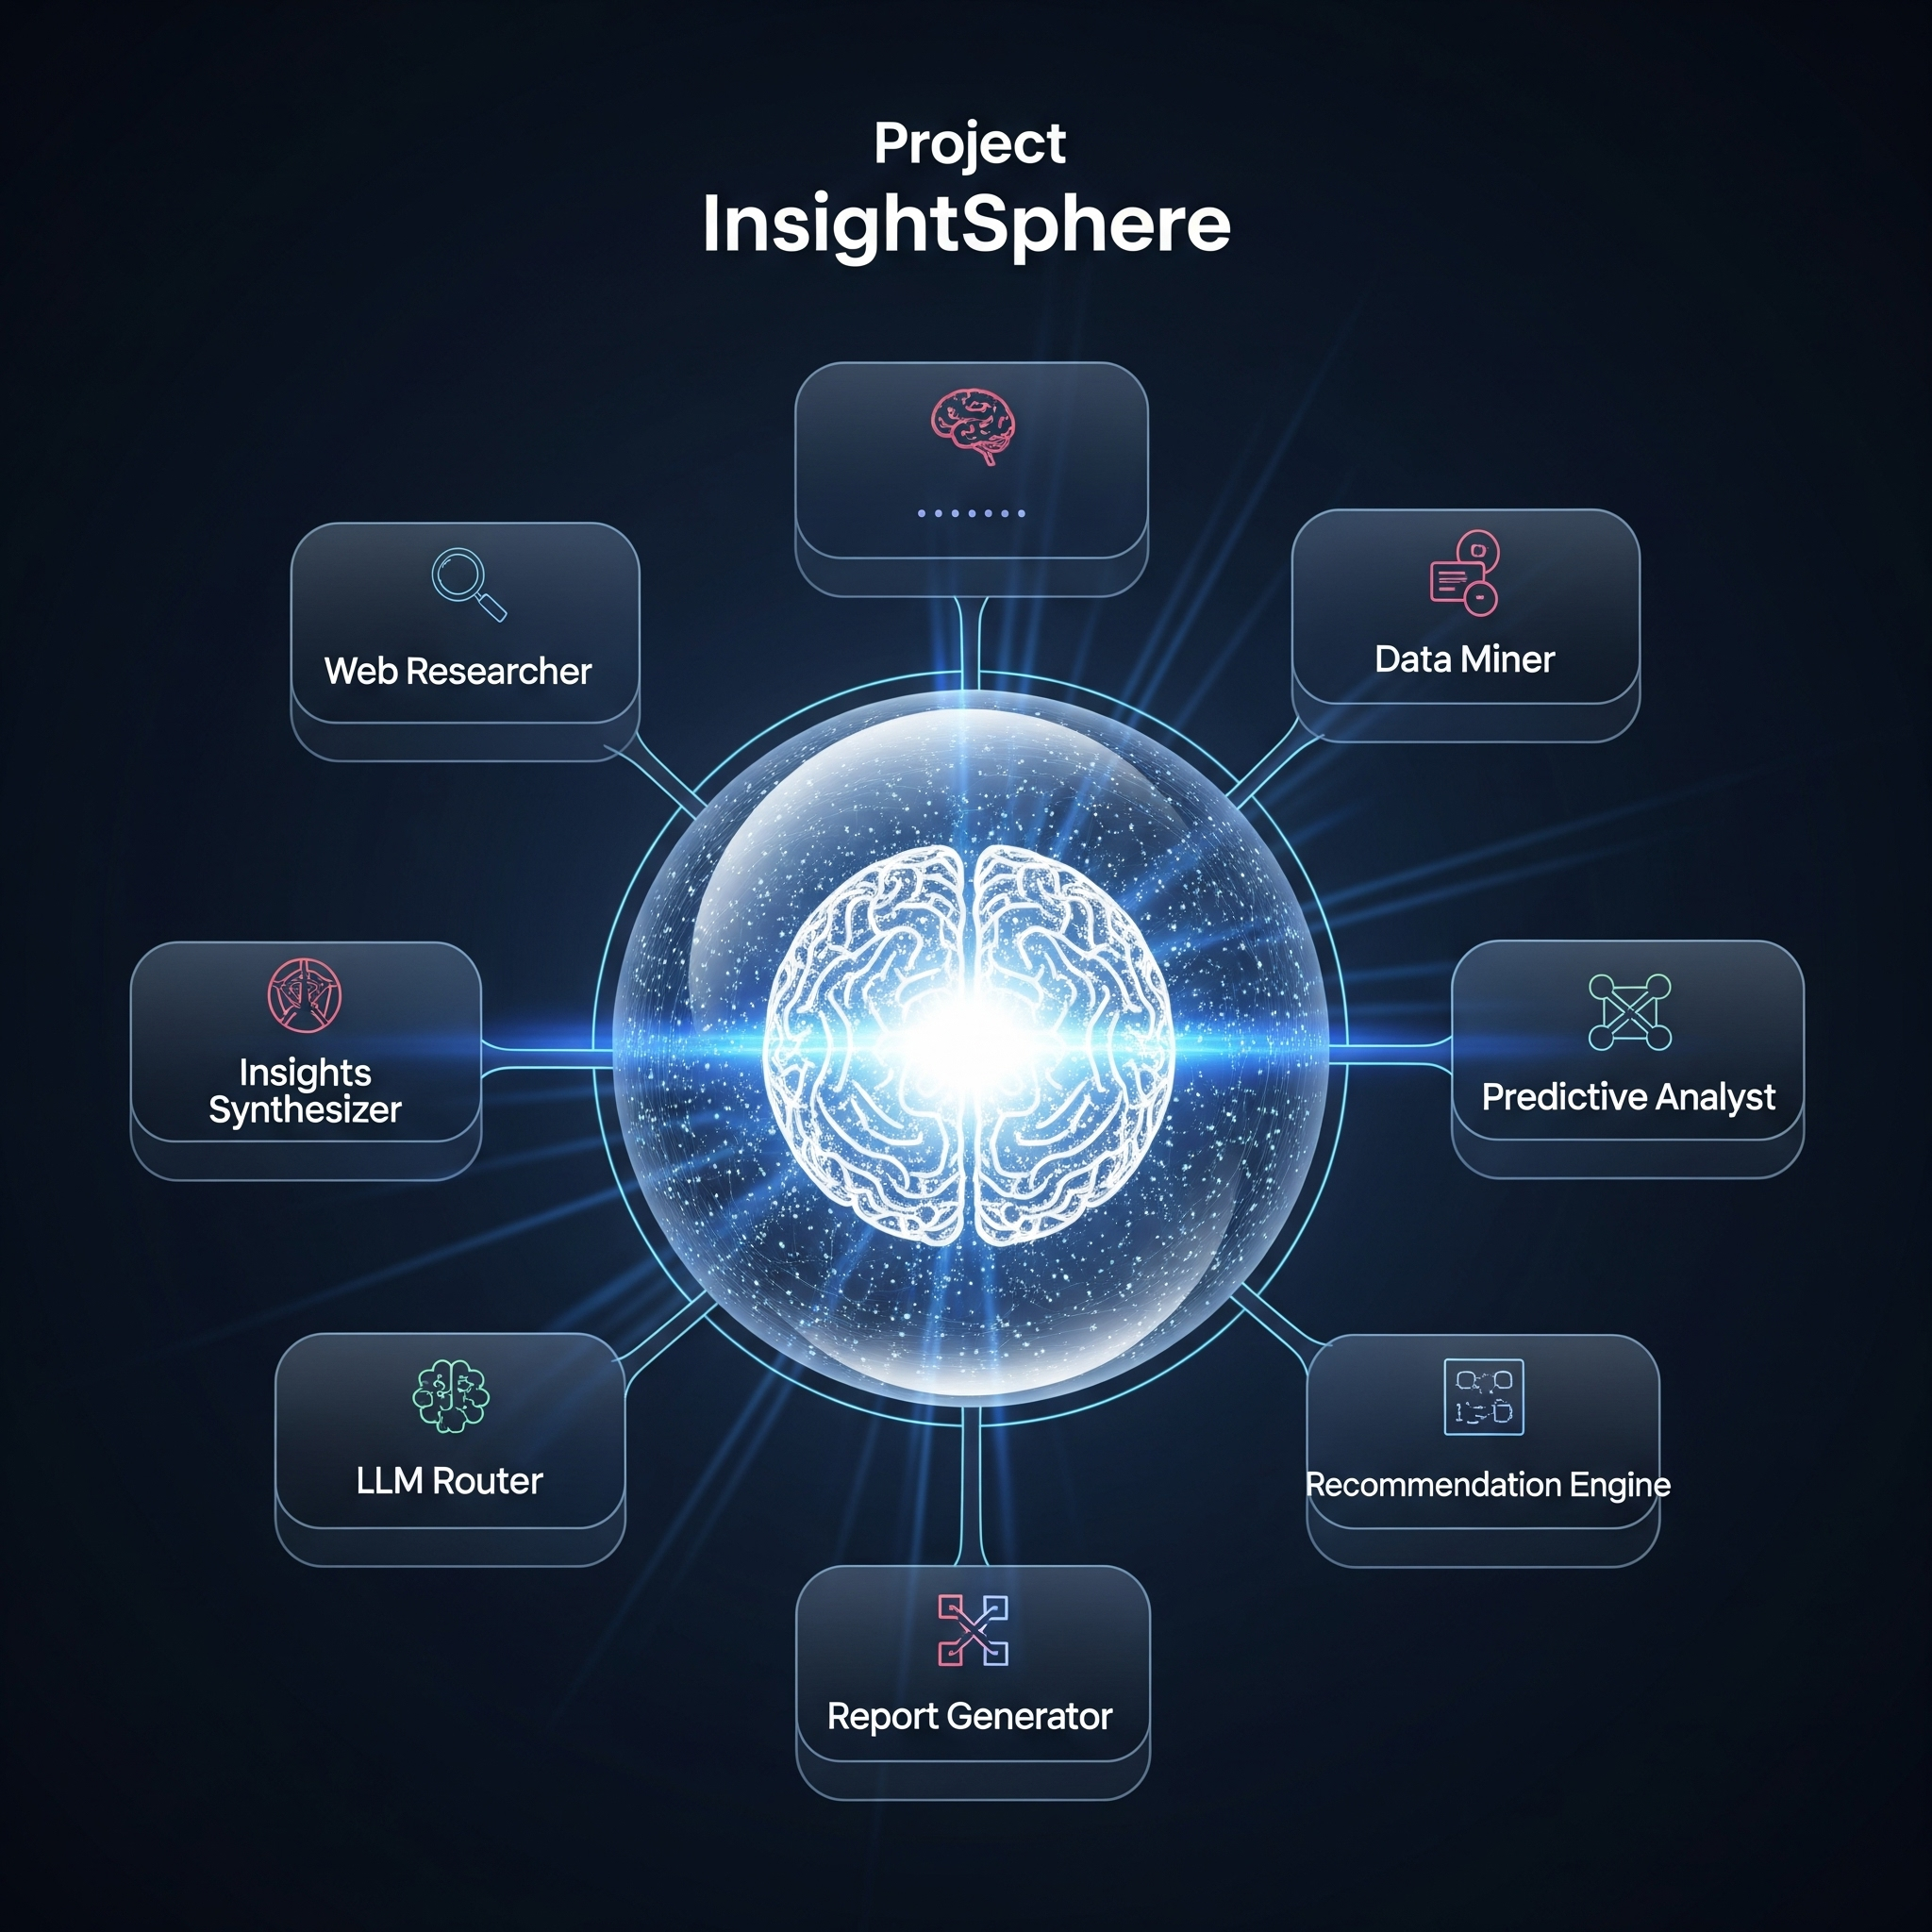
TITLE
HEADING

Slide 2
TITLE
CONTENT
InsightSphere

Slide 3
END

