Slide 1
COMP 4332 / RMBI 4310
Big Data Mining (Spring 2025)
Project 2: Social Network Mining
TA: Tianshi ZHENG (tzhengad@connect.ust.hk) Hong Ting TSANG (httsangaj@connect.ust.hk)
1

Slide 2
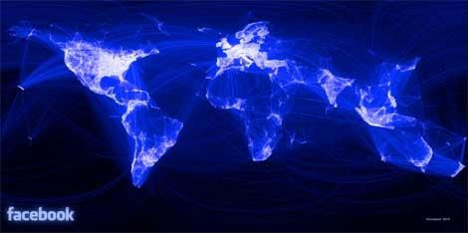
Social Network
https://www.datacenterknowledge.com/archives/2012/02/02/facebooks-1-billion-data-center-network
2

Slide 3
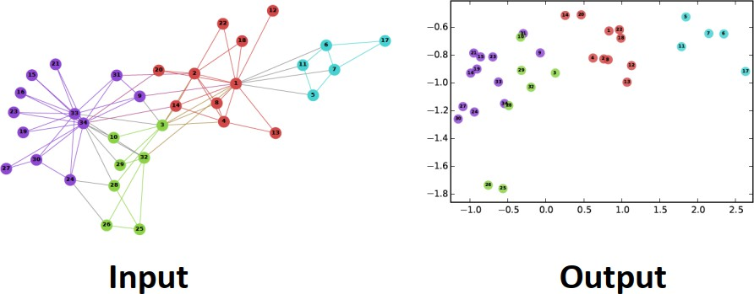
Network Representations
Perozzi, Bryan, Rami Al-Rfou, and Steven Skiena. "Deepwalk: Online learning of social representations." In KDD, pp. 701-710. 2014.
3

Slide 4
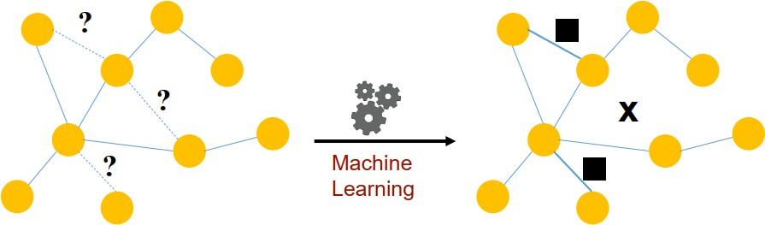
Link Prediction
Predict the relation between nodes with their similarity and calculate the AUC-ROC score.

Slide 5
Pipeline
Dataloader
Random Link Split
Embedding algorithm (GraphSAGE, LightGCN)
Scorer

Slide 6
Dataset
Training data: 196591 nodes, 1143094 edges, 570197 labels
Validation data: 196591 nodes, 1143094 edges, 380130 labels
Test data: 196591 nodes, 1520524 edges, 380,130 labels
Labels: [0, 1]
2

Slide 7
Evaluation
AUC-ROC score on test data
8

Slide 8
Submission
Report (1~2 pages), including analysis of the impact of hyperparameters and model architecture, and the comparison of model performances.
Model Weights of both Models with best performance
Code (Frameworks and even programming languages are not restricted.)
DDL: April 27, 2025
Submission: Each team leader is required to submit the groupName.zip file that contains the report, model weights and your team’s code on canvas.
We will check your report with your code and the AUC scores. You will be graded based on your testing set performance and your report.

Slide 9
Grading Rule
Grade | Model (80%) | Report (20%) | AUC GraphSAGE | AUC LightGCN
60% |  | submission
80% | an easy baseline that most students can outperform | detailed explanation | 0.78 | 0.75
90% | a competitive baseline that about half students can surpass | detailed explanation and analysis | 0.85 | 0.84
100% | a very competitive baseline | excellent visualization and analysis | 0.87 | 0.86

Slide 10
Thank You

