Slide 1

WATER QUALITY MONITORING SYSTEM
GROUP-7

Slide 2

INTRODUCTION
The "Water Quality Monitoring Web App" facilitates researchers in publishing scheduled water quality data, offering viewers access to diverse locations' environmental insights. The app provides a collaborative solution, allowing researchers to publish scheduled water quality data. Users access diverse location insights, fostering community engagement and informed decision-making for sustainable water management. The platform prioritizes simplicity and accessibility, emphasizing valuable contributions from researchers to empower environmental awareness and resource conservation.

Slide 3
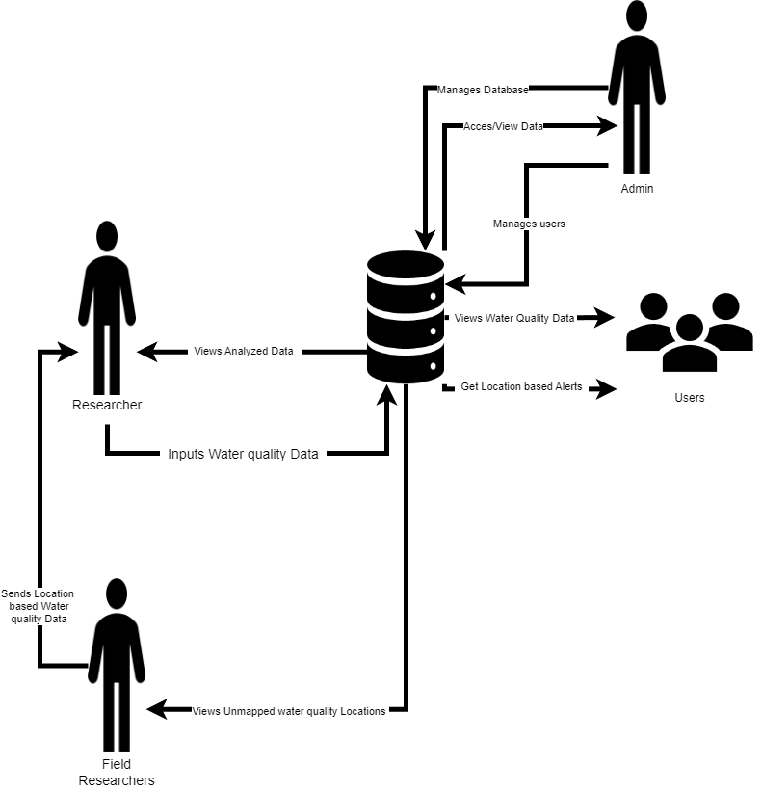
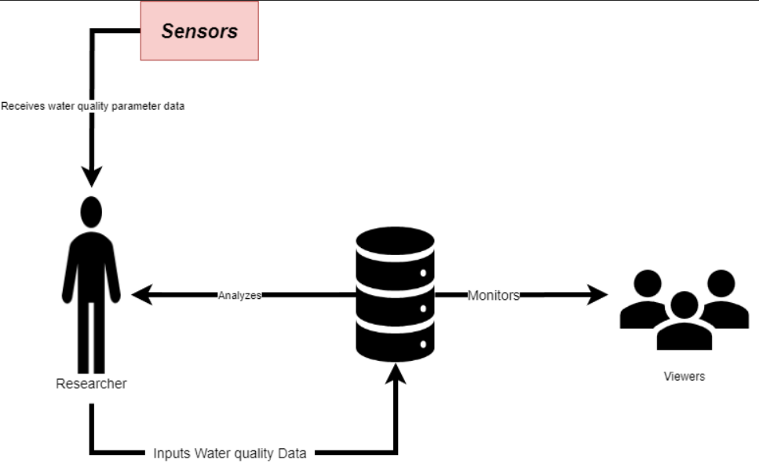
RICH PICTURE
AS IS
You can replace the image on the screen with your own
TO BE

Slide 4
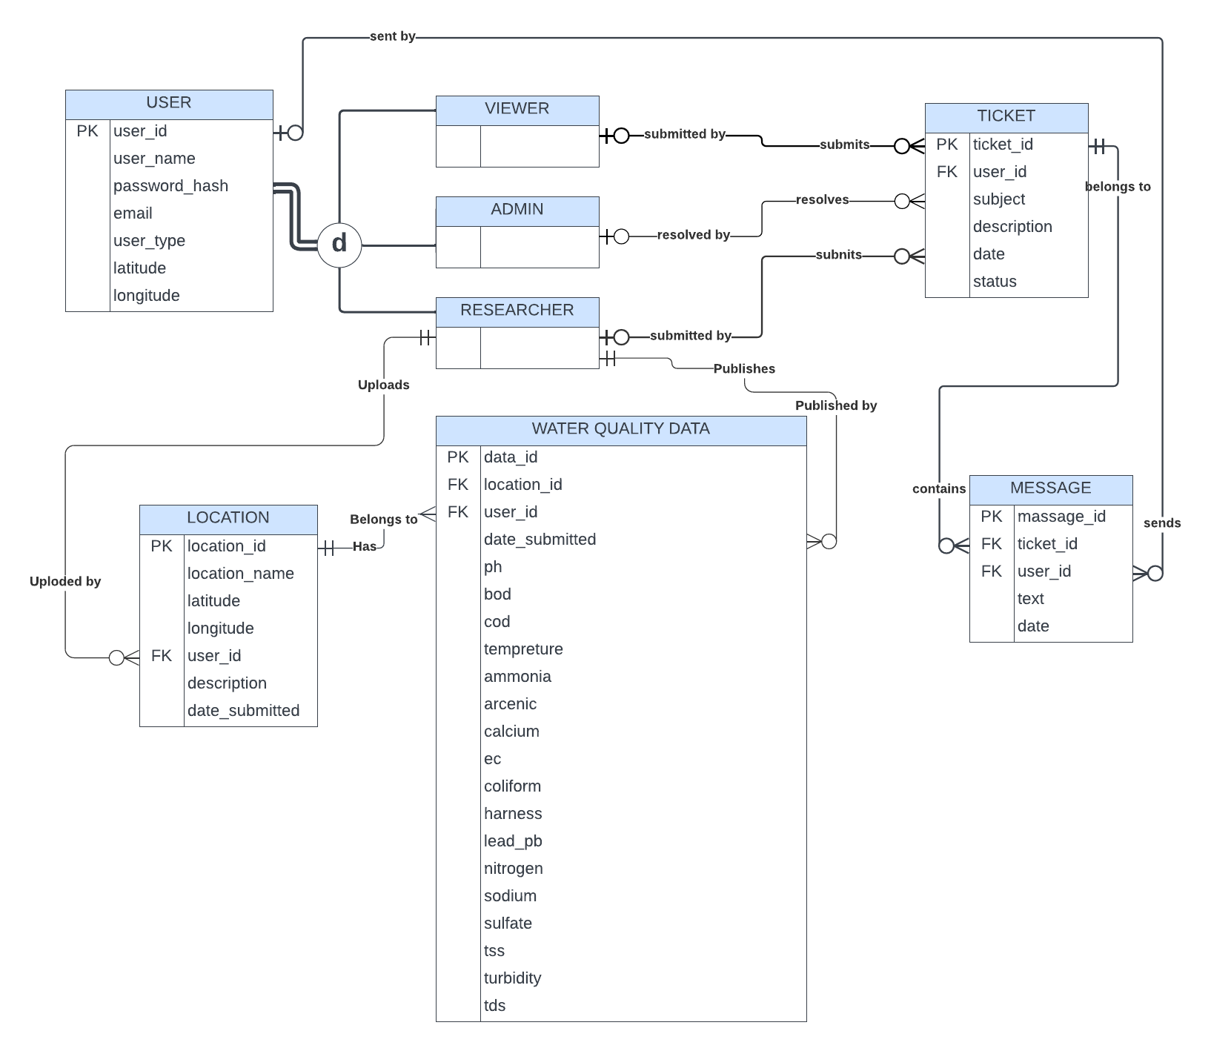
ENTITY-RELATIONSHIP DIAGRAM

Slide 5
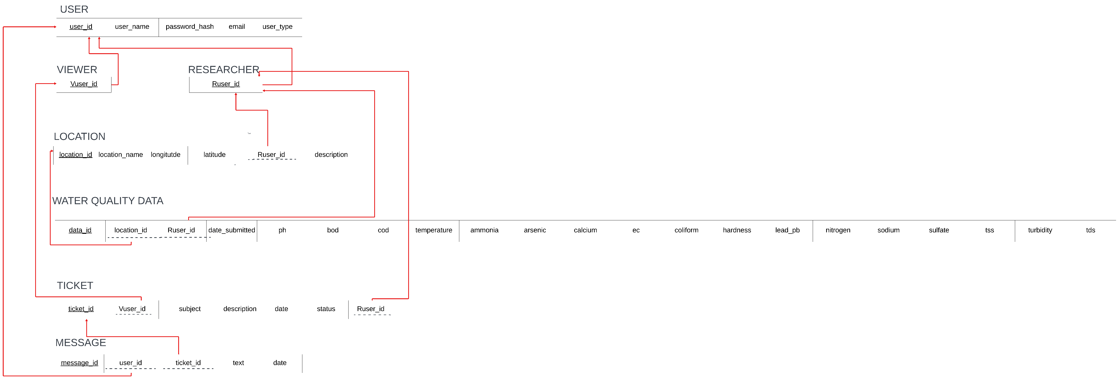
RELATIONAL SCHEMA

Slide 6
Normalized Form

Slide 7
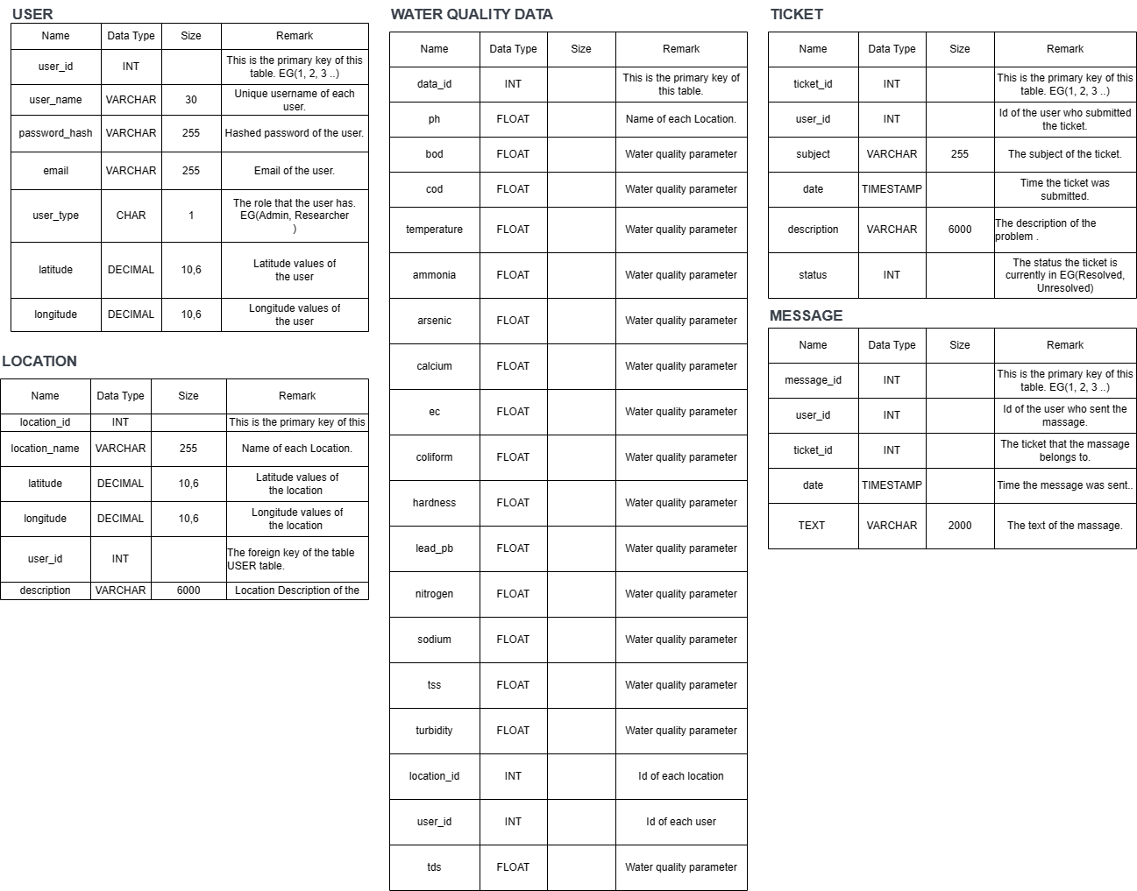
Data Dictionary

Slide 8
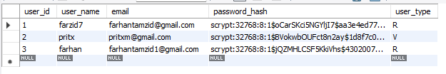
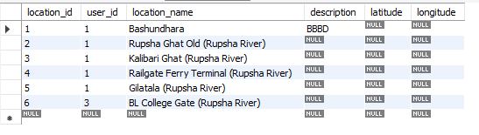
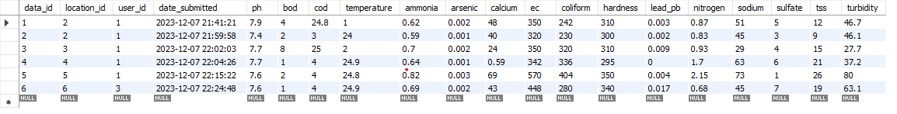
USER TABLE
LOCATION TABLE
IMPLEMENTED DATABASE TABLES
WATER QUALITY DATA TABLE

Slide 9


MESSAGE TABLE
IMPLEMENTED DATABASE TABLES
TICKET TABLE
WATER QUALITY DATA TABL

Slide 10

THANKS

