Slide 1

Bokeh Deployment in Heroku
IKN

Slide 2
What is Heroku?
Heroku is one of the easiest platforms for deploying web applications, entirely in the cloud.
It is free to deploy simple demo applications and fairly cheap in general.
It became popular within the Python community due to its simplicity.

Slide 3

What is Heroku?

Slide 4
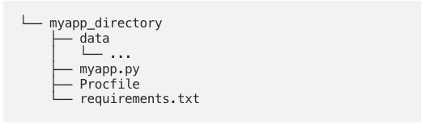
Heroku file structure
Several files are required to ensure that Bokeh, Python and Heroku can communicate with each other and deploy the app.
These are your data, a Python script containing the app, a Procfile, and a requirements file.

Slide 5
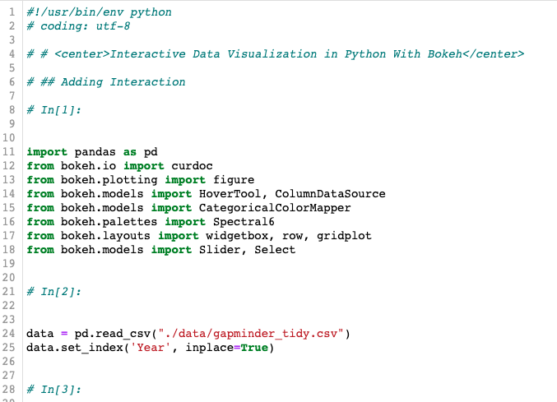
The app data

Slide 6
The Procfile
This file tells Heroku where to source and host the app.
web: bokeh serve --port=$PORT --allow-websocket-origin=myapp.herokuapp.com --address=0.0.0.0 --use-xheaders myapp.py
--port specifies the port that the Bokeh server will listen on; $PORT is set by Heroku.
--allow-websocket-origin=myapp.herokuapp.com specifies your app as the host name.
--address=0.0.0.0 tells Bokeh to figure out which IP address it will be on.
--use-xheaders tells Bokeh to override the remote IP and URI scheme/protocol.

Slide 7
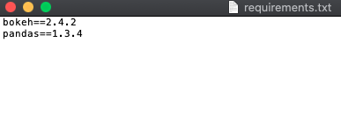
The Requirements file
To create your requirements file, use the following terminal command from inside your app directory:
pip freeze > requirements.txt

Slide 8
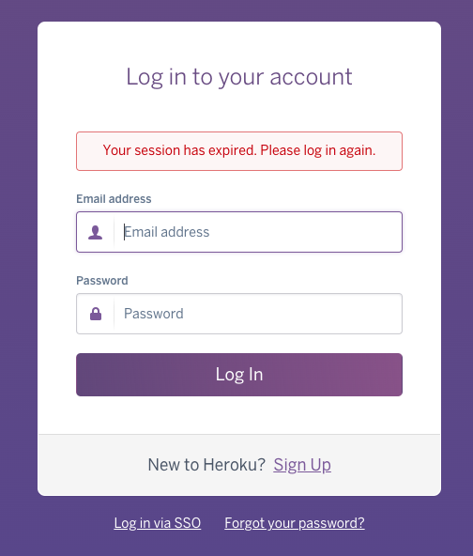
App deployment
Login to your Heroku account

Slide 9
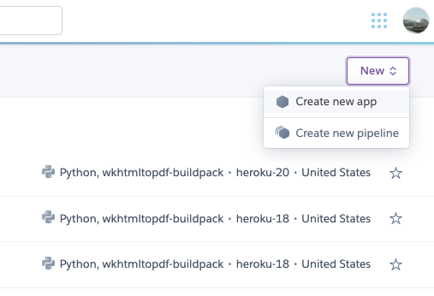
App deployment
Create new app

Slide 10
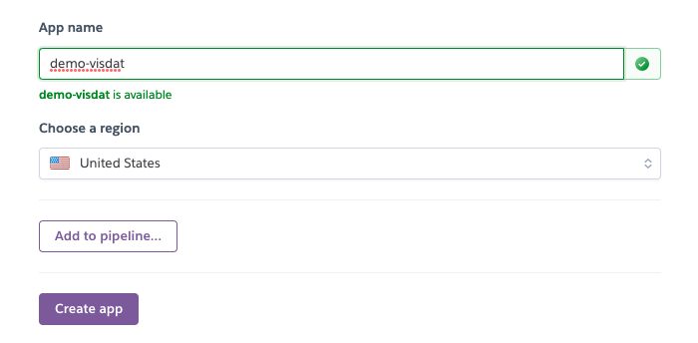
App deployment
Create new app

Slide 11
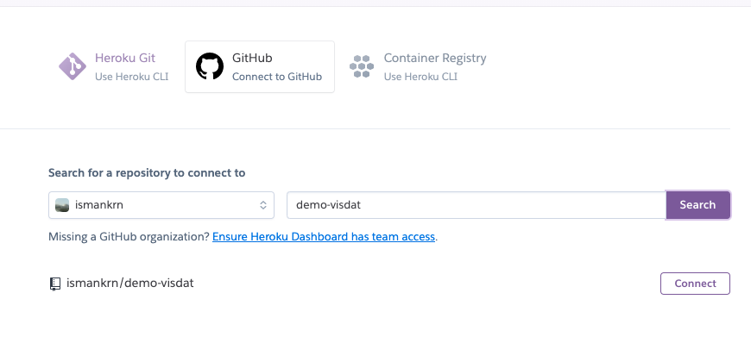
App deployment
Connect the app to github repository

Slide 12
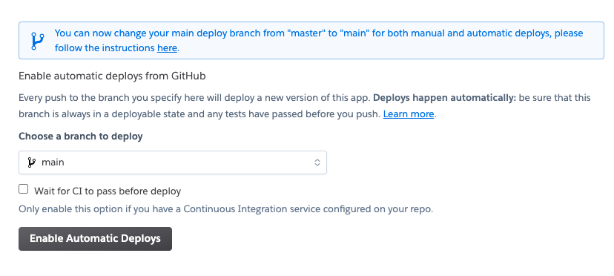
App deployment
Enable automatics deploys

Slide 13
