Slide 1
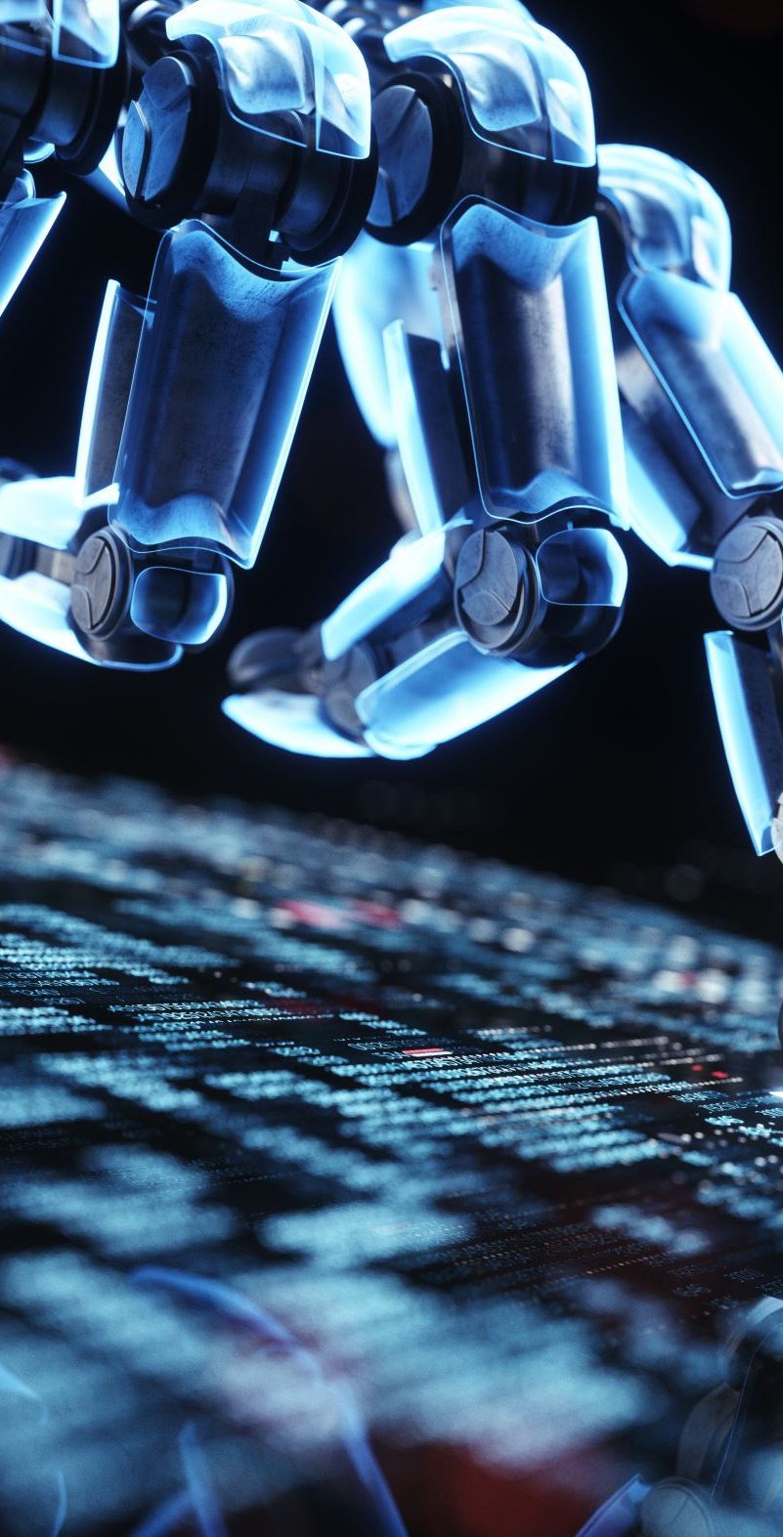
Emotionally Intelligent Dynamic Pathfinding for Service Robots
Farhan Zariwala
Comp 361
April 10, 2026

Slide 2
The Problem Statement
Traditional Robots use 'First-In, First-Out' (FIFO) or Shortest-Path algorithms.
The Flaw: Geometrically precise, but socially unaware.
Example: Delivering to a happy customer 5 feet away while ignoring a furious customer 20 feet away.
Service robots must understand human emotional urgency to be viable in the real world.

Slide 3
The Proposed Solution
Macro-Task Prioritization: Altering WHO the robot serves first, not just collision avoidance.
100% Offline Affective Computing Pipeline: Ensures zero-latency processing without internet dependency.
Dynamic A* Pathfinding: Explicitly overrides geographical efficiency for emotional urgency.

Slide 4
The Brain - Dual-Modality AI
Modality 1 (Semantic): DistilBERT Text-Classification.
- Maps 28 granular emotions into Positive/Neutral/Negative.
Modality 2 (Acoustic): Wav2Vec2 Audio-Classification.
- Analyzes raw soundwave frequencies for non-verbal tone.
Why two modalities? Cross-referencing prevents false positives (e.g., sarcasm or polite words with angry tone).

Slide 5

The Priority Matrix
Wait Time + AI Emotion = Priority Score (1 to 9)
Priority 1: Negative Emotion + Most Wait Time (Urgent!)
Priority 2: Negative Emotion + Some Wait Time
Priority 3: Neutral Emotion + Most Wait Time
Priority 4: Negative Emotion + Just Ordered
...
Priority 9: Positive Emotion + Just Ordered (Lowest Priority)

Slide 6
The Simulation State Machine
State 1: Initialization (9 tables, random wait times assigned).
State 2: Perception Patrol (Robot listens to audio, tables change color).
State 3: Kitchen Interrupt (Orders are flagged as ready).
State 4: Priority Brain (Calculate the 1-9 priority scores).
State 5: Execution (A* Pathfinding delivery in strict priority order).

Slide 7
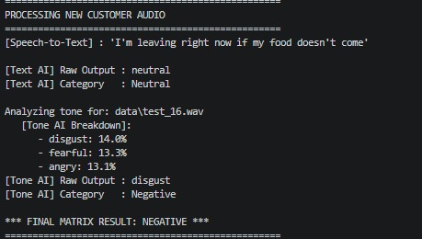
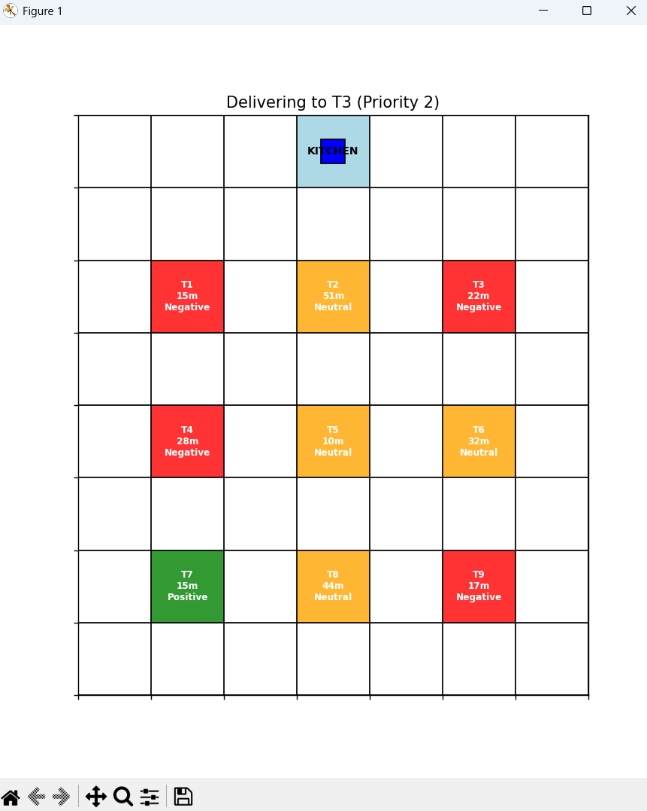
Experimental Results
Terminal Output showing AI Tone & Text breakdown
Matplotlib Grid showing robot path
Success: Matrix conservatively handled conflicts (e.g., Polite text + Angry tone = Neutral).
Success: A* algorithm bypassed closer 'Green' tables to immediately serve 'Red' tables.

Slide 8
Technical Challenges Overcome
Network Firewalls: Migrated Hugging Face pipelines to local .safetensors files for offline execution.
FFmpeg Windows Bug: Bypassed pipeline shortcuts using native librosa loading.
PyTorch Math Crashes: Solved divide-by-zero NaN errors with safe-normalization (1e-9 epsilon) and float32 tensor casting.
Omission of Facial Recognition: Re-scoped to Dual-Modality to preserve real-time computational constraints.

Slide 9

Future Work
ROS & Gazebo Integration: Porting to 3D continuous environment with a physical TurtleBot.
Dynamic Spawning: Interactive simulation with moving obstacles and real-time customer influx.
Triple Modality: Integrating Computer Vision (YOLO Facial Emotion Recognition) with an upgraded GPU.

Slide 10
Conclusion
Affective computing successfully enhances robotic pathfinding.
Integrating semantic and acoustic AI yields a significantly more practical and socially aware service robot.
Thank you!

