Slide 1
Dose Response Curves of 6 Mtb candidate antibiotics in Erdman Lux and 1 Clinical Isolate (Lineage 1.2) in Standard/Rich Growth Condition
Aldridge Lab
4/9/26

Slide 2
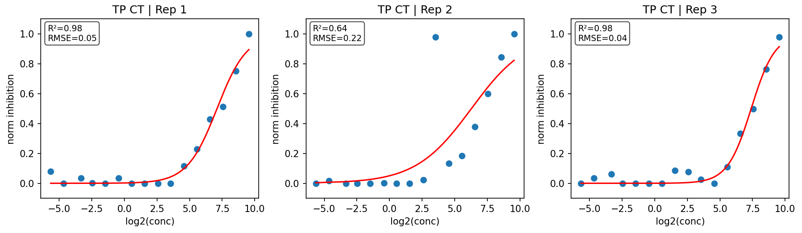
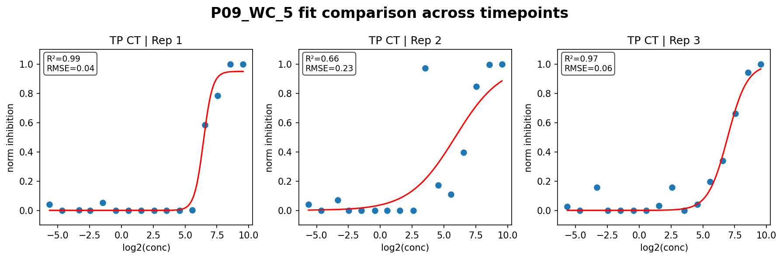
Compound 1
Erdman Lux
vci 185 (Lineage 1.2)

Slide 3
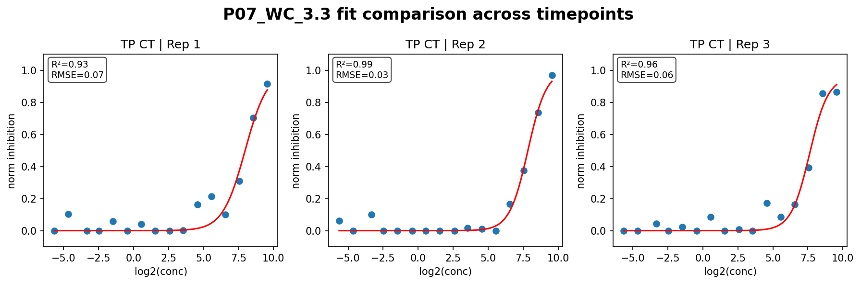
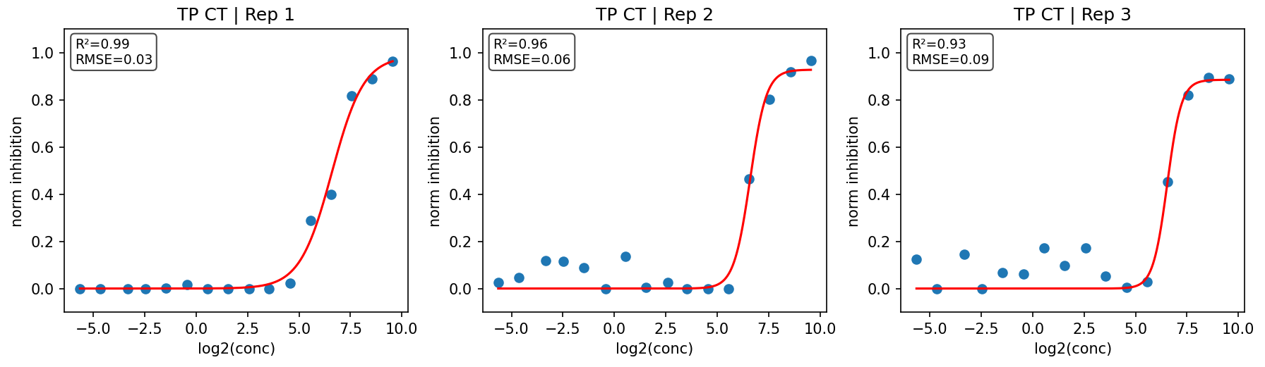
Compound 2
Erdman Lux
vci 185 (Lineage 1.2)

Slide 4
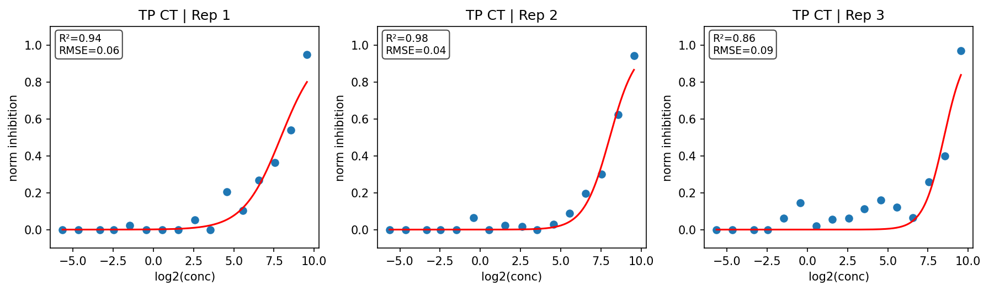
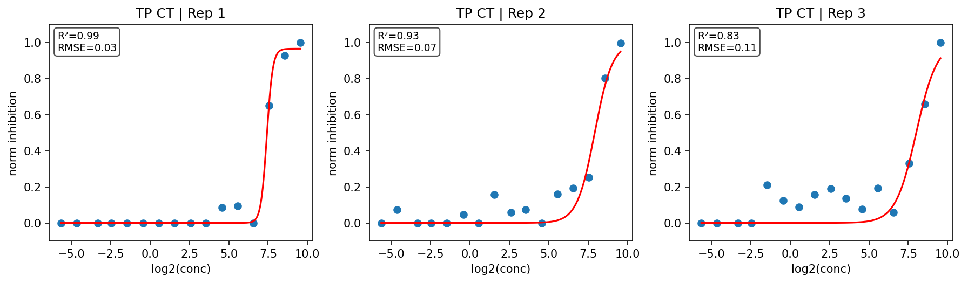
Compound 3
Erdman Lux
vci 185 (Lineage 1.2)

Slide 5
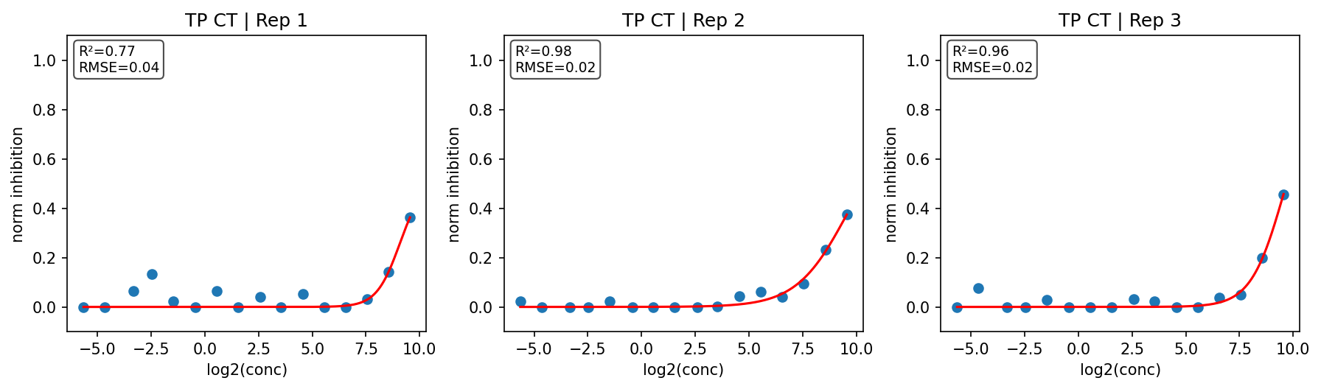
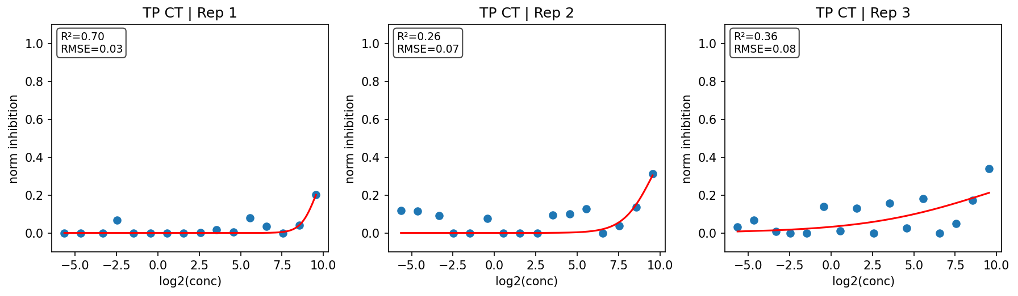
Compound 4
Erdman Lux
vci 185 (Lineage 1.2)

Slide 6
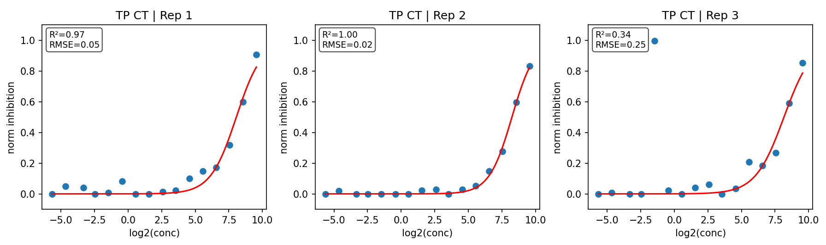
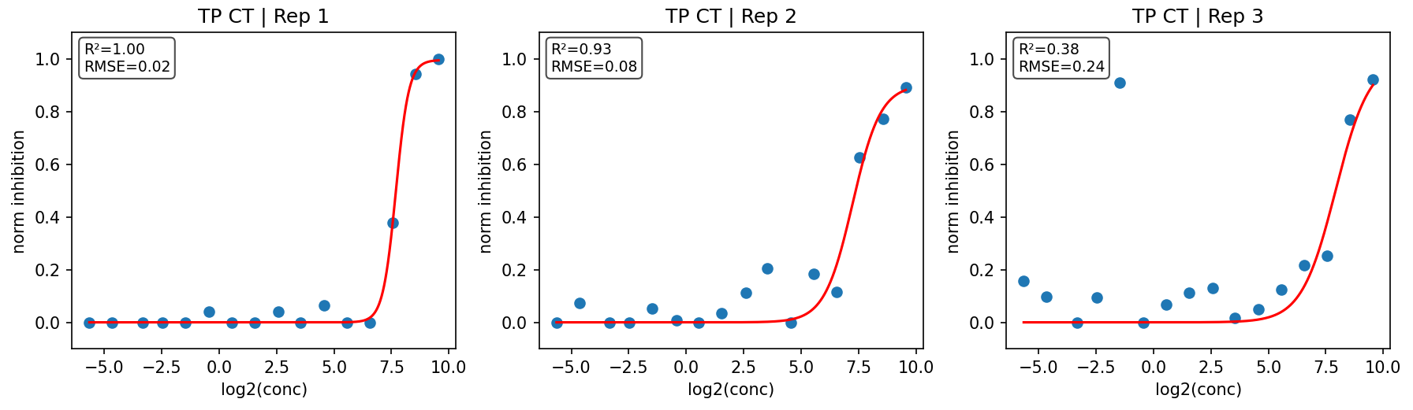
Compound 5
Erdman Lux
vci 185 (Lineage 1.2)

Slide 7
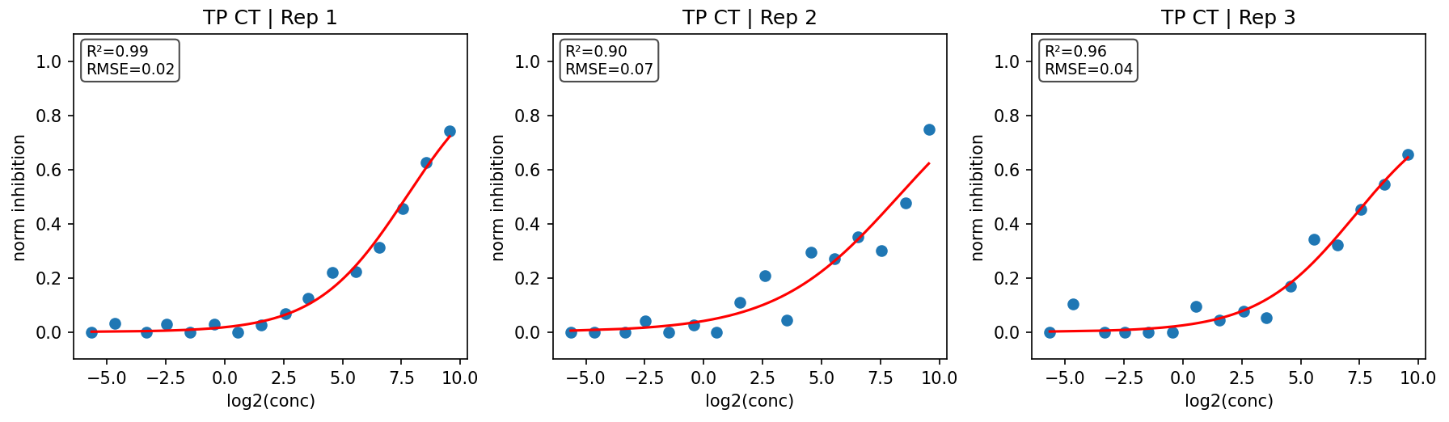
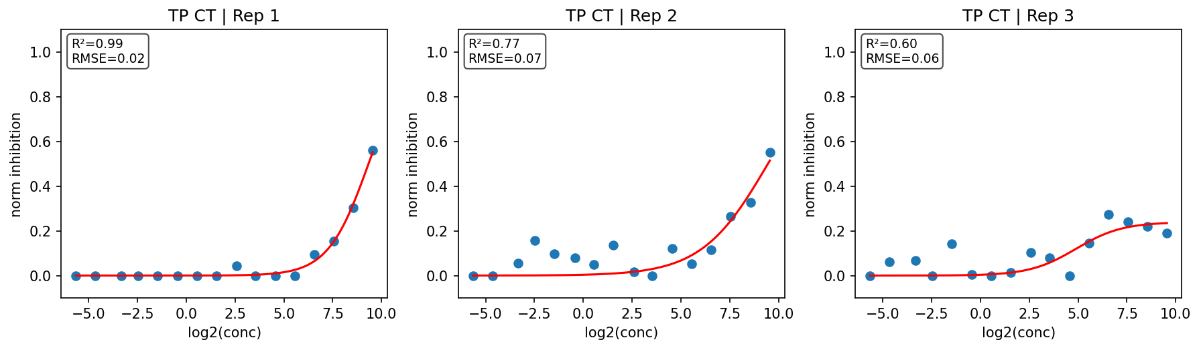
Compound 6
Erdman Lux
vci 185 (Lineage 1.2)

