Slide 1

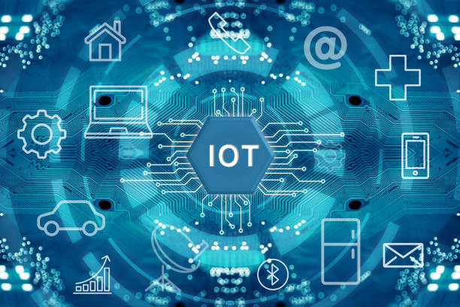
Quantum Computing vs Classical Computing
Presented By :Farhat Jabeen

Slide 2
Table Of Contents:
Introduction
Classical Computing
Quantum Computing
Advantages of Quantum
Challenges of Quantum
Aplication of Quantum
Conclusion

Slide 3
Introduction
What is Computing?
Computing is the process of solving problems using data and algorithms.
Two Main Types:
Classical Computing
Used in today's computers, smartphones, and servers.
Quantum Computing
Uses principles of quantum mechanics to process information.
Key Question: How does quantum computing differ from classical computing?

Slide 4
Classical Computing
How Classical Computers Work
Information is stored as bits.
A bit can be:
0
1
Characteristics:
Sequential processing
Reliable and mature technology
Excellent for everyday applications
Examples:
Laptops
Smartphones
Data centers
Visual: Binary representation (0s and 1s).

Slide 5
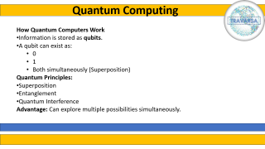
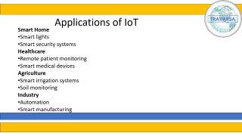
Quantum Computing
How Quantum Computers Work
Information is stored as qubits.
A qubit can exist as:
0
1
Both simultaneously (Superposition)
Quantum Principles:
Superposition
Entanglement
Quantum Interference
Advantage: Can explore multiple possibilities simultaneously.

Slide 6
Advantages
Quantum Computing: Pros & Cons
Advantages
✅ Massive computational power for specific problems
✅ Faster optimization and simulation
✅ Potential breakthroughs in science

Slide 7
Challenges of Quantum
Challenges
❌ Expensive hardware
❌ Qubit instability (decoherence)
❌ Error correction difficulties
❌ Limited practical applications today

Slide 8
Applications
Where Are They Used?
Classical Computing
Web browsing
Office software
Gaming
Databases
Quantum Computing
Drug discovery
Cryptography
Financial modeling
Logistics optimization
Material science

Slide 9
Conclusion
The Future of Computing
Classical computers will remain essential for everyday tasks.
Quantum computers are not replacing classical computers.
Instead, they will complement classical systems.
Quantum computing has the potential to revolutionize science, medicine, and cybersecurity.

Slide 10
Thank You

