Slide 1

Deep Learning-based Anomaly Detection in Credit Card Transactions
Presented By
Farhat Lamia Barsha
Tennessee Technological University
1

Slide 2
Outline
Introduction
Motivation
Contribution
Background Study
Methodology
Result and Discussion
Conclusion
Future Directions
2

Slide 3
Introduction
Credit card fraud is an expression of identity theft that happens when an individual obtains someone’s private information without authorization and uses it for financial transactions.
Deep learning techniques demonstrate exceptional performance in the identification of complex patterns and the acquisition of features.
Challenges in credit card fraud detection includes imbalanced datasets, overlapping data, misclassification, changing fraud patterns over time, feature generation, fraud detection cost, lack of standard metrics, etc.
Dataset balancing is a preprocessing technique in machine learning that involves adjusting the distribution of classes within a dataset, particularly addressing class imbalance.
False positives refer to instances where valid transactions are mistakenly identified as fraudulent, resulting in negative consequences such as customer discomfort, diminished trust, and increased operational expenses.
3

Slide 4
Motivation
Conventional approaches frequently encounter difficulties in accurately detecting the complex patterns and small irregularities that are indicative of fraudulent activities in credit card transactions.
The increasing sophistication of fraudsters necessitates the utilization of deep learning models, which provide crucial robustness and adaptability.
There is currently a lack of research that specifically examines the consequences of false positive cases and strategies to mitigate their occurrence.
Majority of the existing work consider accuracy as an only metric to evaluate algorithms performance while in credit card fraud, precision and recall is more important to consider.
4

Slide 5
Contribution
Deep Learning methods on anomaly detection
Comparison between CNN and ANN
False Positive and False Negative Rates analysis
Emphasis on Precision, Recall, and F1 Score
5

Slide 6
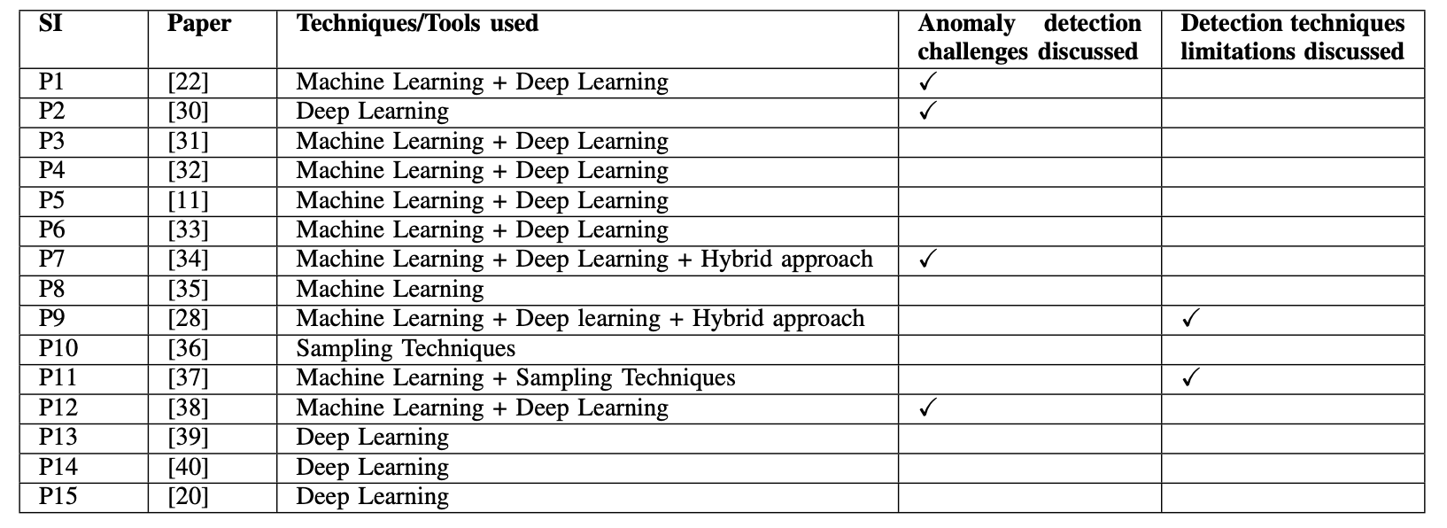
Background Study
Fig: List of the selected research papers on anomaly detection in credit card transactions
6

Slide 7
Methodology
Dataset Preprocessing
Under sampling
Feature Separation
Dataset Splitting
Standardization
Analysis
Evaluation Metrics
Application of CNN and ANN
Data Reshape
Fig: System Methodology
7

Slide 8
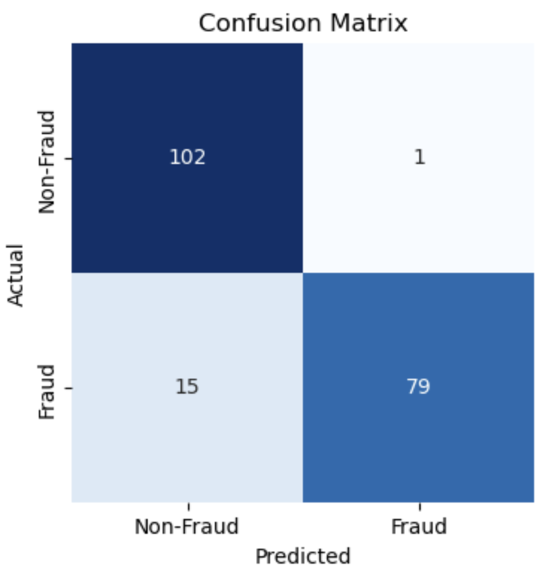
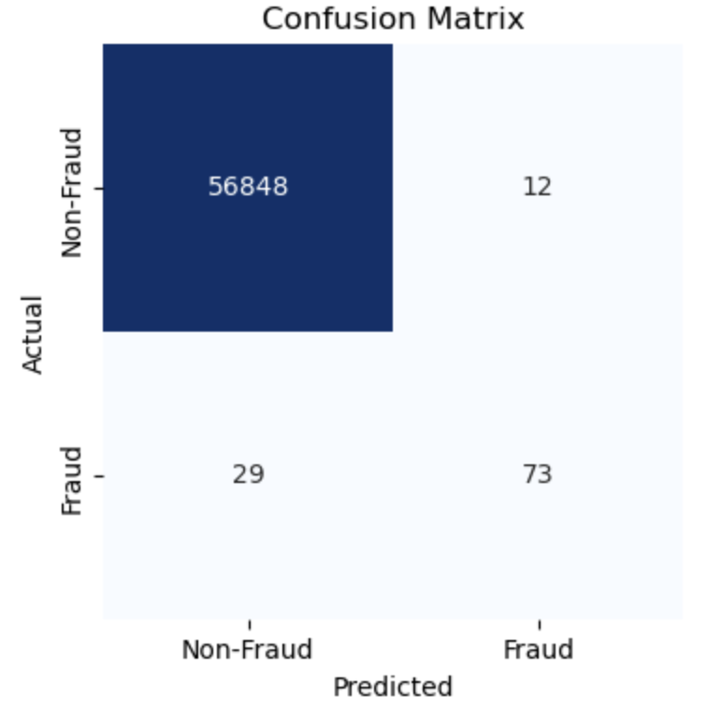
Results and Discussion
Fig: Confusion Matrix by CNN in imbalanced dataset
Fig: Confusion Matrix by CNN in balanced dataset
8

Slide 9
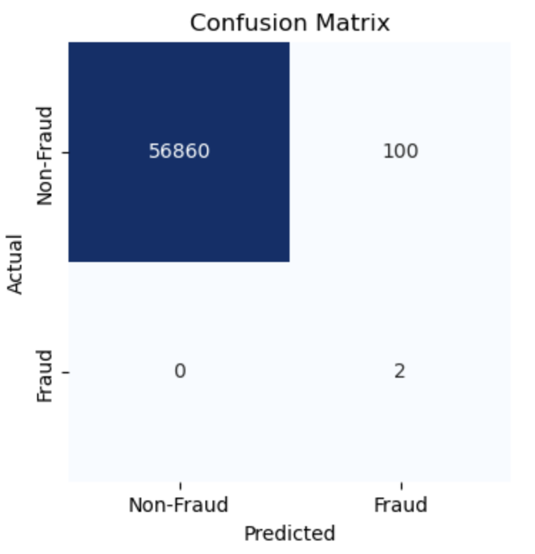
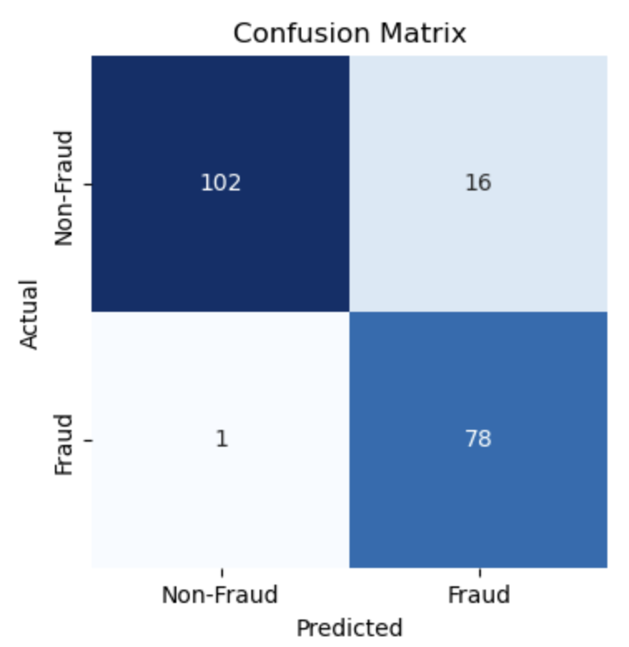
Results and Discussion
Fig: Confusion Matrix by ANN in imbalanced dataset
Fig: Confusion Matrix by ANN in balanced dataset
9

Slide 10
Overall Evaluation
 | CNN (Imbalanced) | CNN (Balanced) | ANN (Imbalanced) | ANN (Balanced)
Accuracy | 99 | 91 | 99 | 91
Precision | 85 | 98 | 100 | 98
Recall | 71 | 84 | 2 | 82
F1-score | 78 | 90 | 4 | 90
Fig: Comparison between CNN and ANN
10

Slide 11
Conclusion
Deep learning exhibits superior performance compared to conventional machine learning algorithms in the domain of credit card fraud detection.
Both CNN and ANN show comparable performance within a balanced dataset.
The CNN algorithm demonstrates exceptional proficiency in reducing instances of false positives.
The ANN algorithm exhibits superior performance in minimizing false negatives.
The study underscores the significance of precision, recall, and F1 score over accuracy for evaluating credit card fraud detection systems.
11

Slide 12
Future Directions
Integrate explainability and interpretability into neural network models for credit card fraud detection.
Understanding the decision-making mechanisms enhances trust among end-users and regulatory entities, promoting the adoption of advanced algorithms in the financial industry.
Investigate the potential of integrating temporal and sequential elements into credit card transaction data analysis.
Utilize time-series analysis with recurrent neural networks to gain insights into dynamic characteristics of fraudulent behaviors.
12

Slide 13
Thank You

