Slide 1
Intelligent Classification of Rural Infrastructure Projects
Presented By: Farheen khan
College Name- Satpuda college of engineering and polytechnic
Department- Btech [CSE]

Slide 2
OUTLINE
Problem Statement
Proposed System/Solution
System Development Approach
Deployment
Result (Output Image)
Conclusion
Future Scope
References

Slide 3
Problem Statement
The Pradhan Mantri Gram Sadak Yojana (PMGSY) aims to build all-weather roads to connect rural villages in India. Over time, this scheme has evolved into multiple phases like PMGSY-I, PMGSY-II, RCPLWEA, etc., each with different goals and rules. Today, it’s tough for government officials to manually classify each project correctly due to complex data formats and multiple parameters. Manual sorting is slow, error-prone, and inefficient. Goal of This Project: To build an AI-powered classification system that can automatically categorize rural infrastructure projects into the correct PMGSY phase using their physical and financial details—saving time, avoiding errors, and helping officials make better decisions.

Slide 4
Proposed Solution
The proposed solution aims to simplify and automate the process of classifying rural road projects under the Pradhan Mantri Gram Sadak Yojana (PMGSY) schemes using Artificial Intelligence (AI). This system will help government officials save time, reduce manual errors, and ensure faster delivery of connectivity to rural India The solution will consist of the following components:
Data Collection:
Gather detailed data for rural road projects, including physical (length, location, road type) and financial (cost, funding) attributes.
Use the official PMGSY dataset from the AI Kosh portal to ensure accuracy and completeness.
Data Preprocessing:
Clean and prepare the data: remove duplicates, fill in missing values, and correct inconsistencies.
Engineer features—that is, create new columns or indicators in the data that help distinguish between different types or phases of projects
Machine Learning Algorithm:
Use supervised machine learning algorithms such as Random Forest or XGBoost to train a classifier on the labeled project dataset.
The model will learn patterns within the data to recognize which projects belong to which PMGSY phase or scheme.
Model Evaluation:
Test the classifier using past project data to check for accuracy, ensuring reliable results.
Use evaluation metrics like accuracy, precision, recall, and confusion matrices to measure performance.

Slide 5
Proposed Solution
Deployment:
Develop a user-friendly web-based interface or API.
Deploy the trained classifier model using IBM Cloud Lite services so it is always available to government planners and officials.
Automation and Insight:
Enable automatic, real-time classification of new rural projects with just a few clicks.
Officials can upload or enter project details and instantly get the predicted scheme category, speeding up planning and approvals.
Benefits:
Reduces manual work and errors.
Ensures faster project processing and better decision-making.
Provides clear reports and visualizations for deeper insight.07:19 PM

Slide 6
System Approach
To develop a machine learning–powered system that can automatically classify rural infrastructure projects under the correct phase of the Pradhan Mantri Gram Sadak Yojana (PMGSY) based on physical and financial attributes.
SYSTEM REQUIREMENTS:
Technologies Used:
IBM Cloud Lite (for model deployment and hosting)
Python 3.x
Hardware Requirements:
Minimum 8 GB RAM
Processor: i5 or above
Internet connection for data access and cloud deployment
Software Requirements:
Jupyter Notebook / IBM Watson Studio
Web browser for accessing deployed model interface

Slide 7
System Approach
LIBRARIES REQUIRED:
For Data Handling:
Pandas
Numpy
For Machine Learning:
scikit-learn
xgboost / randomforest
For Visualization:
matplotlib
seaborn

Slide 8
Algorithm & Deployment
In the Algorithm section, the machine learning algorithm chosen for predicting PMGSY SCHEMES .
Algorithm Selection:
We have selected the Random Forest Classifier, an ensemble learning method that builds multiple decision trees and combines their outputs to make a final prediction.
Random Forest is a robust and accurate model that can handle a mix of numerical and categorical data, which is ideal for our project's diverse dataset. It is also resistant to overfitting and can provide insights into which project features are most important for the classification.
Data Input :
The model will be trained using a diverse set of input features that capture key project characteristics. These include:
Financial Characteristics: Data related to funding, such as the total sanctioned budget and expenditure.
Physical Characteristics: Details of the road itself, including its length, surface type, and location.
Administrative Data: Information that influences project eligibility, such as habitation population size and district category..

Slide 9
Algorithm & Deployment
Training Process:
The model is trained using historical project data to learn classification patterns.
Model Training: The model will be trained on historical project data to learn the relationships between project features and their PMGSY scheme classification.
Validation: We will use techniques like cross-validation to ensure the model's reliability and prevent overfitting.
Optimization: Hyperparameter tuning will be performed to fine-tune the model for the best possible accuracy.
Prediction Process:
Once the model is trained and optimized, it can be used to make predictions on new projects.
Input New Data: The system will receive data for a new, unclassified PMGSY project, including its financial and physical characteristics.
Generate Prediction: The trained model will process this data and output a predicted classification, assigning the project to a specific PMGSY scheme.
Real-time Application: This process can be implemented in a real-time system, allowing for the immediate and automatic classification of new projects as they are initiated.

Slide 10
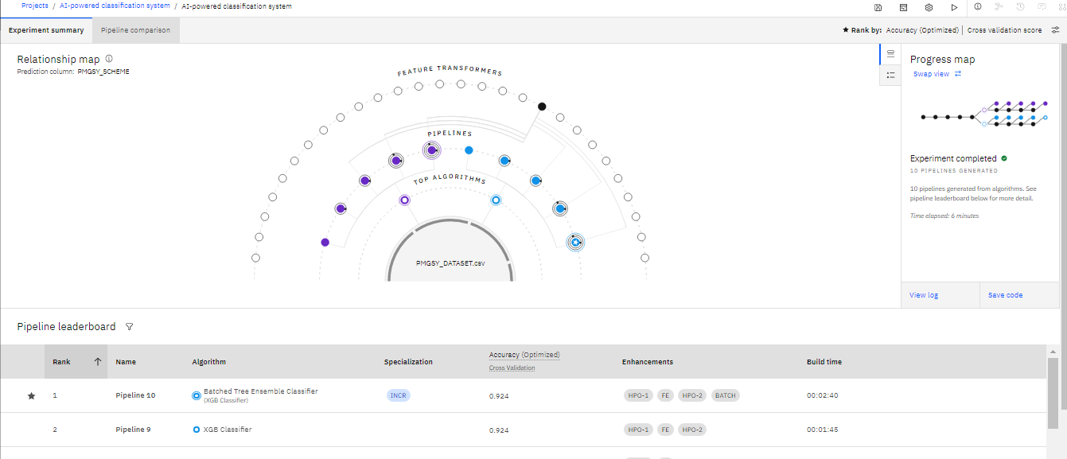
Result

Slide 11
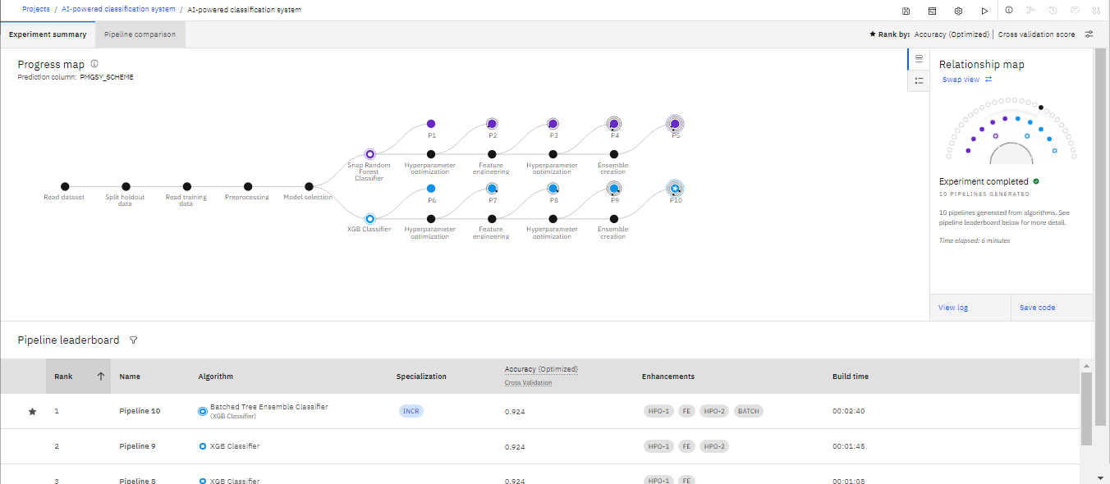
Result

Slide 12
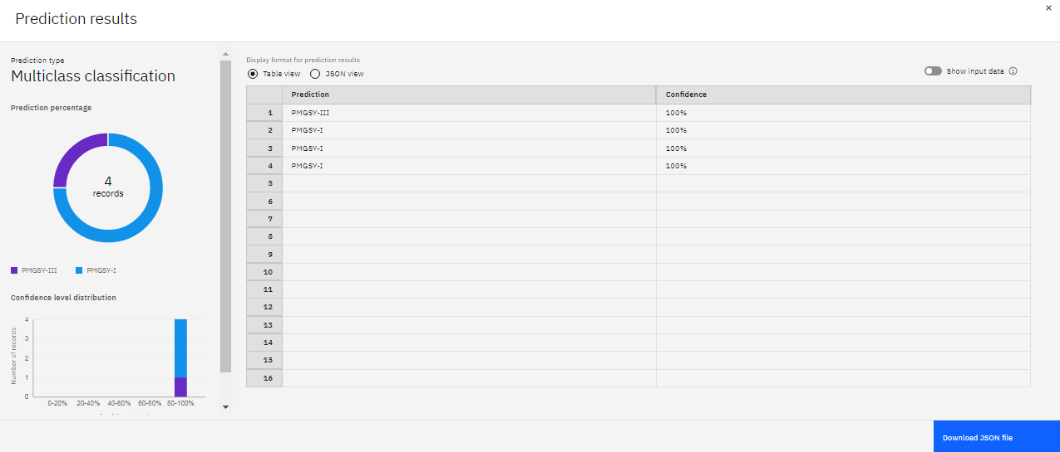
Result

Slide 13
Conclusion
The proposed system successfully automates the classification of rural infrastructure projects under different PMGSY schemes using AI and machine learning. It replaces manual methods with a faster, more accurate, and scalable solution that supports government planning and decision-making. This approach not only improves project tracking and approval speed but also enhances transparency and rural development outcomes

Slide 14
Future scope
Real-Time Data Integration: Connect with live GIS and infrastructure portals for dynamic classification.
Scalability: Expand system to classify other rural assets like bridges, water, and telecom.
Advanced AI Models: Implement deep learning or transformer-based architectures for higher accuracy..
Offline Accessibility: Deploy lightweight models on mobile or edge devices for remote locations.

Slide 15
References
PMGSY Official Site – Details on scheme phases and rural road projects.
AI Kosh Dataset Portal – Source of labeled project data used for training.
https://aikosh.indiaai.gov.in/web/datasets/details/pradhan_mantri_gram_sadak_yojna_pmgsy.html
IBM Watson ML Docs – Guidance on model training and cloud deployment.
Scikit-learn / XGBoost Docs – ML libraries used for implementation.
Research Articles – Studies on rural infrastructure planning using AI.
IBM SkillsBuild Certifications –
Getting Started with AI
Journey to Cloud

Slide 16
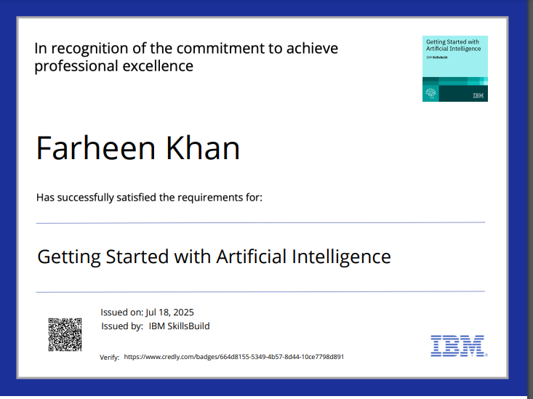
IBM Certifications

Slide 17

IBM Certifications

Slide 18
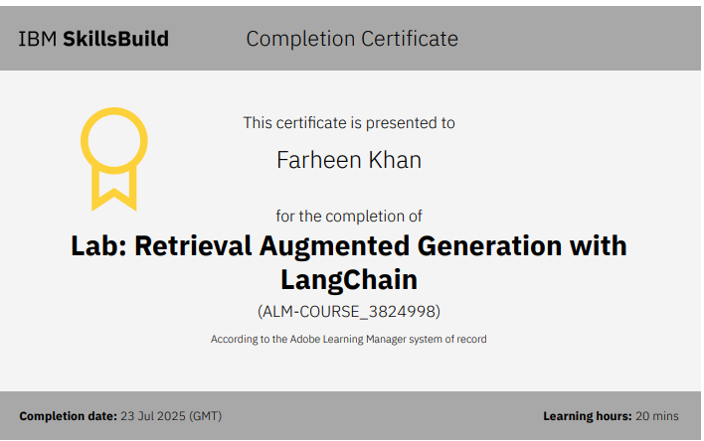
IBM Certifications

Slide 19
THANK YOU

