Slide 1
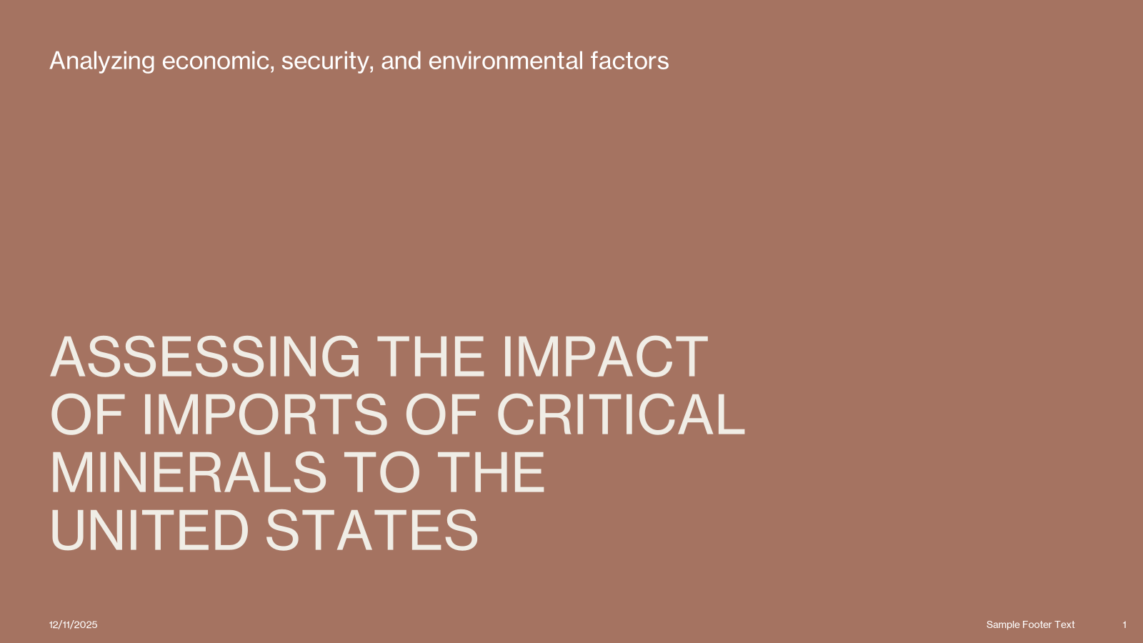
Farhod Ibragimov
DATA 608 Project7

Slide 2
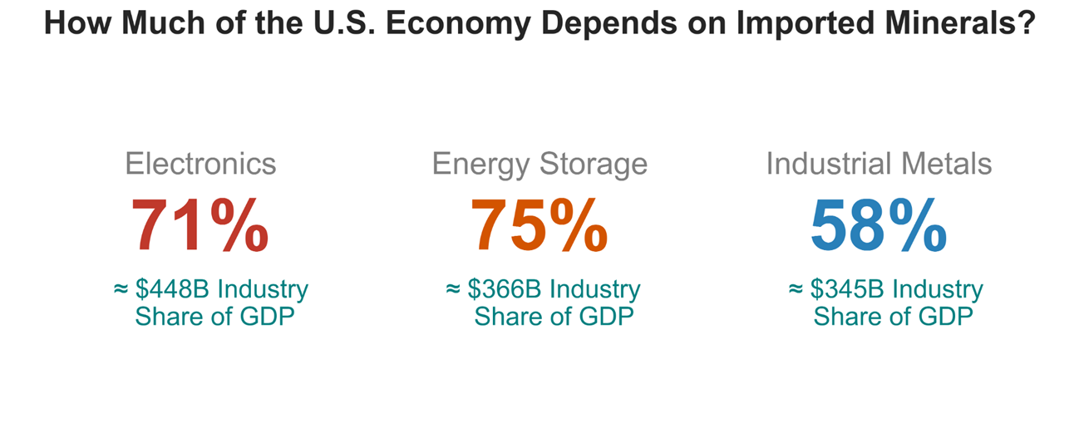
This slide focuses on the GDP weight behind each category.
Electronics is a $448B sector - high reliance means high economic risk.
Energy storage has the highest reliance (75%), which basically confirms that EV supply chains are vulnerable.
Industrial metals are in the middle, but still meaningful because they support manufacturing overall.

Slide 3
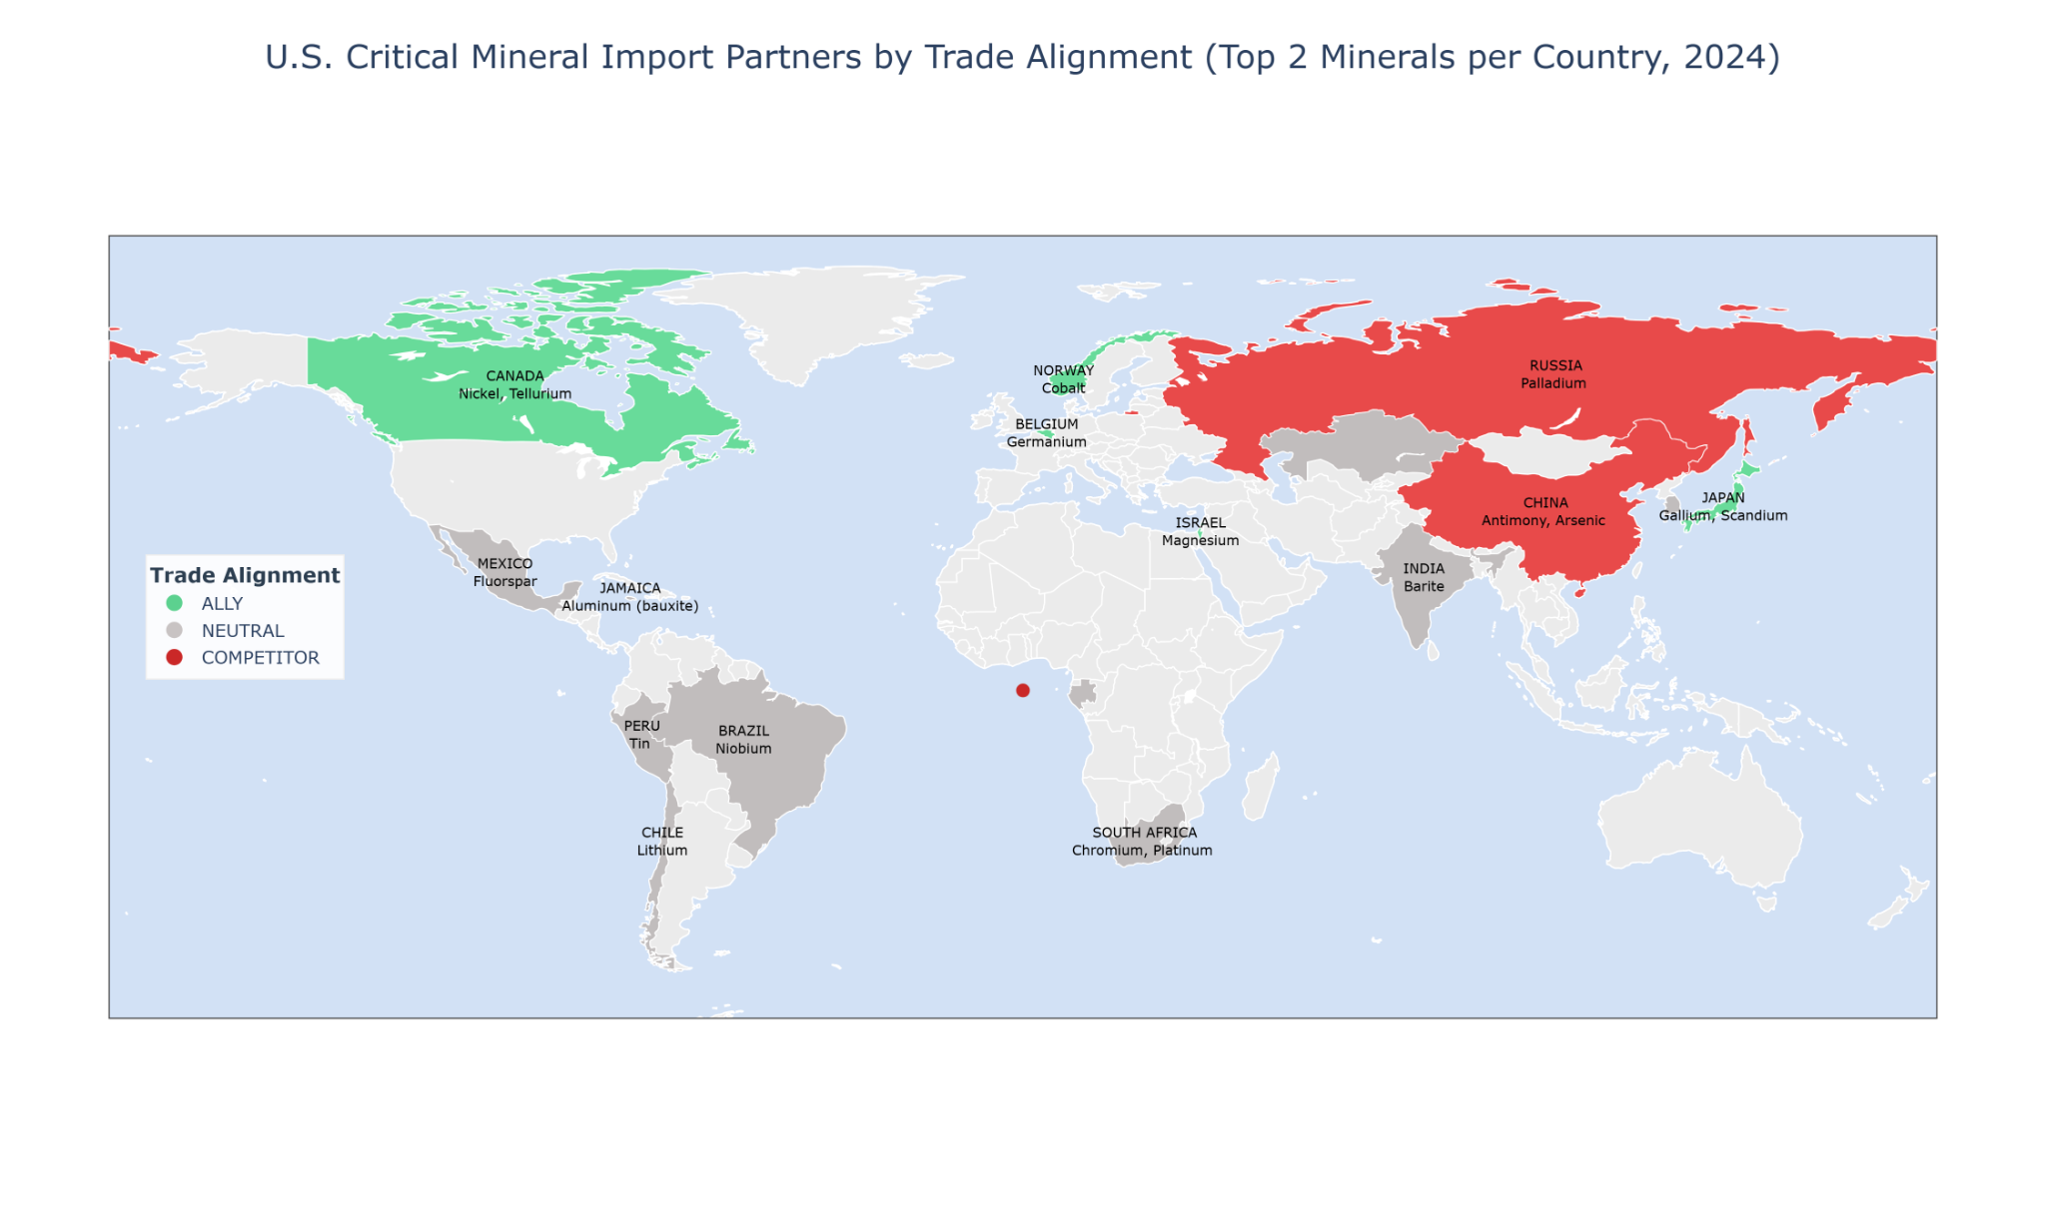
Now the geopolitical angle: not all suppliers are equal.
Problem: a lot of critical minerals come from neutral or competitor countries.
This slide makes it obvious that the supply chain is not aligned with U.S. strategic interests.

Slide 4
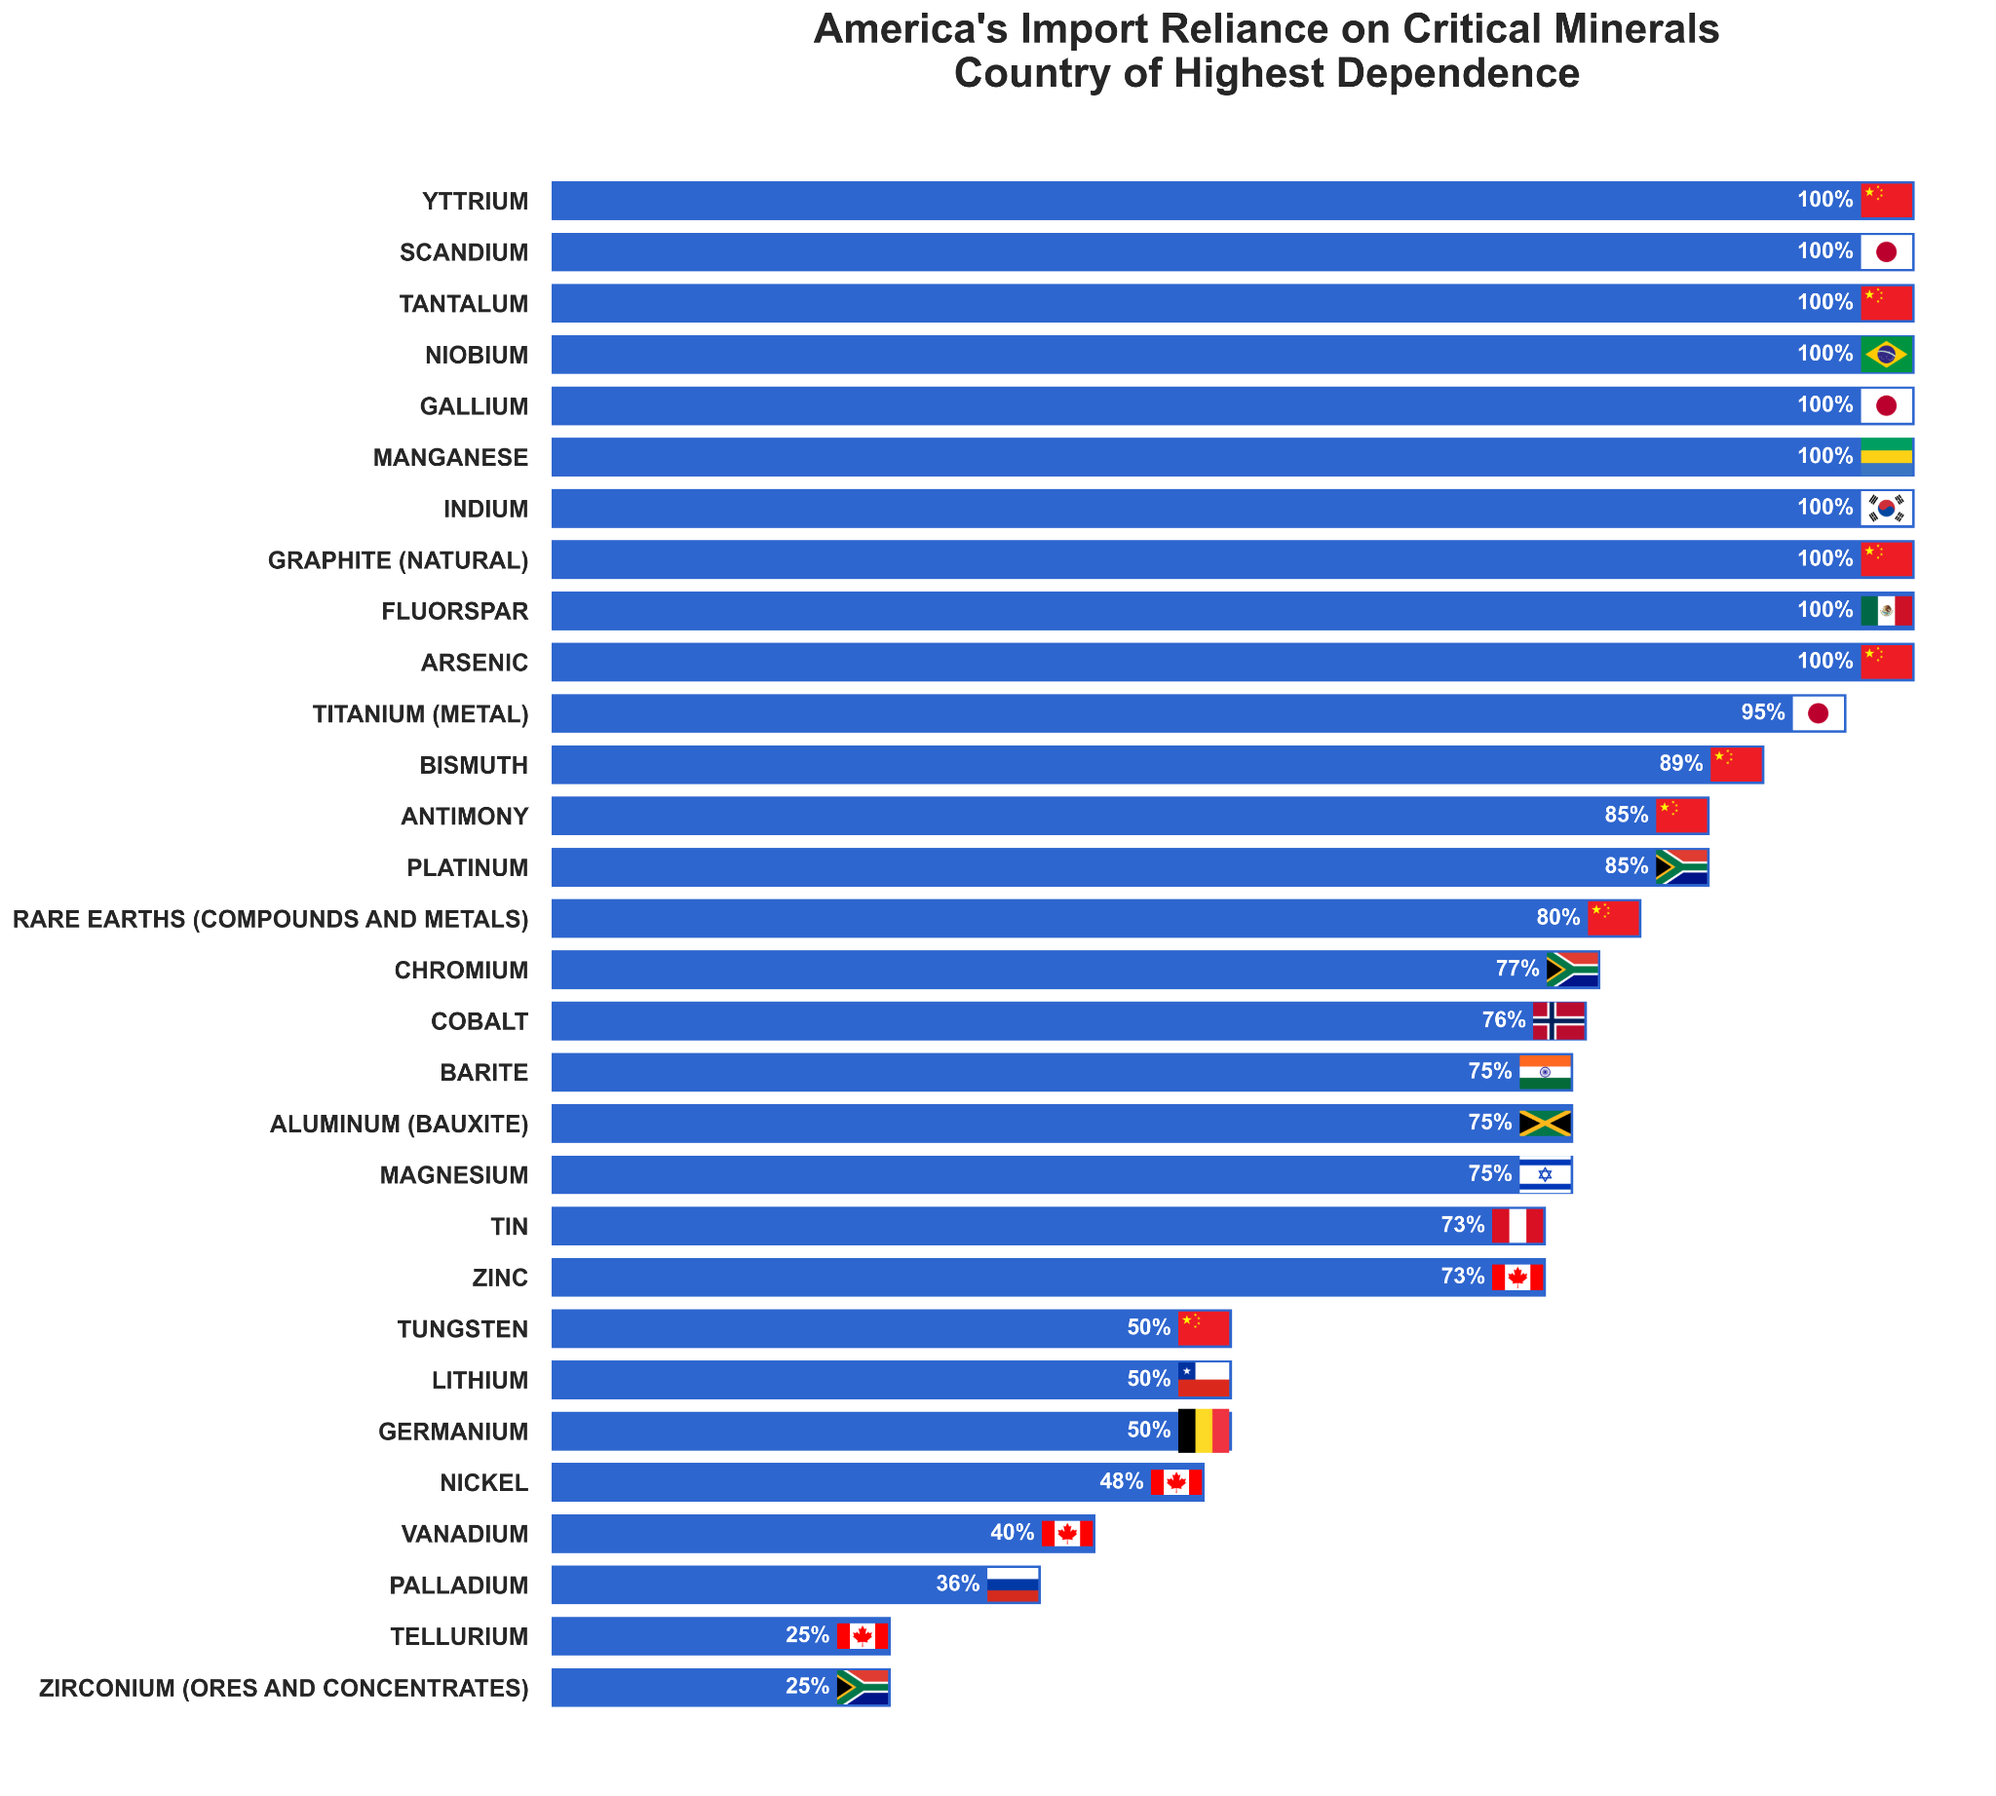
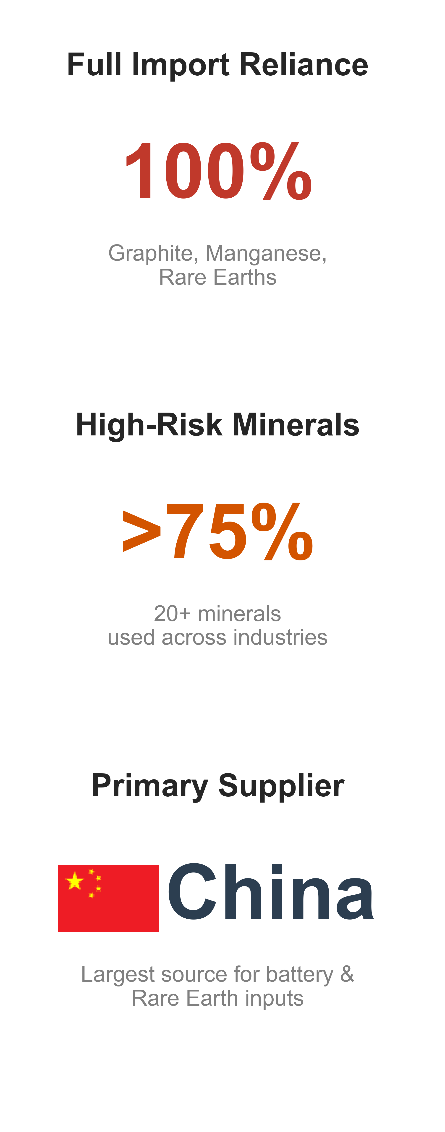
Here’s the mineral-by-mineral breakdown.
Most of the top dependency minerals are 75–100% imported.
What matters is not just the percentage but who the U.S. depends on - China dominates a lot of these bars.
For some minerals (palladium, chromium, cobalt), we rely on countries with either unstable production or geopolitical tension.

Slide 5
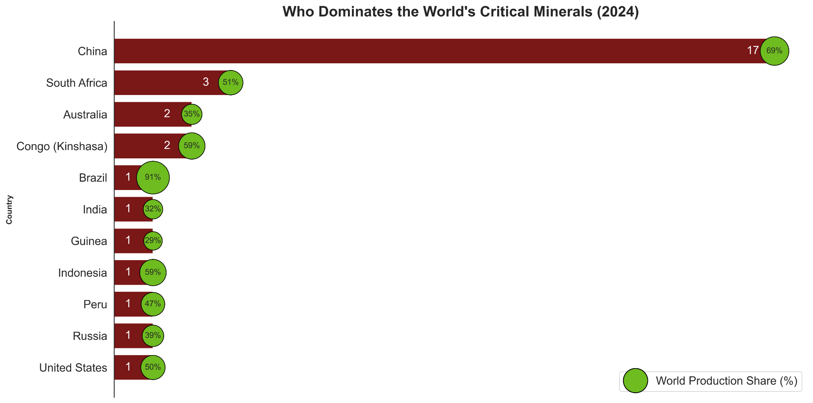
This chart answers the question: “Who controls global production?”
China is in its own league - dominating 17 minerals and nearly 70% average global share.
A few countries like South Africa, Congo, Brazil also show strong dominance in specific minerals.
This matters because even if the U.S. doesn’t directly import from these countries, the global price and supply chain are influenced by them

Slide 6
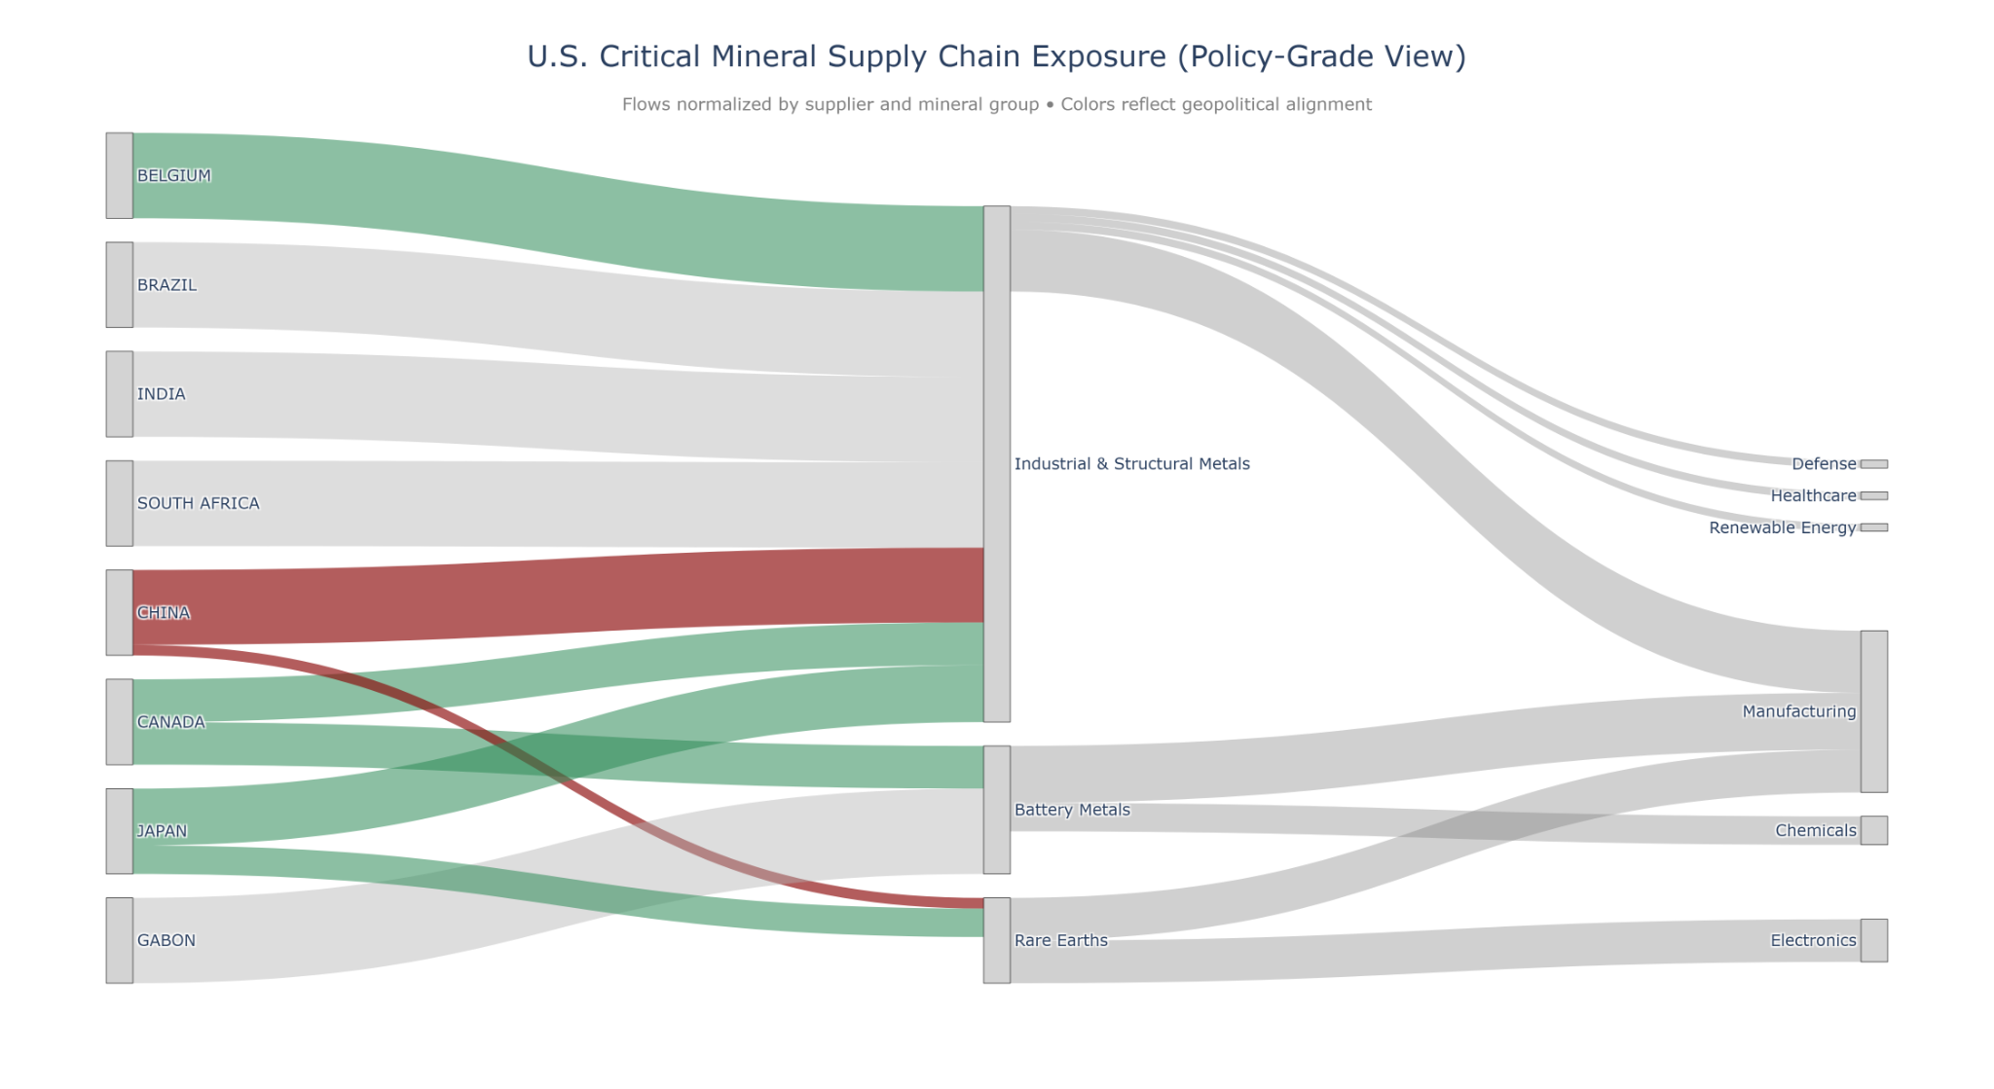
This Sankey chart visualizes upstream → midstream → downstream flow.
Industrial metals and battery metals dominate both volume and strategic importance.
You can see how a few countries feed almost every downstream sector.
The key point: a disruption at the supplier level cascades into manufacturing, chemicals, and electronics quickly.

Slide 7
This heatmap connects specific minerals to industries.
We can immediately see where "single points of failure" exist — for example, cobalt and lithium lighting up energy storage.
Electronics heavily depends on gallium, indium, germanium — all almost fully imported.
The more red an industry is, the fewer domestic options it really has.

Slide 8
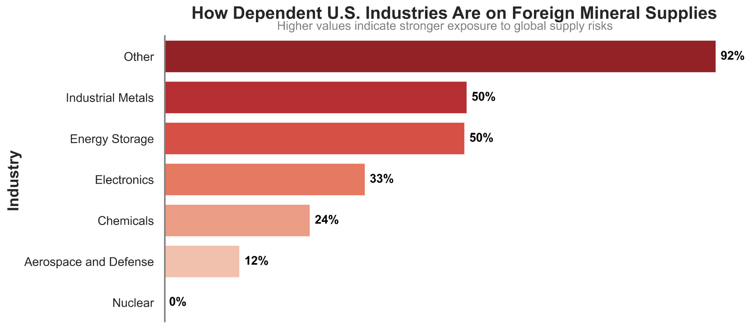
Instead of thinking only in minerals, here’s the industry translation.
Industrial metals, Energy storage and Electronics are the most exposed.
If supply is disrupted, these sectors would feel it first — anything from EV production delays to higher semiconductor prices.
Nuclear is the only sector that looks insulated here (pretty rare to see a clean zero).

Slide 9
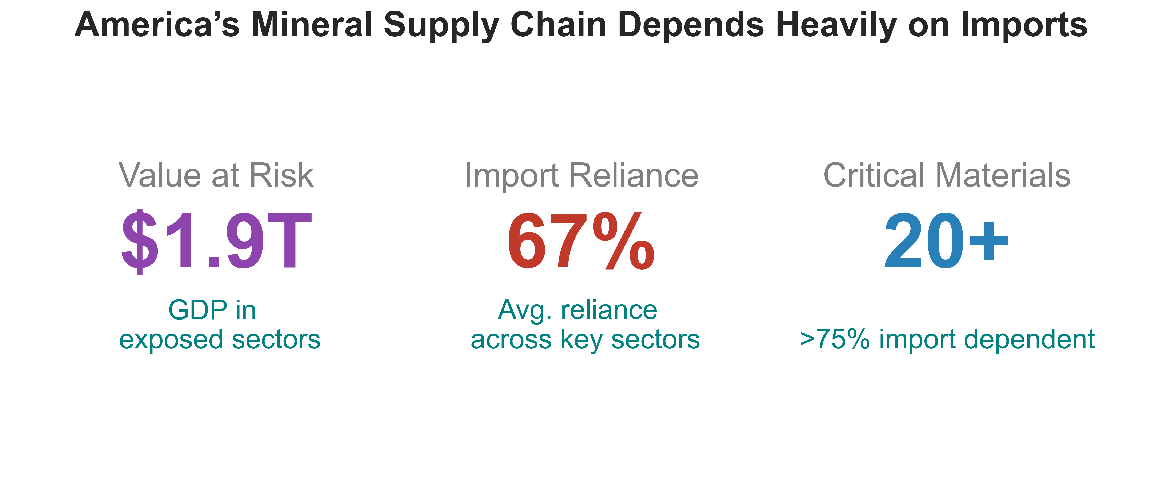
So the picture is pretty simple: $1.9T in exposed value, 67% average import reliance, and 20+ minerals where we’re wide open.
And most of that exposure runs through countries that aren’t exactly aligned with U.S. interests. That’s the real concern - the leverage it creates.
Solving this isn’t about replacing every import. It’s about:
  Reduce single-country dominance – or at least build more stable trade relations when we can (especially with China)
  Building U.S. capacity where it actually pays off.
  Leaning more on trusted partners.
We won’t eliminate dependency, but we can reshape it - so strategic competitors have less control over critical U.S. industries.

