Slide 1
Understanding Food Insecurity in the United States
Patterns Across States, Key Risk Factors, and Consequences for Public Health
Prepared by: Farhod Ibragimov
Sources: USDA ERS, CDC BRFSS, ACS, Feeding America (2023)

Slide 2
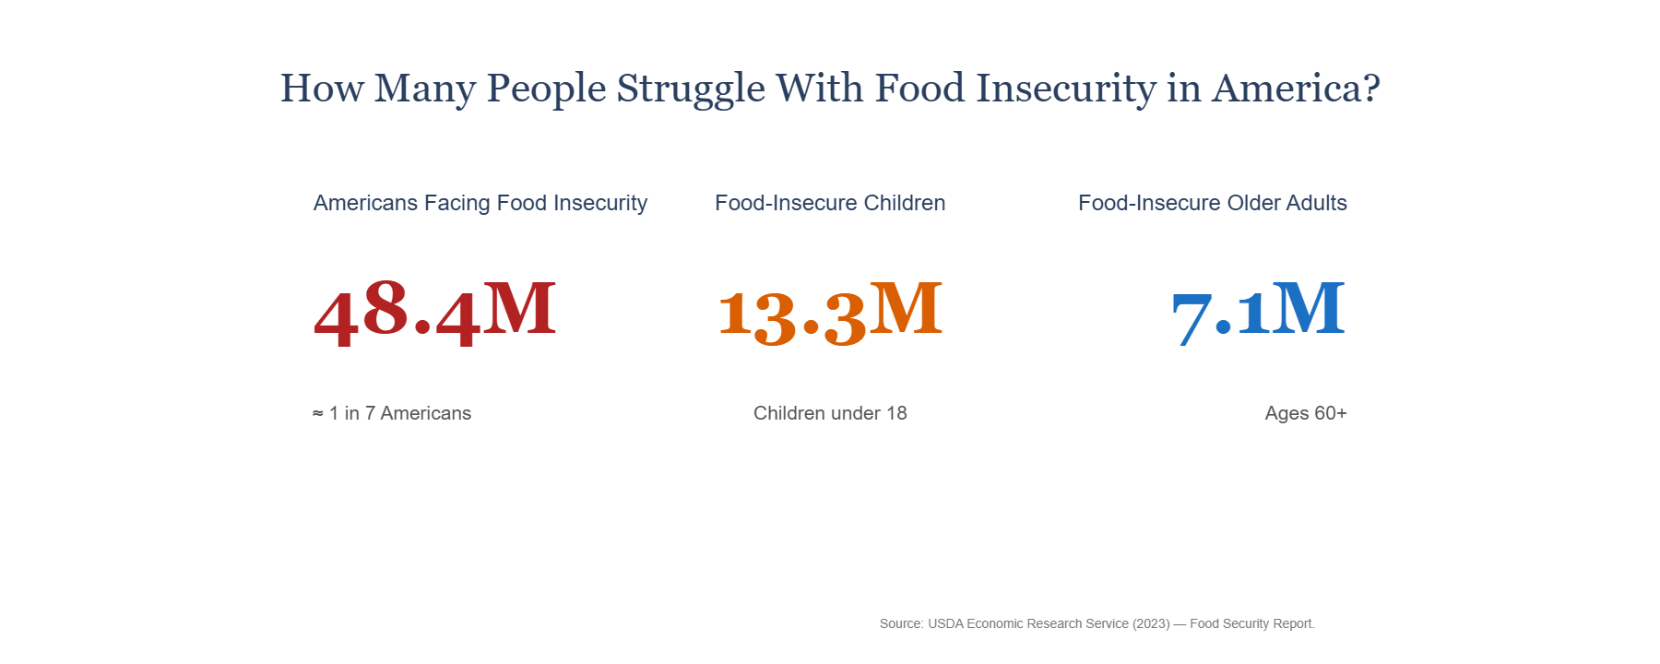
US Population Snapshot 2023
Food insecurity does not hit all groups equally. Nationally, around 48 million people face uncertainty about their next meal. The burden is highest among children and older adults, groups that are especially vulnerable to long-term developmental and health impacts.
Notes:
This slide frames the scale: millions of Americans, including vulnerable groups.
Use this to emphasize urgency and the political stakes.

Slide 3
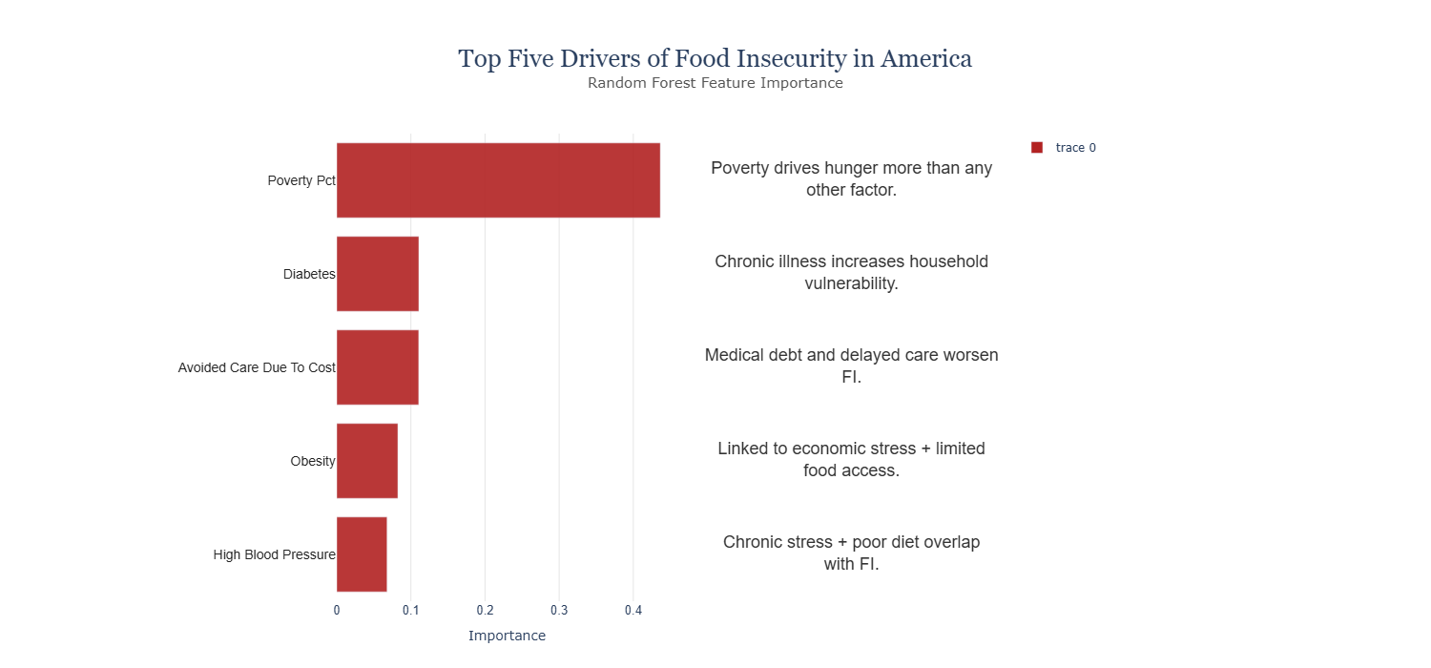
Drivers of Food Insecurity
When we examine the drivers side by side, we see a consistent pattern: states with higher poverty, income inequality, and housing cost burden show significantly higher food insecurity. Healthcare access is also a critical factor — particularly the share of people who avoid care due to cost. These indicators reinforce that food insecurity is not only about food availability, but about affordability and economic stability
Notes:
Highlights structural drivers: housing, healthcare, wages.
Set up for policy discussion.

Slide 4
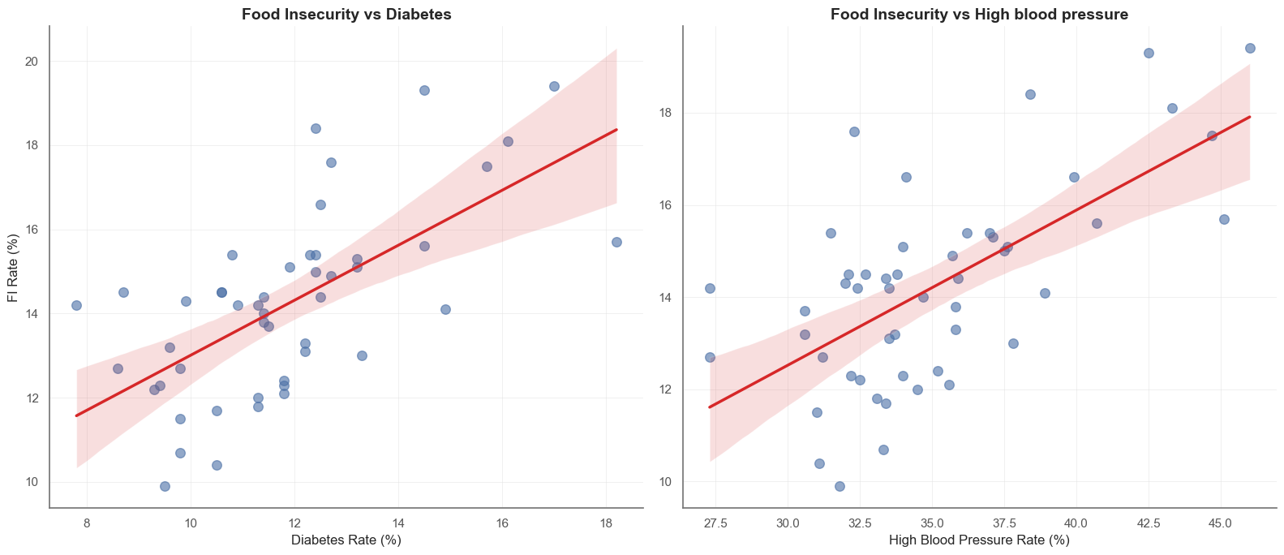
Food Insecurity & Health Risks
This charts highlights the correlation between food insecurity and chronic diseases. The relationship is strongest with diabetes and high blood pressure. These conditions are closely linked to diet quality, healthcare access, and economic stress. The higher the food insecurity rate in a state, the higher the prevalence of these chronic health challenges tends to be.
Notes:
Strong correlation visuals. Position FI as both economic and public health challenge.

Slide 5
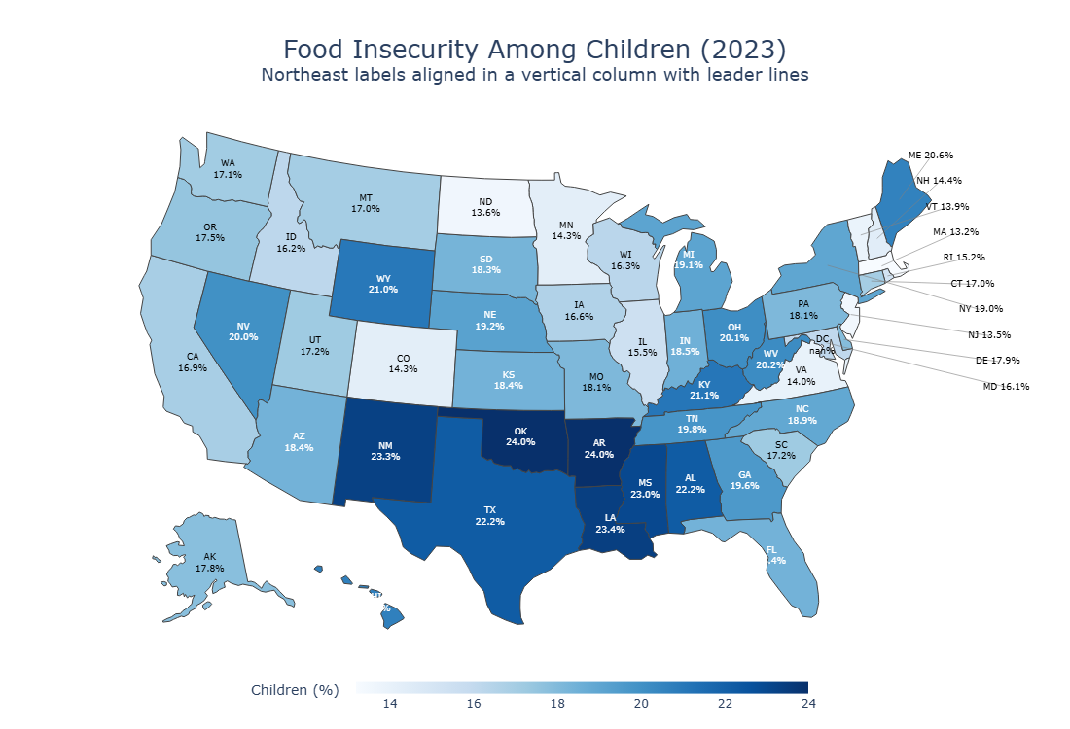
Child Food Insecurity
For children, food insecurity is especially damaging. This map shows where children face the greatest barriers to nutrition. The geographic patterns are clear: the problem concentrates in parts of the South and Southwest, but also appears in pockets of Appalachia and the Northeast. These elevated rates among children create long-term risk for lower academic achievement, health complications, and lower lifetime earnings.
Notes:
Children heavily affected—this resonates strongly with voters and policymakers.

Slide 6
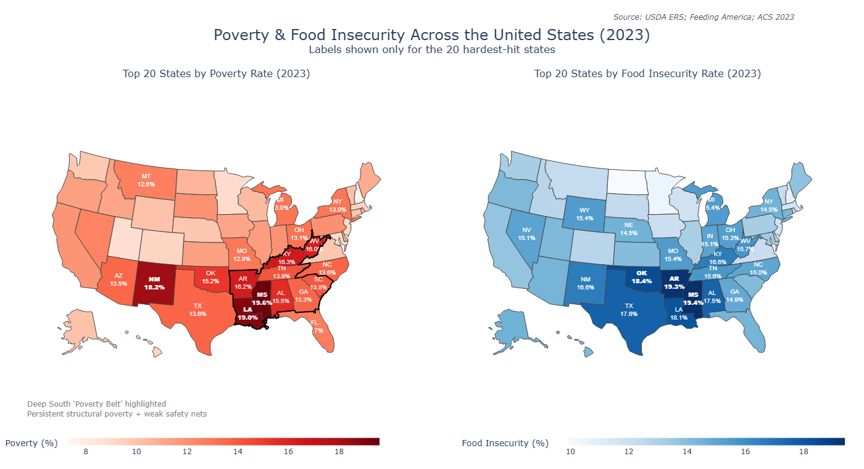
Poverty & FI Maps
When we compare poverty rates and food insecurity side by side, the overlap is striking. States with high poverty — like Mississippi, Louisiana, Arkansas, and New Mexico — also experience the highest food insecurity. However, the differences matter too: some states show higher food insecurity than poverty would predict, which indicates additional factors like housing costs, transportation, and access to food retailers play important roles
Notes:
Geographic disparities. Use to highlight regional policy needs.

Slide 7
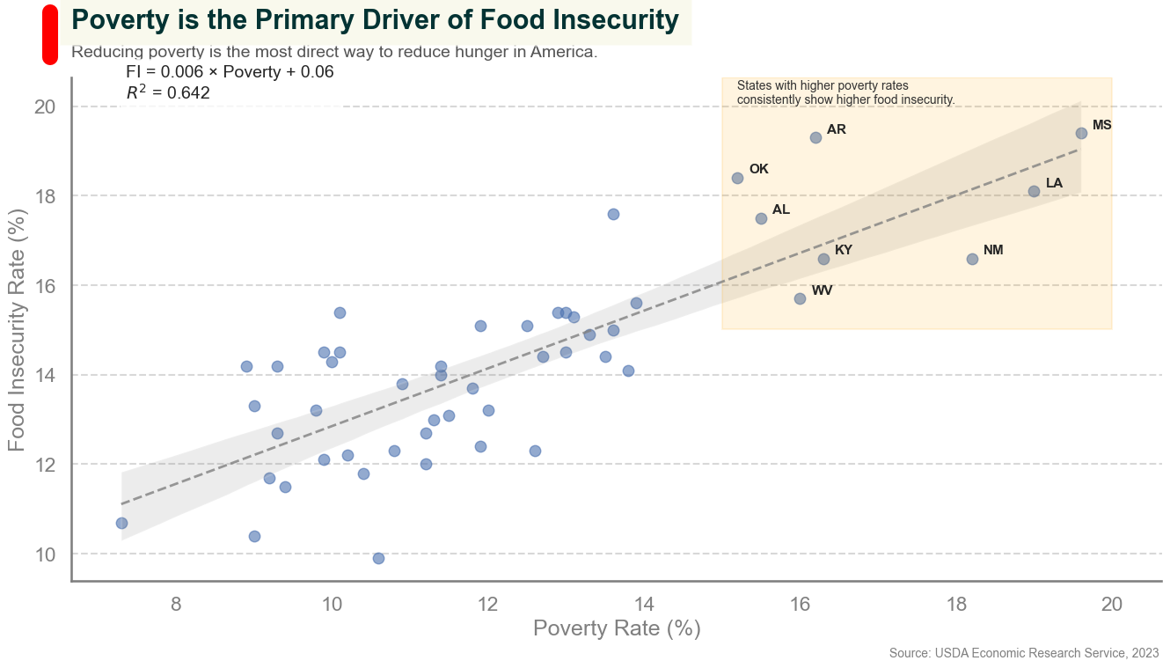
Poverty vs FI Relationship
A quantitative look confirms the strong linear relationship. Food insecurity rises by approximately 1.2 percentage points for every 1 point increase in poverty rate. This makes poverty the single most influential predictor in our model. From a policy standpoint, this highlights why anti-poverty interventions are also food security interventions
Notes:
Clear positive correlation. Useful when arguing for economic relief policies.

Slide 8
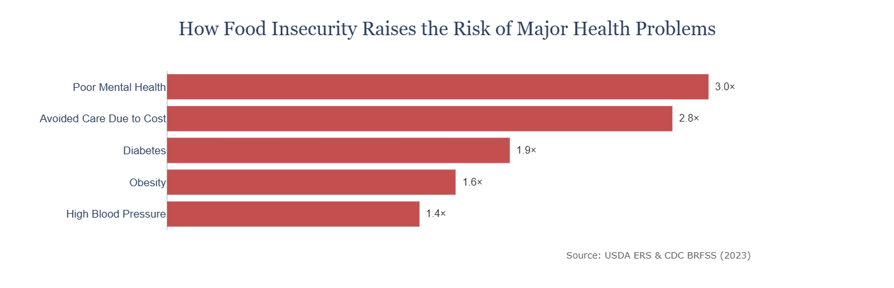
Health Risk Multipliers
Food insecurity amplifies health risks across multiple categories. Individuals facing food insecurity have:
• A 2× higher risk of diabetes complications
• A 1.7× higher risk of hypertension instability
• A 1.8× higher risk of frequent mental distress
• A 2–3× higher likelihood of delaying medical care
These multipliers underline that food insecurity has cascading impacts on both physical and mental health.
Notes:
Shows health burden—connect to Medicaid/Medicare cost arguments.

Slide 9
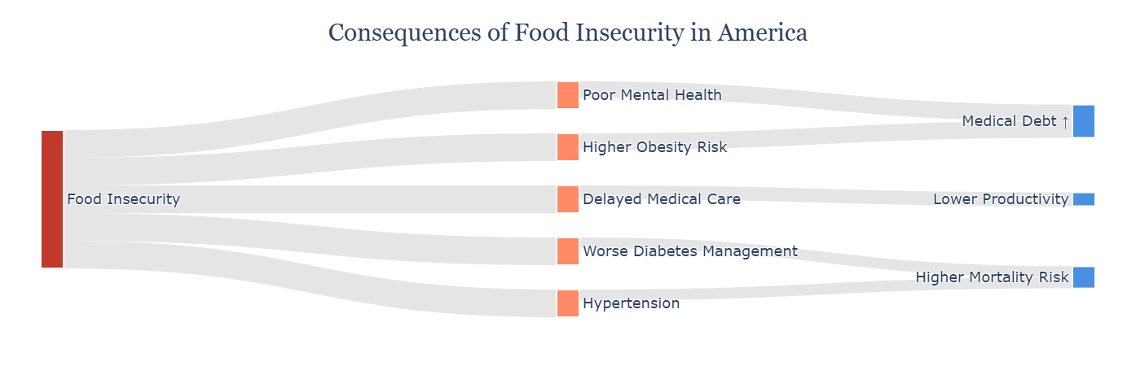
Consequences of Food Insecirity
We can think of food insecurity as the starting point of a broader chain reaction. Economic stress leads to poorer diet quality, which elevates chronic health risks, which then increases out-of-pocket healthcare costs. These health-related financial burdens feed back into the household budget, making food insecurity worse. It’s a self-reinforcing cycle that requires policy intervention to break.
Notes:
Final impact chain—great for summarizing systemic effects.

