Slide 1

ModPulse AI
AI-powered Reddit moderation triage for faster, evidence-based moderator decisions
Elevator Pitch
A Devvit mod tool that analyzes risky posts, scores moderation risk, and generates clear reports for scams, spam, harassment, and privacy risks.
ModPulse AI • AI-powered Devvit moderation triage

Slide 2
Problem
Moderators need speed, consistency, and evidence
Moderators repeatedly review scam, spam, crypto, harassment, and privacy-risk posts.
Manual moderation can be slow and inconsistent across teams.
High-risk posts need evidence, action guidance, and user-facing removal messages.
Existing workflows often show alerts, but not complete decision-ready reports.
Core Pain
Mods spend time reading, judging, documenting, and writing removal responses.
Opportunity
Turn a post into a structured moderation report in seconds.
Hackathon Fit
Directly supports Reddit’s New Mod Tool goal: reduce moderation load.
ModPulse AI • AI-powered Devvit moderation triage

Slide 3
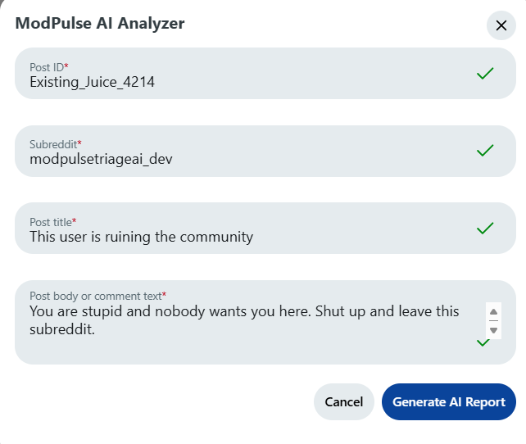
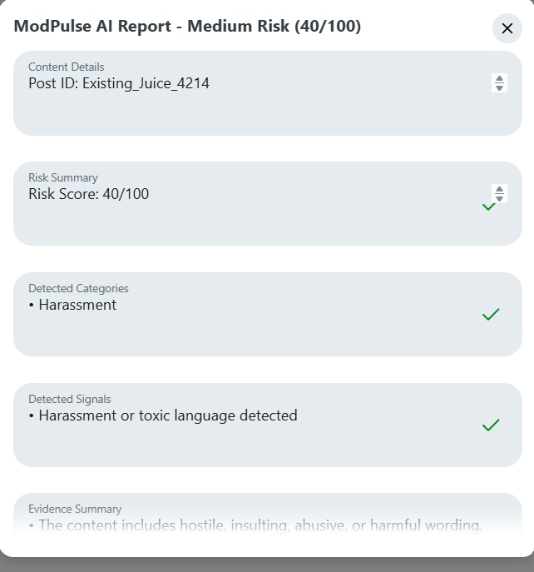
Solution Workflow
From post input to complete moderation report
Analyze → Report
Moderator enters content and gets a full risk report.
ModPulse AI • AI-powered Devvit moderation triage

Slide 4
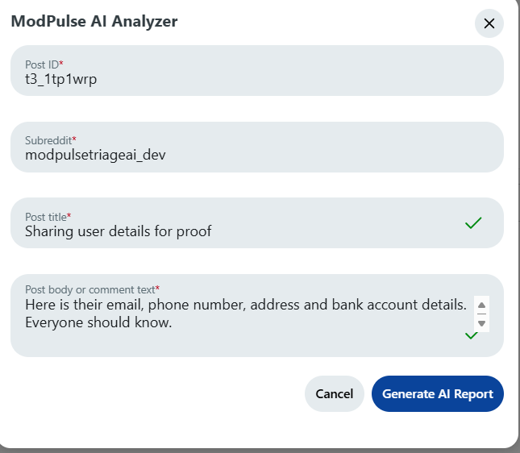
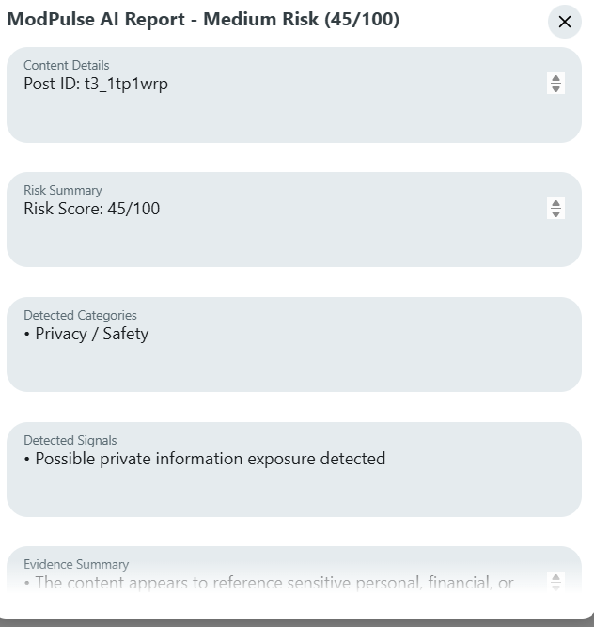
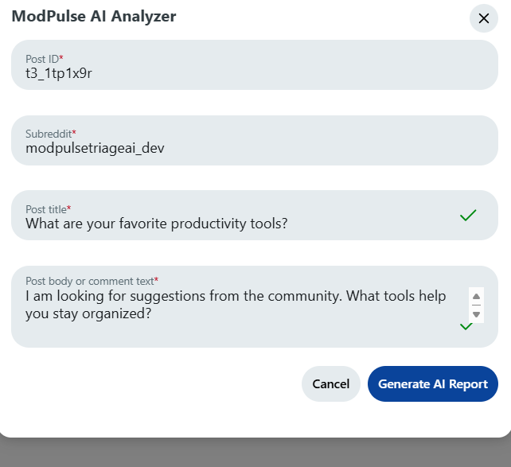
Live Test Cases
Validated with multiple moderation scenarios
Low Risk
Privacy/Safety
Harassment
Community suggestion post scored low risk.
Sensitive personal details detected.
Toxic language detected with action guidance.
ModPulse AI • AI-powered Devvit moderation triage

Slide 5
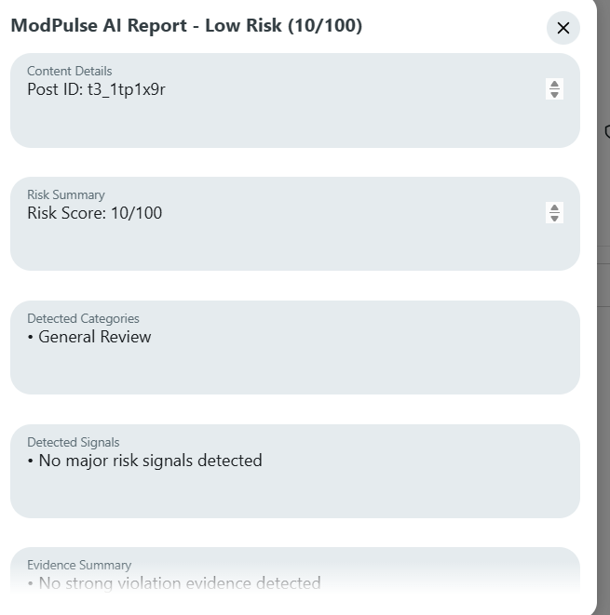
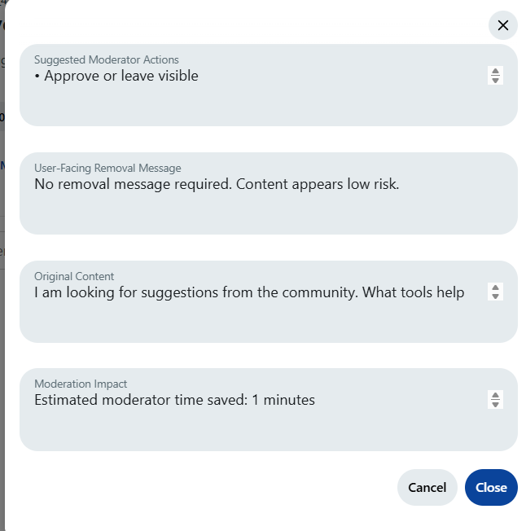
Report Quality
Explainable output that moderators can trust
Evidence-Based
Moderator-Friendly
Shows detected categories, signals, evidence summary, suggested actions, and impact.
Large report modal keeps the result visible until the moderator closes it.
ModPulse AI • AI-powered Devvit moderation triage

Slide 6
Core Features
Designed for real moderator workflow
Risk Score
Detected Signals
Evidence Summary
0–100 score with Low, Medium, High, and Critical levels.
Flags scam, spam, harassment, privacy, and off-platform solicitation signals.
Explains why the content was flagged instead of only giving a score.
Action Checklist
Removal Message
Fallback Reliability
Suggests remove, review, approve, warn, or check user history.
Creates a user-facing message moderators can reuse.
Works with AI-ready design and stable rule-based fallback.
ModPulse AI • AI-powered Devvit moderation triage

Slide 7
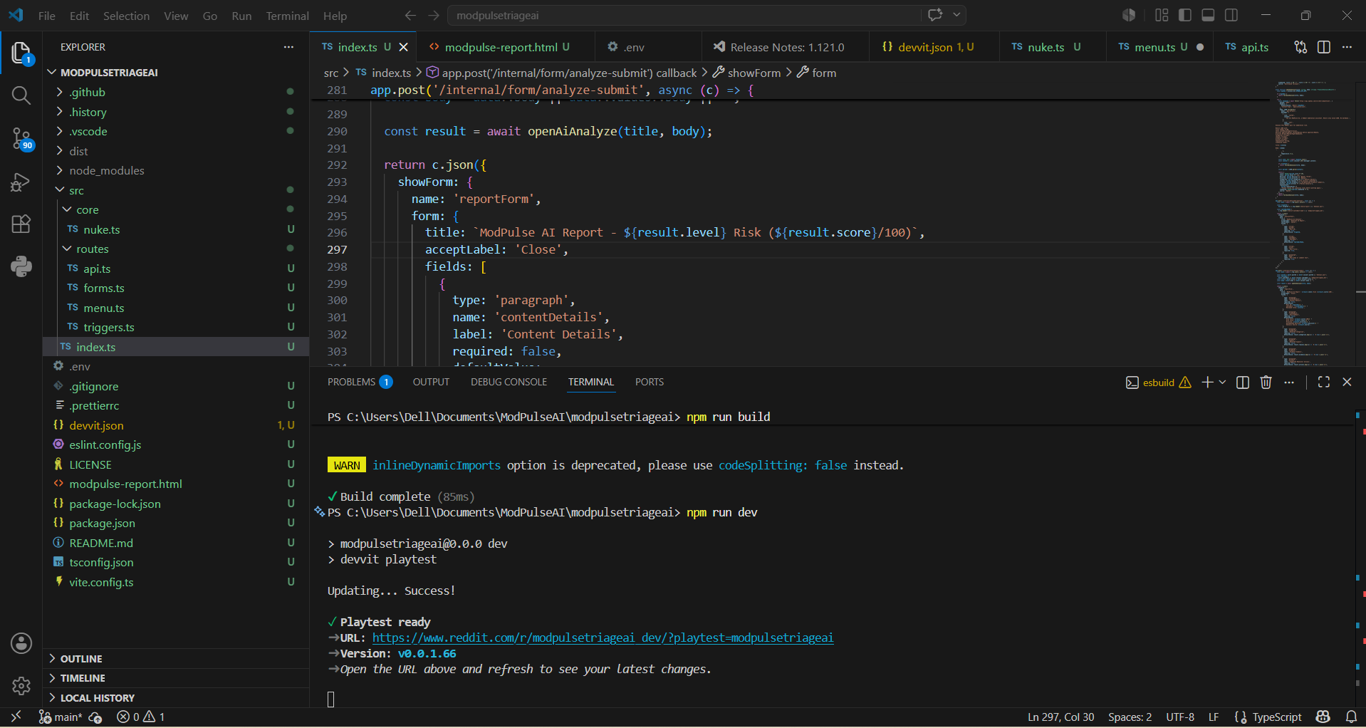
Technical Build
Devvit-native, TypeScript-powered, AI-ready
Devvit app with post-level moderator menu action.
TypeScript + Hono server handles menu and form workflows.
OpenAI-ready analysis path for AI moderation reasoning.
Rule-based fallback keeps demos stable when API access is unavailable.
Report modal displays risk score, evidence, actions, removal message, and time saved.
ModPulse AI • AI-powered Devvit moderation triage

Slide 8
Novelty
More than a basic spam detector
Combines risk scoring, evidence, action guidance, removal messaging, and impact estimate.
Built directly into Reddit’s moderator workflow through Devvit.
Designed for explainability: moderators see why a decision is suggested.
Supports multiple risk types, not only spam.
Stable fallback engine makes it practical for real playtesting and demos.
Can evolve into a full moderation intelligence dashboard.
ModPulse AI • AI-powered Devvit moderation triage

Slide 9
Business & Community Scope
A scalable utility for Reddit communities
Target Users
Market Need
Value
Subreddit moderators, mod teams, community managers, and Reddit App Directory users.
Growing communities need faster triage tools without complex setup.
Safer communities, faster decisions, and more consistent moderation records.
Useful for finance, crypto, marketplace, gaming, tech, education, and general discussion communities.
Can be generalized with subreddit-specific rules and scoring weights.
Supports both small volunteer mod teams and high-volume communities.
ModPulse AI • AI-powered Devvit moderation triage

Slide 10
Future Scope
Roadmap toward a complete moderation intelligence layer
Automatic Post Fetching
PDF Export
Dashboard Analytics
Pull title/body directly from Reddit context when supported.
Generate downloadable moderation reports for records and appeals.
Track risky posts, categories, time saved, and mod actions.
Custom Rules
Repeat Offender Tracking
Queue Prioritization
Let each subreddit configure policies and scoring weights.
Identify repeated risky behavior and escalation patterns.
Rank mod queue items by risk and urgency.
ModPulse AI • AI-powered Devvit moderation triage

Slide 11
Why It Deserves a Prize
Strong fit for Best New Mod Tool and Moderator’s Choice
Solves a real moderator pain point: fast triage of risky posts.
Reduces moderation load with structured reports and action suggestions.
Improves consistency by standardizing risk scoring and evidence summaries.
Shows a working Devvit-native prototype with real screenshots and test cases.
Has clear measurable impact through estimated time saved per review.
Has strong future potential: PDF reports, dashboards, analytics, custom rules, and queue intelligence.
ModPulse AI • AI-powered Devvit moderation triage

Slide 12
ModPulse AI
Faster moderation. Clearer evidence. Safer communities.
Built by Mohamed Farhun M , NandhaKumar S.
A Devvit-powered AI moderation triage tool for Reddit hackathon submission.
ModPulse AI • AI-powered Devvit moderation triage

