Slide 1


Karma
Shoe Shop Semester Project

Slide 2
Table of contents
01
02
03
Front End
Database
Back End

Slide 3

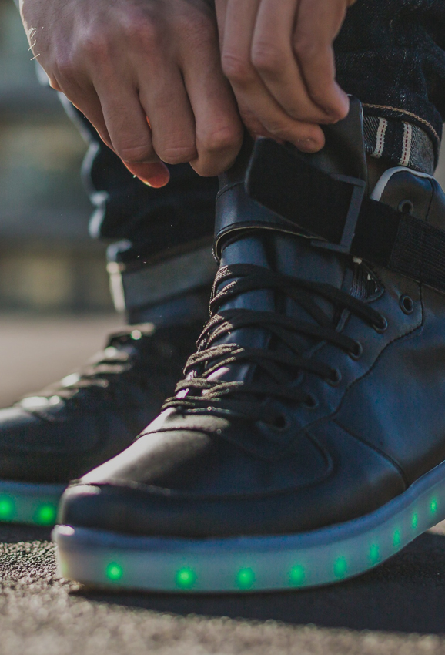

01
Front End
of the project

Slide 4

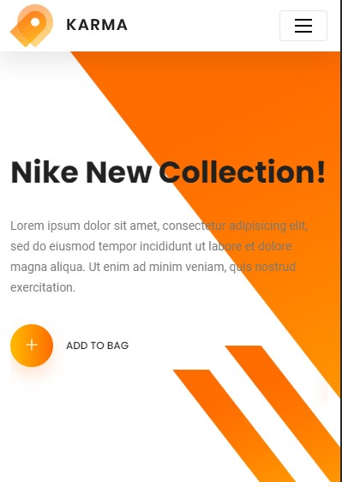
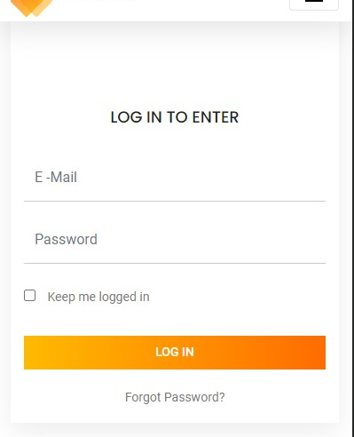
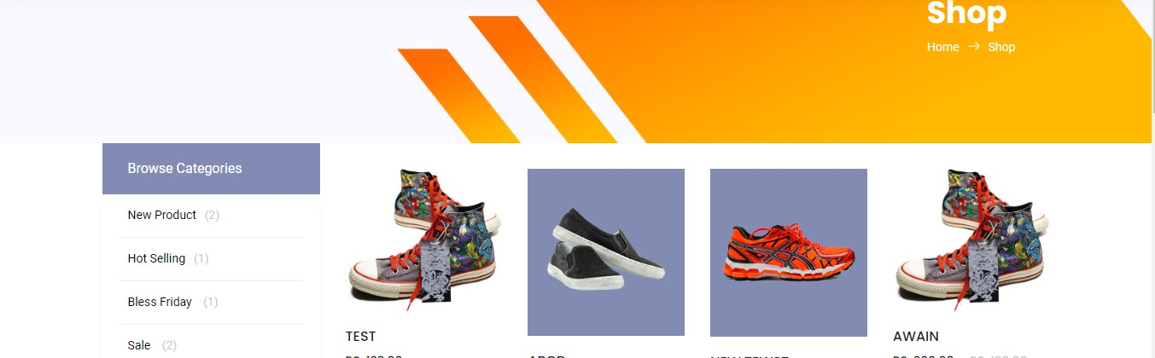
Photo showcase
A photo showcase can be a useful addition to a business project proposal as it can help to visually communicate the concept or idea being proposed

Slide 5
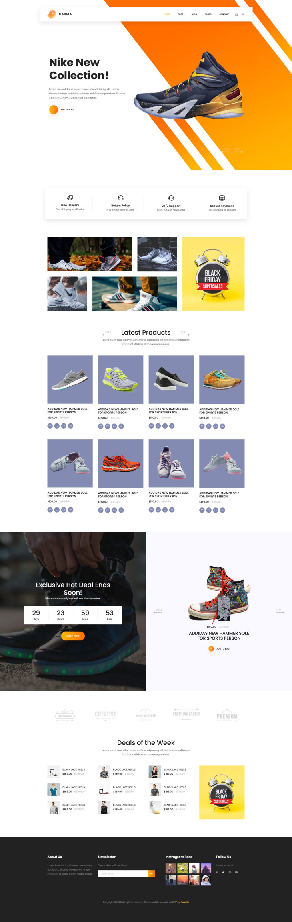
Project Front End

Slide 6
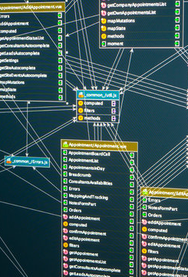
02
Database
of the project

Slide 7
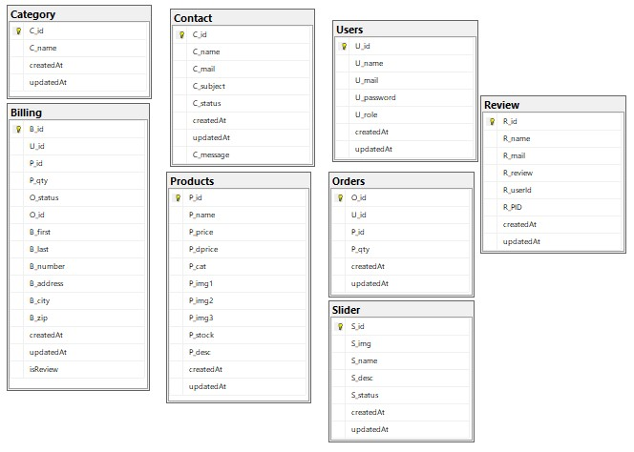
Database of Karma Shoes
Database of Project

Slide 8

03
Backend
of the project

Slide 9

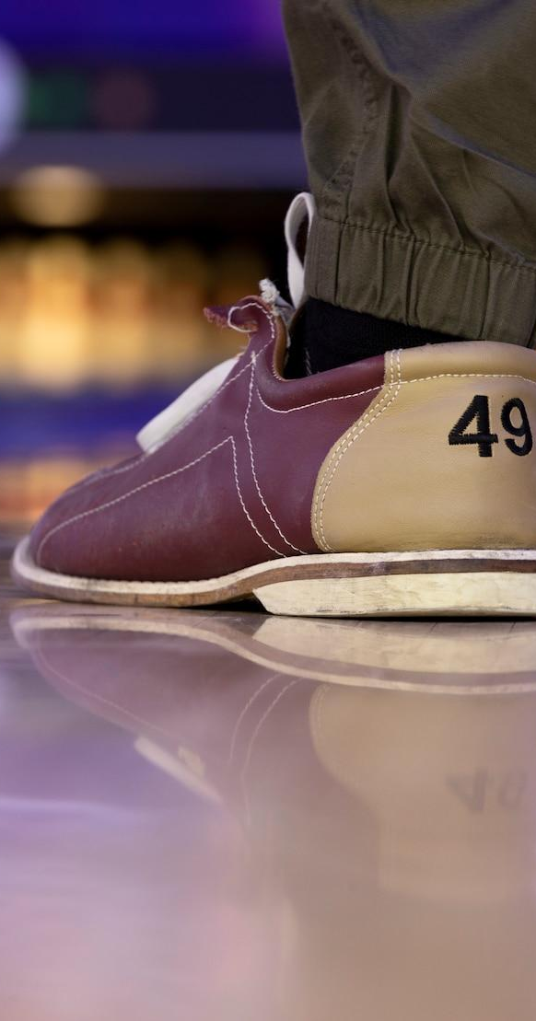

Backend of the Project
Utilizing ASP.NET MVC, our backend architecture stands as the robust foundation of our application. This model-view-controller framework empowers seamless development, allowing for clear separation of concerns. With ASP.NET, we've leveraged the power of C# to create a scalable, secure, and efficient backend system. Its modular structure enhances maintainability and flexibility, enabling us to deliver dynamic functionalities and data-driven experiences for our application users.

Slide 10

Thanks!
Do you have any questions?
farhanatif9990@gmail.com
+92 333 2245 310
farhanatif.netlify.com

