Slide 1
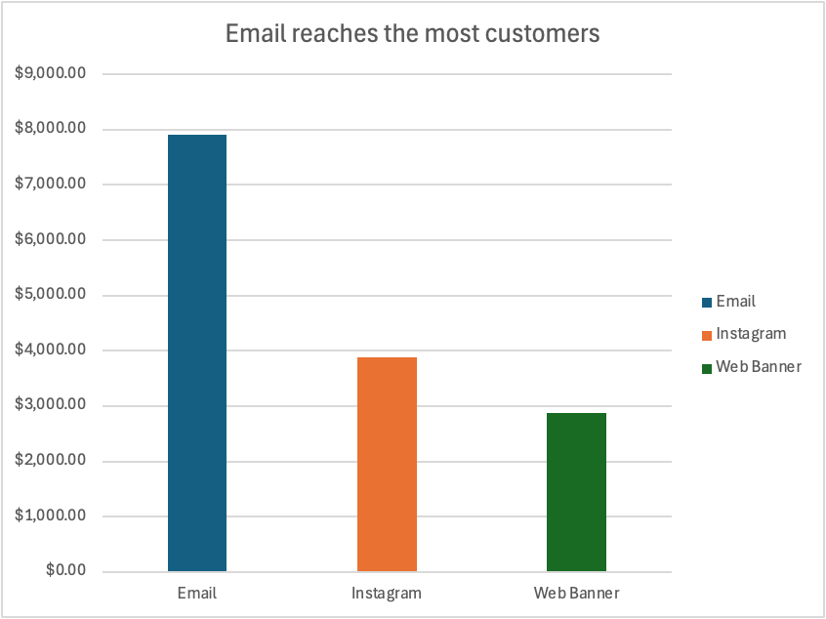
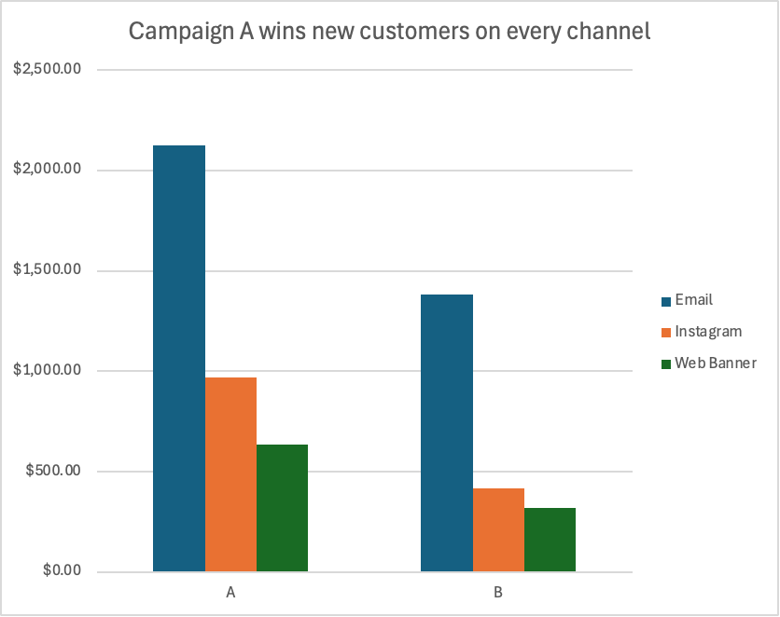
Campaign A via Email Drove the Highest New-Customer Sales
Recommendation: Prioritize Email + Campaign A to grow new customers
Campaign A beat Campaign B with new customers on every channel — $2,124 vs $1,382 on Email, the top combo. Email also had the widest reach. Scale Email + Campaign A and test a follow-up; keep Campaign B for existing customers.

