Slide 1
CATEGORY REVIEW
Chips
Retail Strategy & Analytics — Insights & Recommendations
Prepared by Fariba Kazi
For Julia, Category Manager · June 2026

Slide 2
Agenda
01
Purpose & approach
What we set out to answer and how
02
Who spends on chips
Customer segments and what drives their spend
03
Trial store performance
Did the new layout trial lift sales?
04
Recommendations
Actions for the upcoming strategic plan
Quantium | Category Review: Chips
Prepared by Fariba Kazi
2

Slide 3
Executive summary
Recommendation: Grow the chip category by protecting high-volume family shoppers on price and pack availability, while targeting premium-willing Mainstream singles & couples with higher-margin ranges — and roll out the new store layout, which significantly lifted sales.
Volume base
Premium impulse
Trial works
Budget Older & Young Families drive the most sales through high units per customer.
Mainstream young/midage singles & couples pay the highest price per pack (p<0.001).
Stores 77 & 88 saw a significant sales uplift; store 86 lifted customers strongly.
Quantium | Category Review: Chips
Prepared by Fariba Kazi
3

Slide 4
01
The category: who spends on chips

Slide 5
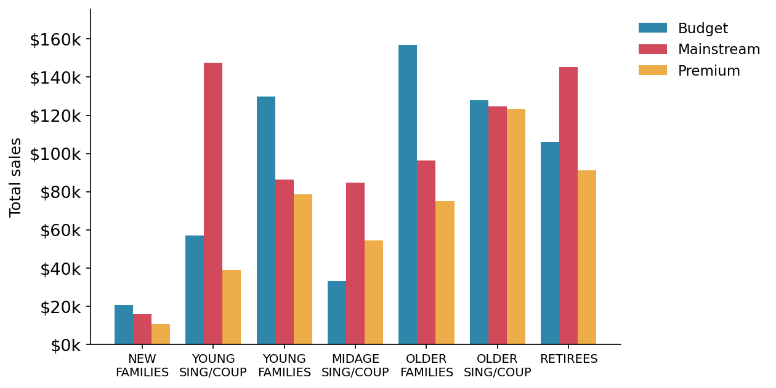
Three segments drive most chip sales
Top sales segments
$157k Budget – Older Families
$148k Mainstream – Young Sing/Coup
$145k Mainstream – Retirees
These three groups are the engine of the category and should anchor range and space decisions.
Quantium | Category Review: Chips
Prepared by Fariba Kazi
5

Slide 6
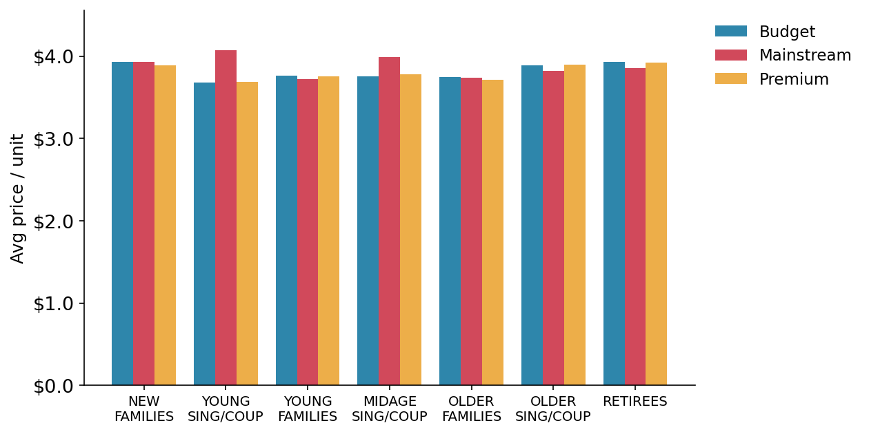
Mainstream singles & couples pay a price premium
$4.07
avg price/unit — Mainstream
Young Singles/Couples
vs $3.69 for Budget / Premium in the same lifestage.
Statistically significant (t = 37.6, p < 0.001). These shoppers buy chips as a treat, not a bargain.
Quantium | Category Review: Chips
Prepared by Fariba Kazi
6

Slide 7
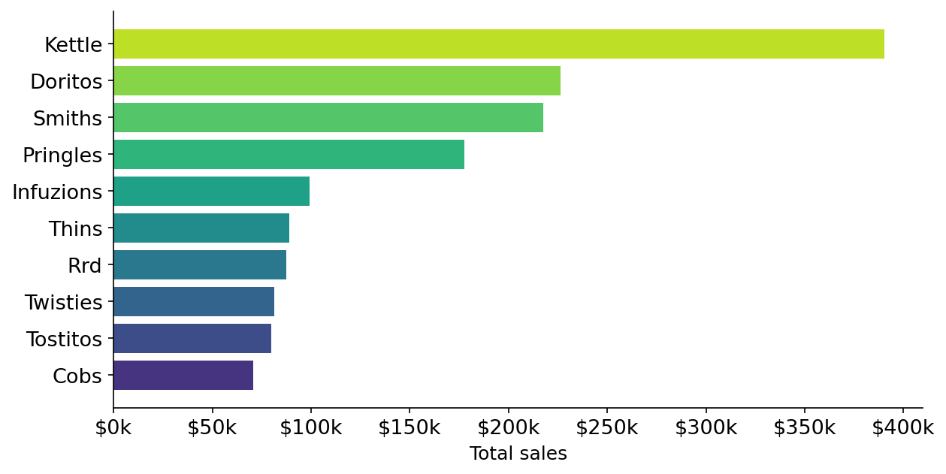
Kettle leads; large sharing packs dominate
Kettle
#1 chip brand by total sales
175g
most popular pack size by units
Anchor promotions and feature space around the winning brand and the sharing-pack format.
Quantium | Category Review: Chips
Prepared by Fariba Kazi
7

Slide 8
02
Trial store performance

Slide 9
How we measured the trial
The challenge: a layout trial ran in stores 77, 86 and 88 (Feb–Apr 2019). To know whether sales rose because of the trial — and not seasonality — each trial store is compared against a matched control store.
1
Match
2
Scale
3
Test
Find an established store whose pre-trial sales and customer counts track the trial store closely (correlation + magnitude scoring).
Adjust the control store to the trial store's level so the two are directly comparable.
Check each trial month against the control's 5–95% confidence band — outside the band = a significant effect.
Quantium | Category Review: Chips
Prepared by Fariba Kazi
9

Slide 10
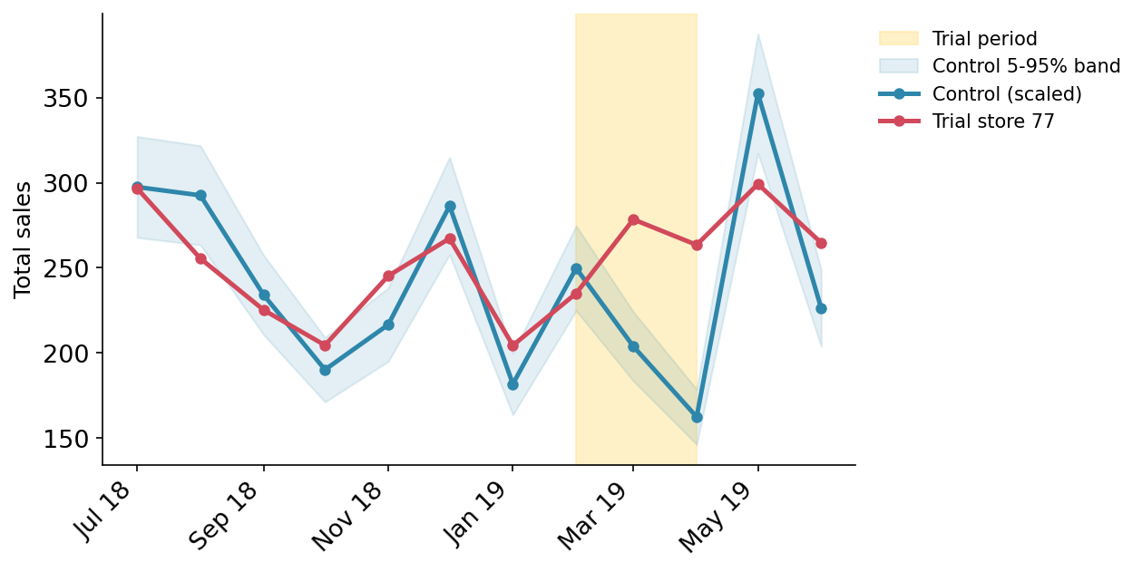
The trial significantly lifted sales
Store 77
Sales significantly above control in Mar & Apr.
Store 88
Significant uplift in two of three months.
Store 86
Customers rose strongly, but sales were inconclusive — check for local pricing/promo differences.
Red line breaks above the shaded control band during the trial window.
Quantium | Category Review: Chips
Prepared by Fariba Kazi
10

Slide 11
Recommendations for the strategic plan
1
Protect the volume base
Keep competitive pricing and reliable stock of popular sharing packs for Budget Older & Young Families — the category's biggest sales source.
2
Win the premium impulse shopper
Target Mainstream young & midage singles/couples with higher-margin and on-trend ranges, plus impulse placement and feature space.
3
Lead with the winning brand & pack
Anchor range, promotions and space around Kettle and the 175g sharing format, which capture the bulk of demand.
4
Roll out the new layout
Sales rose significantly in trial stores 77 & 88. Confirm why store 86 differed, then extend the layout more broadly.
Prepared by Fariba Kazi · June 2026

