Slide 1
Chapel Boys.R
Faris Sbahi, Jonathan Rub, Alex Salas, Nisarg Dabhi

Slide 2
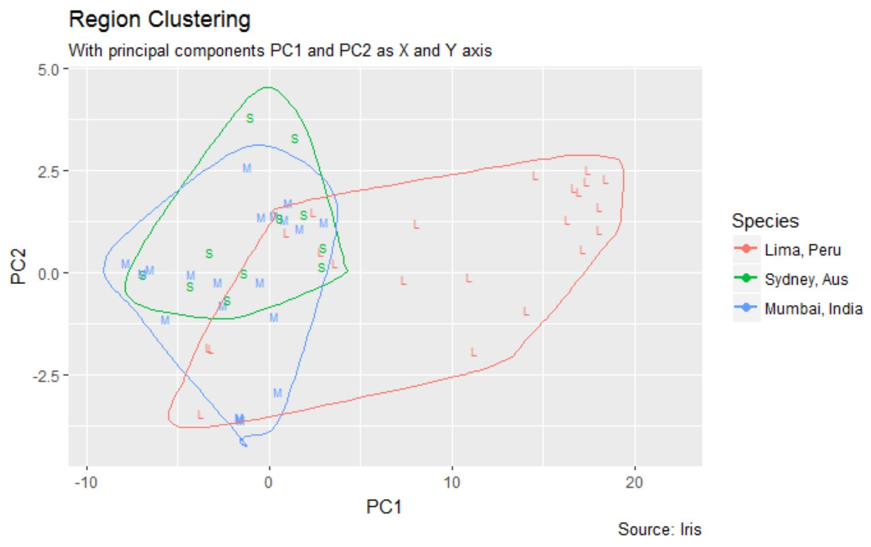
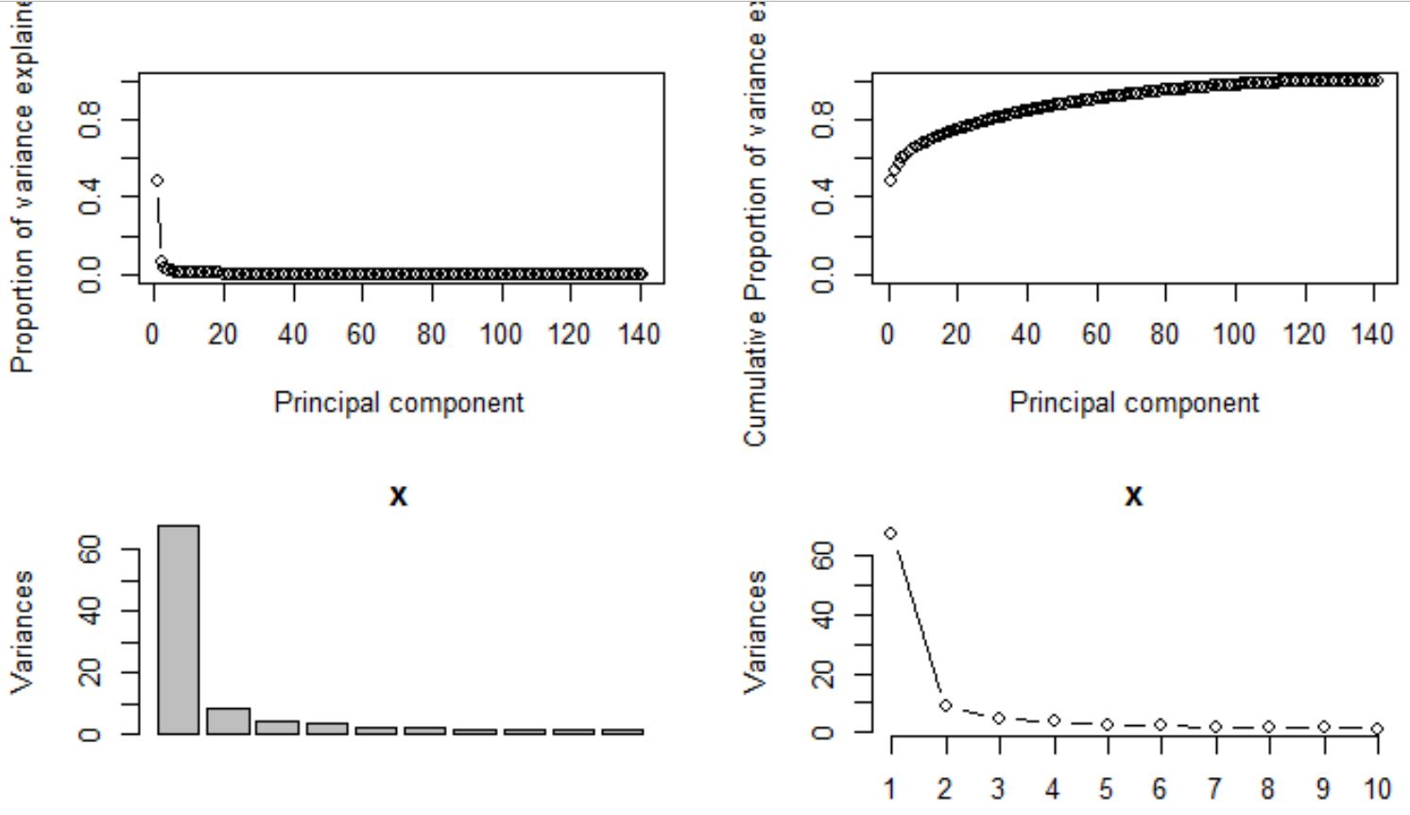
Primary Component Region Clustering
Variance Explained in Primary Component Plots

Slide 3
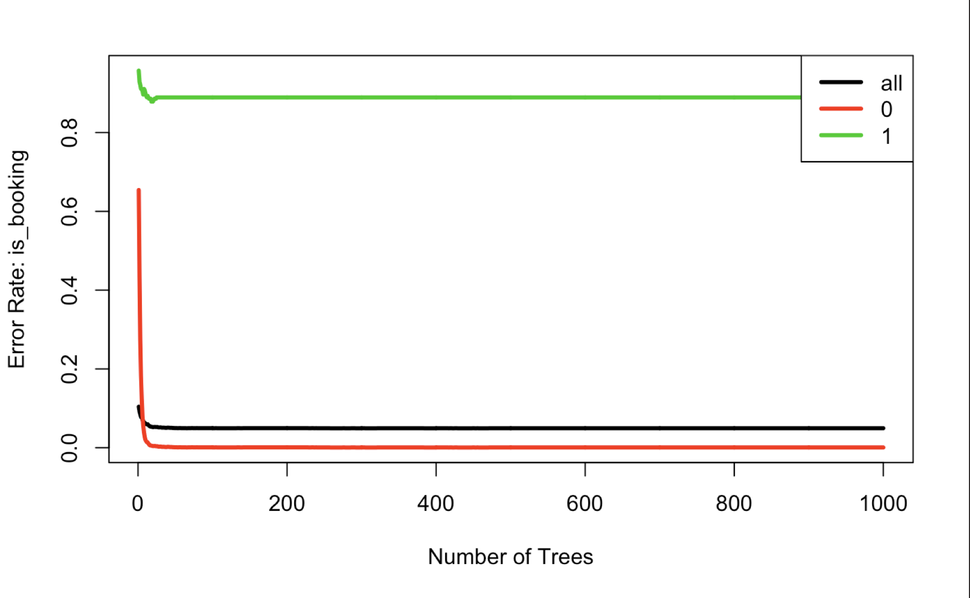
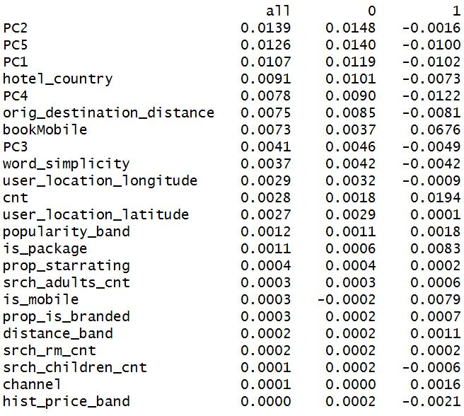
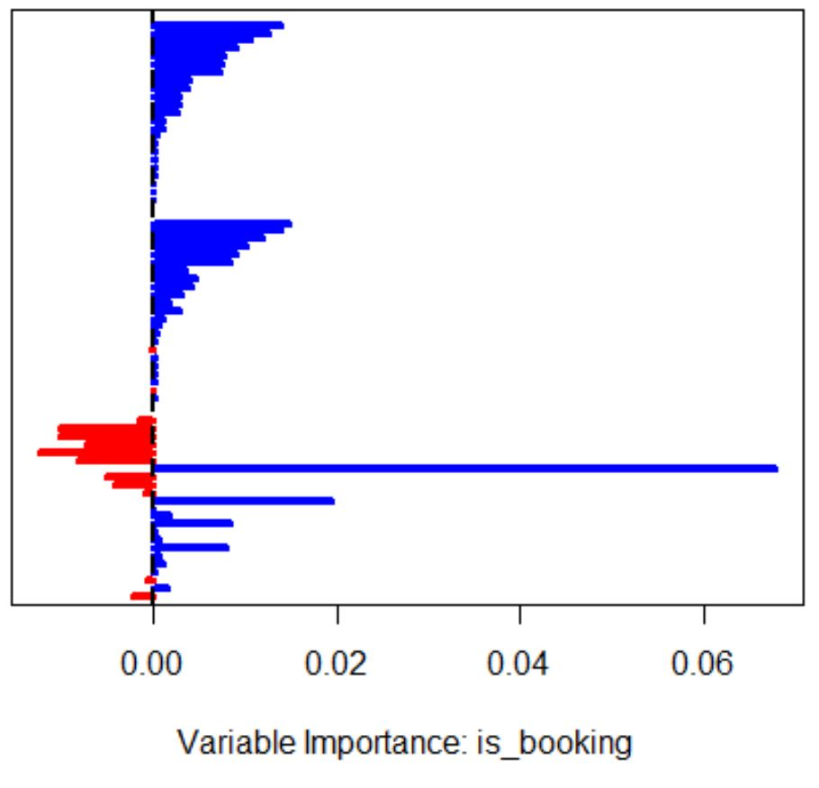
Random Forest Performance Plots

Slide 4
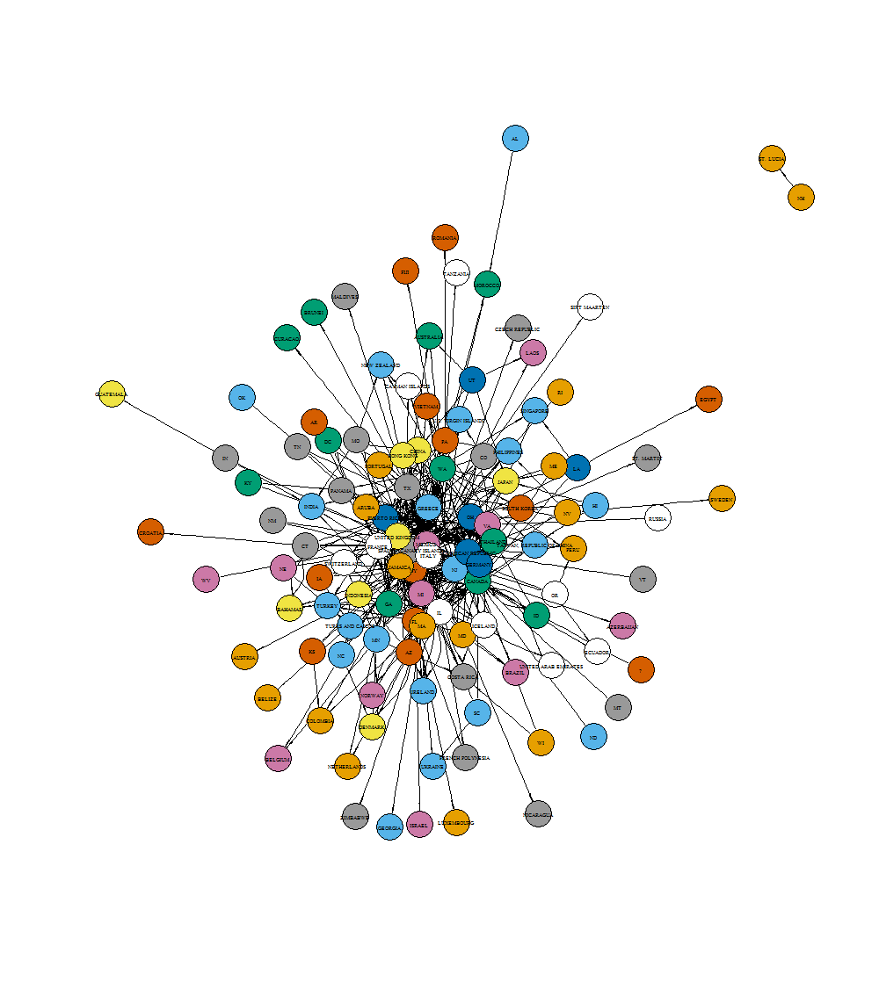
Network of Destinations Colored by Average Pronunciation Difficulty

