Slide 1




IOT SMART HOME (Firebot and Device Automation)
UMKC Hackathon, Fall, 2018
Group Name: IoT Group 2
Group Members: FARID , KENTON, ZARIN, MIHIR

Slide 2

Stand out Features
Visualization of the temperature, pressure and humidity of the home from a remote place.
Sending off an email if the temperature, pressure or humidity goes above a certain set value.
Sensing a fire if there is one and sending a text message via twilio to the home owner.
Putting out the fire by splashing water.
Making a high pitched sound in case of fire which can warn the nearby people.
Controlling the AC, fans, lights in a MIT app inventor android application.
Using a NAO robot which can say the weather condition at home and also can describe the fire situation if there is any.
Economic and cost-effective design for a safe environment at home.

Slide 3

Flow Diagram Hardware Flow Software Flow
Sensor Tag
Raspberry Pi
Database
Firebot
Mobile Phone
NAO Robot
Sensor data
Node-red
Firebase/ Thingspeak
MIT App inventor
Text msg (twilio)/ emails
Choregraphe

Slide 4

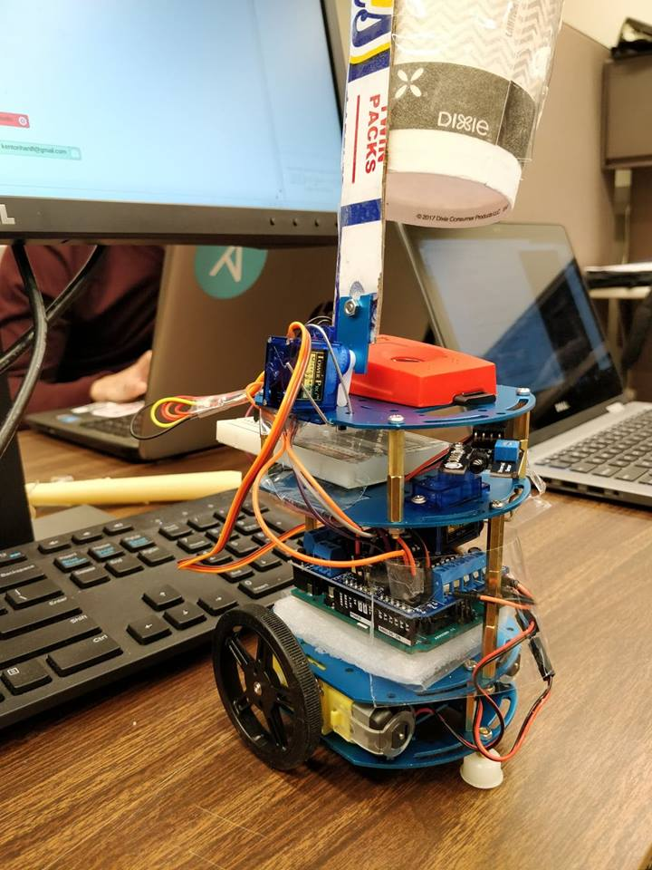
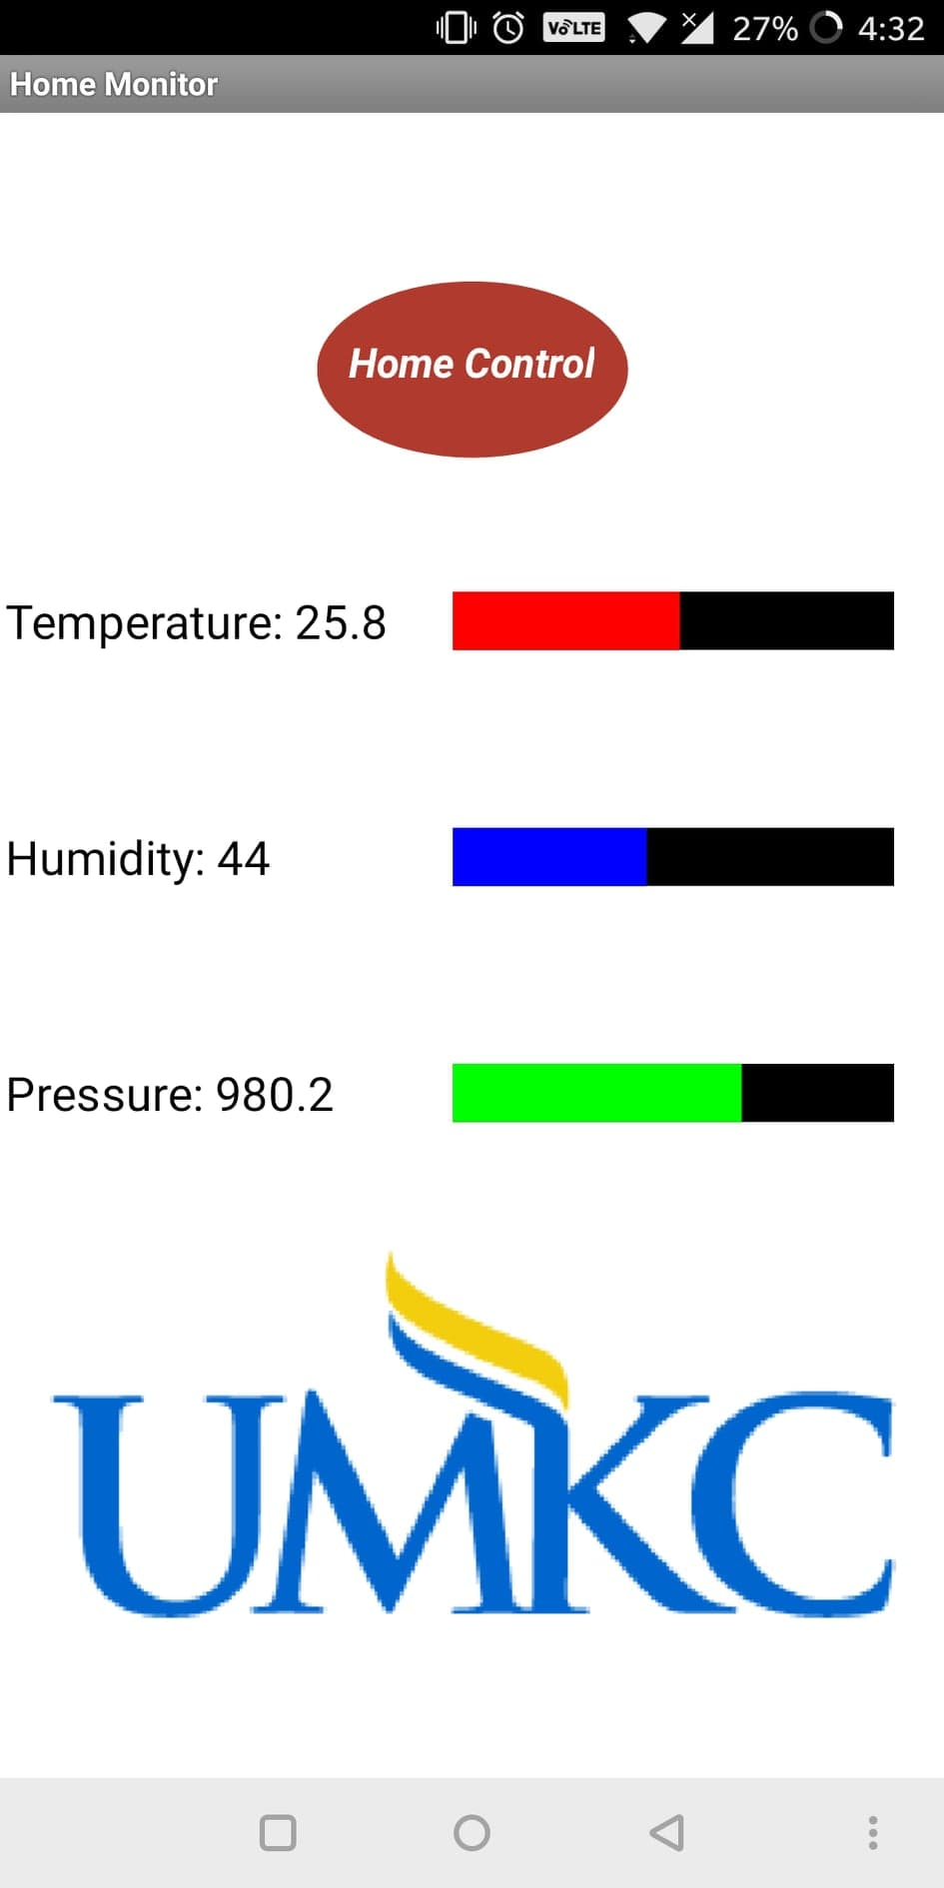
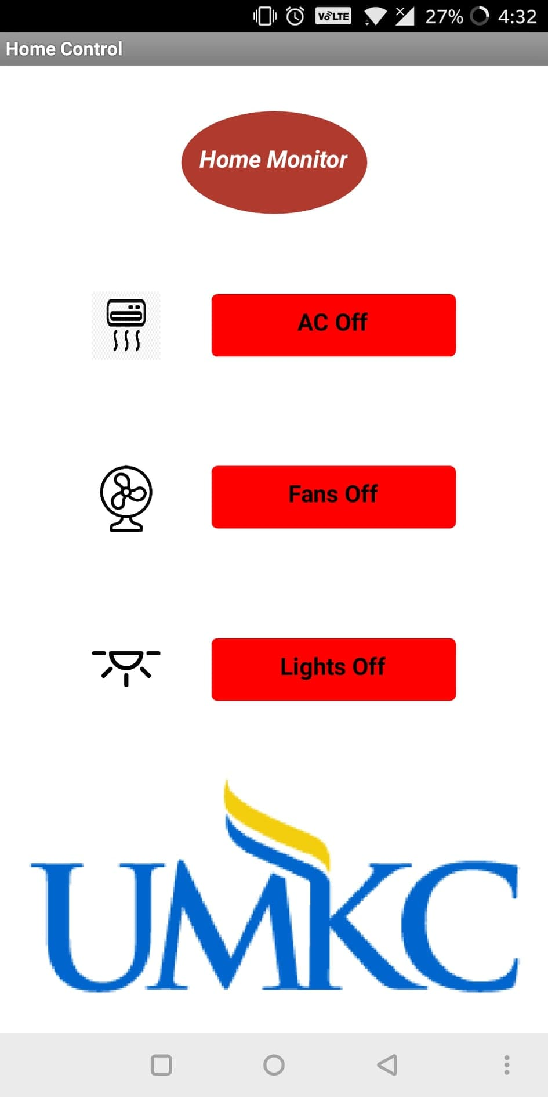
Fire Fighting Robot & User Interface on MIT App Inventor

Slide 5


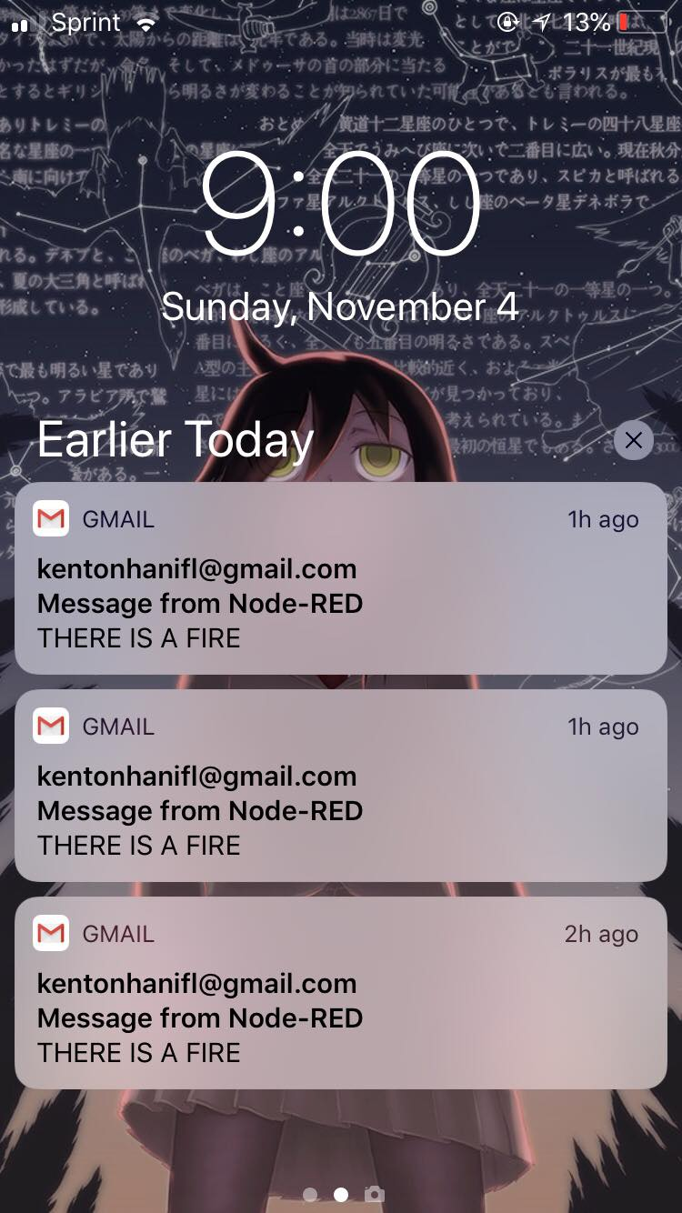
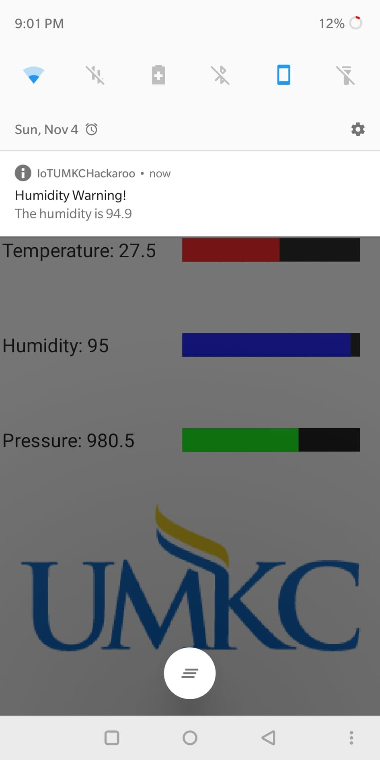
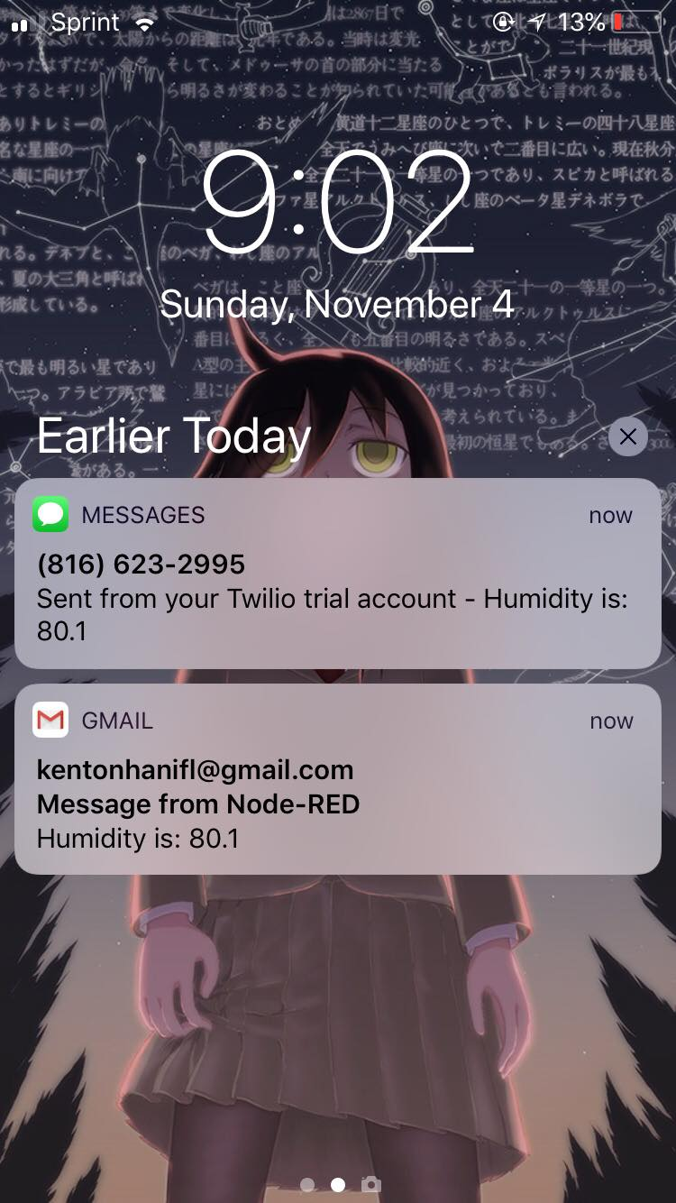
Advantages
Easy to deploy and cost-effective product (around $80) for smart home.
The firefighting robot needs no human interaction to put out a potential house fire.
Possibility of sending text message/ making a call to 911 via node-red.
Interaction with an user using all kinds of communication techniques.

