Slide 1

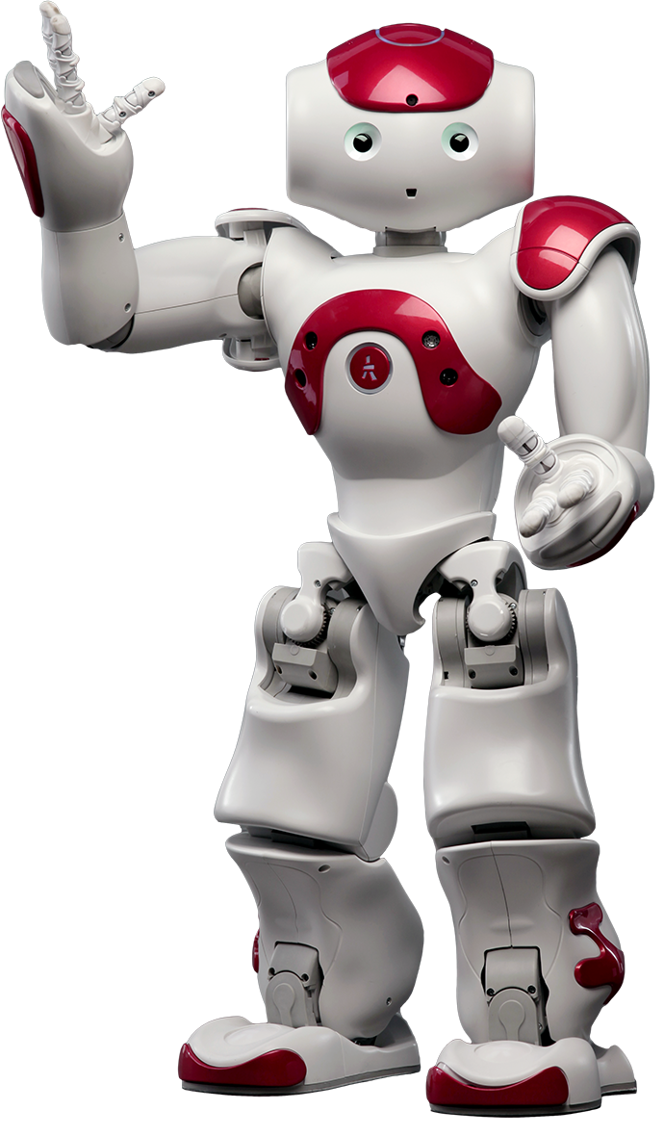
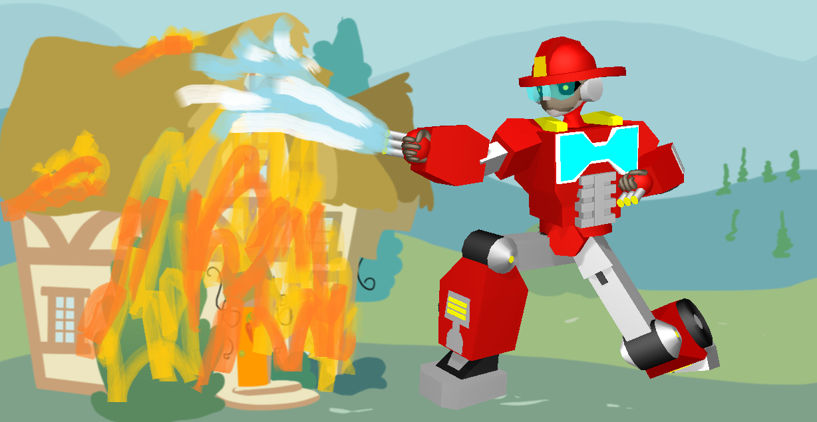
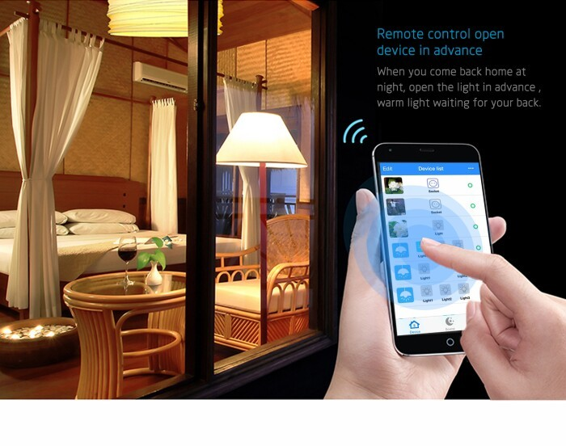
IOT SMART HOME (Firebot and Device Automation)
IOT Group 2 Final Project
Group Name: IoT Group 2
Group Members: FARID , KENTON, ZARIN, MIHIR

Slide 2
Contents
Data flow
Node-red
App
Firebot
Nao Robot
Demo

Slide 3
Work Breakdown
Firebot – Farid, Zarin
Node-red – Kenton, Farid
Nao Robot – Farid, Kenton, Mihir
App – Kenton, Mihir
Documentation – Zarin

Slide 4

Flow Diagram Hardware Flow Software Flow
Sensor Tag
Raspberry Pi
Database
Firebot
Mobile Phone
NAO Robot
Sensor data
Node-red
Firebase/ Thingspeak
MIT App inventor
Text msg (twilio)/ emails
Choregraphe

Slide 5
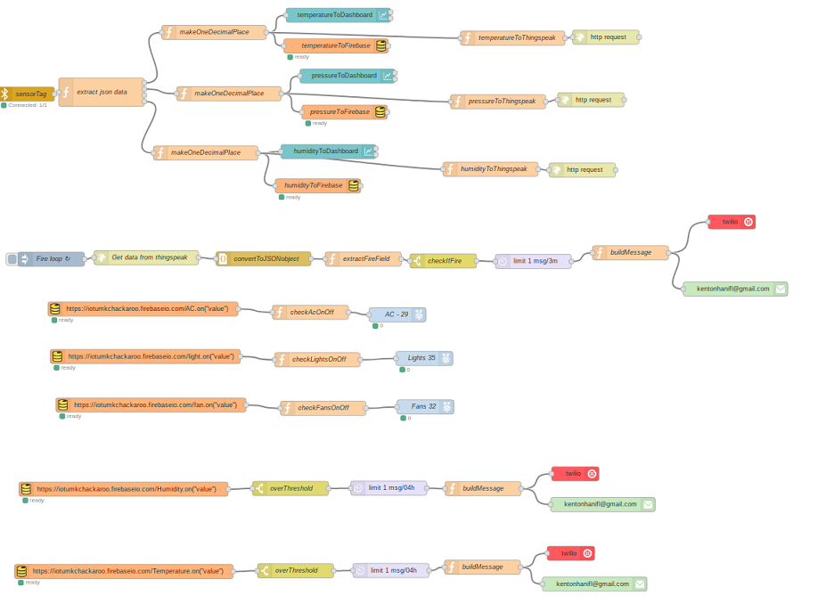
Node-red
Ties together all parts of the system
(Everything goes through it at some point)
Most interaction is passing data along the flow
hardware → node-red → firebase/thingspeak
Or
firebase → node-red → app/hardware

Slide 6
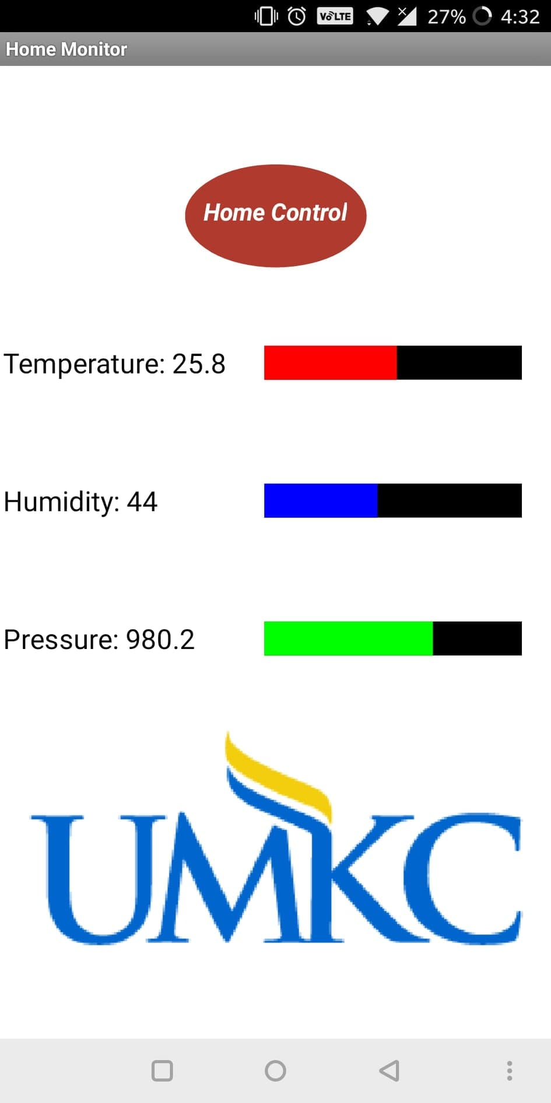
App – Displaying Data
Easy to read display
Temperature, humidity, and pressure
Values and gauges

Slide 7
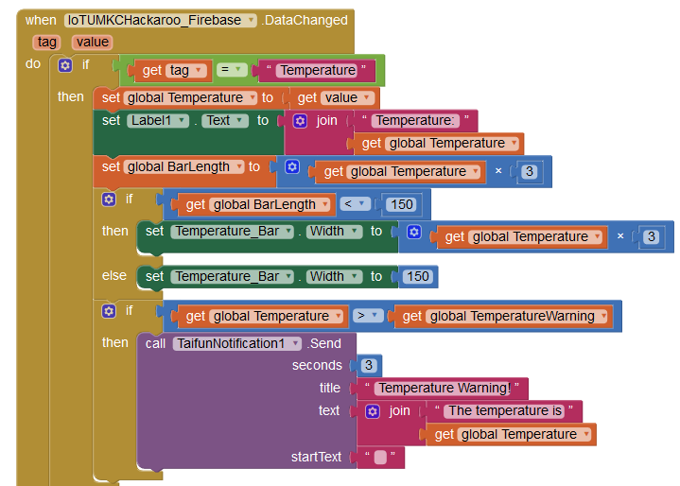
App – Displaying Data
Wait for changes on Firebase
Take that value multiplied by some number to set the gauge
If over a warning threshold, send a notification

Slide 8
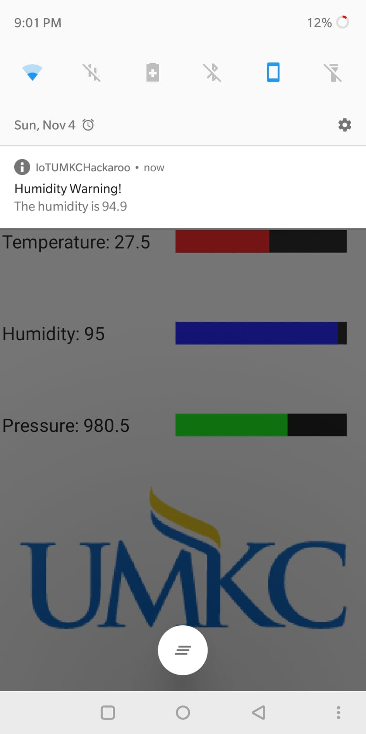
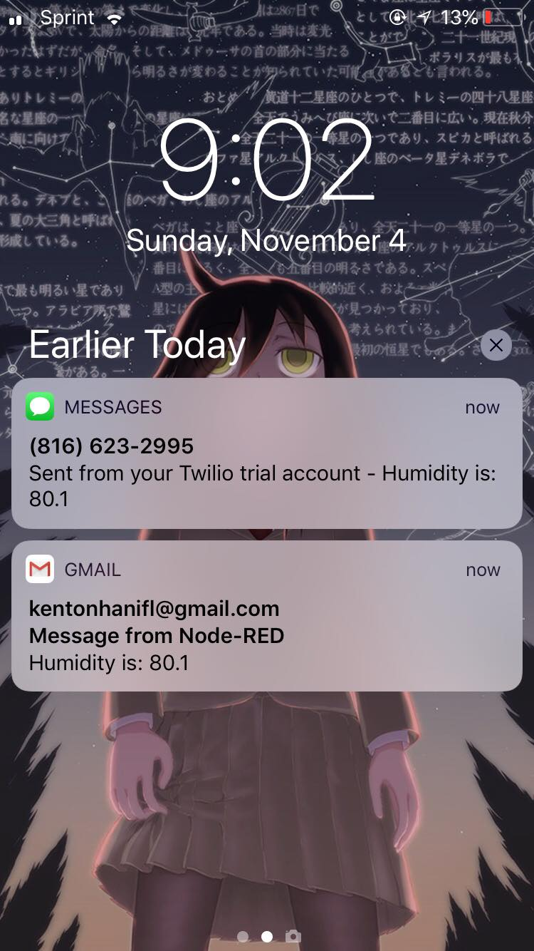
App – Weather Notifications

Slide 9
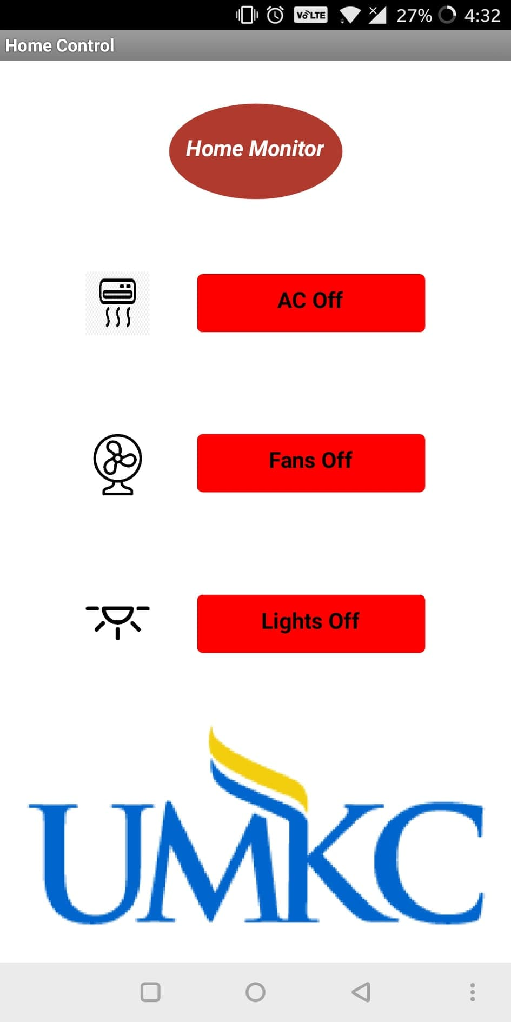
App Controlling Hardware
Simple buttons to control hardware
“Single button” controls for each piece of hardware

Slide 10
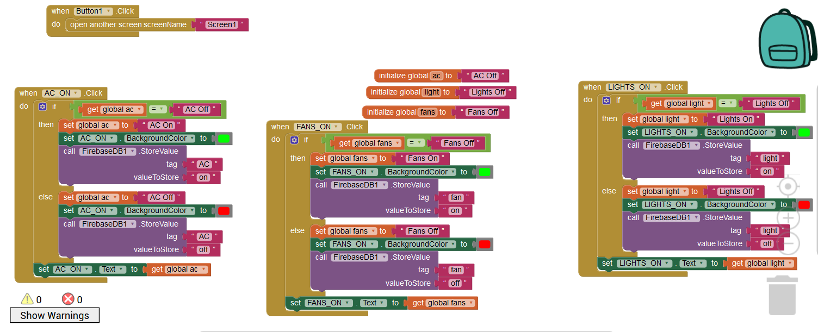
App – Controlling Hardware
Set a value on firebase
Node-red waits for a change and controls hardware (LEDs) accordingly

Slide 11

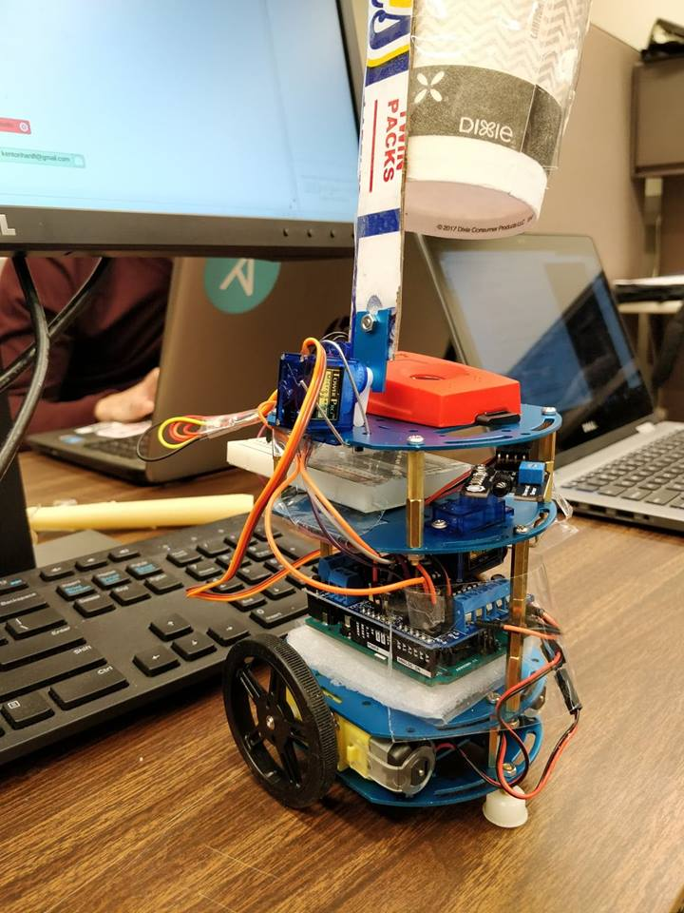
Fire Fighting Robot
Continually tries to detect a fire
If it finds one, it uploads a warning
to the database
Seeks out the fire and extinguishes it

Slide 12
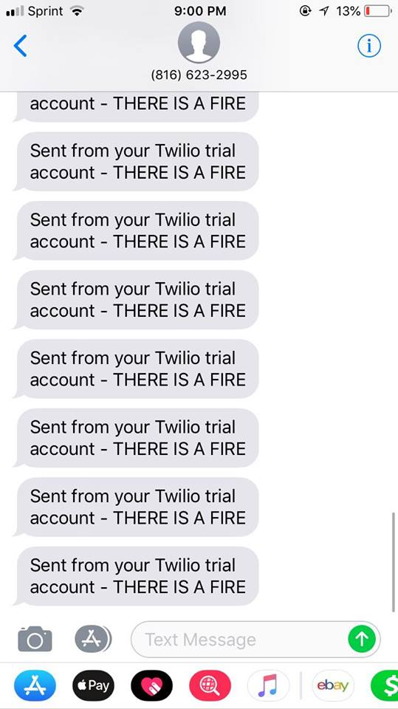
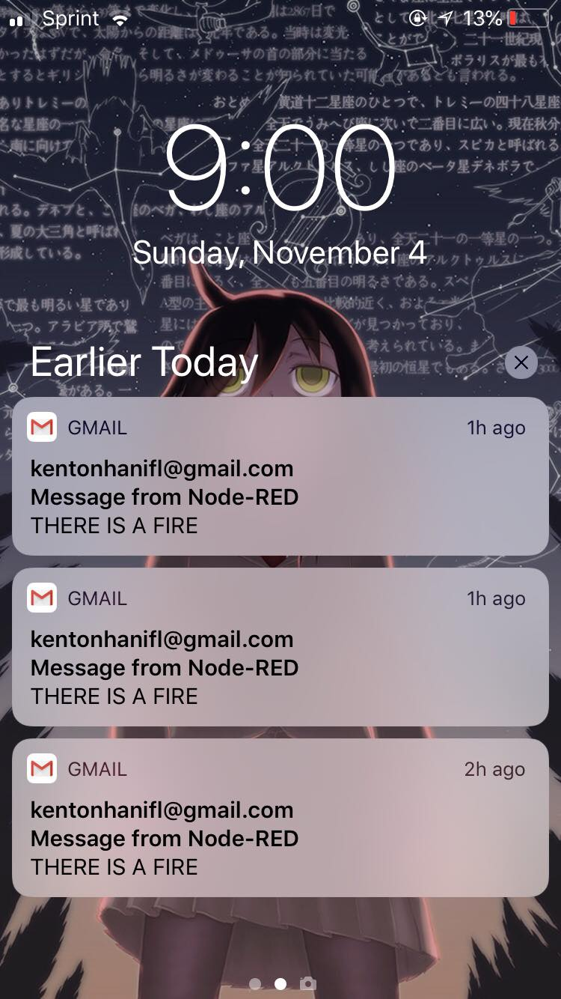
Fire Fighting Robot – Notifcations
A notification is sent to the user’s phone if there is a fire
This can be text or email

Slide 13
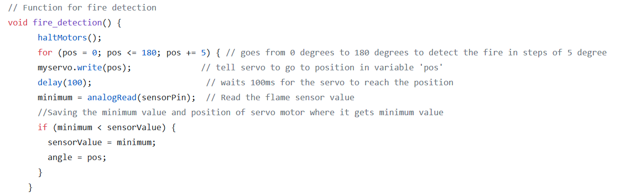
Fire Fighting Robot – Detect Fire Code (1/2)

Slide 14
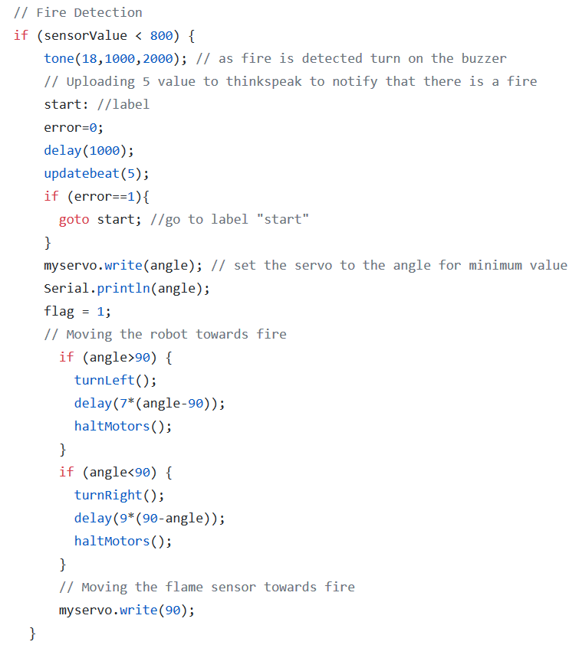
Fire Fighting Robot – Detect Fire Code (2/2)

Slide 15
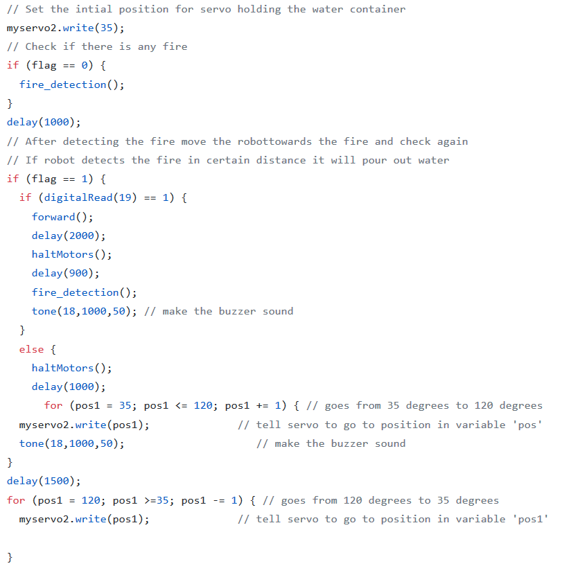
Fire Fighting Robot – Main Loop

Slide 16
Nao Robot
Tells the user about the weather when prompted
Will alert the user if there is a fire if there is one

Slide 17
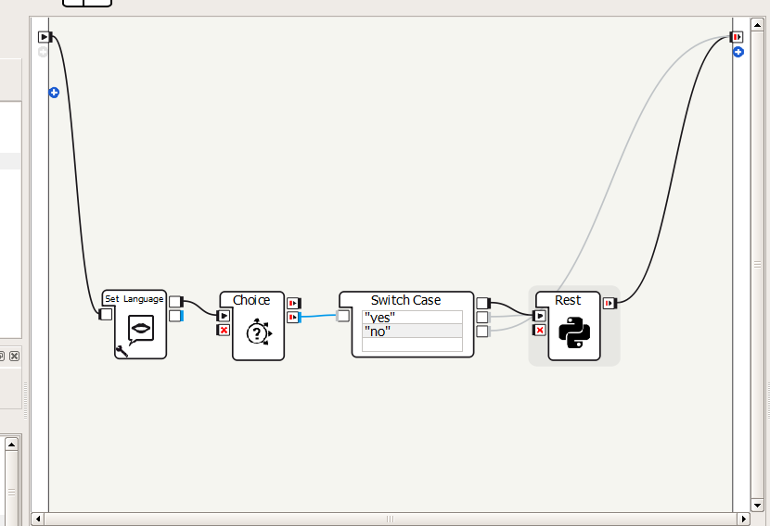
Nao Robot - Flow
User is prompted “Do you want to hear the weather?”
If yes, run a python script:
Fetches data from firebase
Outputs the data in a human like manner

Slide 18
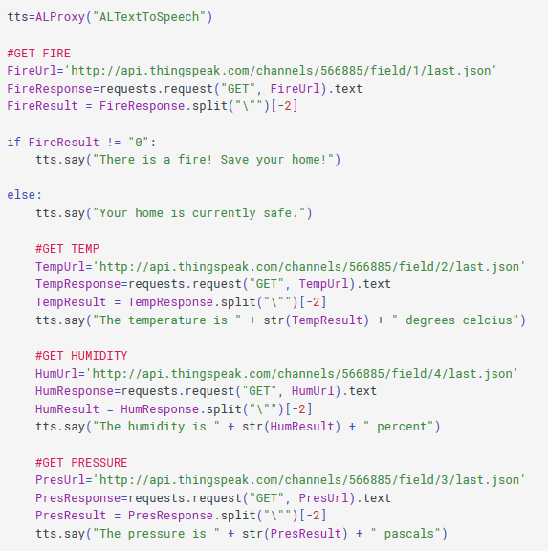
Nao Robot - Code

Slide 19
DEMO

