Slide 1
Community Support and financial Empowerment platform in Egypt

Slide 2
Community support and financial empowerment platform
What are we working on?
Ahmed
Charities NGOs
Layla
Nabil
Notes:
The scenario

Slide 3
About our platform
Community support and financial empowerment platform
transformative initiative designed by GIU’s students to bridge the gap between charitable support and sustainable economic independence in Egypt’s developing economy.
Objectives and core values
Empowerment
Transparency
Community Engagement
Neutrality
Scalability and Sustainability

Slide 4
Community service project proposal infographics
Community support and financial empowerment platform
Functional requirements
Donor
Register , submit legal requirements and create a profile
Browse beneficiaries’ posts and pay them.
Send donations, track their donations through dashboards
Get verified within 24h and then manage their accounts
Receive notifications on how their funds are being utilized with a thanks message.

Slide 5
Community service project proposal infographics
Community support and financial empowerment platform
Functional requirements
Volunteer
Register and create a profile
Receive notications for upcoming events and shifts they are scheduled for.
Browse events organized by NGOs and apply for participation
Get verified and manage their account
Receive the timing and location to be interviewed by the NGO or event details

Slide 6
Community service project proposal infographics
Community support and financial empowerment platform
Functional requirements
NGO
Create profile and wait 24 hours to be verified by the board.
NGOs receive the details of the Volunteers applied with their projects to interview them.
Request donations for specific projects or events
Send notications to registered donors
Organize events and specify the types of volunteers and wait 24 hours to be verified by the board.

Slide 7
Community service project proposal infographics
Community support and financial empowerment platform
Functional requirements
Beneficiary
Register and create profile
Beneciaries receive payments into a secure digital wallet or transferred to a bank account or postal order in most cases
Share funding posts for specific needs, such as medical bills or community projects.
Submit detailed aid requests providing proof then connected to NGO or a donor within a week.
Can share posts for the donations they got

Slide 8
Community service project proposal infographics
Community support and financial empowerment platform
Functional requirements
Admin
Browse all NGOs in the system and aid requests.
Verifies the NGO accounts and activates them.
Receive the beneciaries’ requests and verify them then send them to the NGOs
Segment the Volunteers and NGOs then high Donor segment is assigned to deal with the NGOs directly to manage their charitable contribution deductions from taxes. .
Has a centralized management system for tracking and distributing donations

Slide 9
Community service project proposal infographics
Community support and financial empowerment platform
Non-Functional requirements
Scalability
Security
Reliability
Maintainability
Up to 30 Million active users & expanding operations such as increase in posts
encryption, secure authentication, and role-based access control.
Use reliable cloud to enhance uptime and consistent service
Modular and well-documented
Performance
Transparancy
UX
Data privacy
response time to be within 0.1 second
handle a large volume of data up to 500 GB
financial and aid distribution are logged and verified by relevant stakeholders.
Intuitive and easy to navigate with Arabic Language
Text to speech functionality
compliance with GDPR and Egyptian Data protection Law 151

Slide 10

Community service project proposal infographics
Community support and financial empowerment platform
Conceptual design
Microservices
Benefits
Justification
independently deployable services, dedicated to a core functionality ex: donation tracking, volunteer coordination or community feedback. Each operate autonomously, enhancing the flexibility to adapt to the evolving needs of donors, NGOs, volunteers and rapid deployment and modification of individual services, promoting long-term sustainability
Scalability: Each scale independently based on its specific needs. ex: If there’s an increase in donations around a specific time, only the donation management service would need to scale up to handle the load.
Maintainability: Smaller codebases for each service mean less complexity during maintenance.
Flexibility for Growth

Slide 11

Community service project proposal infographics
Community support and financial empowerment platform
Conceptual design
Event driven
Benefits
Justification
ideal for facilitating communication between Microservices by triggering and responding to events, such as user donations or volunteer registrations. It promotes a decoupled architecture where services interact asynchronously, enhancing the system’s responsiveness and scalability
Decoupling: Reduces dependencies between services, improving modularity.
Responsiveness: Services can react to events in real time, enhancing user experience.
Scalability: Enables more dynamic resource allocation and handling of high loads efficiently.

Slide 12
Community service project proposal infographics
Community support and financial empowerment platform
Conceptual design
And other patterns
Factory Method Pattern
Facade Pattern
Observer Pattern

Slide 13
Community service project proposal infographics
Community support and financial empowerment platform
In order to have a Software Decomposition
Identifying the Problem Domain and its Key Components
Analyzing Requirements and Determining the Scope
Recognizing Potential Areas for Decomposition
Then we saw that Functional and object decompositions were the best

Slide 14
Community service project proposal infographics
Community support and financial empowerment platform
Functional Decomposition
Justification
Detailed decomposition
the problem domain involves multiple distinct functionalities that can be logically separated into smaller components. By breaking down the platform's functionality into smaller, manageable pieces, we can ensure that each part of the system can be developed, tested, and maintained independently.
Donor Management
Volunteer Management
NGO Management
Beneficiary Management
Admin Management

Slide 15
Community service project proposal infographics
Community support and financial empowerment platform
Functional Decomposition
Next steps
Define Interfaces: Data Interface and User Interface
Assign Responsibilities:
Donor Management: Handle donor registrations, donations, notications.
Volunteer Management: Handle volunteer registrations, event scheduling and notications.
NGO Management: Handle NGO registrations, Handle event organization, donation requests, and volunteer coordination.
Beneficiary Management: Handle Beneficiary Registration, aid requests, share aid posts, and payments receiving.
Admin Management: Oversee the platform’s operation, ensuring proper verication, tracking, and reporting.

Slide 16
Community service project proposal infographics
Community support and financial empowerment platform
Functional Decomposition
Next steps
Define Component Dependencies
Donor Management and NGO Management: Donors interact with NGOs through donation requests.
Volunteer Management and NGO Management: Volunteers apply for events organized by NGOs.
Beneficiary Management and Admin Management: Admins verify beneficiary requests for aid.
Donor Management and Beneficiary Management: Donor interacts with the Beneficiary by posts.
Establish Hierarchy: top level then sub components then dependencies.
Refine and Iterate.

Slide 17
Community service project proposal infographics
Community support and financial empowerment platform
Object-Oriented Decomposition
Justification
To break down our complex software system into smaller, more manageable and cohesive functional components or modules enabling us to modify and test each on its own.
System overall Objects
User: abstract base class for all types of users (Donors, Volunteers, Beneciaries, NGO).
Profile: A detailed prole attached to each user.
Dashboard: Provides interfaces for donors and board members to track activity.

Slide 18
Community service project proposal infographics
Community support and financial empowerment platform
Object-Oriented Decomposition
Donor Management
Donor(id, name, email, legalDocuments, veriedStatus, dashboardData, walletBalance): Represents a user who contributes financial support to beneficiaries and NGOs.
PaymentMethod(lastDigits, type): Denes the various ways a donor can make payments (e.g., credit card, bank transfer).
Transaction(transactionId, sender, receiver, amount, type,timestamp, PaymentMethod): Logs financial movements and interactions on the platform between all the entities across the platform.

Slide 19
Community service project proposal infographics
Community support and financial empowerment platform
Object-Oriented Decomposition
NGO Management
NGO(id, organizationName, NGOtype, eventList, donationRequests): Represents non-profit organizations that create and manage events, request donations, and organize volunteer work.
Event(EventId, eventName, date, location, description, organizerId, volunteerIdsList): Captures the details of activities hosted by NGOs, including information about time, place, and volunteer needs.
DonationRequest(RequestId, date, details, type): Represents requests by NGOs for funds from donors.

Slide 20
Community service project proposal infographics
Community support and financial empowerment platform
Object-Oriented Decomposition
Volunteer Management
Volunteer(id, name, appliedEvents, pastEvents, segment): Represents an individual who offers their time and services to assist in NGO activities and events.
VolunteerApplication(applicationId, date, details, type, RequesterId): Manages the process of volunteers applying for specfic events.

Slide 21
Community service project proposal infographics
Community support and financial empowerment platform
Object-Oriented Decomposition
Beneficiary Management
Beneficiary(id, name, aidRequests, walletId,postalNumber, legalDocuments): Represents individuals or groups who receive aid from donors and NGOs.
AidRequest(SubmissionDate, details, type, RequesterId, proofDocuments, approvalStatus): Formalizes requests for aid submitted by beneficiaries, tracking the status and approval process.
DigitalWallet(walletId, balance, transactionHistory): Provides a financial account for beneficiaries to receive, store, and use donations.
Posts(PostId, message, senderId, timestamp, status): shared by the beneficiary to request aid and help.

Slide 22
Community service project proposal infographics
Community support and financial empowerment platform
Object-Oriented Decomposition
Admin Management
Admin(id, boardMemberName, accessLevel, vericationQueue): Represents platform administrators responsible for overseeing platform operations, ensuring all activities are running smoothly.

Slide 23
Community service project proposal infographics
Community support and financial empowerment platform
Domain Driven Desgin
1. Ubiquitous Language
What is the definition and differences in each of the following:
Donor
Beneficiary
NGO
Volunteer
Board, Admin, Administrator
Profile Verification
Digital Wallet
Event, Project
Aid Request
Request, DonationRequest, VolunteerRequest, EventRequest
Post Notification System
Blockchain.
Financial Institution

Slide 24
Community service project proposal infographics
Community support and financial empowerment platform
Domain Driven Desgin
2. Bounded Contexts
distinct subsystems, each with its own domain model and associated responsibilities
Donor Context
Beneficiary Context
NGO Context
Volunteer Context
Admin Context
Financial Institution Context

Slide 25
Community service project proposal infographics
Community support and financial empowerment platform
Domain Driven Desgin
3.1 Entities
Donor:
Attributes: id, name, email, legalDocuments, verifiedStatus, dashboardData, walletBalance
Behavior: Register, donate, track donations, browse Posts.
Beneficiary:
Attributes: id, name, legalDocuments, aidRequests, walletBalance,postalNumber.
Behavior: Register, request aid, create Posts, manage received funds.
NGO:
Attributes: id, organizationName, NGOtype, eventList, donationRequests
Behavior: Register, organize events, request donations, manage volunteers.
Volunteer:
Attributes: id, name, appliedEvents, pastEvents, segment
Behavior: Register, browse events, apply for participation, receive notifications.

Slide 26
Community service project proposal infographics
Community support and financial empowerment platform
Domain Driven Desgin
3.1 Entities
Board:
Attributes: id, boardMemberName, accessLevel, verificationQueue
Behavior: Verify user and NGOs profiles, approve funding requests, monitor donations, create segments.
EventDetails:
Attributes: EventId, eventName, date, location, description, organizerId, volunteerIds
Provides information about an event without an identity.
Digital Wallet:
Attributes: walletId, balance, transactionHistory.
Provides functionality like add funds, withdraw funds, transfer funds to beneficiaries.

Slide 27
Community service project proposal infographics
Community support and financial empowerment platform
Domain Driven Desgin
3.1 Entities
Transaction:
Attributes: sender, receiver, amount, transactionId, type, timestamp, PaymentMethod
Records any financial movements like donations and spendings by beneficiaries.
AidRequest:
Attributes: AidId, SubmissionDate, details, type, RequesterId, proofDocuments, approvalStatus.
Represents the aid requests submitted by the beneficiary and approved by the admin then linked to the NGOs. Post:
Attributes: PostId, interactionCount, message, senderId, timestamp, status.
shared by the beneficiary to request aid and help in the form of posts.

Slide 28
Community service project proposal infographics
Community support and financial empowerment platform
Domain Driven Desgin
3.2 Value Objects
Notification:
Attributes: message, senderId, recipientId, timestamp, status
Represents a communication object that can be sent to any entity.
Request:
Attributes: date, details, type(eventRequest, volunteerRequest, DonationRequest), RequesterId
It represents any request object, such as NGOs creating events, volunteers requesting to participate in such events, and donation requests applying for financial aid.
PaymentMethod:
Attributes: lastDigits, type(bankTransfer, creditCard, instantPayments)
Immutable and defines the details of the payment method for a donation.

Slide 29
Community service project proposal infographics
Community support and financial empowerment platform
Domain Driven Desgin
3.3 Aggregates
Donor Aggregate:
Root Entity: Donor Includes: Transaction objects, notification list.
Beneficiary Aggregate:
Root Entity: Beneficiary Includes: Aid requests, digital wallet details, Posts
NGO Aggregate:
Root Entity: NGO Includes: Event details, volunteer applications, and donation requests.
Volunteer Aggregate:
Root Entity: Volunteer Includes: List of applied events, participation history and event volunteering request
Board Aggregate:
Root Entity: Board Includes: Verification of accounts and aid requests, NGO interactions/requests, donations, events, link Aid Requests with the NGO

Slide 30
Community service project proposal infographics
Community support and financial empowerment platform
Domain Driven Desgin
4. Domain services
Verification Service
Donation Processing Service
Event Management Service
Notification Service
Transaction Management Service

Slide 31
Community service project proposal infographics
Community support and financial empowerment platform
Domain Driven Desgin
5. Domain Events
UserRegisteredEvent
ProfileVerifiedEvent
DonationMadeEvent
FundingRequestSubmittedEvent
FundingResponseEvent
AidDisbursedEvent
EventAppliedEvent
EventOrganizedEvent

Slide 32
Community service project proposal infographics
Community support and financial empowerment platform
Domain Driven Desgin
6.Adapting Architectural Patterns
Microservices
Event driven

Slide 33
Community service project proposal infographics
Community support and financial empowerment platform
Domain Driven Desgin
7.Integratting The Domain Model into the Design & Architecture
Aggregates and entities are translated into classes or objects within the software. They must reflect attributes, operations, and relationships, ensuring consistency and alignment with the problem domain.
Value objects are integrated into the design as immutable classes that encapsulate attributes and operations relevant to their role in the domain.
Domain services encapsulate operations that do not belong to a single entity or aggregate. These services are implemented as stateless modules or classes.
Domain events facilitate communication and interaction between components, maintaining system flexibility and responsiveness.

Slide 34
Community service project proposal infographics
Community support and financial empowerment platform
Domain Driven Desgin
8.Domain Model Interaction with software Architecture
ensuring seamless communication and functionality across the platform.
User Interface. Ex: UI facilitates event creation, donation requests, and volunteer management
Persistence Layer. via the Financial Institutions Context.
External systems. Transaction Management Service ensure compliance with financial regulations.

Slide 35
Community service project proposal infographics
Community support and financial empowerment platform
Domain Driven Desgin
Benfits
Challenges
Enhanced Communication and Clarity
Better Organization of Code and Responsibilities
Understanding Boundaries and Aggregates
Communication Across Teams

Slide 36
Community service project proposal infographics
Community support and financial empowerment platform
Architecural Styles and Justification
Microservices and Event-Driven
Justification
To implement all these functional and non-functional requirements of the platform, we combined a hybrid approach between Microservices and Event-Driven Architecture. With this in place, the system can be designed to be modular and scalable with the responsiveness that any user expects while performance and reliability remain uncompromised.

Slide 37
Community service project proposal infographics
Community support and financial empowerment platform
Alignment with FR
Donor Management: sign-up, legal verification, donation tracking, and dashboards. Event-driven: ability for real-time notications, such as when informed about his contribution usage or automatically gets thank-you messages the moment any transaction happens.
Volunteer Management: sign up, explore events, and be notified about their schedules. The volunteer management is integrated in the event management service, means that updates and maintenance related to events and volunteers can be done without affecting other services. Event-driven: model facilitates the easy sending of notications in real time, such as reminders of upcoming events or volunteer assignments.
NGOs Management: same service for events will handle all NGO related functionality; event organization, requests for donation, and volunteer management for the NGOs. Event-driven: triggers should intimate the concerned stakeholder—for example, NGOs at the time donors make their donations, and similarly volunteers at the time of approval of events.
Beneficiary Management: Donation Processing Service ensures the Beneciaries can send in their requests and get in touch with the donor or NGOs within the stipulated time as well as the management of their financial accounts handled . Events ease this process by sending notications when there is a match for donation or aid requests.
Admin: The board of the platform will be able to view all the data of the system and manage the operations through the centralized services. Event-driven updates allow for real-time tracking of donated resources and requests for aid, thus ecient decision-making.

Slide 38
Community service project proposal infographics
Community support and financial empowerment platform
Alignment with NFR
Scalability: Microservices: Services scale independently based on demand, e.g., the donation service can scale without affecting others. Event-Driven: Asynchronous communication supports scaling to 30 million users by handling events like donation notifications without system strain.
Performance: Microservices: Isolated services enable fast responses for critical functionalities like dashboards or aid requests. Event-Driven: Real-time updates ensure dashboards refresh in under a second, and notifications are sent in less than 0.1 seconds.
Reliability: Microservices: Service isolation prevents bugs in one area (e.g., donations) from impacting others. Event-Driven: Buffered events ensure consistent operations even during temporary outages.
Safety: Microservices: Secure protocols and role-based access control protect sensitive services like donation management. Event-Driven: Blockchain integration provides tamper-proof tracking and transparency.
Transparency: Microservices: Modular design enables precise tracking of transactions and aid distributions. Event-Driven: Logs of events and donations ensure verifiable transparency for stakeholders.
User Experience :Microservices: Independent updates improve usability, such as interface enhancements. Event-Driven: Real-time updates enhance experiences for volunteers, donors, and other users.

Slide 39
Community service project proposal infographics
Community support and financial empowerment platform
Other Architectures and their trade-offs
1. Layered Architecture:
○ Pros: Easy to implement and maintain, as it clearly separates the concerns (UI, business logic, and data layers). ○ Trade-offs: Less flexible scaling because the entire layer stack has to be scaled for even localized performance demands. As an example, this means that scaling up donor tracking would require scaling other unrelated functionalities, which would lead to inefficiencies.
2. Monolithic Architecture:
○ Pros: Easier to construct and deploy at first, especially for smaller systems.
○ Trade-offs: A tightly coupled monolithic system does not suit the scale and complexity of our platform. Any update requires redeployment of the system, which means downtime and slows down the pace of development. For example, an update of event management stops donation tracking and beneficiary aid processing.
3. Pure Event-Driven Architecture:
○ Advantages: Great for handling both real-time and asynchronous jobs, such as sending notications or managing volunteer schedules.
○ Trade-offs: Purely event-driven systems are more difficult to debug and manage due to their decentralized nature. Further, tasks requiring strict workflows, such as donor verification, are better supported with structured interactions afforded by Microservices.

Slide 40
Community service project proposal infographics
Community support and financial empowerment platform
Other Architectures and their trade-offs
4. Service-Oriented Architecture (SOA):
○ Advantages: It enables reutilization and integration, especially in applications whose systems need shared services.
○ Trade-offs: This dependency on a single centralized service bus can be a bottleneck and a single point of failure under heavy loads. In other words, when there are too many donation events through the service bus, the delays will affect other functionalities such as NGO notications. SOA also does not provide the modularity and autonomy that Microservices can give, and hence it does not suit our scalability requirements. Also, a single database wouldn’t be feasible in a system of that scale.
Why Microservices and Event Driven is the best ?
This hybrid approach balances modularity, scalability, and responsiveness. Microservices ensure each functionality is independently deployable and scalable, while event-driven design facilitates seamless communication and real-time interactions across services. Together, they will create a robust, adaptable, user-friendly platform that can grow with our users' evolving needs. Whether it's keeping donors informed on how their funds are being used, or managing volunteer activities, or matching beneciaries with NGOs, this architecture provides the performance, reliability, and exibility to help us achieve our mission.

Slide 41
Community service project proposal infographics
Community support and financial empowerment platform
Let’s see the use cases

Slide 42
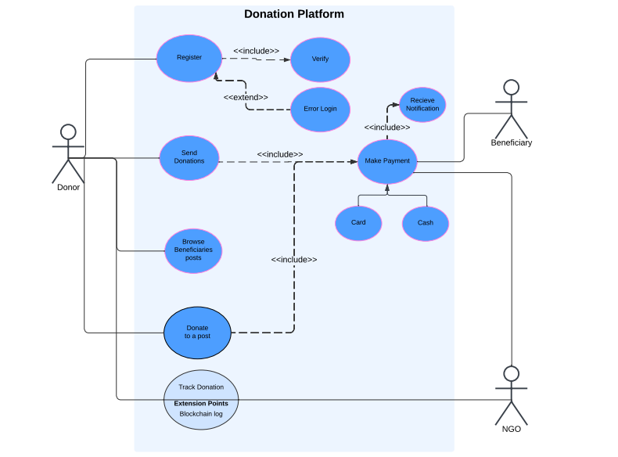
Community support and financial empowerment platform

Slide 43
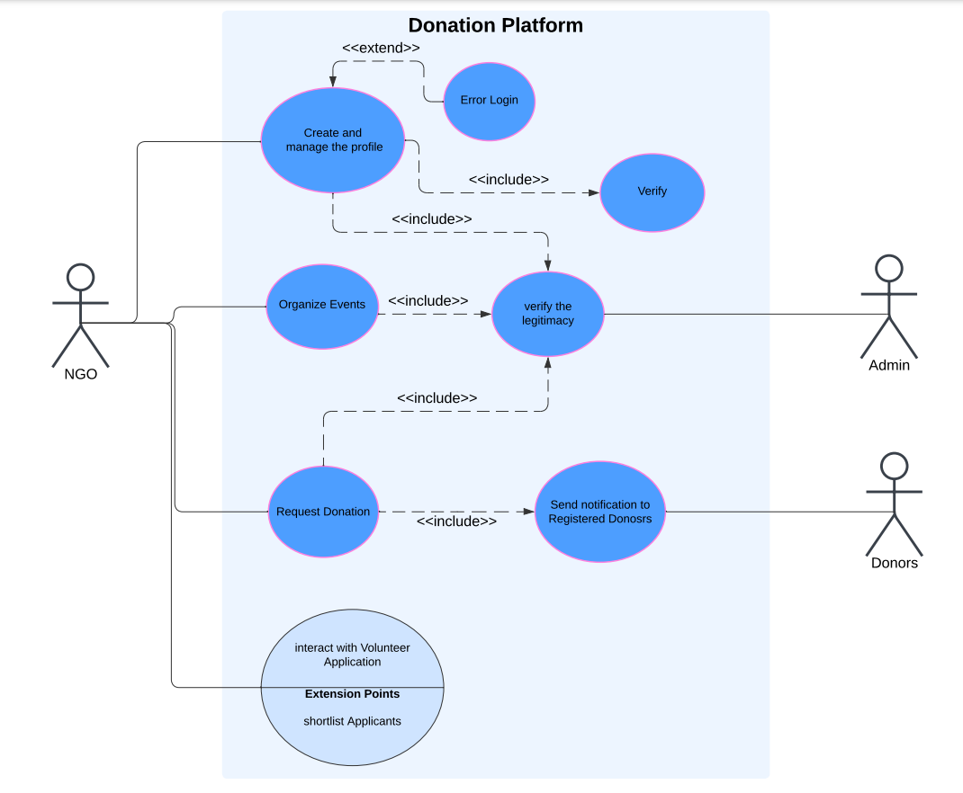
Community support and financial empowerment platform

Slide 44
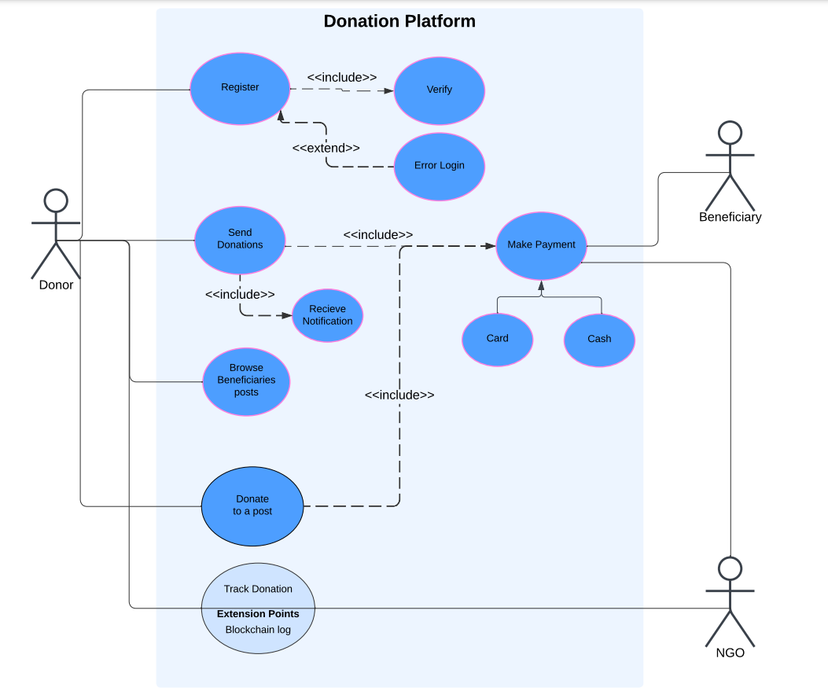
Community support and financial empowerment platform

Slide 45
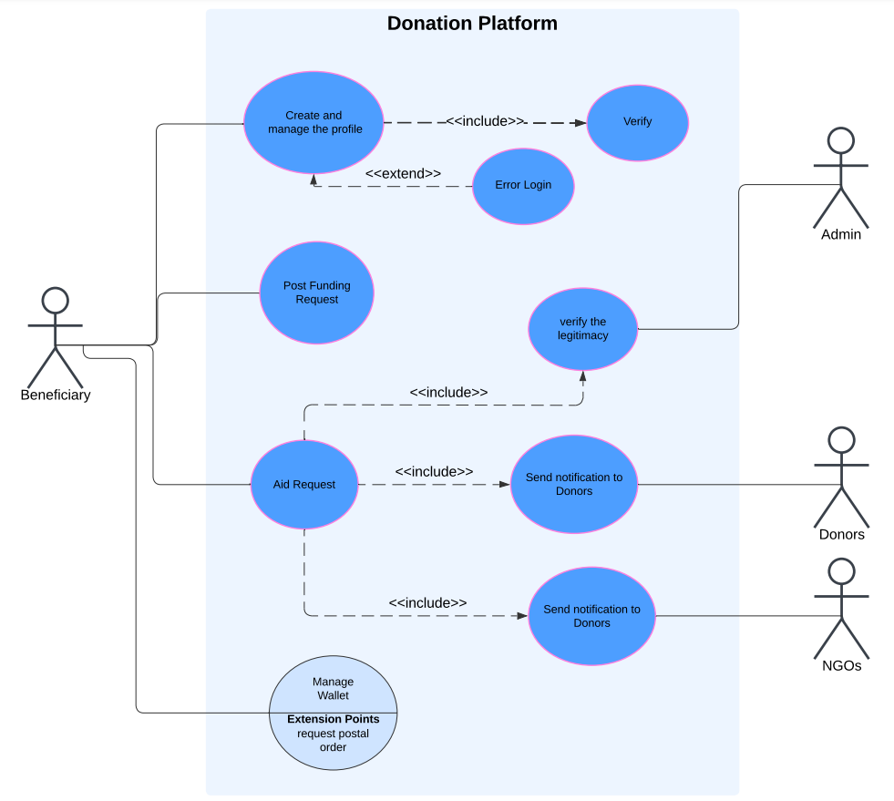
Community support and financial empowerment platform

Slide 46
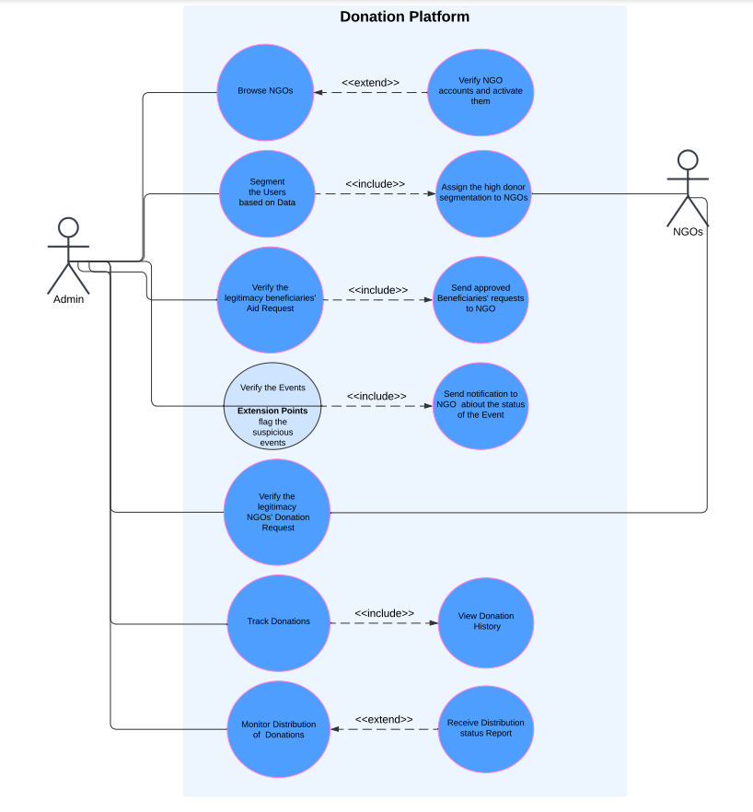


Slide 47
Community service project proposal infographics
Community support and financial empowerment platform
High-Level Architecture Diagram

Slide 48
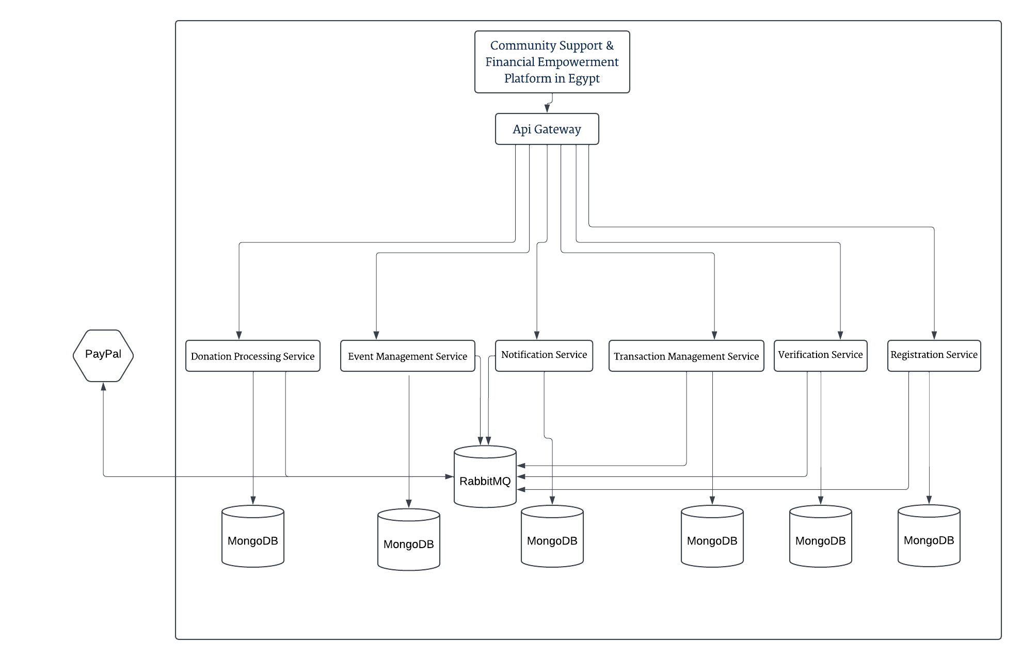
Community service project proposal infographics

Slide 49
Community service project proposal infographics
Community support and financial empowerment platform
Class Diagram

Slide 50
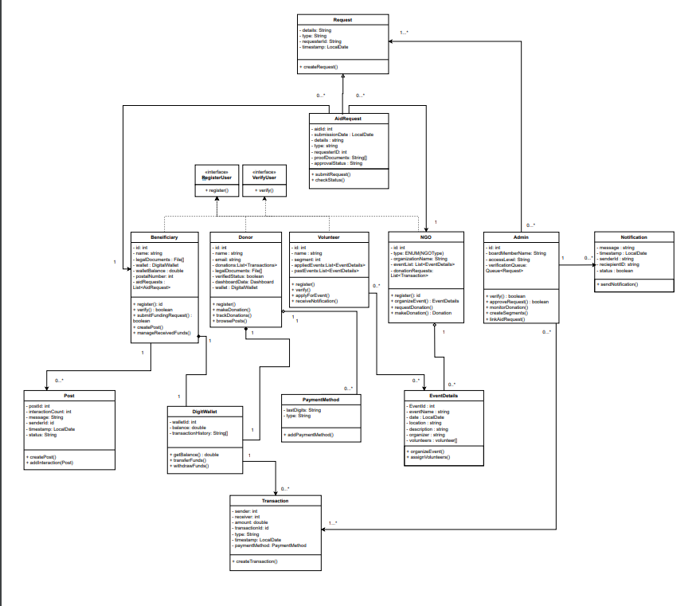
Community service project proposal infographics
Access through :
Clear View

Slide 51
Community service project proposal infographics
Community support and financial empowerment platform
Integration with milestone 1
Conceptual design
Event-driven architecture was not taken into account. However, when building the architecture and diagrams; it was evident that a message broker needed to be implemented. The reason being that the system is full of concurrent events that need to happen asynchronously. Notications needed to be implemented asynchronously to ensure a fast and reliable experience. Moreover, logs of all transactions were needed to be stored in the Transaction Management Service to ensure history availability for Admin Tracking, Security, and for extension features (Think of an AI Model). Moreover, to ensure a smooth and fast Verification Process, the Registration Service needed a way of forwarding data to the Verification Service since such a process is costly and can not be done synchronously. For that reason, we integrated event-driven architecture into our existing Microservices architectural design

Slide 52
Community service project proposal infographics
Community support and financial empowerment platform
Integration with milestone 1
DDD
some adjustments were needed. Firstly, some methods were added in some of the classes like the Digital Wallet and the Transaction Classes. The reason being that in the previous DDD only the general picture was represented without diving deep into the details, and when implementing the DDD we realized that some relationships are not modeled correctly in our DDD. Class Diagram helps translate the DDD components that we did into a static overview of the system classes and objects, and when diving deep into the relationships, we realized some methods needed to be added to have a fully functional system. Moreover, drawing a class diagram made us dene relationships, for example we needed to include a Wallet in the Donor to have a composition relationship with the Digital Wallet Class such that a Donor is able to use a Wallet.

Slide 53
Our lovely team
Sarah El-Feel
Danya Danish
Alaa Ashraf
Abdelrahman Elnagar
Abdelrahman Samir
Omar Sherif
Mohamed Hossam
Hussein Mansour

Slide 54
Community service project proposal infographics
Community support and financial empowerment platform
Thank You
Any Questions ?

