Slide 1
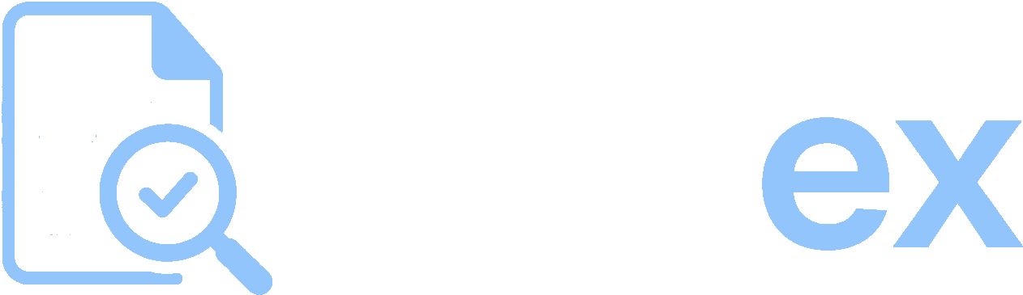
Turn documents into
defensible decisions.
A compliance and document-intelligence platform for teams that review documents in bulk — and have to defend every decision afterwards.
Investor & partner brief founder@docex.app · docex.app

Slide 2
THE PROBLEM
The same documents. Read by hand. Every time.
Grants, finance, procurement and compliance teams receive documents in bulk — applications, invoices, policies, reports — and answer the same questions and check the same rules against each one, manually.
200+
documents in a single review cycle
It is slow. It is inconsistent between reviewers. And it leaves no trail. When a donor or auditor asks why something was approved, the answer is buried in someone's inbox.
~15
questions asked of every applicant
2 wks
of analyst time, per cycle, lost to reading
DOCex
founder@docex.app
2

Slide 3

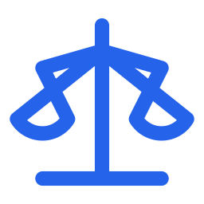
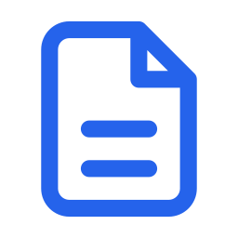
WHY IT MATTERS
Three failures hiding in manual review
Slow
Inconsistent
Indefensible
Days disappear into reading. Good partners get missed because the deadline arrives before the pile is finished.
Two reviewers, two answers. The standard applied to applicant 1 quietly drifts by applicant 80 — and no one can see it.
No trail. When a funder or auditor asks 'why this one?', the reasoning lived in a person's head and an email thread.
DOCex
founder@docex.app
3

Slide 4
WHAT DOCEX IS
A repeatable system of record for document-heavy review.
DOCex reads a stack of documents and returns structured, cited answers — the source file, the exact quote, the page, and a confidence level. Define your questions or your policy once; run them the same way across one applicant or two hundred.
Cited
Repeatable
Audit-ready
Built for the field
DOCex
founder@docex.app
4

Slide 5
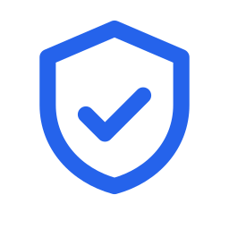





THE PLATFORM
Six capabilities, one engine
Compliance & approvals
Document extraction
Reusable templates
Policy becomes a reusable rulebook. Every payment gets a per-rule verdict — pass, flag, block — cited from both sides.
Plain-language questions across a document stack. Each answer cites source file, exact quote, page and confidence.
Save the questions and policy sets you run every cycle and apply them identically at scale.
Attendance & payment
Knowledge Q&A
Bank verification
Match attendance to a payment list, apply per-diem, and verify bank accounts before finance sees them.
Ask a library of reports and decks; get answers with citations to the exact slide or page.
Confirm a recipient matches the bank-of-record holder before money moves — one account or a schedule.
DOCex
founder@docex.app
5

Slide 6
HOW IT WORKS
From policy to a decision that holds up
1
2
3
4
Turn policy into a rulebook
Check a payment against it
Resolve in one thread
Approve with a frozen trail
Upload your procurement, travel or donor policy. DOCex extracts every testable rule into a set you can edit.
Drop in the invoice or voucher. Every rule returns a verdict, cited from both the policy and the payment.
Escalate to a reviewer or query a vendor by email — the question, answer and trail stay in one place.
Every check, escalation and sign-off is timestamped. Edit the policy a year later; the old audit stays intact.
DOCex
founder@docex.app
6

Slide 7



WHY IT HOLDS UP
What a chatbot can't give a team
Cited, not just confident
Every answer and verdict points back to the source — the exact quote, the page, the rule. Nothing to take on faith, which is the whole point when an auditor asks.
Repeatable, not one-off
A saved rulebook or template runs identically on document 1 and document 200. Consistency a fresh prompt can never guarantee.
Defensible by design
Checks, escalations and signatures are timestamped and frozen. Yesterday's audit doesn't change when today's policy does.
DOCex
founder@docex.app
7

Slide 8
PROOF
Born on the hardest version of the problem
TA Connect is a public-health NGO in Abuja whose sub-award team screens 200+ partner applications a cycle — 5–8 documents each, against ~15 standard questions. It is exactly the volume, variety and stakes DOCex was built for: real partners get overlooked when the reading runs past the deadline.
150+
applications screened in an afternoon
~2 hrs
to do what took two weeks
DOCex collapses weeks of manual review into an afternoon — and applies one consistent standard to every applicant, with a citation behind every answer.
100%
one standard, applied to every file
DOCex
founder@docex.app
8

Slide 9
MARKET
Anyone who receives documents in bulk
The same engine, pointed at a different document set. Each is a team that reviews at volume and has to defend the outcome.
Compliance & finance
Grants & sub-awards
Legal & risk
Invoices and vouchers against policy, with an audit trail
Partner applications screened against standard questions
Contracts scanned for clauses, obligations and red flags
Procurement
Foundations
HR & talent
Supplier proposals compared on the criteria that matter
Reports and reconciliations checked at portfolio scale
CVs and credentials matched against a role specification
DOCex
founder@docex.app
9

Slide 10
THE PAYOFF
What changes for the team
Hours, not weeks
One honest standard
Audit prep that's already done
A review cycle that consumed an analyst for a fortnight finishes in an afternoon — without cutting corners.
The criteria applied to the first file are applied to the last, so the strongest partners stop slipping through.
Because the trail is captured as you work, the funder's question is answered before it's asked.
DOCex
founder@docex.app
10

Slide 11
HOW TO START
A pilot on your own documents
Scoped to one real review cycle. Low lift, high signal — you see DOCex run against your documents, not a demo dataset.
WEEK 1
WEEK 2–3
WEEK 4
Scope & setup
Run a live cycle
Review & decide
We agree the questions or policy that matter, and stand up your rulebooks and templates.
Your team runs a real batch end-to-end. We tune against the edge cases your documents throw up.
We walk the results and the time saved together, and decide how to roll DOCex out from there.
Pilots are scoped per team, in conversation.
DOCex
founder@docex.app
11

Slide 12
Bring one cycle of real
documents. We'll do the rest.
Built from a real NGO office in Abuja, for every team that has to turn a pile of documents into a decision it can defend.
founder@docex.app docex.app

