Slide 1
Handover Management in SDN-based Mobile Networks
Advisor :Professor Bih-Hwang Lee
Student :Muhammad Farid Wajdi
Date :2017/08/12

Slide 2
Outline
I. Introduction
II. Mobility Management Foundations
III. Existing Mobility Management Approaches
IV. Handover Management in SDN
V. Conclusion

Slide 3
Outline
I. Introduction
II. Mobility Management Foundations
III. Existing Mobility Management Approaches
IV. Handover Management in SDN
V. Conclusion

Slide 4
Introduction
Originally the main goal of creation of mobile networks was to provide voice services.
Right now the main goal is to provide high speed access to Internet for mobile network users.
The most critical part of all mobile networks is RAN (Radio Access Network).
The capacity of RAN can be increased by the usage of relatively small cells due to higher frequency reuse factor.

Slide 5
Introduction
Fast moving users can trigger many handovers that have to be handled in a very short time. Such handovers therefore have to be fast and the handover mechanism has to be scalable.
So, we can considered a completely new approach to mobility management based on the SDN paradigm.
The main goal of the paper is to discuss how SDN can be applied in order to efficiently handle the connected-state mobility in dense mobile networks.

Slide 6
Outline
I. Introduction
II. Mobility Management Foundations
III. Existing Mobility Management Approaches
IV. Handover Management in SDN
V. Conclusion

Slide 7
Mobility Management Foundations
The mobility management deals with two major tasks :
location management
handover control
The term handover (or handoff) in mobile networks refers to the process of transferring an ongoing voice call or data session from one wireless node (or node sector) to another one
The basic purpose of handover management is to maintain the session continuity from the point of view of applications. while accepting relatively short brakes of the physical connection.

Slide 8
Mobility Management Foundations
The most common handover is hard handover (the breakbefore- make approach).
In case of hard handover the key issue is minimization of the time when the connection between the mobile node and the network is broken.
Typically the handover is based on measurements of the signal strength made by mobile nodes. The nodes measure the strength of the received signal of the serving and neighbouring base stations.

Slide 9
Outline
I. Introduction
II. Mobility Management Foundations
III. Existing Mobility Management Approaches
IV. Handover Management in SDN
V. Conclusion

Slide 10
Existing Mobility Management Approaches
X2 based handover procedure in LTE
Handovers in IP networks

Slide 11
X2 based handover procedure in LTE
Using X2 interface makes this approach a distributed one.
The handover procedure is composed of following three phases:
Handover preparation
Handover execution
Handover completion
when the handover decision is taken, on the basis of a mobile node’s report sent to serving eNodeB
In LTE the GTP protocol is used to establish tunnels for terminals, between S-GW and P-GW (Packet Data Network Gateway), and between S-GW and MME.

Slide 12
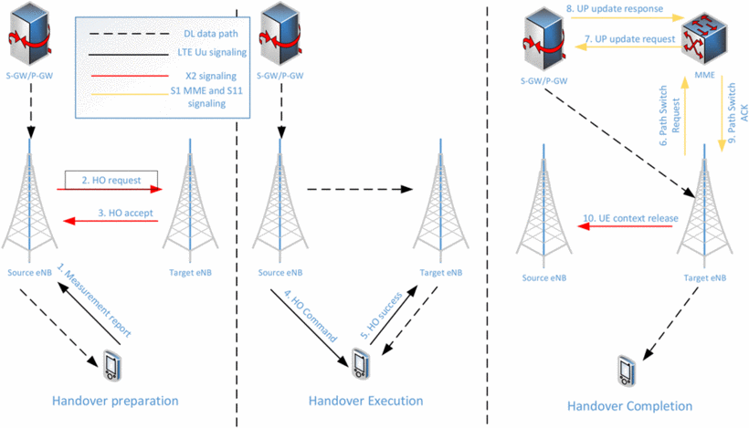
Intra-frequency X2 based handover in LTE

Slide 13
Handovers in IP networks
In the latest generations of mobile networks and probably in the future ones the IP protocol will be the only one used on every interface except CPRI (Common Public Radio Interface).
The added value of such approach is simplification of the inter-system (so-called vertical) handover.
The main goal of Mobile IP is to allow for location-independent routing of IP packets.

Slide 14
Handovers in IP networks
In general, in IP networks there is no separation of control and data planes, therefore in the centralized case data and control plane operations have to be centralized.
In the context of this paper it is worth to note that the basic goal of all IETF mobility approaches is to cope with the necessity of IP address change caused by the mobility of nodes.

Slide 15
Outline
I. Introduction
II. Mobility Management Foundations
III. Existing Mobility Management Approaches
IV. Handover Management in SDN
V. Conclusion

Slide 16
Handover Management in SDN
SDN original properties lie on: separation of data and control planes and centralization (at least logical) of the control plane (the data plane is distributed).
SDN is a high level of programmability of the control plane, which can be programmed by an operator or user nearly from scratch.
SDN controller can dynamically change the forwarding rules for each flow by appropriate update of forwarding tables of SDN switches.

Slide 17
Handover Management in SDN
in the past in 3GPP mobile systems we had no possibility for direct manipulation of routing and we solved this problem using GTP tunnels.
SDN gives the ability to handle mobility not only per user but also per flow basis.
SDN can contribute significantly to load balancing of the radio and the fixed part of the mobile network.

Slide 18
Handover Management in SDN
In order to apply SDN to wireless networks the base stations (eNodeB) have to support the OpenFlow protocol.
SDN based mobile networks the controller has to include MME and PCRF (Policy and Charging Rules Function) functionality in order to handle data transfer and handle mobility in the whole network, moreover it has to handle mobility management in the idle and connected state.
However common in the SDN based approach is the centralization (global or semi-global) of control and real-time management (autonomic) functions in the controller and reduction of intelligence of base stations and other nodes (S-GWs/P-GWs) of the mobile network.

Slide 19
Handover Management in SDN
A short analysis of three different variants of SDN usage in mobile networks is presented.
Centralized SDN
Semi-centralized SDN
Hierarchical SDN

Slide 20
Centralized SDN
Only logically single controller exists, it can be however implemented as a cloud.
This approach requires many high quality control links, which provides deterministic and low delay communication with all the data plane nodes, including radio nodes and the controller.
The controller exchanges such information only with the RAN node that actually handles the data session and the one that will handle it after handover execution and switches.
The handover decisions can be based on a global network view and take into account many important parameters like radi network load, wired links load, etc.

Slide 21
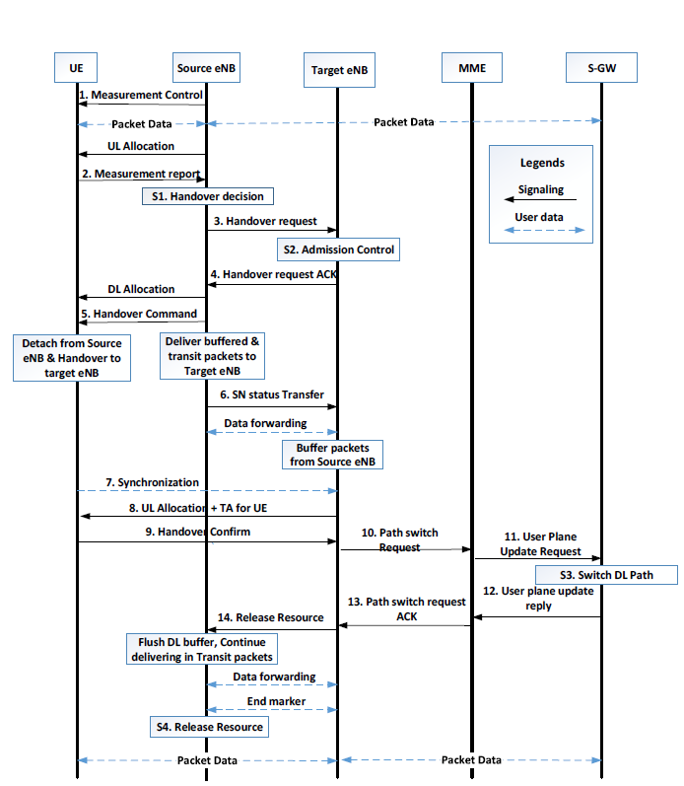
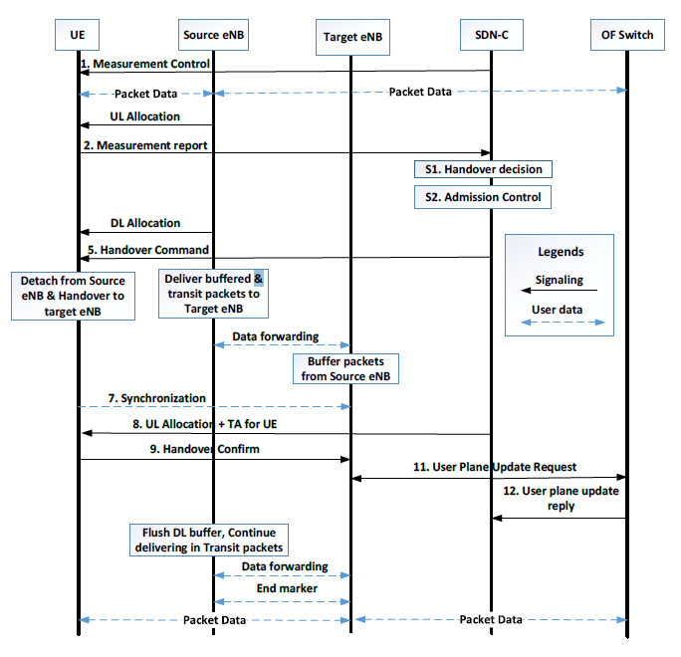
Message sequence chart for handover in centralized SDN

Slide 22
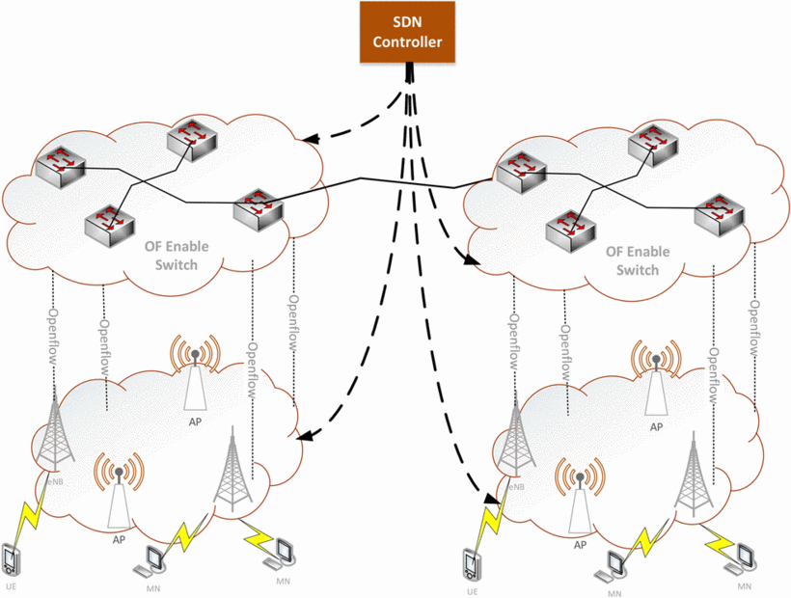
Centralized SDN

Slide 23
Semi-centralized SDN
In the semi-centralized approach there are multiple SDN controllers that typically serve independent geographical regions.
In order to handle such handovers every radio node should broadcast information about its domain membership.
The view of the network is limited to two domains only, The number and size of controller domains may have important impact on number of inter-domain handovers.

Slide 24
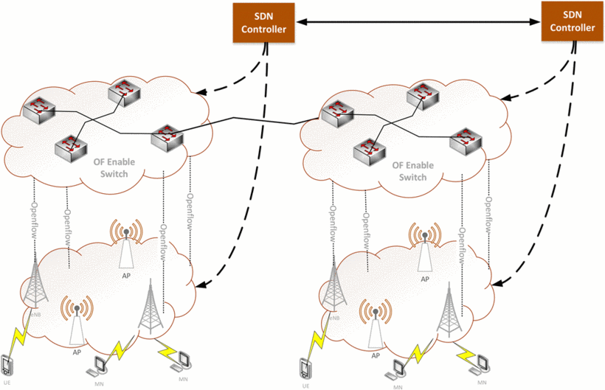
Semi-centralized SDN

Slide 25
Hierarchical SDN
The hierarchical SDN designed for mobility handling is an evolution of the semi-centralized approach.
It can be assumed that there are only two layers of controllers, The lower layer of controllers is composed of distributed controllers like in the previous variant, however there exists also a controller at the higher level of the controllers’ hierarchy.
The upper layer controller if used for handling of inter-domain handovers has to pass additional information between handover domains

Slide 26
Hierarchical SDN
The benefit of this approach is that inter-domain operations are based on a global network view, due to additional information exchange between controllers.
The drawbacks of this approach lies on a bit more complex information exchange that in the semi-centralized case and includes pretty intensive information exchange between this controller and the lower layer controllers.

Slide 27
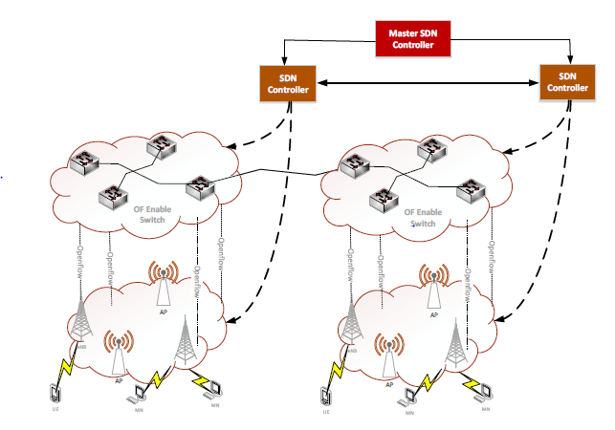
Hierarchical SDN

Slide 28
Outline
I. Introduction
II. Mobility Management Foundations
III. Existing Mobility Management Approaches
IV. Handover Management in SDN
V. Conclusion

Slide 29
Conclusions
In this paper we presented benefits of using SDN in mobile networks for connected-state mobility management.
Centralized or semi-centralized handover decisions that can be based on multiple criterions in a way that optimize the usage of the network resources and last but not least faster handover operations.
The work presents some comparisons of different variants of SDN applied to mobility management

