Slide 1
OpenFlow-based Mechanisms for QoS in LTE Backhaul Networks
Advisor :Professor Bih-Hwang Lee
Student :Muhammad Farid Wajdi
Date :2017/08/26
2016 IEEE Symposium on Computers and Communication (ISCC)
Luciano Jerez Chavesy, Islene Calciolari Garciay, and Edmundo Roberto Mauro Madeiray Computer Science Department, Federal University of Juiz de Fora (UFJF), Brazily Institute of Computing, University of Campinas (Unicamp), Brazil. Emails: flchaves, islene, edmundog @ic.unicamp.br

Slide 2
Outline
I. Introduction
II. Long Term Evolution (LTE)
III. SDN And LTE Integration
a. Existing solutions in the literature
b. Proposed integration scenario
IV. QoS Mechanisms For LTE Backhaul Network
a. Traffic routing and bearer admission control mechanisms
b. GBR / Non-GBR coexistence mechanism
V. Conclusions And Future Work

Slide 3
Outline
I. Introduction
II. Long Term Evolution (LTE)
III. SDN And LTE Integration
a. Existing solutions in the literature
b. Proposed integration scenario
IV. QoS Mechanisms For LTE Backhaul Network
a. Traffic routing and bearer admission control mechanisms
b. GBR / Non-GBR coexistence mechanism
V. Conclusions And Future Work

Slide 4
Introduction
The world is witnessing a rapid growth in mobile communication, According to Cisco Systems, Inc [1].
Long Term Evolution (LTE) networks have been de facto employed for high-speed wireless communication, providing a highly efficient, packet-optimized service.
The growing demand is forcing network operators to deploy more base stations to increase capacity through frequency reuse, especially in densely populated areas [2].
A scenario like that requires a backhaul network with higher connectivity thus, it is necessary to assist the access to these networks [3].

Slide 5
Introduction
As indicated by the Open Networking Foundation (ONF), network operators are facing challenges as demand for mobility and bandwidth increases, and meeting current market requirements is virtually impossible with traditional network architectures [4].
Software Defined Networking (SDN) and the OpenFlow protocol [4] have emerged as promising paradigm, providing a shift toward a flow-centric model designed to enable more agile and flexible networks.
It decouples the control and data planes, allowing simplified forwarding hardware controlled by intelligent centralized software, which is assisted by applications that orchestrate service delivery in the network.

Slide 6
Introduction
This paper discusses how the OpenFlow protocol [8] can be integrated to the existing 4G LTE networks.
Three novel mechanisms that can be used to provide the required QoS in the LTE backhaul infrastructure are propose
a traffic routing
an admission control function
a traffic coexistence mechanism
Simulations are performed in the Network Simulator 3 (ns-3) to validate the proposed solutions, and the results confirm the effectiveness of these mechanisms.

Slide 7
Outline
I. Introduction
II. Long Term Evolution (LTE)
III. SDN And LTE Integration
a. Existing solutions in the literature
b. Proposed integration scenario
IV. QoS Mechanisms For LTE Backhaul Network
a. Traffic routing and bearer admission control mechanisms
b. GBR / Non-GBR coexistence mechanism
V. Conclusions And Future Work

Slide 8
Long Term Evolution (LTE)
LTE is a 3rd Generation Partnership Project (3GPP) collection of standards for high-speed wireless communication. It consists of the radio access and core networks, through the Evolved Universal Terrestrial Radio Access Network (E-UTRAN) and Evolved Packet Core (EPC), respectively.
The E-UTRAN is made up of essentially the Evolved Node B (eNB).
The EPC supports access to the Packet Data Network (PDN) domain only and consists of the PDN GateWay (P-GW) and the Serving GateWay (S-GW) for packet forwarding in the data plane.

Slide 9
Long Term Evolution (LTE)
In the control plane, the Mobility Management Entity (MME) is a key element, in charge of security, gateway selection, mobility, roaming, and handovers.
The Home Subscriber Server (HSS) stores information for each UE, while the Policy Control and Charging Rules Function (PCRF) handle QoS policy decisions.
The EPS uses the concept of bearers to route IP traffic over the EPC [9], EPS bearer uniquely identifies packet flows that receive a common QoS treatment.
The resource type can be classified into Guaranteed Bit Rate (GBR) bearers and Non-Guaranteed Bit Rate (Non-GBR) bearers.

Slide 10
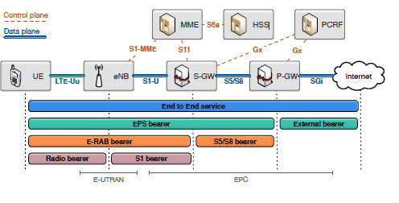
Long Term Evolution (LTE)
Fig. 1. The Evolved Packet System (EPS) network architecture.

Slide 11
Outline
I. Introduction
II. Long Term Evolution (LTE)
III. SDN And LTE Integration
a. Existing solutions in the literature
b. Proposed integration scenario
IV. QoS Mechanisms For LTE Backhaul Network
a. Traffic routing and bearer admission control mechanisms
b. GBR / Non-GBR coexistence mechanism
V. Conclusions And Future Work

Slide 12
Existing solutions in the literature
LTE architecture is complex and inflexible. The E-UTRAN provides high throughput under ideal conditions but eNBs suffer from efficient coordination on dense deployments [11].
In the mobile backhaul network, a congestion control solution is proposed by Venmani et al. [13], where the OpenFlow backhaul network can be shared among mobile operators, providing backup links in case of congestion.
Mahmoodi et al. [15] realize the SDN concept into the backhaul network through a distributed SDN control plane including the MME, HSS, and PCRF elements.

Slide 13
Jin et al. [17] introduce SoftCell,a disruptive solution that removes GTP tunnels and replaces all datapath EPC elements by simple OpenFlow switches and a set of middleboxes.
Kempf et al. [18] present a study on the evolution of cloud-based EPC, where all the control functions of EPC elements are moved into the cloud. The user plane is shifted into the OpenFlow switches, and these switches are extended to support GTP
A new OpenFlow-based control plane for EPC is presented by Said et al. [20], with the focus on resiliency and load balancing. The proposed architecture easily ensures the on-demand connectivity service even in critic situation such as network equipment failure and overload situations

Slide 14
Outline
I. Introduction
II. Long Term Evolution (LTE)
III. SDN And LTE Integration
a. Existing solutions in the literature
b. Proposed integration scenario
IV. QoS Mechanisms For LTE Backhaul Network
a. Traffic routing and bearer admission control mechanisms
b. GBR / Non-GBR coexistence mechanism
V. Conclusions And Future Work

Slide 15
Proposed integration scenario
The proposed integration scenario focuses on the use of SDN at the backhaul network, connecting eNBs to the EPC via OpenFlow switches.
The proposed scenario preserves the GTP routing, so no EPS element that handles tunnel endpoints needs to be replaced and no changes in control protocols are necessary, This allows a soft integration of new OpenFlow network elements within a legacy infrastructure.
The OpenFlow was extended with two new GTP match fields: the 2 byte GTP header flags field and the 4 byte GTP Tunnelling End ID (TEID) field.

Slide 16
This approach dismisses the de/encapsulation operations, but can only match fields at tunnel headers (the outermost IP and UDP headers). In this way, the OpenFlow protocol is used to bring relevant information from encapsulated payload to tunnel header.
The backhaul network is a ring with an arbitrary number of OpenFlow switches, The gateway element is attached to the first switch, and eNBs are connected to the other switches.
Connections are built with fast Ethernet full duplex links (100 Mbps), with an average delay estimated at 100 s, for a typical 20Km metropolitan fiber cable.

Slide 17
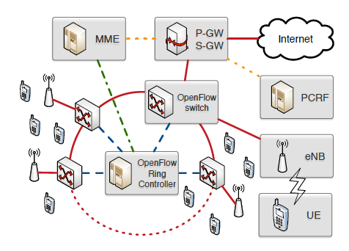
This scenario was implemented in the Network Simulator 3 (ns-3), using the new OpenFlow 1.3 module (OFSwitch13), introduced by the same authors of this paper in Chaves et al. [10].
Fig. 2. Wired backhaul network topology.

Slide 18
Outline
I. Introduction
II. Long Term Evolution (LTE)
III. SDN And LTE Integration
a. Existing solutions in the literature
b. Proposed integration scenario
IV. QoS Mechanisms For LTE Backhaul Network
a. Traffic routing and bearer admission control mechanisms
b. GBR / Non-GBR coexistence mechanism
V. Conclusions And Future Work

Slide 19
QOS MECHANISMS FOR LTE BACKHAUL NETWORKS
The QoS mechanisms proposed in this paper are implemented in the OpenFlow EPC controller, which communicates with the MME element in order to monitor for EPS bearer context Procedures
The QoS mechanisms are related to network traffic routing, bearer admission control and GBR/ Non-GBR traffic coexistence in backhaul infrastructure.

Slide 20
Traffic routing and bearer admission control mechanisms
Traffic routing:One of the advantages offered by the SDN paradigm is the possibility to exploit different routing strategies by the centralized controller.
One of the advantages offered by the SDN paradigm is the possibility to exploit different routing strategies by the centralized controller.
For the ring network, the routing options are reduced to the clockwise or counter-clockwise direction. In this way, the controller can use two different routing policies :
The Shortest Path Only
The Shortest Path First

Slide 21
Bearer admission control
The EPC controller also provides an admission control mechanism for GBR bearer activation and modification requests.
To ensure the associated QCI requirements, GBR bearers call for some bandwidth allocation in the backhaul network
The proposed mechanism monitors only for GBR bearer request. Once a bearer is blocked, the UE can optionally send the traffic over any Non- GBR bearer, with no QoS guarantees.

Slide 22
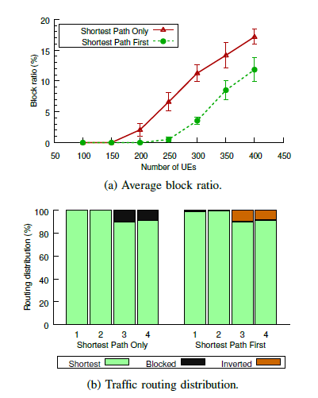
Performance evaluation
Simulations were used to investigate how the traffic routing and the bearer admission control mechanisms can work together, The backhaul ring network was configured with 5 switches (switch 0 connected to the S-GW, and one eNB attached to each remaining switch in the clockwise direction).
Thirty percent of the UEs are attached
to eNBs 1 and 2, while seventy
percent are attached to eNBs 3 and 4.
Fig. 3. Routing and bearer admission control performance evaluation.

Slide 23
Outline
I. Introduction
II. Long Term Evolution (LTE)
III. SDN And LTE Integration
a. Existing solutions in the literature
b. Proposed integration scenario
IV. QoS Mechanisms For LTE Backhaul Network
a. Traffic routing and bearer admission control mechanisms
b. GBR / Non-GBR coexistence mechanism
V. Conclusions And Future Work

Slide 24
B. GBR / Non-GBR coexistence mechanism
The available resources in the LTE backhaul infrastructure network are shared among all GBR and Non-GBR bearers and the network is supposed to allocate the requested bandwidth for GBR bearers accepted by the admission control mechanism. As the traffic management is not specified by 3GPP standards, vendors and network operators can establish policies and set up equipment accordingly.
The backhaul ring network was configured with 10 OpenFlow switches, with UEs equally distributed among 9 eNBs. The routing policy in use is the shortest path first, which exploits the selective routing

Slide 25
Coexistence mechanism: LTE is IP-based, it can leverage L3 Differentiated Services (DiffServ) [21] for providing QoS on a per-hop basis. DiffServ uses the 6-bit DiffServ Code Point (DSCP) field in the IP header for traffic management.
To enable for traffic separation and fast classification OpenFlow switches connected to the gateway or to the eNBs implement a QCI to DSCP mapping function, translating from bearer-level QoS (QCI) to transport-level QoS (DSCP). In this way, packets associated with a specific QCI are marked with a specific DSCP for forwarding in the backhaul network [9].

Slide 26
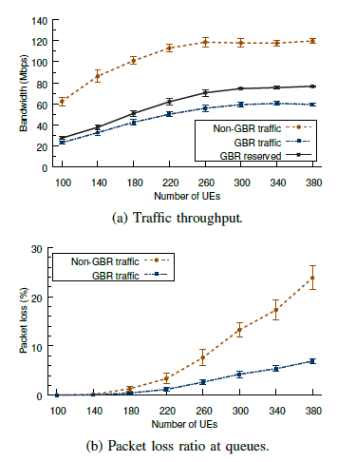
To limit traffic throughput up to the allowed bandwidth, the OpenFlow meter table is used to measure and control the rate of packets. The meter triggers a meter band if the packet rate or byte rate passing through the meter exceed a predefined threshold. Two types of meters are in use :
GBR per-flow meter
Non-GBR coexistence meter,

Slide 27
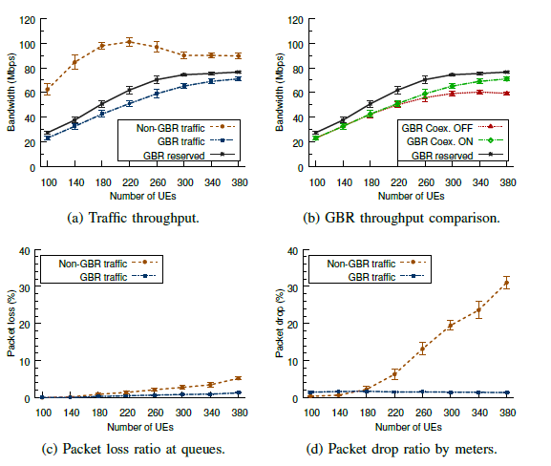
Performance evaluation
Fig. 5. GBR/ Non-GBR traffic coexistence with OpenFlow.

Slide 28
VoIP improvement
An additional improvement to the coexistence mechanism is the use of OpenFlow queue support to better treat VoIP traffic. To provide the required voice quality, QoS capability must be added to the traditional dataonly network.
In an environment of mixed real-time and bulk traffic, it is natural to use priority queuing to provide the realtime traffic priority service.
New simulations were performed, now mapping VoIP traffic to a second high-priority queue at each OpenFlow output port

Slide 29
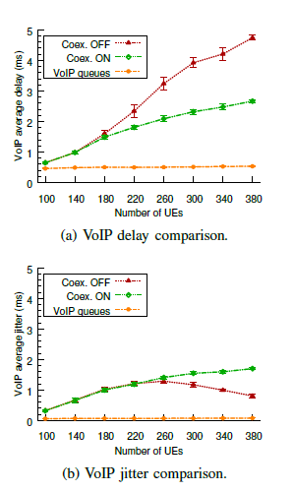
Fig. 6. VoIP traffic analysis

Slide 30
Outline
I. Introduction
II. Long Term Evolution (LTE)
III. SDN And LTE Integration
a. Existing solutions in the literature
b. Proposed integration scenario
IV. QoS Mechanisms For LTE Backhaul Network
a. Traffic routing and bearer admission control mechanisms
b. GBR / Non-GBR coexistence mechanism
V. Conclusions And Future Work

Slide 31
Conclusions
This paper explores how the OpenFlow protocol can be used to realize the LTE QoS requirements into mobile backhaul networks.
Three OpenFlow-based mechanisms were introduced:
traffic routing, bearer admission control, and the traffic
coexistence.
For the routing and bearer admission control, the number of accepted bearers was increased by 33%, while the coexistence mechanism properly limited the Non-GBR traffic and allowed a constant delay and jitter for VoIP traffic, regardless how congested the network is

