Slide 1
SDN optimized caching in LTE mobile networks
Advisor :PROFESSOR BIH-HWANG, LEE
Student :Muhammad Farid Wajdi
Date :2017/09/15
Jose Costa-Requena, Maël Kimmerlin, Jukka Manner, Raimo Kantola Communications and Networking Department AALTO University Espoo, FINLAND

Slide 2
Outline
I. Introduction
II. LTE Mobile Networks
III. SDN Mobile Data Plane
IV. SDN Optimized Content Delivery
V. Conclusion

Slide 3
Outline
I. Introduction
II. LTE Mobile Networks
III. SDN Mobile Data Plane
IV. SDN Optimized Content Delivery
V. Conclusion

Slide 4
Introduction
Major challenge of future mobile networks is providing the needed throughput for the increased traffic demand with acceptable cost.
We propose a disruptive transport based on the benefits of SDN technology.
This new transport mobile networks allows to design and deploy an optimized content delivery system based on dynamic caching.
The paper shows how we can model mobile networks using SDN concepts and migrate the 3GPP mobile architecture to SDN, thus setting the basis for 5G networks.

Slide 5
Introduction
The resulting SDN based mobile networks with the disruptive transport provides the basis of a caching system enhanced with dynamic reallocation.
The number of mobile devices has surpassed the total population of the world, and by 2017 there will be nearly 1.4 mobile devices per user.
NSN predicts [3] that from 2010 till 2020 the traffic in mobile networks will grow 1000 times.
It is natural that operators will invest last to increase the number of base stations because this has the highest cost, but at the same time unlikely to want to pay more than they are paying today for the service.

Slide 6
Introduction
We show how to structure the LTE control functions into a chain of SDN applications, so that the data plane of the mobile network can be built using standard OpenFlow [4] switches
We propose a disruptive data plane where the tunneling methods are removed.
As a result of using SDN we can remove the GTP tunnel from the current LTE networks

Slide 7
Outline
I. Introduction
II. LTE Mobile Networks
III. SDN Mobile Data Plane
IV. SDN Optimized Content Delivery
V. Conclusion

Slide 8
LTE Mobile Networks
Mobile networks consist of physical and logical layers. The physical layer is made of network switches (L2), routers (L3) and physical links with different technologies and topologies.
The physical layer (L2 and L3) provides the connectivity and transport functionality to the logical layers that implement the mobile specific control functions.
The access network consists mainly of the eNodeBs that provide the radio access to the User Equipment (UE).

Slide 9
LTE Mobile Networks
Mobility in LTE networks is implemented through different methods depending on whether the new target eNodeB is under a different Tracking Area ID (TAI) associated to a different Mobility Management Element (MME).
The common solution in mobile networks consists of using tunneling UE IP packets in GTP tunnels that are established between the eNodeB and the S/P Gateway.
A GTP tunnel uniquely identifies traffic flows that receive a common QoS treatment between a UE and a PGW
The GTP tunnel endpoint identifier (TEID) unambiguously identifies the tunnel endpoint of a user data packet, separates (identifies) the users.

Slide 10
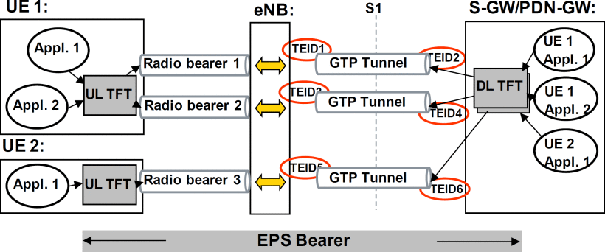
LTE Architecture
Fig.1 LTE Architecture for MTC Services

Slide 11
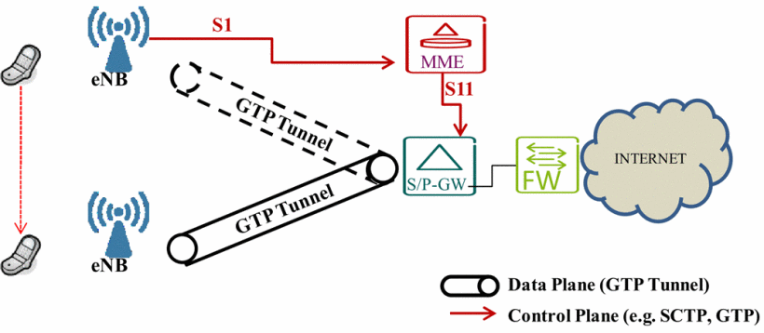
Handover process
Fig. 2. Handover process controlled from MME through S1 and
communicated to S/P-GW to recreate a GTP tunnel

Slide 12
Outline
I. Introduction
II. LTE Mobile Networks
III. SDN Mobile Data Plane
IV. SDN Optimized Content Delivery
V. Conclusion

Slide 13
SDN Mobile Data Plane
The current SDN have to enable mobile specific requirements where the data plane is optimized for high speed and flow-level processing (using OpenFlow)
The proposal is to move controller and current S/P-GW functionality in the same network element together with the MME functionality.
The current S/P-GW functionality disappears and instead a SDN based switched packet network is used.
In the proposed integration we remove GTP transport entirely and replace it with Ethernet VLANs.

Slide 14
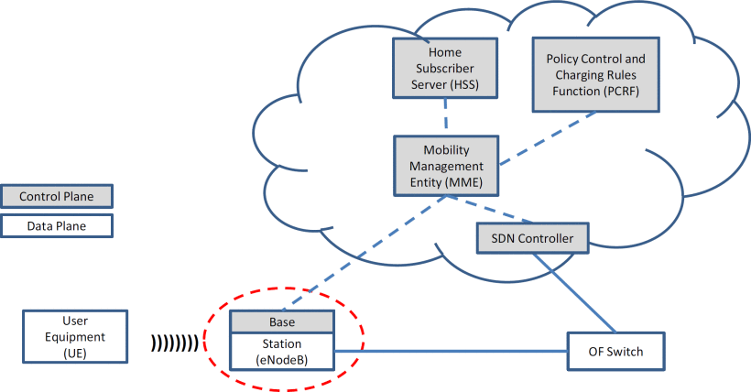
Integration LTE with MME
Fig. 3. Disruptive integration of SDN with MME.

Slide 15
SDN Mobile Data Plane
Having tight linkage between the MME and the SDN controllers allows that the time-constrained functions of mobility are handled efficiently from the SDN controller.
The OpenFlow controller adds and removes the flow entries from the flow table as soon as handover event is received from the MME. An entry in the flow table has three fields: a packet header to define the flow, an action that defines packet processing, and finally statistics.
Besides the integration of the MME and the SDN controller we propose using 802.1ad to allow double tagging in Ethernet switches.

Slide 16
SDN Mobile Data Plane
The MME maintains the current standard process and establish GTP tunnels between legacy eNodeB and S/P-GW
Simultaneously the MME can include the new SDN functionality establish communications between them new model of eNodeB and IP router directly at layer 2 without GTP tunneling.
The usage of 802.1ad in the backhaul and integration of MME with the SDN controller allows the removal of GTP.

Slide 17
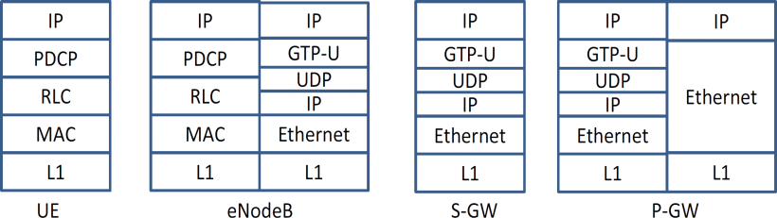
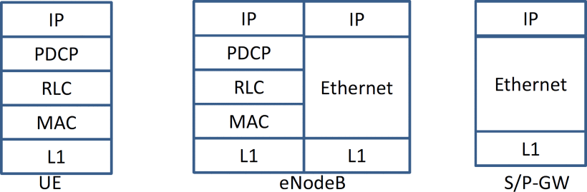
Compare layer LTE SDN
Fig. 4.a. Current LTE user plane networking stack.
Fig. 4. b. SDN based user plane networking stack.

Slide 18
Outline
I. Introduction
II. LTE Mobile Networks
III. SDN Mobile Data Plane
IV. SDN Optimized Content Delivery
V. Conclusion

Slide 19
SDN Optimized Content Delivery
CDNs leverage the power-law nature of content popularity distribution where many users request popular contents within short period of time.
Storing a copy of popular contents in caches placed at the proximity of end users reduces server load, decreases network congestion, and lowers delay.
we advocate the usage of multi-stage caches with a rather small general purpose Last Recently Used (LRU) cache collocated in every base station to absorb retransmission events high temporal locality demands and large caches spread over the different points of presence and able to aggregate traffic of a large portion of users, reducing so the traffic in the core

Slide 20
SDN Optimized Content Delivery
The usage of SDN with the proposed integration facilitates the dynamic relocation of the cache based on the number of users.
We deployed pilot to demonstrate the effect on the network when moving the cache.
We use HTTP live streaming for video file and the tests have been performed with the architecture presented in Fig 6.

Slide 21
Architecture of the testbed
Fig. 5. Architecture of the testbed

Slide 22
SDN Optimized Content Delivery
The usage of SDN with the proposed integration facilitates the dynamic relocation of the cache based on the number of users.
we simulated a user streaming a video by an http download of the segments with a bandwidth limitation to 2Mb/s, and multiplying the bandwidth limitation by the number of users simulated

Slide 23
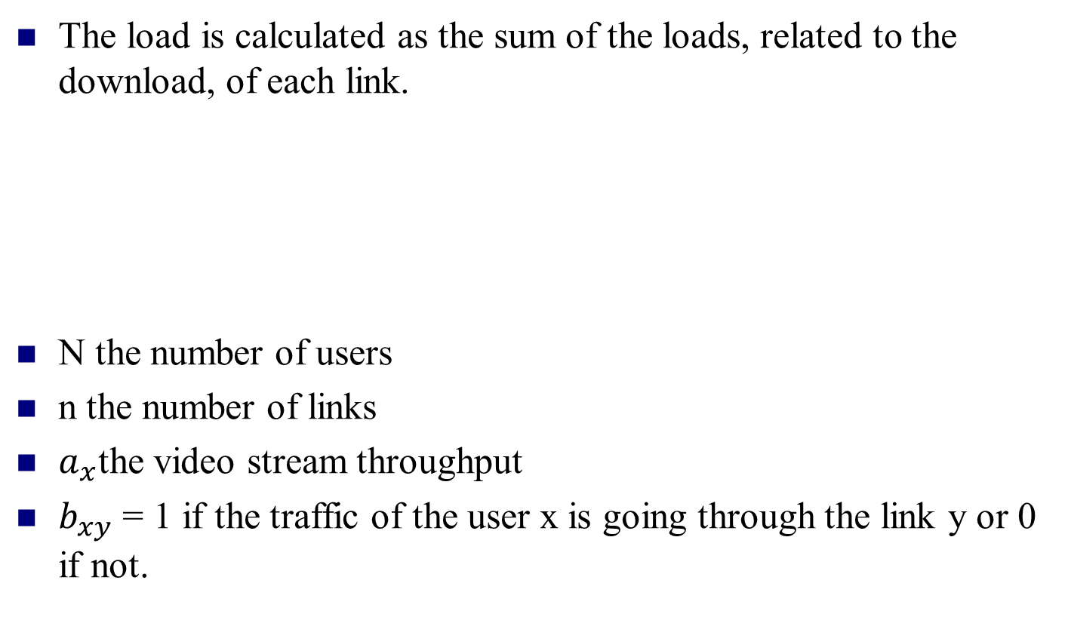
SDN Optimized Content Delivery
The load is calculated as the sum of the loads, related to the download, of each link.
N the number of users
n the number of links
$a_{x}$the video stream throughput
$b_{xy}$ = 1 if the traffic of the user x is going through the link y or 0 if not.

Slide 24
Load for different type of caching
Fig. 6. Load for different type of caching

Slide 25
Network load depending on the video throughput
Fig. 8. Network load depending on the video throughput

Slide 26
Outline
I. Introduction
II. LTE Mobile Networks
III. SDN Mobile Data Plane
IV. SDN Optimized Content Delivery
V. Conclusion

Slide 27
Conclusions
The usage of SDN will bring down the costs of acquiring and maintaining standard switches.
One of the important benefits of the proposed SDN integration and data plane without mobile tunneling is to allow dynamic relocation of the cache.
The results shown might be applicable to any caching but the usage of SDN to remove the GTP allows that caching can be performed besides any switch of the network

