Slide 1
Enabling Transparent Caching in LTE Mobile Backhaul Networks with SDN
Advisor :PROFESSOR BIH-HWANG, LEE
Student :Muhammad Farid Wajdi
Date :2017/10/14
2016 IEEE Conference on Computer Communications Workshops (INFOCOM WKSHPS): SWFAN 16: International Workshop on Software-Driven Flexible and Agile Networking

Slide 2
Outline
I. Introduction
II. Background
a. Mobile Backhaul Architecture
b. MPEG DASH Streaming
III. Transparent Caching in The Mobile Backhaul
a. Design and Function Placement
b. Switch-based transparent caching for LTE
IV. Prototyping and experimental evaluation
a. Prototype Implementation
b. Experiment Methodology
c. Throughput Performance
V. Conclusion

Slide 3
Outline
I. Introduction
II. Background
a. Mobile Backhaul Architecture
b. MPEG DASH Streaming
III. Transparent Caching in The Mobile Backhaul
a. Design and Function Placement
b. Switch-based transparent caching for LTE
IV. Prototyping and experimental evaluation
a. Prototype Implementation
b. Experiment Methodology
c. Throughput Performance
V. Conclusion

Slide 4
Introduction
In the last decade Internet traffic significantly increased owing to the penetration of broadband access.
The increase is mainly driven by the rapid innovation and diffusion of mobile terminals and video related services and it is predicted that by 2020 more than 60% of Internet traffic will be originated by mobile terminals.
The current mobile network architecture is an IP packet switched network built around 3GPP specifications that define the Evolved Packet System (EPS) architecture.
Although this architecture has been able to drive the ongoing mobile revolution, it lacks the flexibility needed to dynamically control the constantly increasing amount of mobile traffic.

Slide 5
Introduction
Indeed, GTP tunnels impose that packets traverse the whole mobile infrastructure, and transform the mobile backhaul into a passive network segment in which traffic cannot be dynamically managed.
Forced by the limited flexibility of the current infrastructure, to meet bandwidth and latency requirements despite the increasing amount of traffic in their networks, mobile network operators have been constantly increasing their network capacity.
To alleviate this problem, motivated by cache-ability studies [2], [3], [4], edge caching solutions have been explored recently [5], [6], and commercial edge caching products have become available.

Slide 6
Introduction
These solutions are, however, limited to the network edge, and since they do not allow to bypass GTP tunnels, they miss the potential benefits of in-network caching and dynamic traffic management.
While Software Defined Networking (SDN) is considered as an enabler for the emerging 5G mobile backhaul architecture, co-existence with EPS requires that an SDN-based backhaul would have to support dynamic traffic management for the existing architecture, without additional middleboxes.
In this paper we propose a solution to enhance the mobile backhaul’s flexibility based on SDN technology, compliant with the current architecture.
In particular we propose a user-space extension to OpenFlow switches inside the mobile backhaul and show the benefits of network devices’ programmability by designing and prototyping a transparent cache service.

Slide 7
Introduction
The proposed in-network caching system can be deployed on top of OpenFlow switches in order to reduce the excessive load observed in the mobile backhaul network and can be offered by the mobile network operators to Content Providers.
The main contributions of the paper are
(i) design space analysis for the introduction of SDN inside the current mobile backhaul architecture through the in-network caching use case;
(ii) design of a solution for transparent caching of MPEG DASH multimedia content;
(iii) prototype of SDN-enabled in network caching solution compatible with current standards and protocols;
(iv) feasibility analysis of the proposed solution

Slide 8
Outline
I. Introduction
II. Background
a. Mobile Backhaul Architecture
b. MPEG DASH Streaming
III. Transparent Caching in The Mobile Backhaul
a. Design and Function Placement
b. Switch-based transparent caching for LTE
IV. Prototyping and experimental evaluation
a. Prototype Implementation
b. Experiment Methodology
c. Throughput Performance
V. Conclusion

Slide 9
Mobile Backhaul Architecture
The backhaul is the part of the mobile network that ties the core, which connects to the Internet, to the antennas that provide wireless access to mobile devices.
Over the years mobile backhaul evolved from a plesiosynchronous digital hierarchy (PDH) and ATM transport to an Ethernet based transport network, in which data are transmitted over IP.
The MME is the key element of the mobile backhaul’s control plane and is responsible for multiple control operations such as UEs’ mapping, authentication, authorization, etc. Finally, the PGW is the termination point of the mobile backhaul, and connects the network to the Internet.

Slide 10
MPEG DASH Streaming
MPEG Dynamic Adaptive Streaming over HTTP (DASH) [9] is a popular video-on-demand protocol adopted in 3GPP for video streaming over mobile networks.
The DASH client retrieves stream’s metadata by downloading from the Media Presentation Description (MPD) file, which specifies segment information including timing, duration, available bitrates and resolutions, and the URL.
DASH naturally lends itself to caching due to relying on HTTP, GTP tunneling in the mobile backhaul makes it challenging to implement efficient dynamic caching.

Slide 11
Outline
I. Introduction
II. Background
a. Mobile Backhaul Architecture
b. MPEG DASH Streaming
III. Transparent Caching in The Mobile Backhaul
a. Design and Function Placement
b. Switch-based transparent caching for LTE
IV. Prototyping and experimental evaluation
a. Prototype Implementation
b. Experiment Methodology
c. Throughput Performance
V. Conclusion

Slide 12
TRANSPARENT CACHING IN THE MOBILE BACKHAUL
The introduction of SDN switches would provide mobile network operators a more flexible architecture allowing them to sustain the increasing amount of traffic while reducing infrastructure’s maintenance costs, as well as giving them a way to increase their revenue by introducing novel in-network services.
To investigate the feasibility of SDN introduction in the current mobile backhaul architecture, in this section we explore the use case of transparent in-network caching for MPEG DASH video content.

Slide 13
TRANSPARENT CACHING IN THE MOBILE BACKHAUL
To enable DASH content’s transparent caching the proposed architecture needs to:
Intercept an HTTP GET request in a TCP segment transmitted in a GTP tunnel.
Decide if the request cacheable content.
Decide if the requested segment is cached and, if yes
remove the request from the GTP tunnel and the TCP connection, redirect it to the appropriate cache, and then
insert the data received from the cache into the GTP tunnel and TCP connection so that caching remains transparent to the UE
Finally, for charging purpose, caching architecture should offer a way for tracking requests satisfied by local caches

Slide 14
TRANSPARENT CACHING IN THE MOBILE BACKHAUL
Function (i) Requires stateless DPI, and since all UE traffic traverses the backhaul in a GTP tunnel, it has to be performed by SDN switches, as otherwise all packets would have to be transmitted to the controller.
To decide whether the request is for cacheable content, function (ii) matches the destination socket of the request (extracted from the GTP tunnel) against a list of known content server sockets, maintained in the Content Server Directory (CSD).
To support function (iii) we maintain a Content Location Directory (CLD), which holds content placement information i.e., the address(es) of the cache(s) serving the segment, and a reference to the DASH MPD file
To support functions (iv) and (v) we designed a splicing network function that transparently extracts and reinserts segments into a TCP connection, and packets into the GTP tunnel.

Slide 15
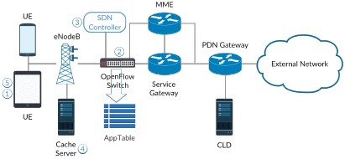
TRANSPARENT CACHING IN THE MOBILE BACKHAUL
Finally function (vi) requires that operations (iv) and (v) are registered by the centralized controller in order to keep pricing consistent when traffic flows are served from the in-network caches.

Slide 16
Design and Function Placement
Controller-based: SDN switches use a stateless DPI engine to perform function (i) and redirect the identified requests to the central SDN controller.
Functions (ii)-(vi) are then performed in the controller. Since splicing (function (iv) and (v)) is located in the controller, video segments are delivered from the caches via the controller to the switch and charging (function (vi)) is centralized at the controller.
Switch-Controller Hybrid: SDN switches use a stateless DPI engine to perform functions (i) and (ii). If the requested content is cacheable, the packet is redirected to a controller, where functions (iii)-(vi) are performed.

Slide 17
Design and Function Placement
Switch-based: SDN switches perform functions (i)-(v) by using stateful L5-L7 packet inspection, similar to [12]. Function (vi) is then performed locally at the switch that regularly provide statistics on charging to the controller, With this solution, the SDN switch still exchange messages with the Controller (using the CLD to find the best cache to serve the request, in the case of a centralized CLD).
While currently available SDN switches do not have the required features for the implementation of the switch-based design, various switches will include DPI and stateful connection tracking (e.g., Open vSwitch [10]) in the near future.

Slide 18
Switch-based transparent caching for LTE
The proposed solution for SDN enabled transparent caching in the mobile backhaul relies on a local AppTable in the user space of the SDN switch, similarly to [12]. In this solution, the SDN switch has rules with ’goto AppTable’ actions instead of ’fwd to controller’.
If functions (i), (ii) identify a request for cacheable content, the request is redirected to the AppTable .AppTable entries provide the location of the best cache if the same content segment has been previously requested.
Otherwise, the request is forwarded to the CLD (located in the switch or in the controller). If the segment is cached, the CLD returns the location of the best cache (and other information,as described later), and the request is served in the switch’s AppTable scope using functions (iv) and (v).

Slide 19
Switch-based transparent caching for LTE
The AppTable is an Openflow table in which matching can be performed on L5-L7. AppTable entries are of the form.
<IPaddress ><port ><segmentpath> <action>
where IPaddress and port are web server’s IP address and port number. The segmentpath field is a string of the format “GET path/to/cachedvideosegment”, and action is the address of the cache where the video segment is cached.

Slide 20
Switch-based transparent caching for LTE
GTP and TCP splicing: Functions (iv) and (v), i.e., the removal and insertion of packets into the GTP tunnel and the TCP connection, are based on splicing.
TCP splicing is a technique for enhancing L7 proxy performance, which allows the proxy to forward TCP segments received from one endpoint to the other, avoiding application layer segment processing [13].
Unlike a regular proxy, we do not splice all TCP connections traversing the switch, but only connections that are requesting content cached by local caches.
If a request for cached content is identified in an established TCP connection, the segment containing the request to the local cache is redirected through splicing. The response sent by the cache is then spliced into the connection between the client and the server.

Slide 21
Outline
I. Introduction
II. Background
a. Mobile Backhaul Architecture
b. MPEG DASH Streaming
III. Transparent Caching in The Mobile Backhaul
a. Design and Function Placement
b. Switch-based transparent caching for LTE
IV. Prototyping and experimental evaluation
a. Prototype Implementation
b. Experiment Methodology
c. Throughput Performance
V. Conclusion

Slide 22
PROTOTYPING AND EXPERIMENTAL EVALUATION
In this section we present a prototype-based evaluation of the transparent SDN-based in-network caching solution.
In order to evaluate the feasibility of the proposed architecture we implemented a proof-of-concept prototype.
Due to the lack of DPI support in OpenFlow, we choose to implement the solution based on a centralized controller

Slide 23
Prototype Implementation
Prototype implementation is based on Open vSwitch v2.0.2 [15], and Floodlight v1.1 1 running on Ubuntu 14.04. The prototype consists in a Floodlight controller’s module we identify as the Transparent Caching (TC) module.
TCP Splicing: To implement TCP splicing, upon identifying a request for cached content, we buffer the segment corresponding to the GET method, and we initiate an active open from the module to the local cache by sending a SYN segment. Once the local cache acknowledges the segment of the GET method with a TCP ACK, the state of the connection is set to Connected and data start to be spliced.
If either the DASH client or the local cache sends a FIN segment then the state of the connection is changed to Sync, Disconnecting and Disconnected after FIN-ACK and ACK messages are sent, or if the connection is inactive for a 2 minutes Maximum Segment Lifetime. When a connection is considered as Disconnected the module removes it from the list of spliced connections.

Slide 24
Prototype Implementation
GTP support: In order to enable GTP in Floodlight we developed two subclasses of the BasePacket class found in net.floodlightcontroller.packet, one for GTP-C (GTP Control plane, used for signaling) and the other for GTP-U (GTP User plane, used to transport data packets) packets, packets. The implemented subclasses allow us to handle GTP packets in the developed module.

Slide 25
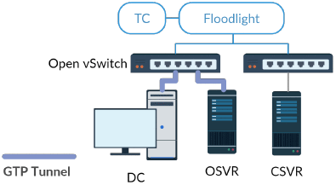
Experiment Methodology
A GTPv1 tunnel is established between a DASH Client (DC) and the Origin server (OSVR), traversing an OVS switch. The GTP tunnel is created using the ggsn and the sgsnemu tools in OpenGGSN2

Slide 26
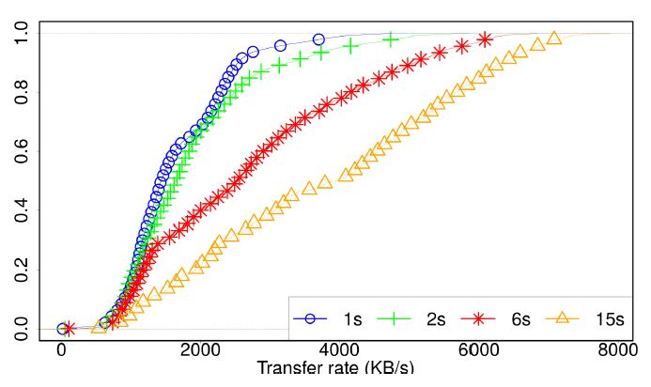
Throughput Performance
In the first set of experiments we consider a single DC that downloads DASH segments to evaluate the impact of the TC module on the achievable download rate.
We used DASH video segments of lengths between 1s and 15s worth of video content and bitrates between 150 and 8000kbps
(a) Box plot of bitrates for 15s length video segments.
(b) CDF of bitrate for 1s-15s segments for GTP+TC scenario.

Slide 27
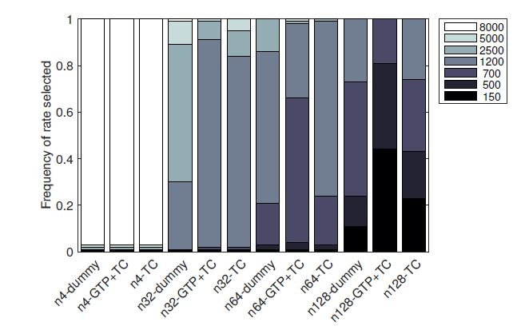
DASH Streaming Performance
In the second set of experiments we consider multiple DCs simultaneously streaming DASH content to evaluate the impact of the TC module on the achieved streaming rate, and the impact of the module on the rate selection algorithm of the DC.

Slide 28
Outline
I. Introduction
II. Background
a. Mobile Backhaul Architecture
b. MPEG DASH Streaming
III. Transparent Caching in The Mobile Backhaul
a. Design and Function Placement
b. Switch-based transparent caching for LTE
IV. Prototyping and experimental evaluation
a. Prototype Implementation
b. Experiment Methodology
c. Throughput Performance
V. Conclusion

Slide 29
Conclusions
In this paper we investigated the feasibility of introducing SDN in the current mobile backhaul archiatecture through the use-case of transparent in-network caching.
We analyzed the design space for the introduction of SDN in the mobile backhaul for in-network caching, and proposed a scalable solution compatible with the existing backhaul architecture.
We made a controller-based prototype implementation of the proposed solution that demonstrates that the overhead of the network functions needed in order to enable in-network caching in the mobile backhaul through SDN switches (and controllers) is negligible.
Furthermore, our results show that the proposed solution has a minor impact on the streaming clients’ behaviour.

