Slide 1
A Comparison of SDN and NFV for Re-designing the LTE Packet Core
Advisor :PROFESSOR BIH-HWANG, LEE
Student :Muhammad Farid Wajdi
Date :2017/11/04
Aman Jain, Sadagopan N S, Sunny Kumar Lohani, Mythili Vutukuru
Department of Computer Science and Engineering, Indian Institute of Technology, Bombay
2016 IEEE Conference on Network Function Virtualization and Software Defined Networks (NFV-SDN)

Slide 2
Outline
I. Introduction
II. Related Work
III. Background: LTE EPC Procedure
IV. SDN-based EPC
V. NFV-based EPC
VI. Evaluation
VII. Conclusion

Slide 3
Outline
I. Introduction
II. Related Work
III. Background: LTE EPC Procedure
IV. SDN-based EPC
V. NFV-based EPC
VI. Evaluation
VII. Conclusion

Slide 4
Introduction
Mobile cellular networks have witnessed an abrupt increase in the volume of data traffic due to growing user demands and an almost pervasive presence of modern gadgets such as smart phones and tablets.
Current telecom network architectures are expected to face difficulties scaling to this load, causing mobile operators to look for new alternatives to overcome this challenge
Let us consider the particular case of the popular mobile packet core architecture in use today, the 4G/LTE EPC.

Slide 5
Introduction
The well-known problems with the traditional EPC architecture are :
Cost
Flexibility
Scalability
Signaling overheads
There is an immediate need to re-design the LTE packet core network to make it more scalable, flexible, and cost effective in the coming years.

Slide 6
Introduction
Several new architectures for the LTE EPC have been proposed recently (the emerging trends of Software Defined Networking (SDN) and Network Functions Virtualization (NFV).
SDN is a new paradigm which decouples the network control functions (control plane) and the forwarding functions (data plane), enabling network administrators to program the network in a dynamic and flexible manner.
The control plane is built in software as applications running on top of a controller, whereas general purpose switches constitute the data plane.

Slide 7
Introduction
NFV is another network architecture concept that has gathered significant interest recently.
NFV proposes that network functions (e.g., functionality of components such as MME,SGW, PGW) should migrate from custom hardware equipment to virtualized software appliances.
NFV greatly reduces the cost and complexity of implementing network functions, by having network functions run on clusters of virtual machines (VMs) hosted on commodity high-end servers.

Slide 8
Outline
I. Introduction
II. Related Work
III. Background: LTE EPC Procedure
IV. SDN-based EPC
V. NFV-based EPC
VI. Evaluation
VII. Conclusion

Slide 9
Related Work
There have been several recent proposals to redesign various components of mobile data networks using principles of SDN and NFV. Proposals that deal with the LTE EPC form a bulk of the work, given the significance of the packet core to the operation of mobile data networks.
Basta et al. [7], [8] have proposed the use of SDN and NFV to redesign LTE EPC. Their work has discussed several tradeoffs between various futuristic EPC architectures.
Several other researchers [9], [10], [11], [12 propose using the idea of SDN in different ways to redesign various components (or replace the entire architecture) of the EPC.

Slide 10
Related Work
NFV-based EPC implementations have also seen significant interest from academia and industry.
Authors in [13] evaluate a commercial NFV-based EPC, and demonstrate that its performance can match that of a hardware-based appliance.
In [15], the central MME core node is distributed into multiple replicas and pushed closer to the access edge, resulting in reduced latency and better handover performance.

Slide 11
Outline
I. Introduction
II. Related Work
III. Background: LTE EPC Procedure
IV. SDN-based EPC
V. NFV-based EPC
VI. Evaluation
VII. Conclusion

Slide 12
LTE EPC Procedure
LTE network is composed of two parts: a Radio Access Network (RAN) and an Evolved Packet Core (EPC).
UE attach : A UE that wishes to connect to an LTE network sends an attach request to the MME via its eNodeB.
MME proceeds to implement the various authentication and security setup procedures.
Uplink/downlink UE data transfer : Once a UE attaches and establishes a tunnel through the EPC, it can send/receive data to/from the PDN via eNodeB and EPC.

Slide 13
LTE EPC Procedure
UE initiated detach: When a UE wishes to disconnect from the mobile cellular network, it initiates a detach procedure. All state associated with the UE, including its bearer, is cleared from all the EPC components. The MME sends a detach accept response to the UE via eNodeB.

Slide 14
Outline
I. Introduction
II. Related Work
III. Background: LTE EPC Procedure
IV. SDN-based EPC
V. NFV-based EPC
VI. Evaluation
VII. Conclusion

Slide 15
SDN-BASED EPC
SDN a separation of control and data planes for the EPC Gateways SGW and PGW.
The MME is only a control plane entity. So the MME, SGW-C and PGW-C run as applications on top of an SDN controller.
The SGW-D and PGW-D are realized as SDN (OpenFlow) switches which forward packets based on the forwarding rules installed by the controller.
The eNodeB has an SDN switch apart from the radio components, which contains the forwarding rules installed by the controller to divert traffic to the EPC switches.

Slide 16
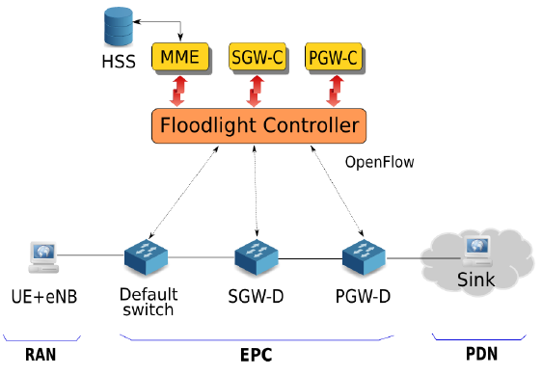
SDN-BASED EPC
Fig. 1: SDN-based LTE EPC implementation

Slide 17
Outline
I. Introduction
II. Related Work
III. Background: LTE EPC Procedure
IV. SDN-based EPC
V. NFV-based EPC
VI. Evaluation
VII. Conclusion

Slide 18
NFV-BASED EPC
The core network functions of the EPC (MME, HSS, SGW and PGW) are built as software modules, and are run on VMs hosted on a private cloud.
This simulation also built a RAN-simulator module that combines the functionalities of the UE and eNodeB into a single logical entity for the purpose of generating traffic to our EPC.
We use tun devices to perform GTP encapsulations and decapsulations of TCP traffic at the source and sink.

Slide 19
NFV-BASED EPC
Each of the EPC components (MME, SGW, PGW, HSS) is implemented as a multi-threaded server that services requests (e.g., UE attach request) from the downstream nodes and sends responses back.
The MME application module uses a multi-threaded SCTP server to handle requests from the downstream eNodeB.
The EPC gateways are built around a multi-threaded UDP server, because the protocol stack of the gateways uses UDP to communicate with the other components.

Slide 20
NFV-BASED EPC
Multi-threaded SCTP Server Architecture : The SCTP server architecture consists of a single master thread and several worker threads. The master thread communicates with each of the worker threads via a logical Unix pipe The master thread listens for incoming client connections on a stream socket and creates an additional socket file descriptor for every new SCTP client that is accepted.
Multi-threaded UDP Server Architecture :The UDP server at the gateways consists of a single datagram socket being serviced by multiple server threads, All server threads try to read a UDP packet from the common shared socket The thread that succeeds in reading the packet is responsible for processing the request and sending a response back to the downstream node.

Slide 21
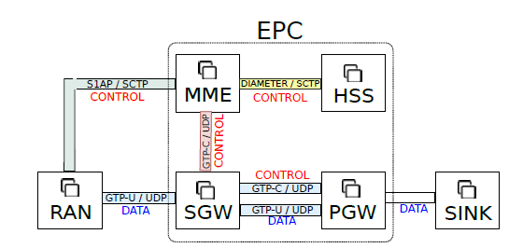
NFV-BASED EPC
Fig. 2: NFV-based LTE EPC implementation.

Slide 22
Outline
I. Introduction
II. Related Work
III. Background: LTE EPC Procedure
IV. SDN-based EPC
V. NFV-based EPC
VI. Evaluation
VII. Conclusion

Slide 23
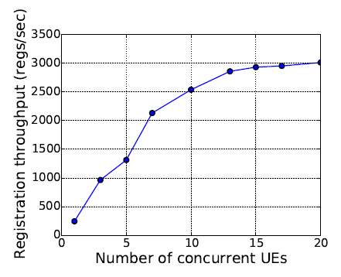
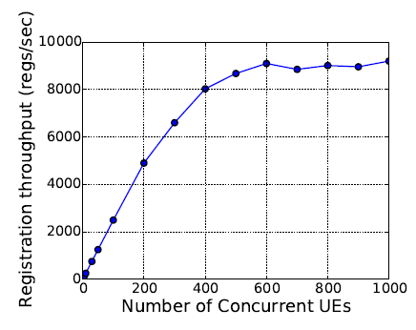
Evaluation
Control plane performance
Fig. 3: SDN EPC: Registration throughput vs. no. UEs.
Fig. 4: NFV EPC: Registration throughput vs. no. UEs.

Slide 24
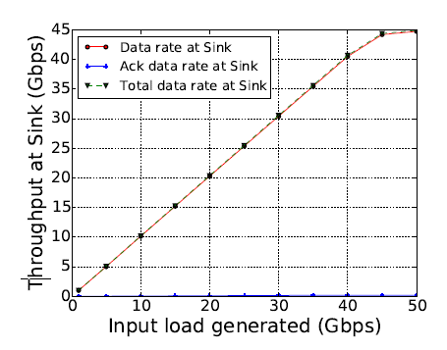
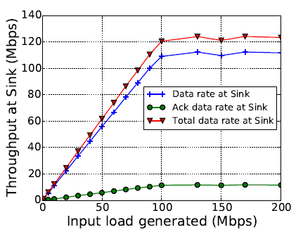
Evaluation
Data plane performance
Fig. 5: SDN EPC: Data plane throughput vs. input load.
Fig. 6: NFV EPC: Data plane throughput vs. input load.

Slide 25
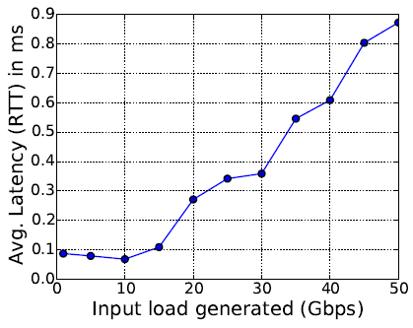
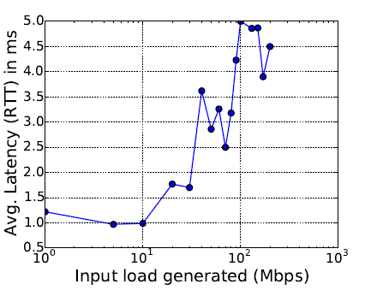
Data plane performance
Data plane performance
Fig. 7: SDN EPC: Data plane latency.
Fig. 8: NFV EPC: Data plane latency.

Slide 26
Outline
I. Introduction
II. Related Work
III. Background: LTE EPC Procedure
IV. SDN-based EPC
V. NFV-based EPC
VI. Evaluation
VII. Conclusion

Slide 27
Conclusions
We presented two implementations of the LTE EPC, one based on the principles of SDN, and the other based on the idea of NFV.
Our results show that an SDN-based EPC is a better design choice when handling large amounts of data traffic, since it incurs lesser overhead when forwarding packets from the kernel or the switching hardware, as compared to an NFV setup that makes forwarding decisions in user space.
Other hand, an NFV-based EPC setup is better at handling large signaling load, because communicating every signaling message with the controller and processing the resulting rule updates quickly overwhelms the SDN switches.

