Slide 1
Leveraging LTE Security with SDN and NFV
Advisor :PROFESSOR BIH-HWANG, LEE
Student :Muhammad Farid Wajdi
Date :2017/11/25
2015 IEEE 10th International Conference on Industrial and Information Systems, ICIIS 2015, Dec. 18-20,2015, Sri Lanka

Slide 2
Outline
I. INTRODUCTION
II. BACKGROUND
a. Long Term Evolution (LTE) Architecture
b. Software-Defined Networks (SDN)
c. Network Function Virtualization (NFV)
III. LTE SECURITY ARCHITECTURE
a. LTE Security Principles and Architecture
b. LTE Security Architecture
c. Limitations on LTE Security Architecture
IV. SDN BASED SECURITY ARCHITECTURE FOR LTE
a. Expected Benefits of SDN based Security Architecture
b. Current Limitation of SDN based Security Architecture
V. NUMERICAL RESULTS
VI CONCLUSION
V.

Slide 3
Introduction
The introduction of IP based LTE architecture has significantly changed the behavior of telecommunication.
IP based LTE networks not only provide high bandwidth, simplified network control but also support a wide range of heterogeneous network services.
However, legacy LTE security mechanisms are isolated, uncoordinated, complex and rigid to meet the security requirement of future mobile network services.

Slide 4
Introduction
The Future LTE networks need an inclusive and intrinsic security model across the entire mobile network. Enhanced visibility, real time threat detections, centralized intelligence and network wide control are required features to design a scalable, dynamic and optimized security mechanism for future LTE networks.
SDN and NFV concepts are the promising technologies which offer capabilities to solve the limitations in legacy LTE security mechanisms. SDN and NFV offer the required improvements in visibility, flexibility, scalability and coordination to design high performing security mechanisms for LTE networks.

Slide 5
Introduction
This paper proposes a new security architecture for LTE networks based on SDN and NFV concepts. It also highlights how SDN and NFV features can be used to overcome the limitations in present-day LTE security mechanisms, Moreover, we analyze the performance of SDN based security architecture with the existing LTE security mechanisms in a simulation environment.

Slide 6
Long Term Evolution (LTE) Architecture
The LTE architecture was standardized as a part of 4G (4th Generation) networks. LTE proposes an all-IP network architecture called EPS (Evolved Packet System). It can be divided in to two systems: E-UTRA (Evolved Universal Terrestrial Radio Access) and EPC (Evolved Packet Core) [2].
E-UTRAN is the radio access network of the LTE transport network. It contains eNodeBs (evolved NodeBs) and interconnections (X2 interface) between them.
EPC is the core network segment of the LTE transport network. It contains network control elements such as Mobilit Management Entity (MME), Home Subscriber Server (HSS), Serving Gateway (S-GW), Packet Data Network Gateway (P-GW), and Policy and Charging Rules Function (PCRF).

Slide 7
Long Term Evolution (LTE) Architecture
Recent research work is highly focused on 5G (5th Generation) networks by developing new network architectures. However, it is expected that 4G LTE will still be utilized during the next few decades.
It is equally important to improve the performance and security of existing LTE networks in order to address the demands of future traffic needs.

Slide 8
Software-Defined Networks (SDN)
Software-Defined Networking (SDN) is considered as the new norm for future networks [6], [7].
SDN proposes to decouple the control and data planes of the network. It places the control functions outside of the switches and enables external control through a logical software entity called the network controller.
SDN based networks support simple abstractions to describe the underlining devices, the functions and features they support, and a network protocol to manage the forwarding plane from a remote controller via a secure control channel.

Slide 9
Software-Defined Networks (SDN)
The value of SDN in mobile networks lies specifically in its ability to provide new capabilities like centralized control, abstraction, network virtualization, common device standards and automation [6]-[9]. These features are useful for designing scalable, dynamic and optimized security mechanisms.

Slide 10
Network Function Virtualization (NFV)
Traditionally, network operators have always used dedicated and specially designed black box type network equipment to construct their networks, this approach inevitably leads to high time-to-market and costs (CapEx).
It also requires a dedicated staff (OpEx) to deploy and run the networks. NFV technology aims to build an end-to-end infrastructure that enables the consolidation of many heterogeneous network devices by moving network functions from dedicated hardware onto general purpose computing/storage platforms such as servers.

Slide 11
Network Function Virtualization (NFV)
The main idea behind NFV is to virtualize a set of network functions by deploying them as software packages in a cloud environment.
In such systems, network functions are implemented independent of the physical resources and are deployed in virtualized environments, such as mobile clouds, so that a given service is available to many devices on a demand basis. SDN is the key enabler of NFV.

Slide 12
LTE Security Principles and Architecture
It provides IP based end-to-end communication from eNodeBs in Radio Access Network (RAN) to core network elements in EPC, While this flat architecture has simplified the operation of mobile network, it has increased the overall risk of vulnerabilities and threats.
The challenge is to design a complete and effective security defense framework which can provide fault isolation as well as protect the interworking of legacy and non-3GPP networks.
The 3rd Generation Partnership Project (3GPP) has defined an LTE security architecture that covers security features.

Slide 13
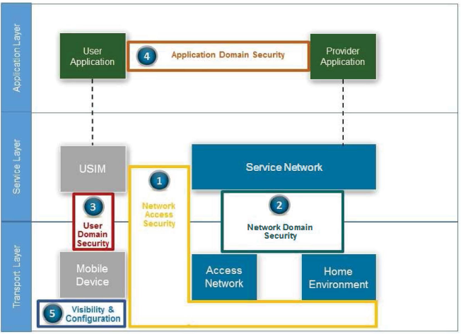
LTE Security Principles and Architecture
Fig. 1: 3GPP Security Architecture [12]

Slide 14
LTE Security Architecture
LTE security architecture contains different security mechanisms at different levels. First of all, E-UTRA reuses the security mechanisms which were used in 2G/3G network. For instance, LTE uses USIM cards in User Equipment (UE) and RNL (Radio Network Layer) encryption for radio links
LTE introduces new security mechanisms, such as: key derivation mechanism during mobility (KASME), protection of radio interfaces (PDCP frames, user session ciphering, RRC radio signaling integrity control and ciphering).
LTE introduces a new interface called X2 to exchange the user and signalling data at EUTRA. GTP (GPRS Tunnelling Protocol) and IPsec tunnels are used to protect X2 interface.

Slide 15
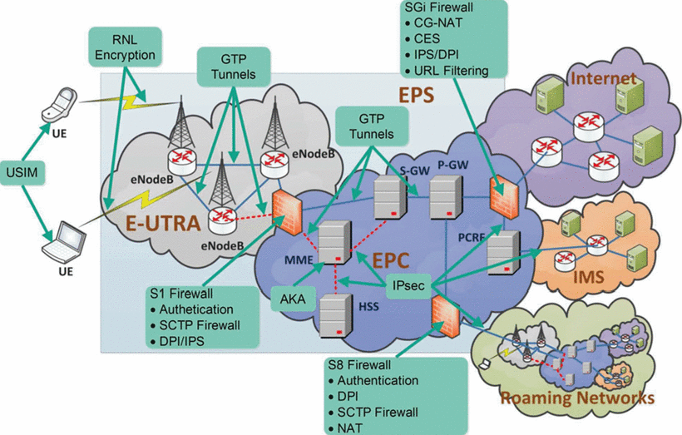
LTE Security Architecture
Fig. 2: LTE Security Architecture

Slide 16
Limitations on LTE Security Architecture
Open Mobile Networks: LTE and new mobile architecture were designed to be more flexible and supportive to outside networks such as partner roaming networks, IMS and the Internet. All voice and data services are now served over the IP protocol, This openness has offered agility. However, it has exposed the network to new threat vectors such as IP spoofing, network worms and DDoS attacks.
PIN (Place In Network) Based Security Model: Most of the security controls in today's LTE security architecture are point based implementations. For instance, NAT (Network Address Translation), DPI (Deep Packet Inspection), IDS. CES (Customer Edge Switching), firewalls are applied only at the Internet, mobile access and roaming borders [I] [2]

Slide 17
Limitations on LTE Security Architecture
Isolated Security Model: A diverse set of noncoordinating security mechanisms are deployed in different sections of the mobile network [I] [4]. Security is deployed in a fragmented manner which eventually presents a complex and uncoordinated picture of the overall security and health of the LTE network. These security mechanisms take autonomous decisions and may apply redundant or contracting security features.
Lack of interoperability: Most of the LTE security systems are vendor proprietary and designed to service a specific function. As a result, such systems are closed in nature and it is difficult to obtain a "mixed and matched" use of different security solutions [8].

Slide 18
Limitations on LTE Security Architecture
Over-provisioned security resources: Today's LTE security mechanisms are always designed to handle busy hour traffic. They prevent the service disruptions by overpopulating the resources for security mechanisms. Therefore, most of the security resources are underutilized for long periods of time
No protection against backhual devices compromised and impersonated attacks : LTE networks uses small cell based stations such as mobile femto cells which are deployed in customer premises. These small base stations are not physically secured in the same way as a conventional base station.

Slide 19
SDN BASED SECURITY ARCHITECTURE FOR LTE
SDN/NFV based security architecture is proposed following key modifications to existing LTE architecture.
1) The backhaul and access network switches and routers are replaced with SDN switches;
2) Security controlling functions are implemented at the application plane as software applications;
3) Security middle boxes are softwarificated and virtualized;
4) Logically centralized controller is used to control security mechanisms in the network

Slide 20
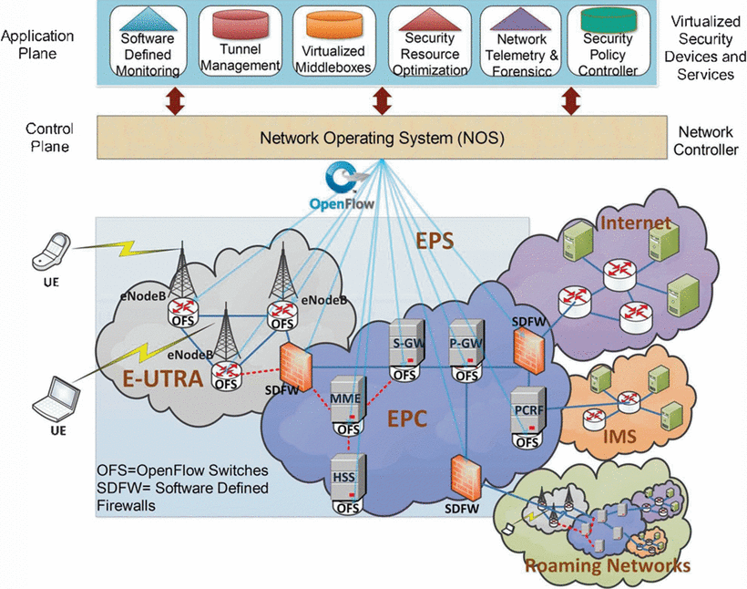
SDN BASED SECURITY ARCHITECTURE FOR LTE
Fig. 3: The SDN based Security Architecture for LTE

Slide 21
Expected Benefits of SDN based Security Architecture
Simplified and Automated Security Management : One of the main advantages of SDN is that it simplifies security management. Moreover, programmability allows fast and easy implementation and deployment of the new security mechanisms at both hardware and software levels.
Dynamic Attack Mitigation: Reaction to vulnerabilities and attacks is also improved by giving the ability to quickly assess the network from a centralized viewpoint. Furthermore, it is possible to apply dynamic changes and automate mitigation actions rapidly.

Slide 22
Expected Benefits of SDN based Security Architecture
Efficient Segmentation:SDN supports efficient segmentation which ensures that critical assets (e.g. Home Subscriber Server HSS DB) are accessible during a security breach or network attack.
Network Telemetry : SDN improves the network intelligence by enabling network-wide visibility of one's network.
Resource optimization: SDN and NFV makes possible the sharing, aggregation and management of available security resources t implement security mechanisms across mutliaccess and multi-operator networks.
Abstraction: SDN and NFV offer the virtualized abstraction by hiding the complexity of hardware devices from the control plane and SDN applications.

Slide 23
Expected Benefits of SDN based Security Architecture
Centralized intelligence and control orchestration: With a centralized control plane and telemetry information system, SD application can correlate required information to intelligently push network and security updates.
DDoS Mitigation: DDoS is the top security threat to mobile networks that consumes network bandwidth and resources and significantly downgrades the quality of mobile services.

Slide 24
Current Limitation of SDN based Security Architecture
SDN based security architecture is also suffering form several limitations.
Starting from the application plane, applications can pose serious security threats to SDN-based architecture since applications comprise most of the network functionality through the software-based control plane.
In SDN, authentication and authorization of applications is very important, but there are no compelling authentication and authorization mechanisms for user and third-party applications, Moreover, there are no mechanisms to establish trust relationship between the controller and remote SDN applications

Slide 25
Current Limitation of SDN based Security Architecture
Since the control plane is centralized, its visible nature makes it prone to security threats. The centralized nature also makes it a favorite choice for DoS attacks.
In SDN, most of the flow forwarding decisions are taken in the control plane hence, the scalability of the control plane can be targeted by sending a huge number of flow-setup requests.
The control and data plane separation can be exploited by attackers due to the weak nature of the security of the control channel between the data and the control planes

Slide 26
Current Limitation of SDN based Security Architecture
Enabling programmability requires strict isolation between different applications' traffic and scrutiny of applications before deployment to avoid conflicting modules that create security vulnerabilities.
Conflicting software modules can create security problems, such as deploying contradictory flow rules and exposing sensitive network information or APIs for malicious activities

Slide 27
Numerical Results
The performance of SDN based security architecture (SDMN) is compared with the existing LTE architectures by using MATLab simulation environment. Our simulation model contains a backhaul network which has 100 backhaul devices.
The model network is generated by using stochastic Kronecker graphs [23],We assume that every backhaul device has equivalent amount of resources and the bandwidth of the network is set to 100 Mbps.
we compare the performance of tunnel management mechanism of SDMN architecture. SDMN architecture uses the real-time and historical flow information to dynamically the estimate tunnel duration

Slide 28
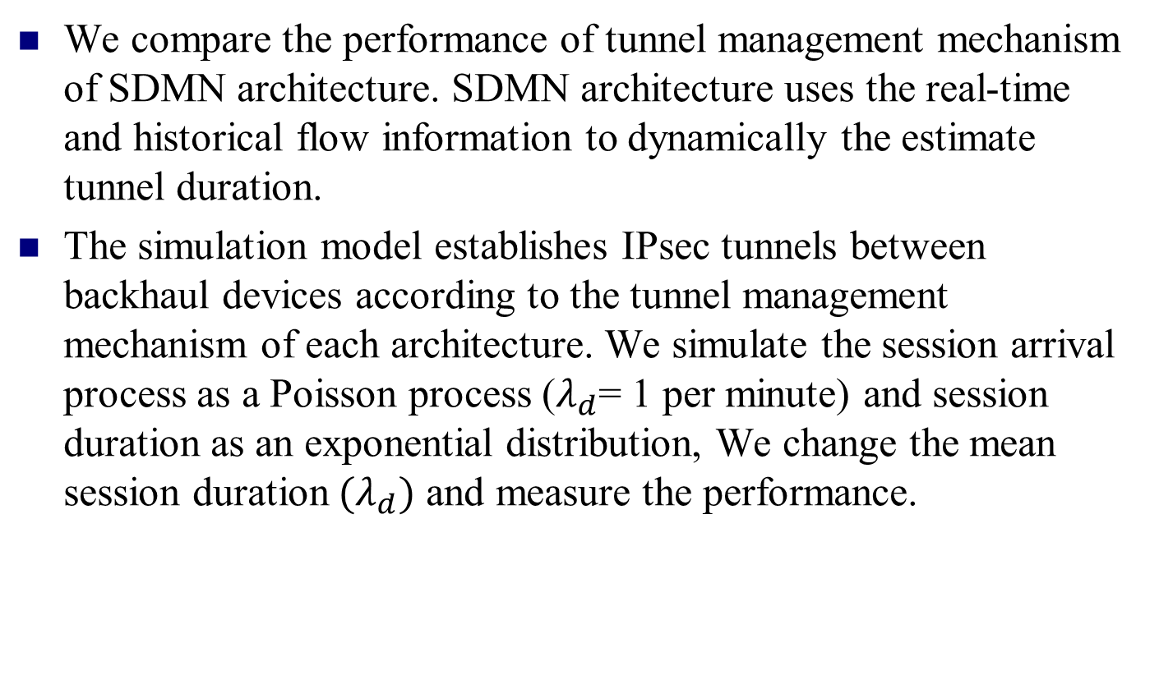
Numerical Results
We compare the performance of tunnel management mechanism of SDMN architecture. SDMN architecture uses the real-time and historical flow information to dynamically the estimate tunnel duration.
The simulation model establishes IPsec tunnels between backhaul devices according to the tunnel management mechanism of each architecture. We simulate the session arrival process as a Poisson process ($λ_{d}$= 1 per minute) and session duration as an exponential distribution, We change the mean session duration${ (λ}_{d})$ and measure the performance.

Slide 29
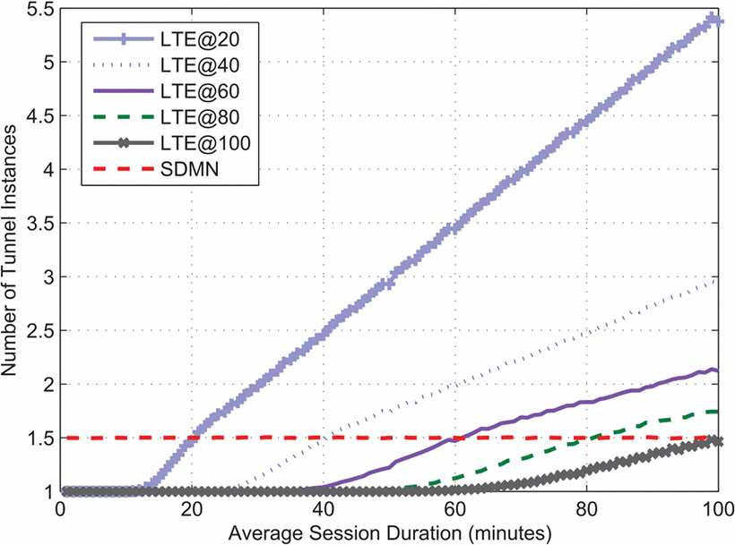
Numerical Results
Fig. 4: Tunnel Establishment Instances per Session

Slide 30
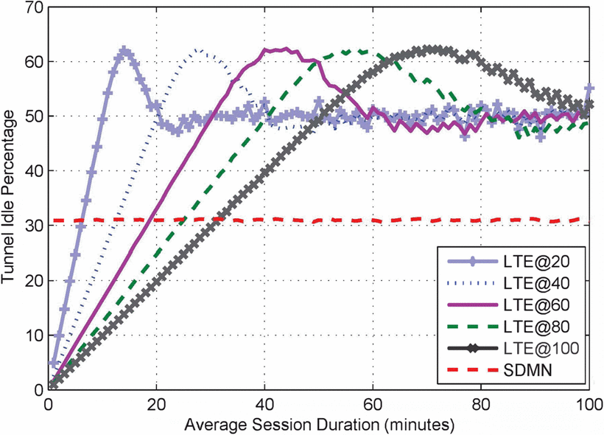
Numerical Results
Fig. 5: Percentage Tunnel Idle Time

Slide 31
Conclusions
Legacy LTE security mechanisms are inflexible, uncoordinated, distributed, complex and too static to address the security requirement of future mobile.
we presented new security architecture for LTE networks based on SDN and NFV concepts. We also discussed the expected advantages and limitations of SDN based security architecture.
SDN based security architecture uses the real-time and historical flow information to dynamically estimate the tunnel duration.

Slide 32
Conclusions
SDMN architecture reduces the percentage of time the tunnel is idle and the number of tunnel establishments per session
In the future, we will focus on the development of new security services based on SDN based security architecture and show how we solve the existing limitations in operating settings.

