Slide 1


UltrasoundToGo
LSI Demo 2016
Federico Angiolini, Aya Ibrahim, Ahmet Yüzügüler, William Simon
LSI, EPFL

Slide 2
Design Objectives
3D imaging to decouple operator’s skills from diagnosis
Single-chip beamformer built with off-the-shelf components
Power consumption compatible with a portable device
High image quality
High-end transducers feature up to 100x100 piezo elements
Most high-end systems limit complexity (electronics and cabling) by pre-compounding in the analog domain the signals onto ~16x16 channels
Support for 32x32 channels from transducer

Slide 3
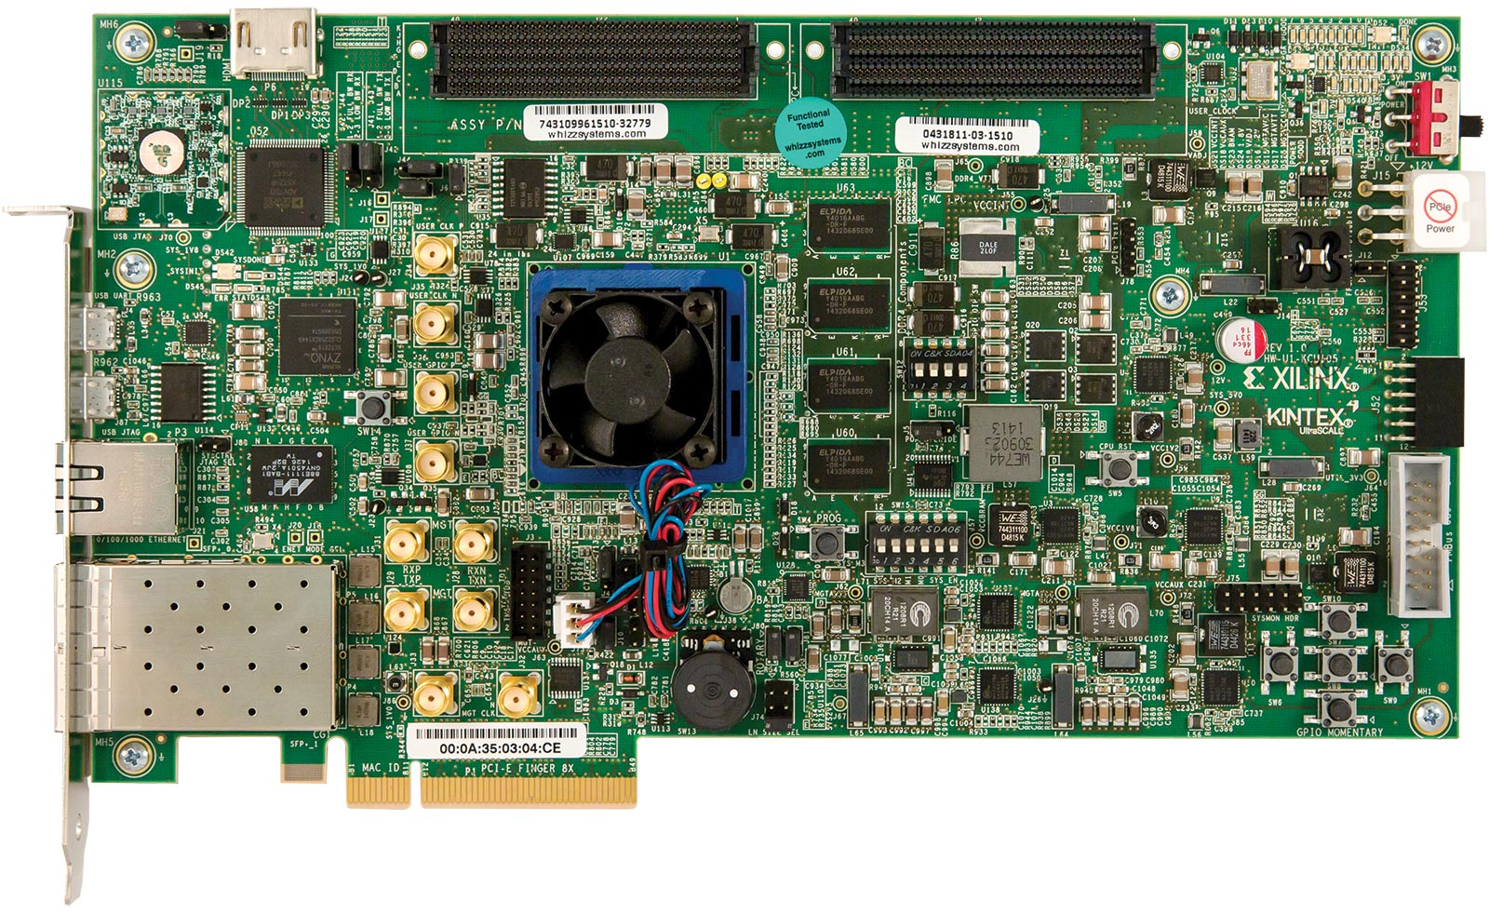
Kintex Ultrascale Dev Board
HDMI port
Video output
Gigabit Ethernet port
Kintex Ultrascale FPGA chip
Performs 1024-channel beamforming (delay, apodization, sum)

Slide 4
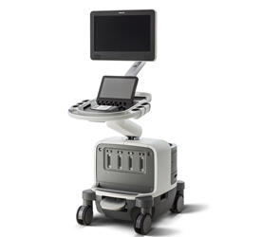

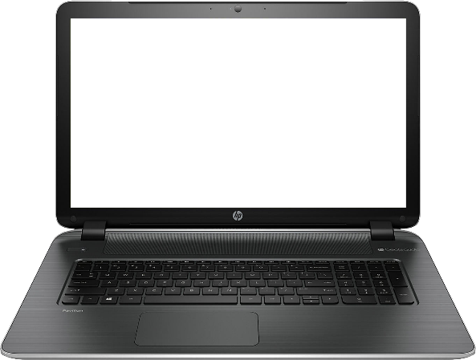

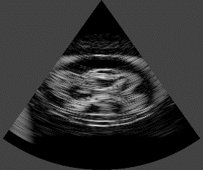
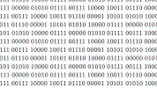
Current System Setup
or
Beamforming
FPGA
Ethernet
Pre-processing
Post-processing

Slide 5
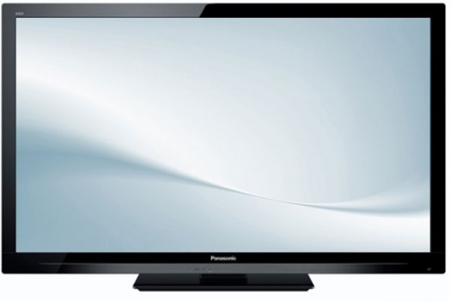

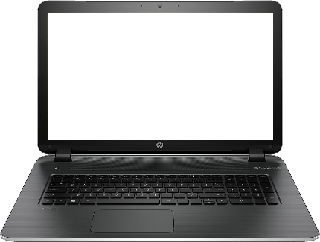
Target System Setup
HDMI
FPGA
or
Ethernet
Pre-processing
Beamforming
Post-processing
Optic Fiber

Slide 6
Beamforming Pipeline
Digitized echoes
High
pass
TGC
Apod
Delay + sum
De mod
Scan Conv
BF image
Pre-processing
Low-cost. Currently done on laptop.
Beamforming. Extremely high-cost. On FPGA.
Apodization. Low- to high-cost. On FPGA (static only).
Post-processing
Medium-cost. Demod: on FPGA. Scan Conversion: currently done on laptop.

Slide 7
FPGA Design Architecture
Microblaze processor
DDR Memory Interface
Ethernet Interface
Ancillary
AXI bus
Beamformer

Slide 8
Beamforming Architecture
AXI bus
32x16 2-ported BRAM array
Two elements per BRAM Max blanket thickness = 153
Apodization (static 2D Hanning)
B
B
B
B
B
Voxel Queue
w/Demodulator
B
B
B
B
B
Adder Tree 1024:1
B
B
B
B
B
Delay Computation Unit

Slide 9
Processing Flow
The volume is swept nappe-by-nappe
Delay calculation logic uses approximations (Ibrahim 2015) and architectural optimizations to select the samples
The delay calculation logic produces 32x32 delay values per cycle, i.e. one voxel per cycle
Reference volume: 73°x73°x10cm (configurable) in 64x64x600=2.5M voxels
Single insonification per frame
Architecture can ideally produce 1 frame per 2.5M cycles
Vogel 2014

Slide 10
Demodulator
Nappe 1
Nappe 2
Nappe 3
Nappe 4
Nappe P
Output nappe
Demod BF voxel
BF voxel
(P-1)th-order FIR filter
abs()
P-deep circular buffer

Slide 11
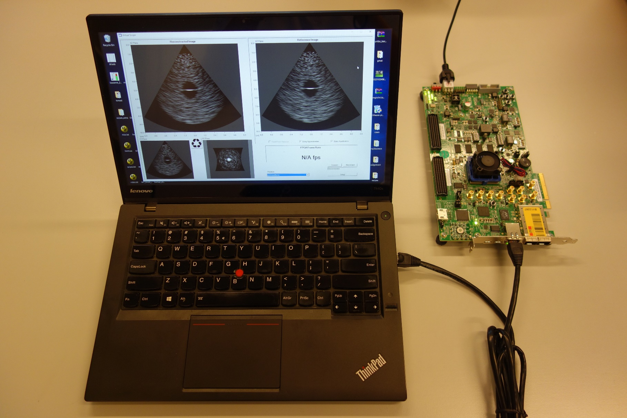
Overall System

Slide 12
Implementation Results
 | LUTs | Registers | BRAMs | DSPs
Utilization | 49.6% | 24.1% | 71.0% | 2.2%
Estimated power consumption: 5W
Clock frequency: beamformer block at 133 MHz
Maximum theoretical frame rate: 53.2 vps

Slide 13
Main Bottlenecks
Ethernet input is limiting
With perfect utilization (input only) of 1 Gbps port, max. 14 fps
For higher frame rates, higher-bandwidth interfaces needed
PCI Express, optical, custom board
BRAM-count also limiting
KU-040 has 1200 BRAMs
We sample 32x32 = 1024 input channels, two on each BRAM.
About 41x41 channels could be fitted on current FPGA, with further complexity and bandwidth tradeoffs.
To increase channel count further, larger FPGA would be needed
Larger Ultrascale chips have up to 3.5-6X BRAMs

Slide 14

Questions Are Welcome

