Slide 1

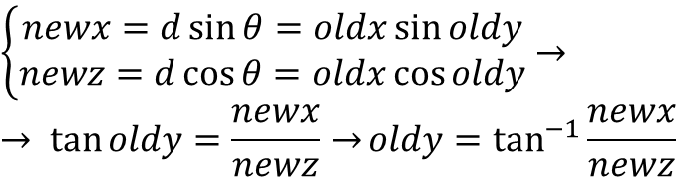
-θ_{max}
old_x (depth “d”)
θ_{max}
old_y (θ)
-θ_{max}
θ_{max}
new_x
θ
$$oldx=d= \sqrt{{newx}^{2}+{newy}^{2}}$$
$\left\{\begin{aligned}newx=d\sin{θ=oldx\sin{oldy}} \\ newz=d\cos{θ=oldx\cos{oldy}}\end{aligned}\right.$ $→$
$$→ \tan{oldy=\frac{newx}{newz}→}oldy=\tan^{−1}{\frac{newx}{newz}}$$
d
new_z

Slide 2
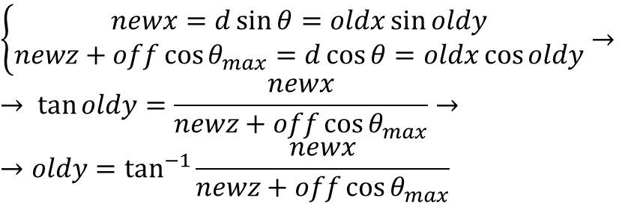
-θ_{max}
off
old_x (depth “d”)
θ_{max}
old_y (θ)
-θ_{max}
θ_{max}
θ
$$oldx=d= \sqrt{{newx}^{2}+{(newy+off\cos{θ_{max}})}^{2}}$$
off
new_x
$\left\{\begin{aligned}newx=d\sin{θ=oldx\sin{oldy}} \\ newz+off\cos{θ_{max}}=d\cos{θ=oldx\cos{oldy}}\end{aligned}\right.$ $→$
$$→ \tan{oldy=\frac{newx}{newz+off\cos{θ_{max}}}→}$$
$$→oldy=\tan^{−1}{\frac{newx}{newz+off\cos{θ_{max}}}}$$
d
new_z

Slide 3

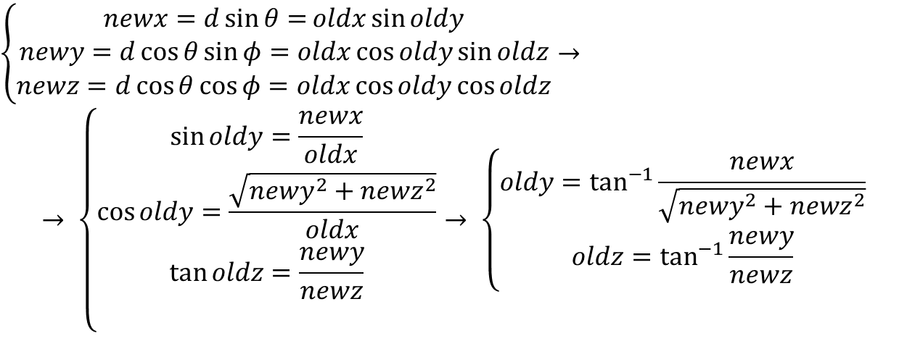
old_z (φ)
-θ_{max}
φ_{max}
old_x (depth “d”)
-φ_{max}
θ_{max}
old_y (θ)
-φ_{max}
$$oldx=d= \sqrt{{newx}^{2}+{newy}^{2}+{newz}^{2}}$$
-θ_{max}
θ_{max}
new_x
φ
$\left\{\begin{aligned}newx=d\sin{θ=}oldx\sin{oldy} \\ newy=d\cos{θ\sin{φ}=oldx\cos{oldy}}\sin{oldz} \\ newz=d\cos{θ\cos{φ}=oldx\cos{oldy\cos{oldz}}}\end{aligned}\right.$ $→$
$$→ \left\{\begin{aligned}\sin{oldy}=\frac{newx}{oldx} \\ \cos{oldy}=\frac{\sqrt{{newy}^{2}+{newz}^{2}}}{oldx} \\ \tan{oldz=\frac{newy}{newz}} \\ \end{aligned}\right.→ \left\{\begin{aligned}oldy=\tan^{−1}{\frac{newx}{\sqrt{{newy}^{2}+{newz}^{2}}}} \\ oldz=\tan^{−1}{\frac{newy}{newz}}\end{aligned}\right.$$
φ_{max}
new_y
d
new_z

