Slide 1

Conceptual Structure
For AI students

Slide 2
Words and concepts
Theory

Slide 3
Relations between words and contents
The typical approach is to assume that words are associated with concepts or a network of conceptual representations
We need to first have a good theory of what the conceptual structure is like.. and then we can see how this structure is used to represent meaning when referred to by words.
Ultimately, a word is a sound or written pattern, and it is generally assumed that a single word corresponds to a single concept. Would help with word-embedding models etc’. But there are complications

Slide 4
Evidence against 1<->1 form<-> meaning mapping
Another possibility is that a word specifies a set of potentials that is then refined by context to determine which sense is intended.
Polysemy: aphenomenon where a single word can have multiple meanings depending on the context in which it is used, such as "cinema" which can refer to different things in different contexts.
American cinema is naïve, vs.
This cinema is ugly.
Same thing with bank: financial institution or the building where it is
According to Murphy, it is impossible for a single concept to fully capture the meaning of a polysemous word.
Do we represent these multiple senses (e.g., ‘table’)? If so how? Murphy: each use of table is picking out a different sense. Process of meaning extension that is not a result of ‘natural change’ (chaining) but a matter of online derivation.
Klein and Murphy (2001) found evidence suggesting that the different senses of polysemous words can be stored, as they observed priming effects when a word was used twice in the same sense, and interference effects when the sense was switched.
Another possibility is that a word specifies a set of potentials that is then refined by context to determine which sense is intended.

Slide 5
Specific problems with word access (lookup); sim sound dif meaning
Homophones are words that sound the same but have different meanings, such as "bait" and "bate" (in an angry mood) or "might" and "mite“
Homophones are separate words, but their similarity in sound requires interpretation using context when converting from sound-to-text
Homonyms are words that have the same spelling but different meanings, such as "bank" (financial institution) and "bank" (of a river). Contextual disambiguation is necessary to distinguish between the different meanings of homonyms.
Polysemy (mentioned): a single word with multiple related senses.
The distinction between meaning and lexical form is important; anomia is a type of aphasia that results in the inability to retrieve the lexical form of a concept for production, even though the ability to recognize or define the term is maintained.

Slide 6
Focusing on conceptual structure
Understanding word meaning requires understanding the organization of conceptual structure in the mind-brain.
Concepts represent our knowledge of things in the world and enable us to identify things, infer features, or know how to interact with them.
Access to conceptual structure can be achieved through various means, including words, pictures, or music.
The study of conceptual structure or "semantic memory" should be independent of what governs word meaning or how word meanings are accessed through language.
Much of this psych’ work focuses on how people represent categories, with classical experiments focused on artificial, non-linguistic categories to see how people ‘summarize’ those. We won’t get into that, but be aware of the link
In much of the literature, concepts are studied by using words, assuming that words map onto conceptual knowledge and are a reasonable ‘proxy’ for studying relations between concepts.

Slide 7
The Classic View of word meaning: a definition
A definition: Definitions are sets of necessary conditions that are jointly sufficient.
Bachelor == Man, unmarried.
Every object is either within a category or not
Implications
There are no different levels of category membership – all members are equivalent to others.
what is learned? The set of defining features!
Advantage
This classical view of concept structure / word meaning has the advantage of supporting hierarchical structure and inheritance.

Slide 8
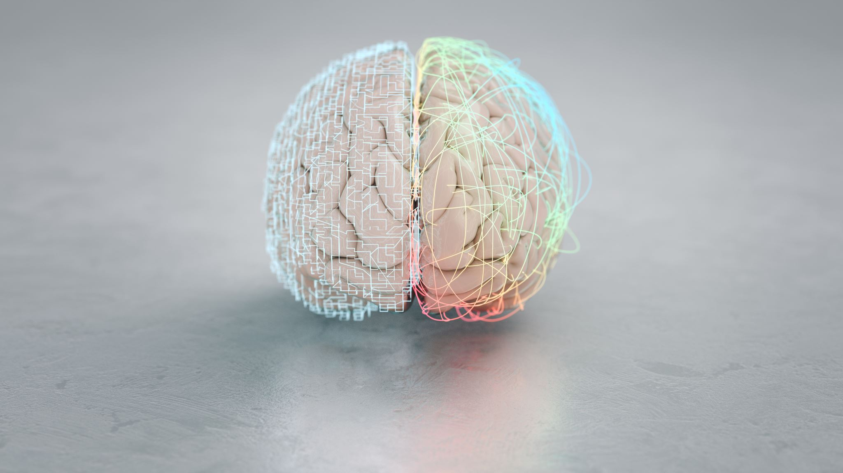
Representing the meaning of concepts
in the mind/brain

Slide 9
Propositional networks
Dog: a member of the canine species, that is domesticated. Useful for AI. Can inherit the default features of the canine class, add a few exceptions if non-default.
Flesh out: Define canine (then mammal, vertebrate, animal, organism, etc’ in the taxonomy).
Add some reference to visual features
Anderson’s propositional representations captured this sort of attempt

Slide 10
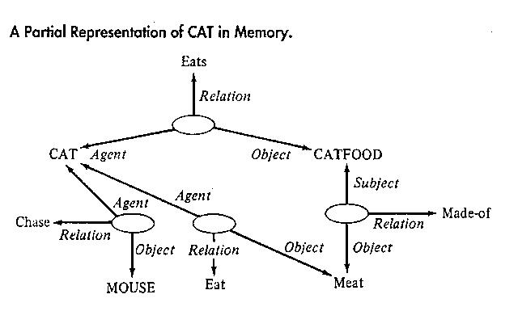

Slide 11
Propositional networks as psych model (Collins & Quillian, 1969)
Collins and Quillina's study of conceptual structure involved measuring response latencies for statements such as "Robins eat worms/have feathers/have skin".
The study proposed that some features of a concept are directly stored while others are inferred through inheritance.
For example, the feature "have skin" can be inferred after traversing three links in the ISA hierarchy: "is bird", "is animal", "animals have skin". On the other hand, "have feathers" can be inferred from a lower level in the hierarchy.
The latencies of affirmative responses were expected to reflect this distinction.
One question that the study raises is whether these hierarchies are pre-represented in memory or whether they are formed on the fly when people are asked questions.

Slide 12
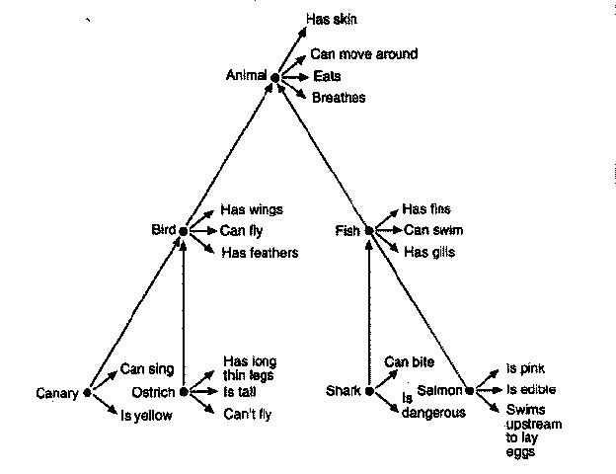
Propositional networks as psych model (Collins & Quillian, 1969)

Slide 13
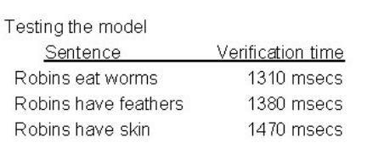
Propositional networks as psych model (Collins & Quillian, 1969)

Slide 14
Problems for propositional networks
Issue 1: Verification time is not solely determined by hierarchical relations but also influenced by the frequency of encountered statements. For instance, "apples are eaten" is verified faster than "apples have dark seeds."
Issue 2: The propositional network approach suggests that verification times should increase as the number of ISA links traveled increases. However, people are faster to verify "dogs are animals" than "dogs are mammals."
Issue 3: The approach expects clear logical inferences, such as "if A is a B and B is a C, then A is a C." But this assumption has been challenged. For example, while a car seat is a seat and people agree that seats are furniture, car seats are not considered furniture.

Slide 15
Rosch and the refutation of ‘classic view’ in psychology: the insight.
Rosch argued against the idea of “Sets of necessary and sufficient features” , taking the example of ‘game’
there is no set of necessary and sufficient conditions that is in common to all games.
Team? Yes/no. physical skill? Yes/no etc’.
Instead: what makes all games ‘games’ is their family-resemblance to each other
The prototypical members are highly similar to other members within the category but less similar to members of other categories.

Slide 16
Rosch and the refutation of ‘classic view’ in psychology: empirical support.
Typicality effects evident in verification times (Rosch, 1973)
Robins are birds faster to verify than Chicken are birds
Typicality also evident in ratings
People are very systematic in rating whether a certain member is a typical member of a category
.. Also in generation tasks when listing members:
for “birds” many more list robins than chicken, and for “sports” many more list soccer than weightlifting.
Conclusions: Categories have central and peripheral members.

Slide 17
Psychological properties of prototypes
Idea: A prototype of a category is a (hypothetical) member of a category for which all the values are the default or most popular. Shown by Rosch and Mervis.
Data 1: Had feature listing for various items (in different categories)
Data 2: Asked people to rate how typical items were of category
Analysis 1: Counted how many category members tended to share features listed
Final (important) analysis: correlation: items that had more features shared with other items in the category were, independently, rated as more typical of the category (they cross-reference the typicality ratings against the number of shared features).

Slide 18
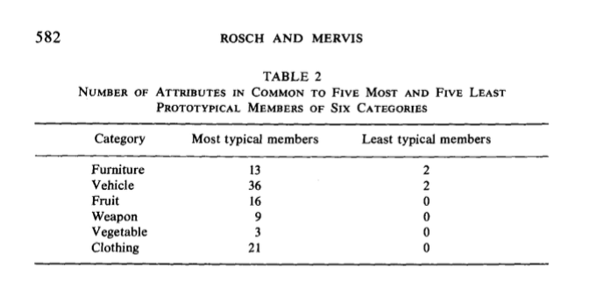
Notes:
More typical items share more features with each other.

Slide 19
Another problem for propositions: fuzzy category boundaries
Natural categories do necessarily not have fixed boundaries
Mcloskey and Glucksberg (1978) showed that people’s judgments about category membership differ with typicality: all agree that cancer is a disease and happiness isn’t, but stroke? Opinions differ.
Also, people are unsure. When you ask them a month later, many change their min (11/30 reverse on ‘stroke is a disease’).

Slide 20
Why do we end up with the words we have?
Levels of abstraction and informativeness: why do the world split the world the way they do?

Slide 21

Describe this picture

Slide 22
What did you say?
I see a Siamese Cat?
I see a Cat?
I see an Animal?

Slide 23
If you said “A cat”
Advantage over “Siamese cat”: perhaps good enough level of representation? Tells you “what you need to know”?
If someone said “that’s an animal” – likely correct, but offers little information.. (superordinate).
The basic level offers much more information, while still capturing relatively large amount of variance within the category. (superordinate captures much variance, but doesn’t give much info).

Slide 24
Levels of abstraction I
People likely represent the world at different levels of granularity
Basic level
Subordinate level
Superordinate level
People will use the level of abstraction corresponding to the level of discrimination they need: a tree is a useful category for urban dwellers, but people who live in the countryside will make finer distinctions.

Slide 25
Levels of abstraction II
What makes them useful?
Murphy: informativeness and distinctiveness.
Informativeness: the amount of facts linked to the category
Distinctiveness: the extent to which a category differs from other categories at the level
Superordinate: inf: no, dist: yes
Basic: inf: yes, dist: yes
Subordinate inf: yes, dis; no
We don’t create a subordinate concept for each item due to reasons of cognitive economy. Yes, they maximize information, but without offering much distinction.

