Slide 1
Next 3 topics: modeling conceptual organization
*
Modeling typicality (Blake et al.)
Modeling Similarity Spaces expressed in human behavior and brain responses (Kriegeskorte et al., Peterson et al.)
Can feature models explain behavioral and brain responses? (Mitchell et al., Wen et al. Baroni et al.)

Slide 2

Deep Neural Networks Predict Category Typicality Ratings for Images
Lake et al. 2016

Slide 3
Background
Can deep-learning systems serve as potential cognitive models?
They try to predict human typicality ratings for a set of naturalistic images
“for any task that requires relating an item to its category, typicality will influence performance, whether it is the speed of categorization, ease of production, ease of learning, usefulness for inductive inference, or word order in language”

Slide 4
Convnets and typicality
Convents may or may not produce representations that track categorical structure with typicality structure.
They learn categorization
But perhaps they categorize by learning prototypes?
.

Slide 5
Method: behavioral
Method:
People rate typicality for images drawn from 8 image categories: Typicality ratings were collected for eight categories: banana, bathtub, coffee mug, envelope, pillow, soap dispenser, table lamp, and teapot.
Mechanical turk. Each participant rates “how well does this picture fit your idea or image of the category”
Mean typicality per image computed across all ss.. Human reliability ratings have good split half . P= 0.92. so two groups of ppl produce similar rankings.

Slide 6
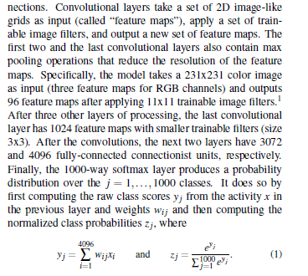
Method: computational
They use 3 convnet architectures. Describe OverDeat (7 layers). Last layer 1000-way softmax
top-five error rate of 14.2%, meaning: for over 85 percent of test images, the correct label appeared in the top five guesses.

Slide 7
Estimating image-typicality
Their assumption: typicality (human) is related to the strength of the model’s classification response (strength) to the category of interest.
Classification-Strength is estimated in two ways:

Slide 8

Raw typicality
The raw category score
Maximize y(j): particular abstract representation of category member that if inserted leads to max activity

Slide 9

Contrast typicality
Benefits images that load on the correct category much more than on other ones.
Most typical image produces Y(j) that is most differentiated from other categories’ response to this image. Indep’ from raw value.

Slide 10
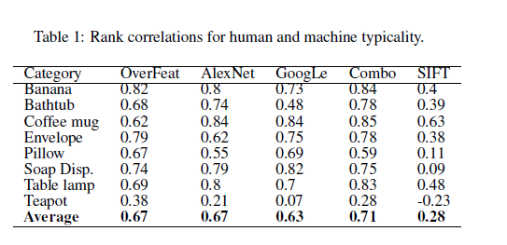
Result: Raw and Contrast scores do similarly well

Slide 11
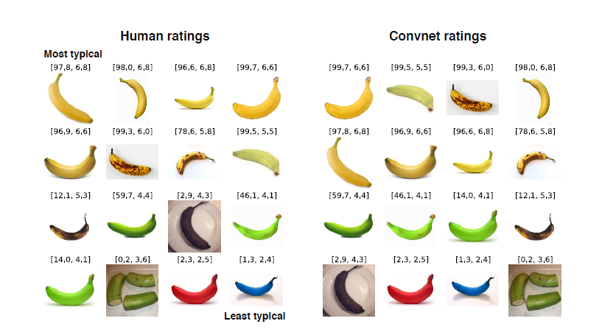

Slide 12
Interim Conclusion
“Our results suggest that deep convnets learn graded categories that can predict human typicality ratings, at least for some types of everyday categories”
Notes:
Frequency effects? Sorts that are presented most often in training set should have votes optimized for them? Frequency of presentation relates to typicality?

Slide 13
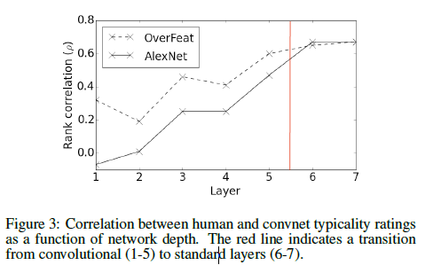
Examination within layers
For each layer, the average activation vector from 1300 training images (not experiment images) was computed for each class to serve as the category prototype.
Typicality was modeled as the cosine distance between the activation vector for a new image and the stored prototype.
Better prediction in deeper conv layers.
Notes:
would have been important to see if prototype structure developed there in terms of 'centroid' in multidimensional space. The centroid is the real prototype

