Slide 1
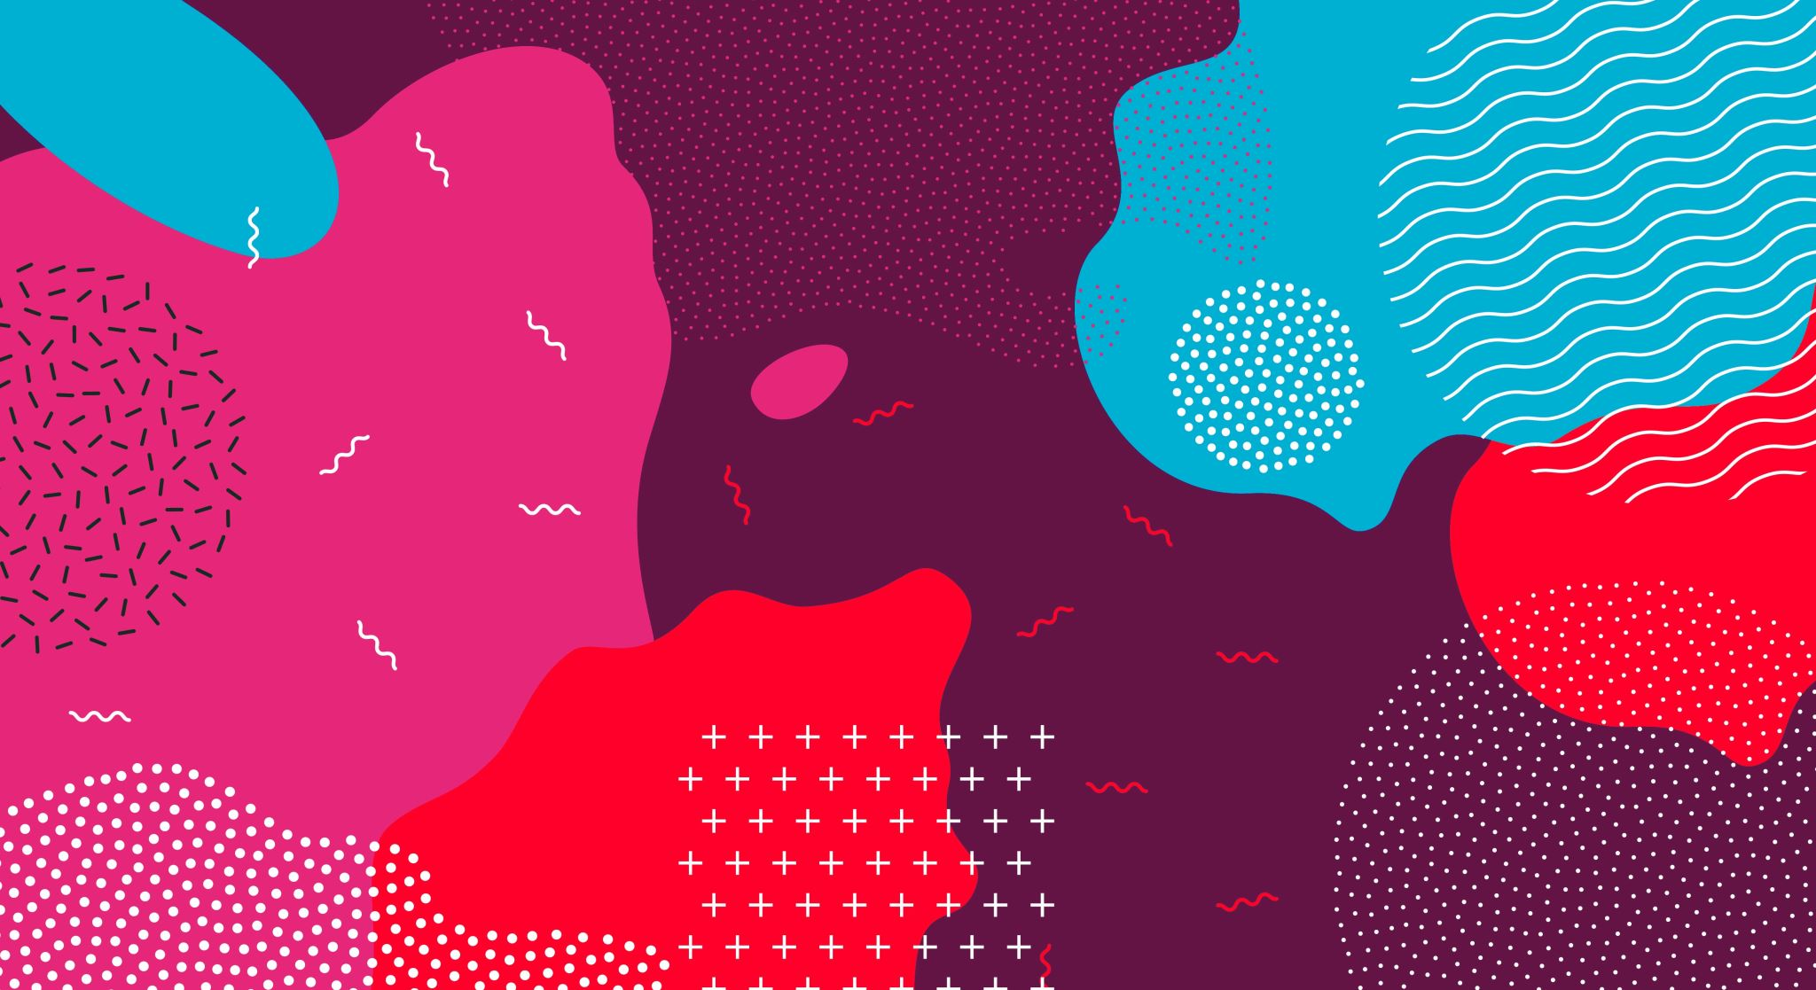
Improving isomorphisms
Pruning vs. reweighting

Slide 2
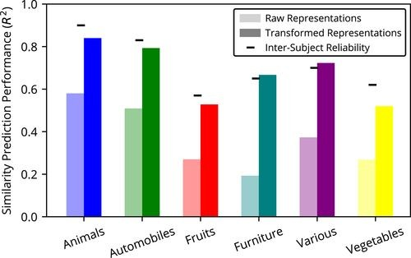
isomorphism between Dnns and human judgment is low. Why?
Peterson: DNNs develop the correct basis set of features, just at the wrong level of saliency.
Learning a reweighting of salience (transformed representation) improves prediction of human similarity judgments

Slide 3
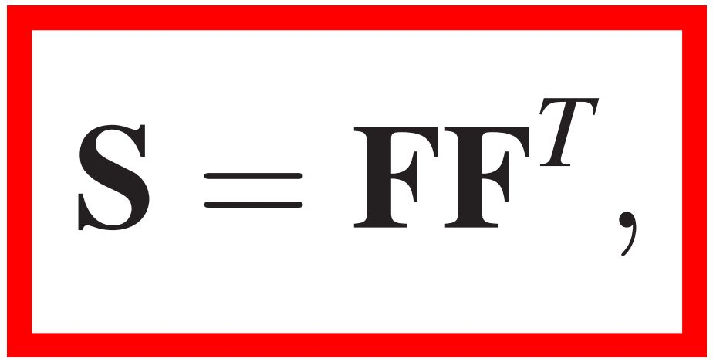
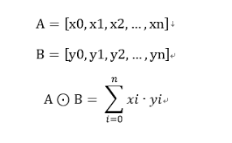
Reminder: Evaluating the correspondence between representations
SIMILARITY MATRIX from humans
FEATURE MATRIX (dot product/ R/ cosine)

Slide 4
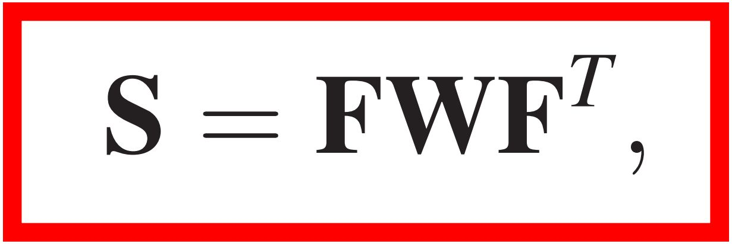
Reminder: Transforming Representations
how can DNN representations be transformed to increase their alignment with psychological representations?
with a set of weights on the features used to compute similarity

Slide 5
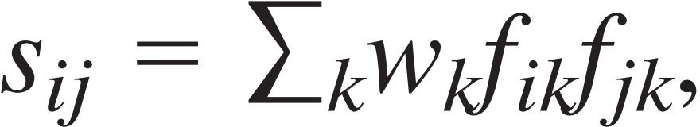
Reminder: Transforming Representations
The similarity sij between objects i and j is therefore modeled as :
Weight of that feature
“k” th feature of the image “i”
Similarity between image “i” and “j”

Slide 6
Transformation are now frequently used
Other forms of linear-transforms of the embedding matrix from images have been studied (Attarian et al., 2020).
In computational linguistics, reweighting of word-embedding vectors were shown to improve prediction of human similarity judgments (Richie and Bhatia, 2020).
Non-linear reweighting was also shown to be effective in modeling similarity judgments (Sanders and Nosofsky, 2020)
Attarian, M., Roads, B. D., and Mozer, M. C. (2020). Transforming neural network visual representations to predict human judgments of similarity.arXiv preprint arXiv:2010.06512.
Richie, R. and Bhatia, S. (2020). Similarity judgment within and across categories: A comprehensive model comparison
Sanders, C. A. and Nosofsky, R. M. (2020). Training deep networks to construct a psychological feature space for a natural-object category domain. Computational Brain & Behavior, pages 1–2

Slide 7
Are transformations necessary
Reweighting operationalizes the assumption that DNNs learn relevant features but assign them different (i.e., wrong/mismatching) levels of salience with respect to humans.
A different possibility: DNNs do acquire the relevant features at appropriate levels of salience.
It is just that that in any particular test-context where human similarity-space is predicted, the contribution of relevant features is diluted by irrelevant ones.
Consider predicting human similarity judgments of animals or tools (both RDMS) from brain activity (an RDM). Would you use the entire brain as feature set for constructing the RDM?
Alternative idea: taking the entire penultimate layer of a DNN as the relevant basis set unintentionally combines two representational sub-spaces: those relevant for a given set of human similarity judgments and those less relevant

Slide 8
Formally
Hypothesis
Feature embeddings from the DNNs can account for human similarity spaces better than can be concluded from raw second-order-isomorphism.
Feature reduction (pruning) by ranking features can improve the fit between DNNs and similarity judgements
General idea (non-technical intro)
Extract DNN image embeddings from the penultimate layer of VGG-19
Identify a subset of features that improves prediction of human similarity judgments (or brain similarity patterns).
Use the same 6 categories and images from Peterson et al.

Slide 9
Method: Sequential feature selection in CV
Determining feature contribution,
Selection-to-criteria,
Out of sample testing.
The process was repeated for 5 folds in a cross-validation framework.

Slide 10
Determining feature contribution (train set only)
In each cross-validation iteration, 20% (n=24) of the images are designated as a test set and 80% (n=96) as train set.
Baseline-2OI was defined as the train-set's 2OI between the DNN representation and human similarity judgments for those 96 images.
We quantified each feature's contribution to baseline-2OI by removing only that feature and recomputing train-set-2OI. The feature was then reinserted and the next removed till the process was repeated for all 4096 features.
Consequently,
`important' features are those whose removal produces a 2OI value below baseline-2OI and
`irrelevant' features are those whose removal produces a 2OI value above baseline-2OI.
This produces a rank order of each feature's independent importance to baseline-2OI.

Slide 11
Selection to criteria (train set only)
After feature ranking, we consecutively insert features, according to their importance rank, into a candidate feature set.
Each time a feature is added to the candidate set, we construct an RDM from the features in the set and recompute 2OI against the train-set human similarity judgments.
We add all features exhaustively and then we identify set of features associated with the maximal value reached.
The set identified this way constitutes the pruned network associated with a specific fold.

Slide 12
Validation (TEST set; out of sample prediction)
Once a pruned node-set is determined, we apply it to the left-out test set.
To begin, we define test-set's baseline 20I which is the R² produced when considering all 4096 nodes.
Evaluating the pruning:
The test-set images are inserted into the DNN, and we extract the activation values for the selected nodes in the pruned layer.
We then construct an RDM for the test-set images and report pruned-net-2OI as R².
We evaluate this value in relation to the test-set's baseline 20I which is the R² produced when considering all 4096 nodes rather than the pruned subset.

Slide 13
Results

Slide 14
Prediction of human similarity judgments
Baseline: 2OI between the DNN and human RDMs prior to any reweighting/pruning, averaged across the five out-of-sample data for the test folds
PAG18: ridge regression as implemented by Peterson 2018, applied to the five out-of-sample folds defined in our process.
Sim-DR: a reweighting approach developed Jha et al 2020, which optimizes a projection of DNN embeddings to a lower-dimensional that matches human similarity judgments
LASSO is our own variation of the reweighting implemented by PAG18 but which uses LASSO-regularized regression that is further constrained to only positive weights.
Pruned: pruning method introduced here

Slide 15
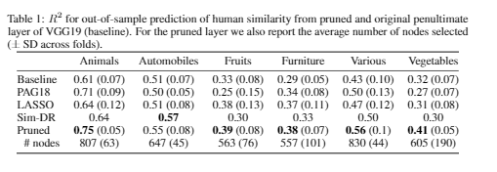
Prediction of human similarity judgments
Baseline: match between the DNN and human similarity space prior to any modification, averaged across the five out-of-sample data for the test folds
PAG18: Reweighting. ridge regression as implemented by Peterson2018, applied to the five out-of sample folds used in our data.
Sim-DR: a reweighting approach developed Jha et al 2020, which optimizes a projection of DNN embeddings to a lower-dimensional that matches human similarity judgments
LASSO is our own variation of the reweighting implemented by PAG18 but which uses LASSO-regularized regression that is further constrained to only positive weights.
Pruned: pruning method introduced here

Slide 16
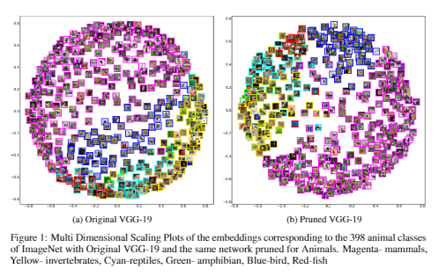
Lower-dimensions of human similarity judgments
Multi Dimensional Scaling (MDS) plots of the non-pruned network and the network pruned for animals, on the 398 ANIMAL categories of ImageNet

Slide 17
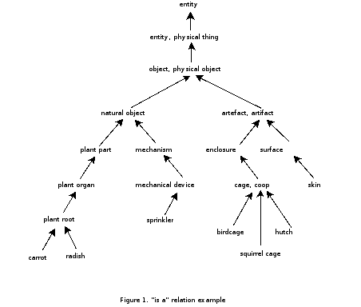
Organization of human similarity judgments vs. wordnet: What is wordnet?

Slide 18
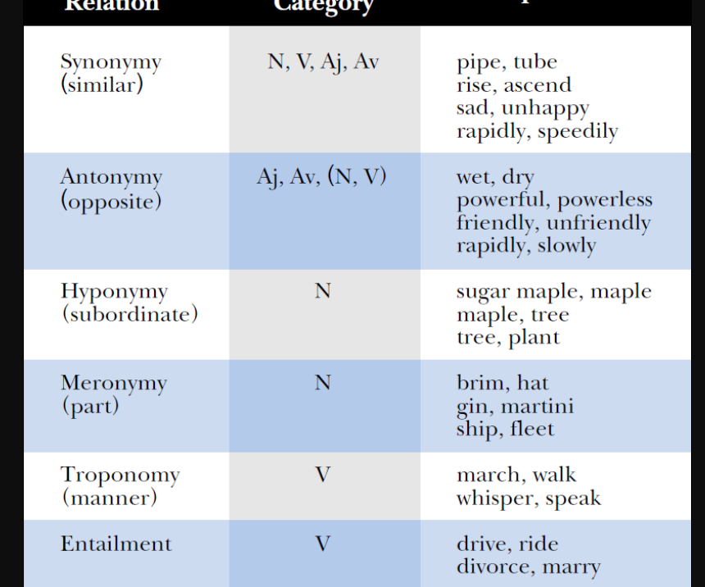
Wordnet relations
We focus on hyponymy paths

Slide 19
Organization of human similarity judgments vs. wordnet
2OI reflects ranking of pair-wise similarities, but it does not directly address hierarchical structure.
Solution: we compare the hierarchical structure latent in the DNN similarity space to that of WordNet

Slide 20
Organization of human similarity judgments vs. wordnet. Quantifying fit
From DNN similarity space: produce clusters, and define ‘local neighborhood’ of each terminal leaf (image)
1
From Wordnet Graph: define ‘local neighborhood’ of each terminal leaf (image). Possible, because image-net categories match wordnet labels.
2
Compute: to what extent are neighbors in the DNN DAG also neighbors in the Wordnet Graph: Average ‘neighborhood fit’ across all nodes using Jaccard Index (set_intersection/ set_union)
3

Slide 21
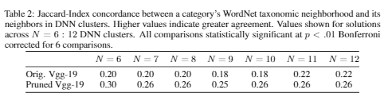
Organization of human similarity judgments vs. wordnet
‘N’ refers to number of clusters in DNN clustering solution (arbitrary)

Slide 22
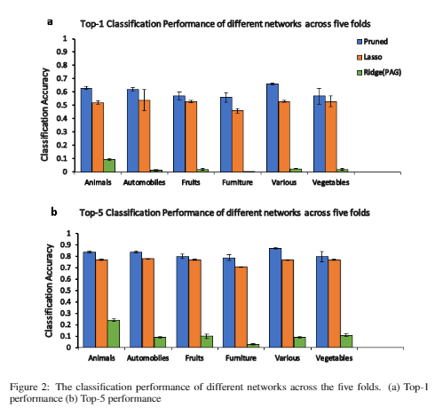
How do pruned and reweighted nets classify?
Top1/top5 of P.A.G(18) ridge; lasso (pos. weights); Pruning

Slide 23
Interim conclusions on supervised pruning
Can be used for (out of sample) prediction of human similarity spaces
Outperformed previous reweighting-based methods for modifying network activation
Better organized latent structure:
hierarchical clustering applied to pruned-embeddings proved a better fit to WordNet’s hierarchy,
MDS spaces produced from pruned embeddings reflected a better clustering into basic-level semantic categories of Animals
Better match for Wordnet.
Maintained top-1/top-5 classification accuracy at higher levels than regularized regression methods.
Implications for theory:
DNNs already capture features relevant to human similarity judgments at an adequate level of salience, and for this reason, node activations do not need to be reweighted.
Need methods to filter out those features/nodes that are less relevant to modeling similarity of the domain at hand.

Slide 24
Understanding brains and dnns
Pruning as dimensionality reduction

Slide 25
Insights into brain and dnn organization
Challenge: prune DNNs to better emulate neural similarity spaces
rather than prune DNNs from human similarity judgments, prune from ‘brain similarity judgments’
Dataset: fmri activity while peopled viewed 144 different images.

Slide 26
The dataset
Two sets of 144 images. Allows pruning based on one set and testing the performance of the pruning mask on the other (‘2 fold CV’)
Data pre-collected and organized for 8 brain areas, some specialized for face and scene perception (FFA, PPA), and other spanning the visual cortex

Slide 27
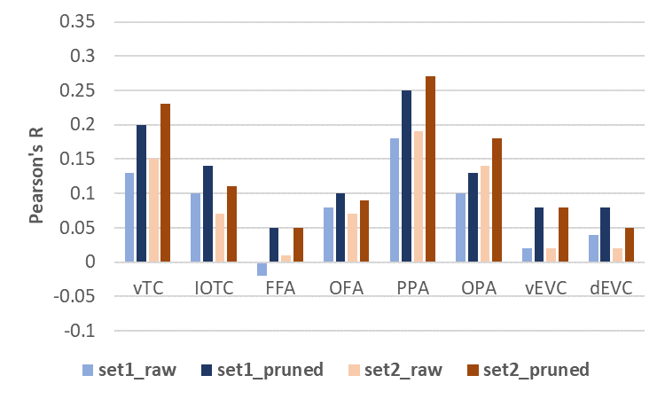
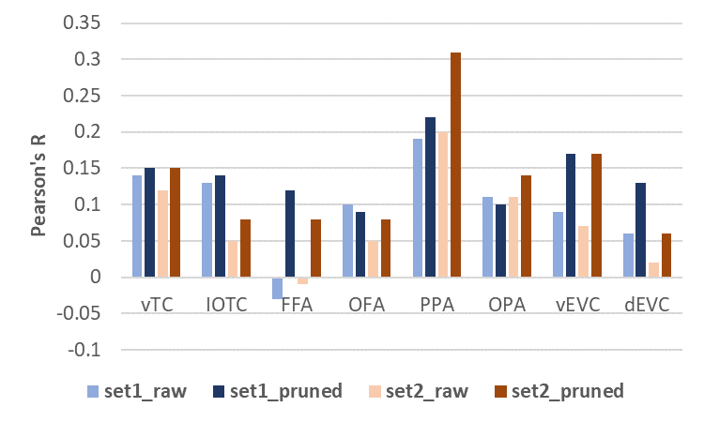
Pruning dnns from one image set, predicting on the other
a. Prediction of brain RDMs; penultimate layer
b. Prediction of brain RDMs; final layer

Slide 28
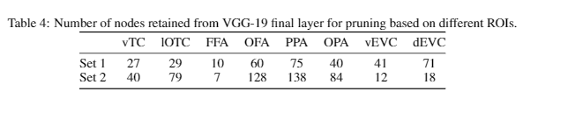
Dimensionality of brain encoding tracked by number of features retained from dnn pruning

Slide 29
Summary and points for thought
Vision DNNs trained to classify already provide a moderate approximation of human representational space
Reweighting is emerging as a new technique to improve this match (useful for practical applications), and was interpreted to suggest that DNNs learn human-like filters, but at wrong levels of salience
Pruning outperforms reweighting in learning prediction of human representational spaces, but also originates in a different perspective on the importance of DNN filters: the filters are effective at the learned levels of salience, but different dataset benefit from different combinations of filters. Pruning is also more easily interpretable as a regularization (data reduction) technique in context of explainable AI and provides insights into brain organization.

Slide 30
Why does pruning work
Insights from ai modeling

Slide 31
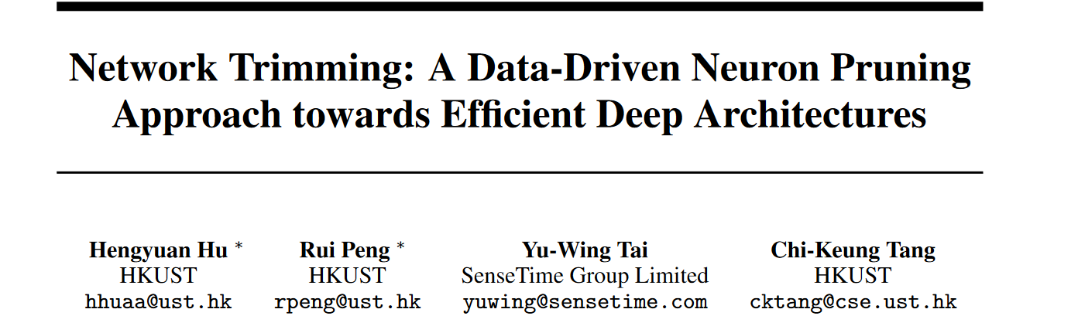
some dnn nodes provide little information

Slide 32
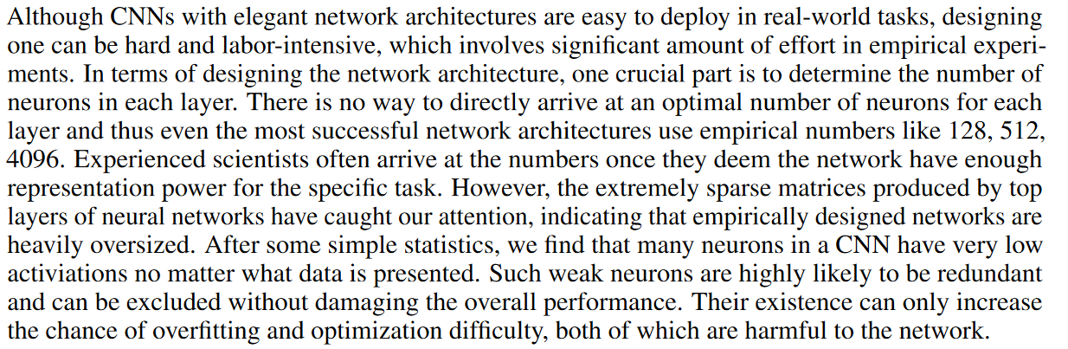

Slide 33
Principle stat: average percentage of ‘0’s
They define Average Percentage of Zeros (APoZ) of a single neuron as percentage of zero activations of that neuron after the ReLU mapping.
Layer is the unit of analysis rather than single neuron, so the analysis is collapsed across all neurons in a layer
For a given dataset with N images APoZ just is the percentage of 0s after RELU (computed as proportion of 0s/N)
(if a neuron contributes to more than on feature map (M>1), the computer number of 0s out of NxM)

Slide 34
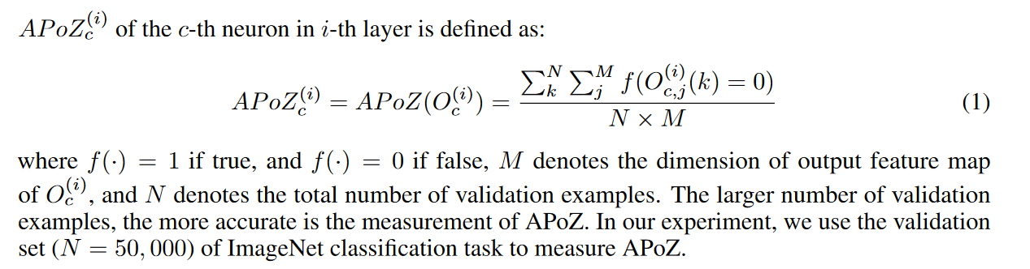
Principle stat: average percentage of ‘0’s

Slide 35
Results
Redundancy is mainly in the deeper convlayers and the fully connected layers
They find >600 neurons with APOZ > 90%

Slide 36
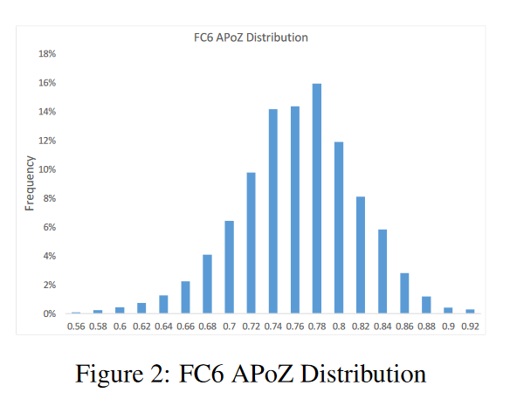
A ‘zoom in’ histogram on apoz distribution in fc-6

Slide 37
Are high-apoz neurons redundant?
They implement a neuron-pruning approach
After training to criteria, the remove all weights to and from high-APOZ nodes (i.e., they remove these nodes from the net)
They then re-init the network with the last set of weights (prior to pruning) and retrain to criteria.

Slide 38
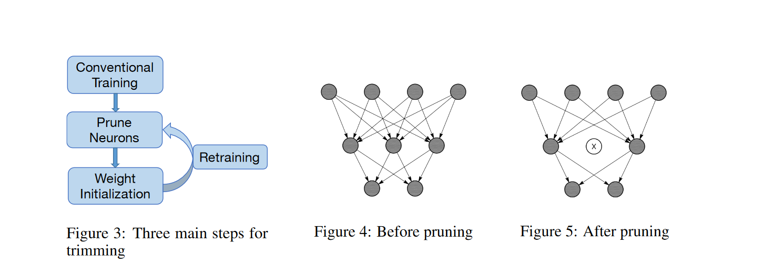

Slide 39
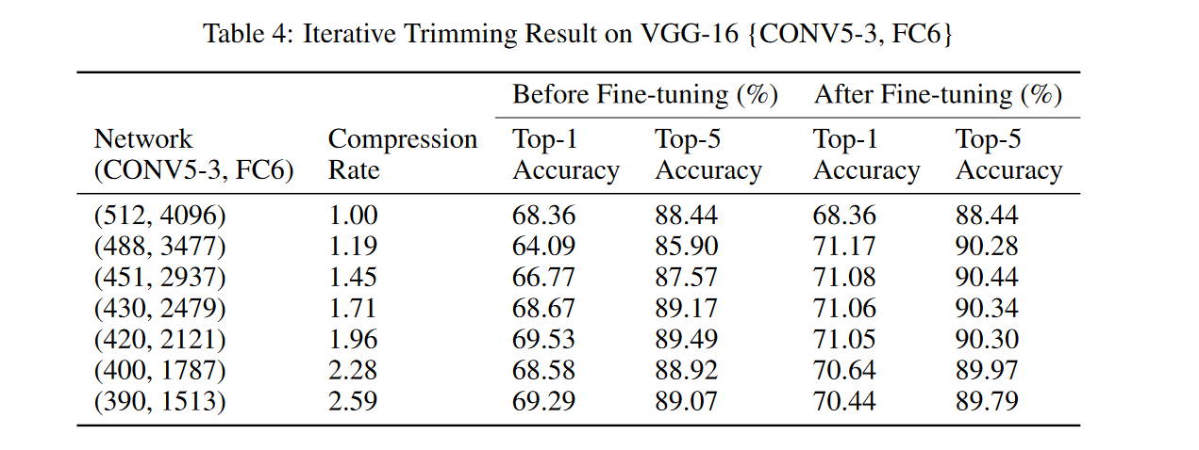
Result: network compression without sacrificing accuracy (or even an increase)
Notes:
Example of trimming nodes in conv 5 and FC6

Slide 40
Redundancy and representational geometry

Slide 41
Low-information features and their impact on representational geometry
For a given dataset, a 100% PoZ feature does not provide discriminating information between objects.
It may serve to separate objects in this dataset from others
However, these features do contribute to pair-wise similarity estimations; i.e., estimation of object-similarity (cosine, Pearson)
QUESTIONS:
How do these features contribute to a DNN’s RDM?
Can their removal improve prediction of human similarity judgments

Slide 42

Impact of all-zero feature on vector correlations
hypothetical embeddings of three images (A, B, C); Node #6 is 0 for all images.
When computed from the full embeddings, the pairwise Pearson similarity values between the three images (A, B; B, C; A, C) are 0.62, 0.56, −0.18. When feature #6 is removed, the values become −0.06, 0.40, −0.94.
Full beddings, Sim(A, B) > Sim(B,C) but when the 0 feature is excluded, Sim(A, B) < Sim(B,C)

Slide 43
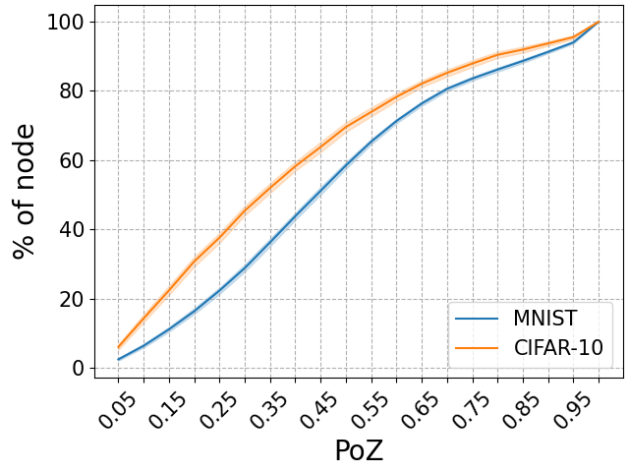
Distribution of poz in mnist and cifar
Notes:
Around 20% of nodes have PoZ above 0.70. Very few have PoZ>0.95, though possible.

Slide 44
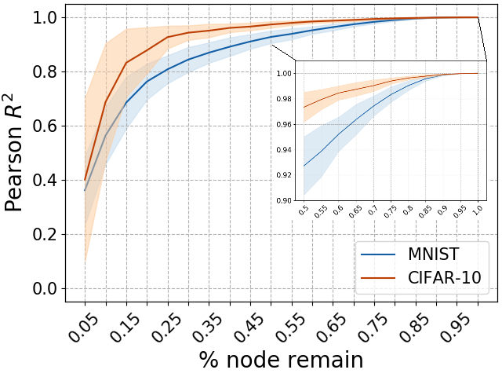
Inserting features from low-to-high poz and computing 2oi vs. full embedding rdm
Features inserted sequentially from low-to-high POZ.
Each time, an RDM from partial set is computed and compared (R2) vs. the RDM of the original embeddings.
For CIFAR-19 high R2 of 0.9 arrived with only 25% of features. R2=0.98 after 50% of features inserted.
Do the high-PoZ features (the remaining 50%) contain any useful information at all?

Slide 45
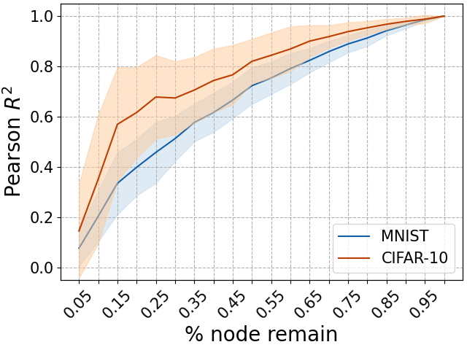
Inserting features from High-to-low poz
As previous slide, in reverse direction
The lowest 20-% already produce R2>0.6 for CIFAR10. PoZ for these is 55% and above.
Conclusion: High-Poz Contain redundant information, distributed across these features.

Slide 46
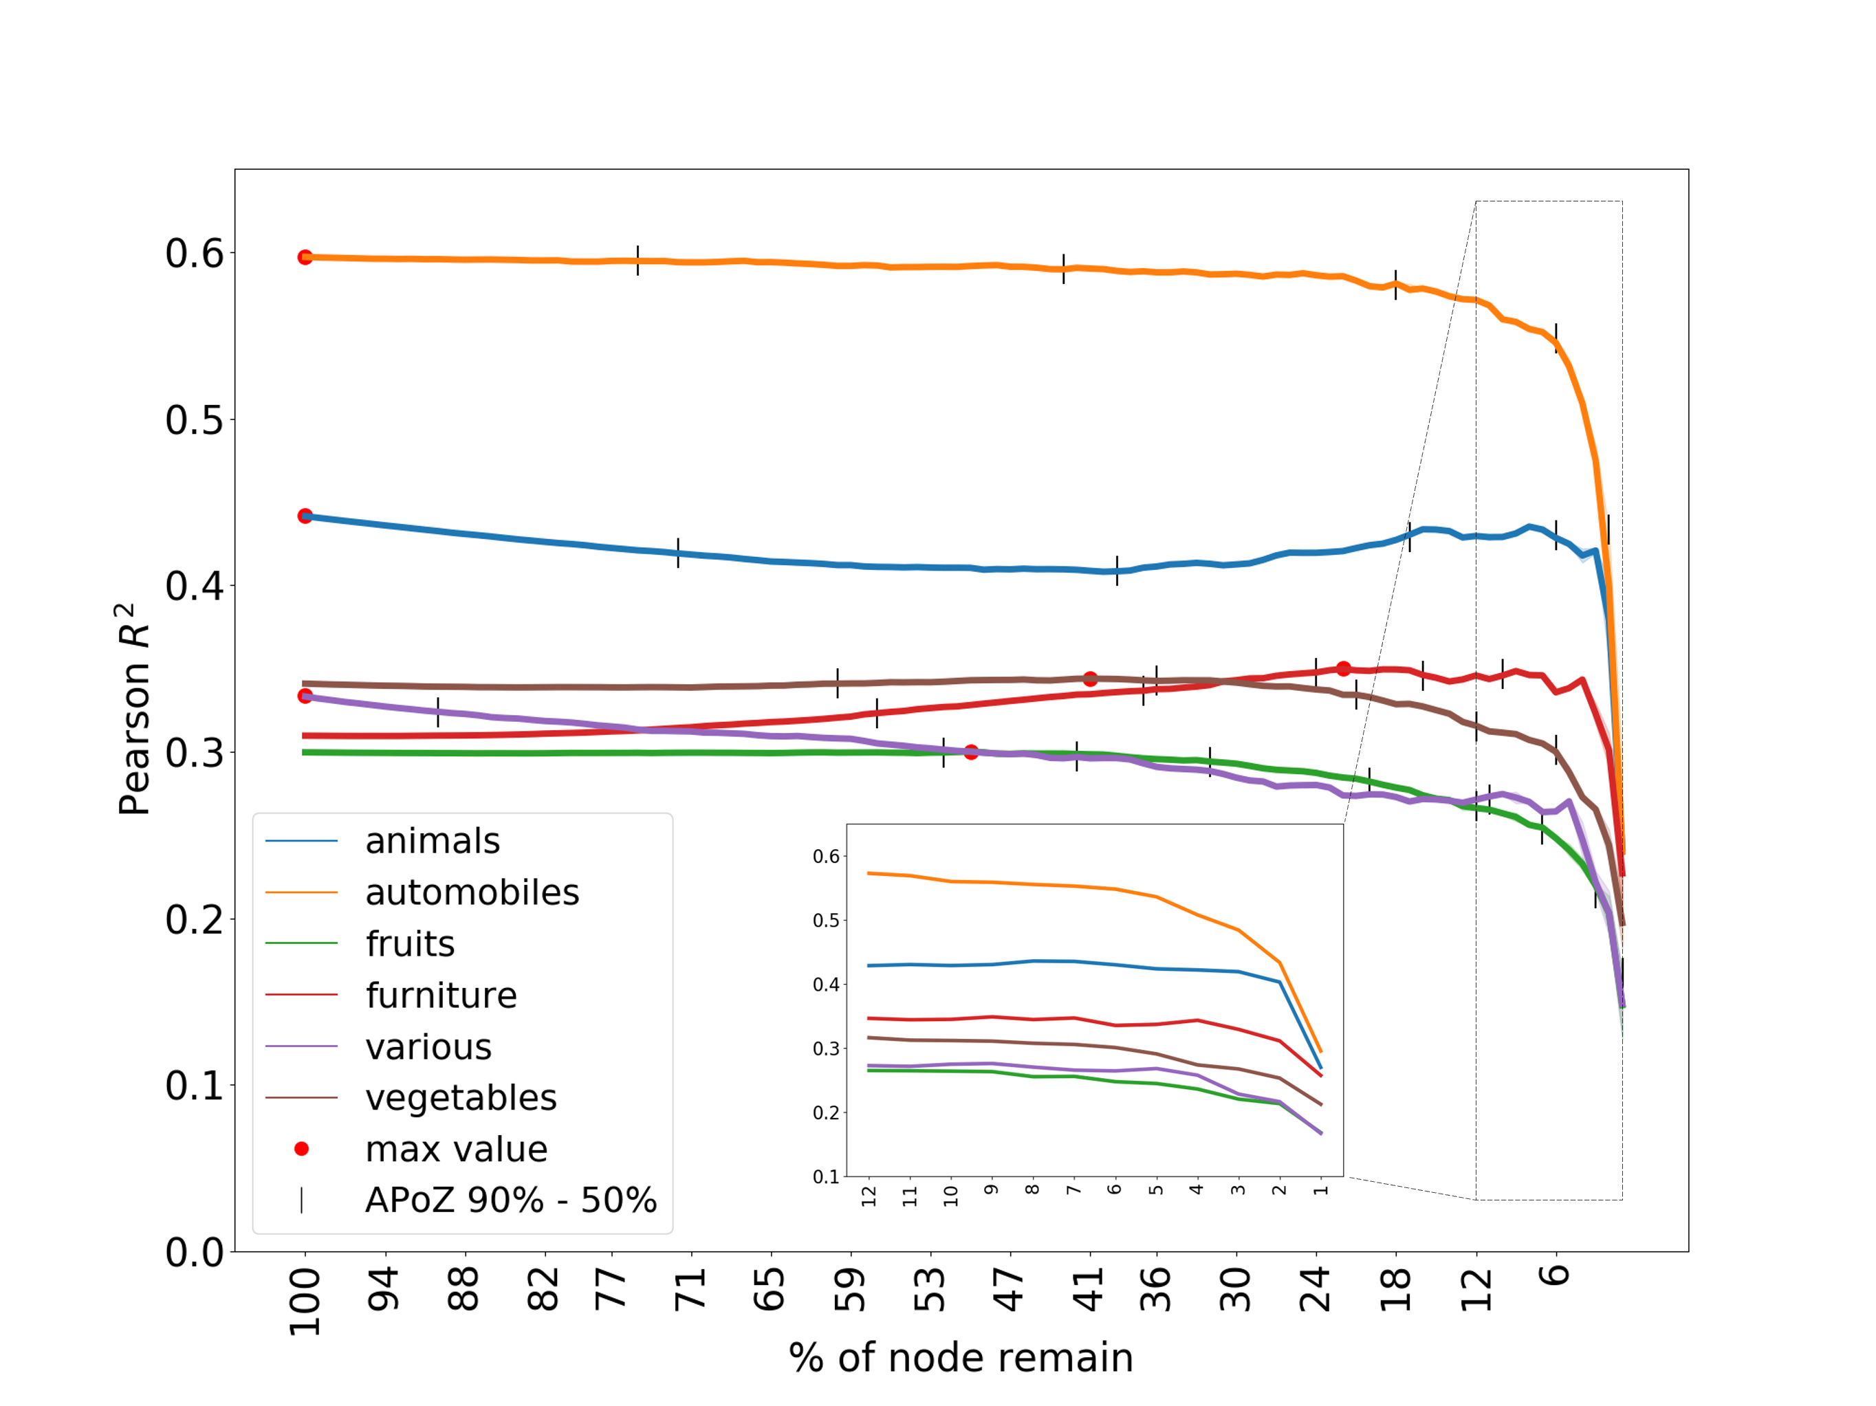
APOZ based pruning and network representation
Evaluation of APOZ-based pruning and impact on prediction of human similarity judgments.
Features remove sequentially from high-to-low PoZ and 2OI computed against Human Similarity Judgments.
Tick lines mark bins of PoZ level.
Notes:
VGG19; trimming using APOZ and evaluating 2OI against human judgments

