Slide 1
Human memory

Slide 2

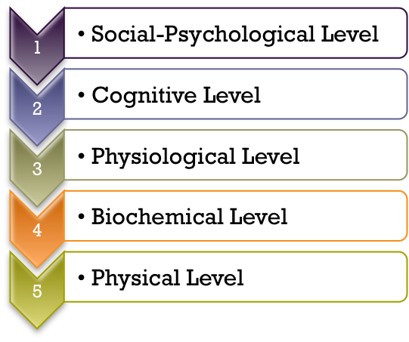
Psychological Theories
Theories are comparable to maps, helping to:
Summarize knowledge in a simple and structured manner
Pose new, testable questions that advance further discovery
Theories, like maps, can be specialized to address questions on a variety of related levels of explanation, which can sometimes inform other levels, through a process called reductionism:
Awareness
Reductionism
m
Processes
Neurons
Molecules
The practice of explaining complex phenomena in terms of lower-level processes
Atoms

Slide 3
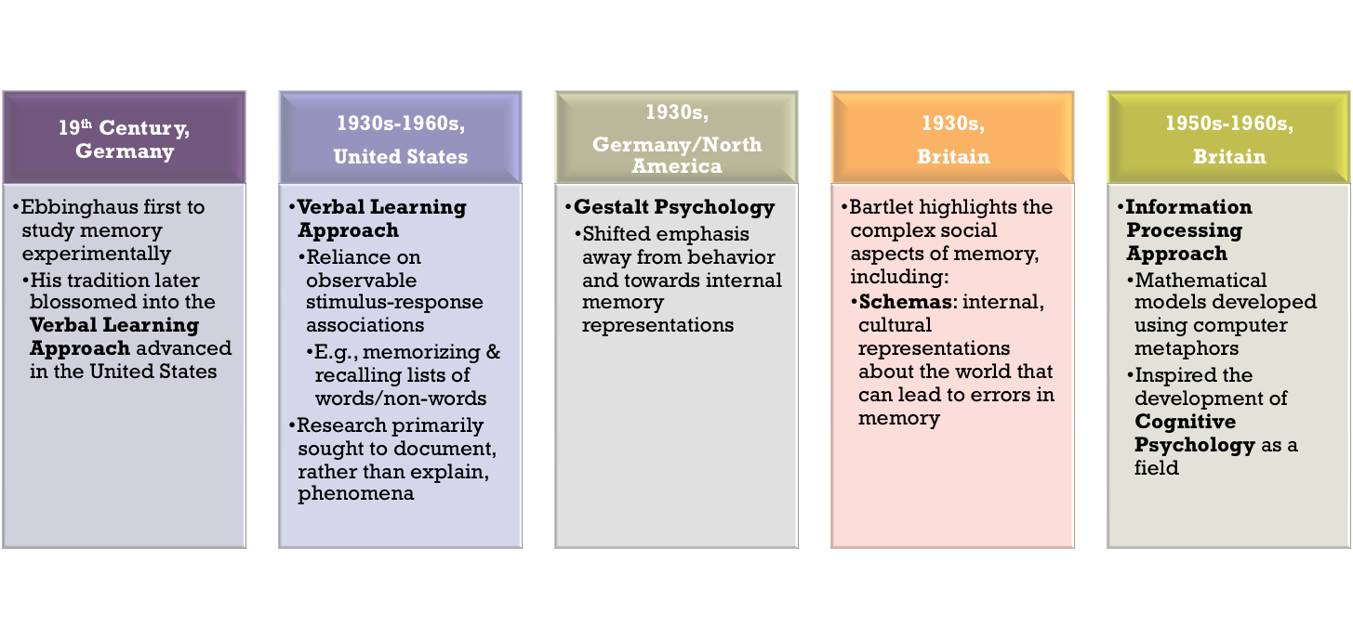
A Brief History of Learning and Memory
Concurrent

Slide 4
19th Century Germany
Ebbinghaus (1850-1909)
Nonsense syllables
PIM DAG ZOL CEK
Learning curve – massed vs spaced practice
Forgetting curve – forgetting occurs rapidly
Overlearning – studying after something is learned
Savings – decreased effort needed to relearn
Bartlett (1886-1969) – a critic
How does prior knowledge influence memory
Reconstruction is guided by schemas (concepts)

Slide 5
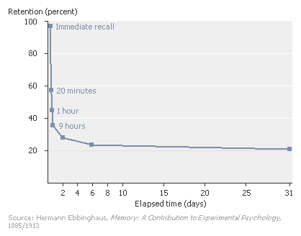
Ebbinghaus Forgetting Curve

Slide 6
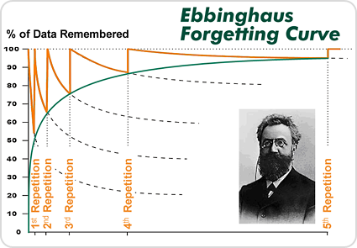
Importance of Practice
The more repetition (practice), the more likely information is to be remembered later.

Slide 7
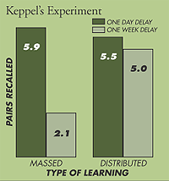
Massed vs Spaced Study
Ebbinghaus, H. Memory: A contribution to experimental psychology. New York: Dover, 1964 (Originally published, 1885).
Keppel, Geoffrey. A Reconsideration of the Extinction-Recovery Theory. Journal of Verbal Learning & Verbal Behavior. 6(4) 1967, 476-486
Notes:
Total time kept constant. Just split different way.

Slide 8
Bartlett’s “War of the Ghosts”
Bartlett (1932) used multiple repetition of recalled material to study distortions over time.
Participants were given a 328 word Native American folk tale “The War of the Ghosts” to read twice and then reproduce 15 minutes later and also hours to months later.
Total recall declined.
What was recalled was shaped by the need to form a coherent understandable story in the context of their own cultural knowledge (schemata – concepts).
He considered memory an active process of construction.

Slide 9
W.O.G content and errors
One night two young men from Edulac went down the river to hunt seals, and while they were there it became foggy and calm. Then they heard war-cries, and they thought: “Maybe this is a war-party.” They escaped to the shore, and hid behind a log. Now canoes came up, and they heard the noise of paddles, and saw one canoe coming up to them. There were five men in the canoe, and they said: “What do you think? We wish to take you along. We are going up the river to make war on the people.” … one of the young men went but the other returned home …
[it turns out that the five men in the boat were ghosts and after accompanying them in a fight, the young man returned to his village to tell his tale] …
and said: “Behold I accompanied the ghosts, and we went to fight. Many of our fellows were killed, and many of those who attacked us were killed. They said I was hit, and I did not feel sick.” He told it all and then he became quiet. When the sun rose he fell down. Something black came out of his mouth. His face became contorted … He was dead. (p.65)
One participant’s ecall of the story (two weeks later): There were two ghosts. They were on a river. There was a canoe on the river with five men in it. There occurred a war of ghosts … They started the war and several were wounded and some killed. One ghost was wounded but did not feel sick. He went back to the village in the canoe. The next morning he was sick and something black came out of his mouth, and they cried: “He is dead.” (p.76)

Slide 10
Contributions of Gestalt Psychology
Gestalt movement (Kohler, Koffka, Wertheimer)
The whole is different that the sum of its parts.
Anti-reductionistic
But they did acknowledge the importance of understanding the components of thought.
Memory is influenced by the configuration of elements and context.
Isomorphism of mental representation – material is represented mentally in the same configuration as it exists in the world.

Slide 11
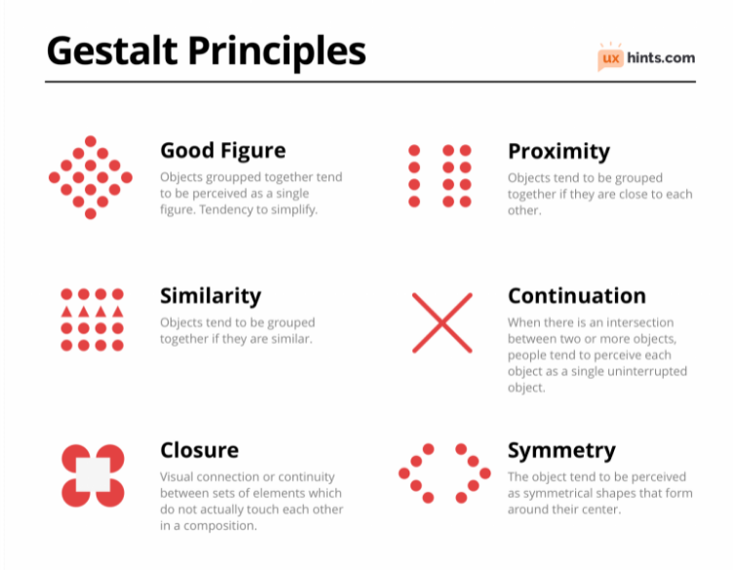
Gestalt: Impact of context
Image taken from: https://uxhints.com/visual-ui-design/gestalt-principles/

Slide 12
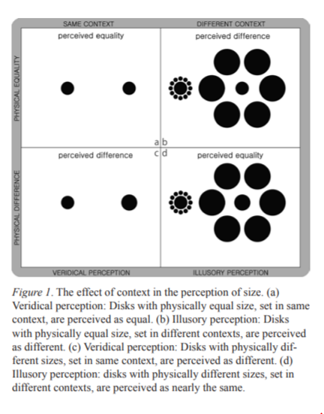

Slide 13
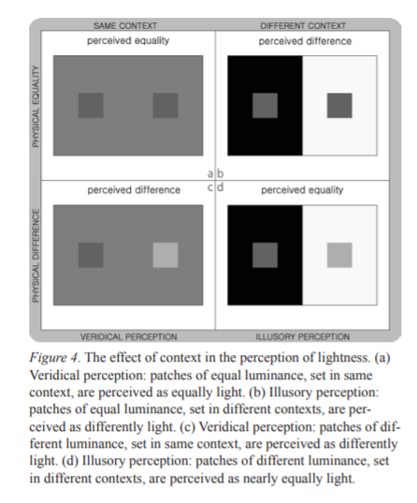

Slide 14
Behaviorism
Behaviorism (Pavlov, Thorndike)
Psychology should be the study of observable behavior not structure of mind.
Behaviorism is associated with the term “learning”.
Later behaviorists (like Tolman) used mental explanations and representations (e.g., cognitive maps).
Important types of learning -- Classical and operant conditioning both depend upon memory – associations are remembered.

Slide 15
Verbal Learning
A behaviorist approach to the learning of verbal materials (words, sentences, stories).
Developed from Ebbinghaus’s work.
Memorization is the “attachment of responses to stimuli.”
Forgetting is the “loss of response availability.”

Slide 16
Early Neuroscience -- Lashley
Lashley (1890-1958) searched for the brain engram (the physical memory trace).
First, rats learned a maze.
Next, Lashley progressively removed larger and larger portions of rats brains from different locations and tested them in the maze to see how memory changed.
Memory was affected more by the amount of brain tissue removed, not the location.

Slide 17
Hebb’s Theory
Hebb (1949) proposed that cortical organization occurs through “cell assemblies” and “phase sequences.”
Cell assembly -- a set of associated neurons that work together because they are activated together.
Phase sequences incorporate several cell assemblies. They form systems involving multiple interconnected areas of the brain.
Repeated stimulation produces structural changes at the synaptic level – Hebb’s rule: “What fires together wires together”

Slide 18
The Cognitive Revolution
Thought is a valid subject for study
This is the field of psychology associated with the term “memory”
Cognitive psychologists adopted the methodological rigor of the behaviorists.
The computer metaphor
hardware (brain) vs. software (thought processes)

Slide 19
Three Definitions of Memory
The location where memory is stored.
The physical entity that holds the memory:
Trace
Engram (biological storage of a trace)
The processes used to acquire (learn), store (encode) or remember (retrieve) information.

Slide 20
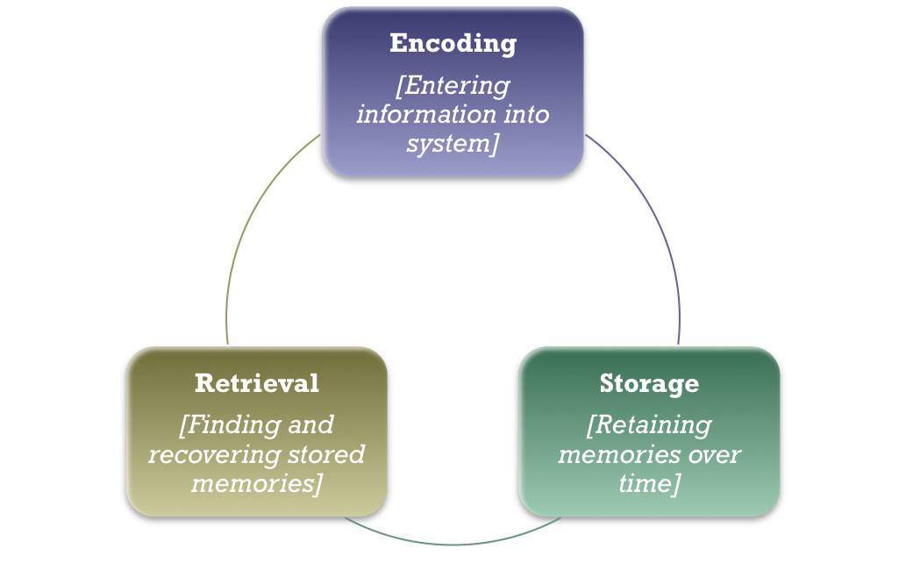
The Information Processing Metaphor
Like a computer, human memory consists of three interacting components:

