Slide 1
Kriegeskorte 2008 - RSA
Studying brain representations via similarity spaces

Slide 2
Simple premise
Relates modalities of human behavior (or brain-activity measurement) and information-processing models by comparing activity-pattern dissimilarity matrices
A similarity-matrix captures similarity between stimuli (either similarity in brain response, or similarity as computed by a model)
RSA is a 2-nd order similarity because it quantifies how alike two similarity-matrices are

Slide 3
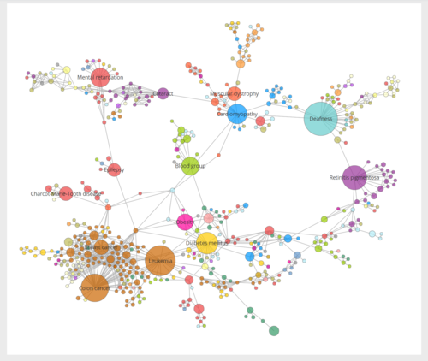
Rsa: features of characterizing
Modality independent
Could relate whatever modality of brain measurement to information processing models
Based on notion of similarity between stimuli.

Slide 4
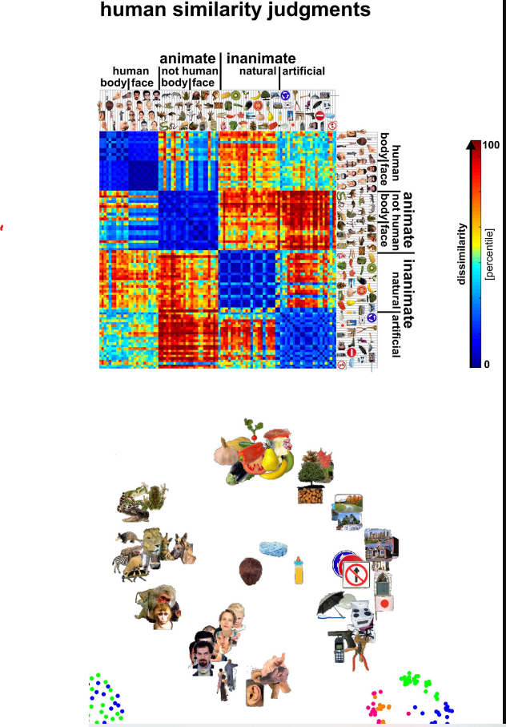
Constructing a single similarity matrix: behavior

Slide 5
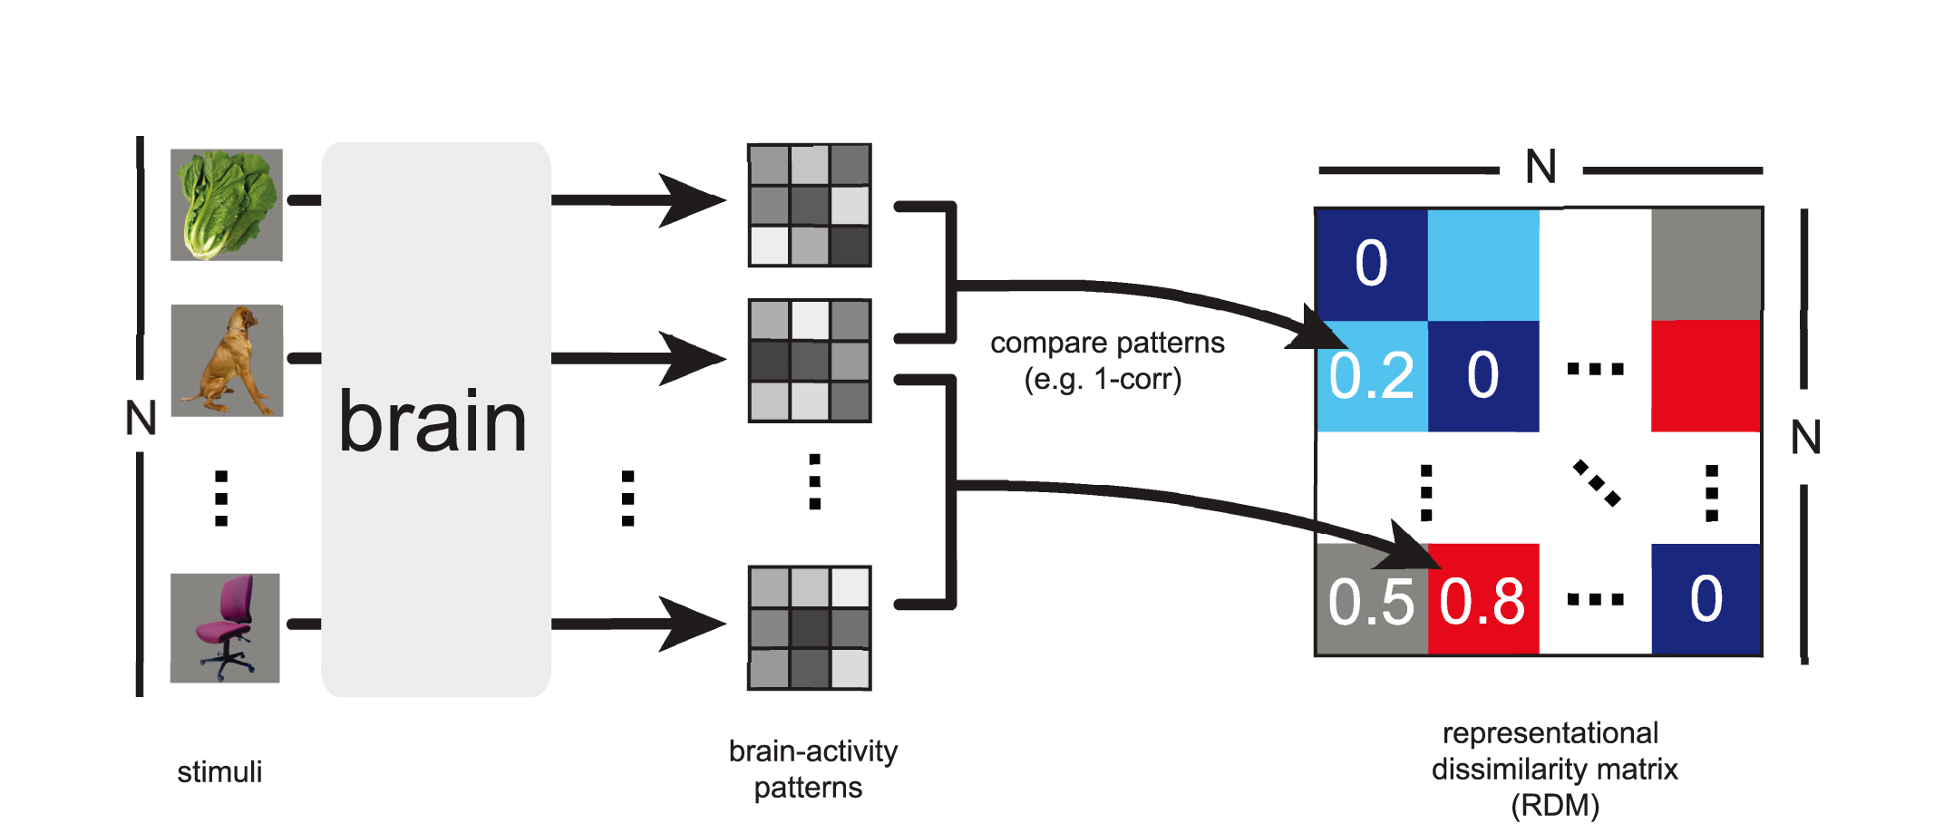
Constructing a single similarity matrix: brain
Representational Dissimilarity Matrix (RDM)

Slide 6
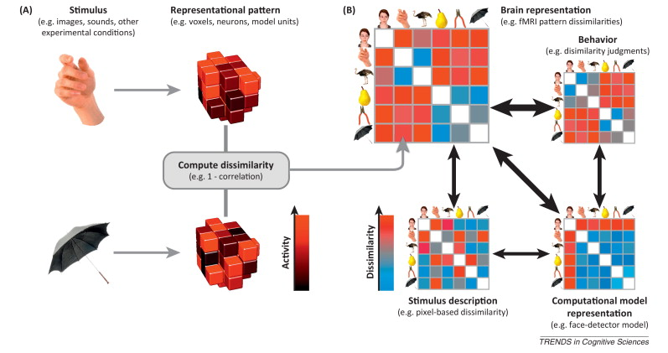
Comparing similarity matrices I
Example of 2 stimuli and brain response

Slide 7
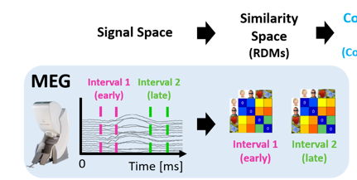
Applicable to sensor x time representations
Notes:
Compute AVG activity per interval window per sensor. Produces vector of length N sensors PER IMAGE. Correlate these between images.

Slide 8
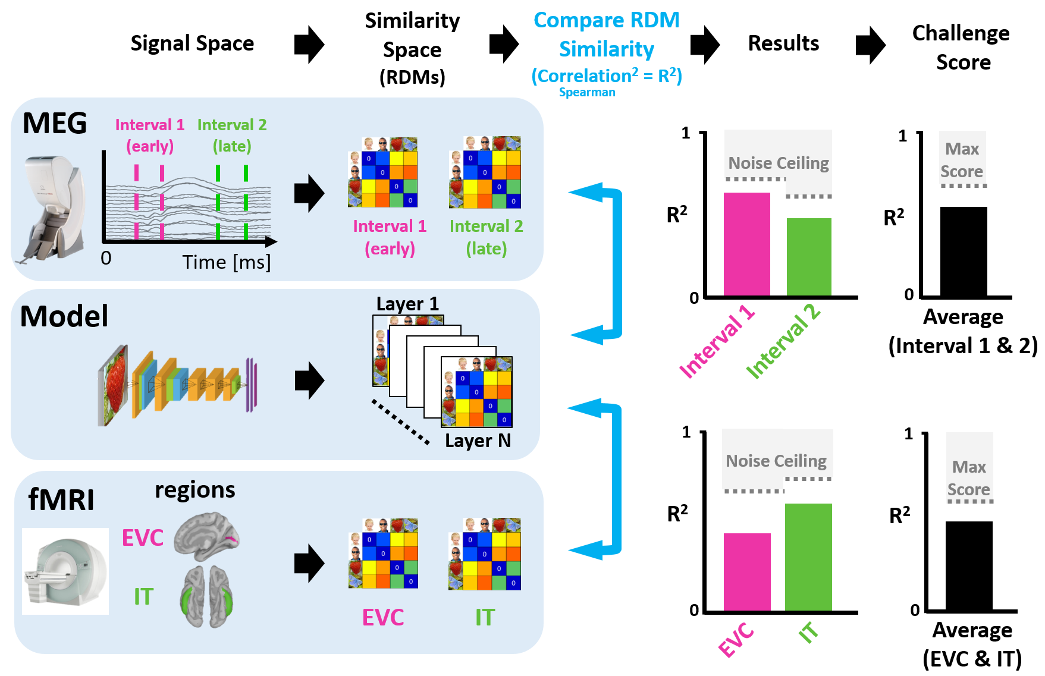
Comparing similarity matrices II
Extrastriate and Inferior temporal fit with DNN

Slide 9
Clarification points
The Noise ceiling is the maximal (ceiling) value expected given the noise in the data.
Oftentimes the noise ceiling is estimated as the correlation between the estimates of the responses in two independent repetitions of the same experimental procedure.
The idea that the ability of X to predict Y cannot exceed the noise ceiling, defined as the correlation between Ys (Y1 and Y2) obtained for the same stimuli on 2 different test data.

Slide 10
applications
Probe for 2-nd order similarity across brain regions (no model): what does this answer?
Relate brain and behavior
Find areas that code similarly for different stimuli across participants or even species.
Allows to code a single set of stimulus across multiple dimensions and code RDMs at each feature level. (Figure5 p. 8 for model, Figure 6 p.9 for RDM)

Slide 11
A note: RSA and loss of dimensions (I)
When using Human Similarity Judgments, we create an RDM directly from those judgments.
When using NeuroBio data to produce RDMs we use an S (stimuli/observation) x V (voxels/sensors/regions) matrix
When using Computational Models to produce RDMs we use an S (stimuli/observation) x F (features >0; can be 1) matrix.
When relating NeuroBio and Computational models the [S x V] and [S x F] matrices are first converted to RDMs.
Consider you can get the exact same RDM from different SxF matrices that differ massively on the number of F. This means that when we convert to RDMs we don’t have specific information on dimensions that produce the alignment.

Slide 12
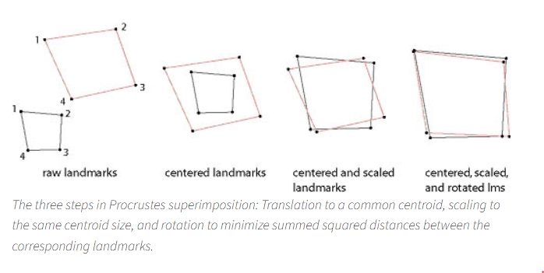
A note: RSA and loss of dimensions (II)
When dealing with 2 domains (brain, model) represented as observation x feature matrices, and when the two matrices reflect the same feature, we could evaluate the fit directly at the matrix level.
The following techniques all probe for strength of common dimensions between two matrices.
Procrustes rotation:
Principal component regression
Partial least squares correlation
Canonical correlation analysis
Notes:
Procrustes rotation> https://www.virtual-anthropology.com/virtual-anthropology/compare/geometric-morphometrics/procrustes-superimposition/

Slide 13
Context
Univariate and multivariate approaches

Slide 14
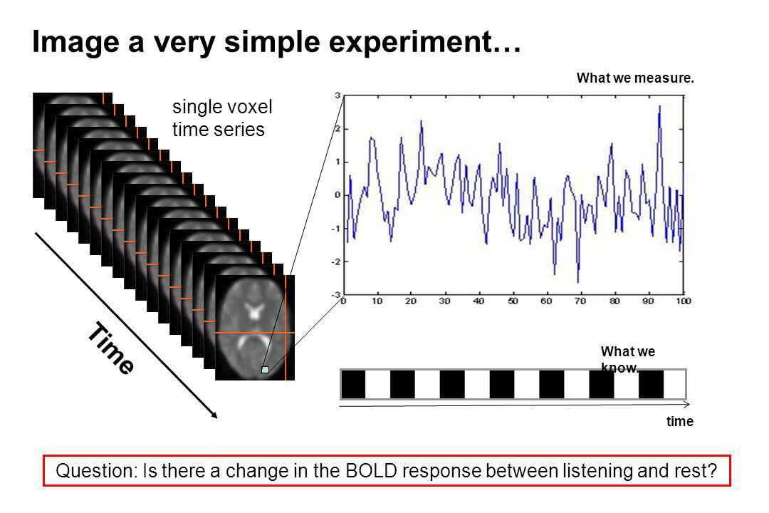
univariate

Slide 15
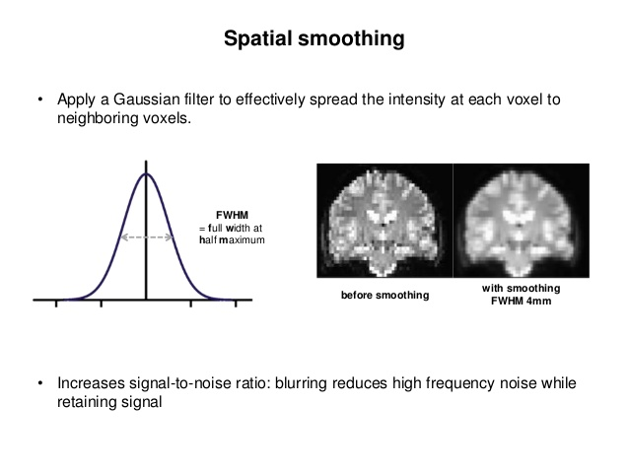
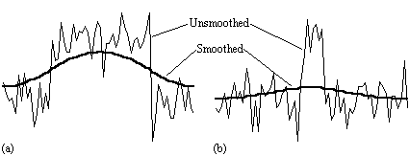
Univariate analyses: some weaknesses
Smoothing increases quality by reducing noise
Smoothing decreases adjacent-voxel independence
But we still analyze the voxels individually!

Slide 16
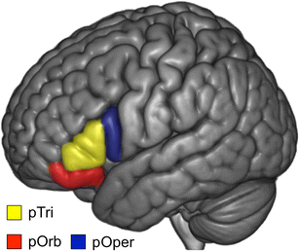



Information contained in multiple voxels: Multivariate analyses
Studied brain responses during narrative comprehension as participants focused on spatial, temporal, or action-related dimensions of a narrative.
We considered each IFG sub-region as a ‘voxel’
Univariate: regional activity in pOper higher for some conditions but null effect for Pars Triangularis.
Multivariate: Considered the entire set of values in each region, and quantified how similar those activity patterns were for the 3 conditions.
Cooper et al., 2011
Multivariate pair-wise similarity of 3 conditions in two IFG sub-regions

Slide 17
Decoding category (binary case) from brain

Slide 18
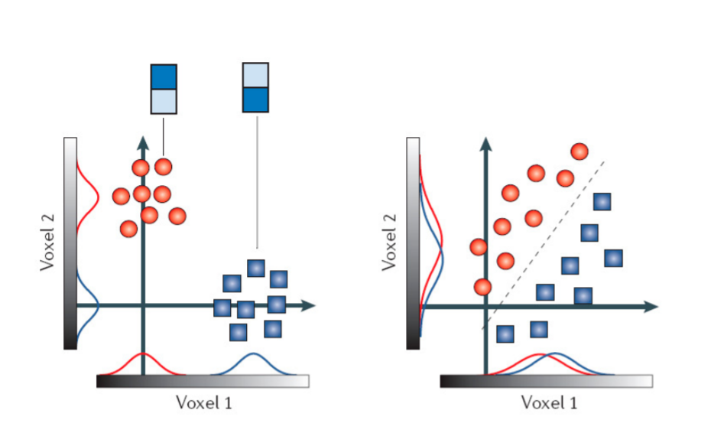
Multi variate patterns: multi voxel pattern analysis (mvpa)
Two conditions are presented, which produce different distributions of activity across trials. Each trial is captured by circle/square.
In Case1, each condition produces different activity levels, in both voxel1 and voxel2. Clearly, the region discriminates the clases.
NOTE: the way to read this: Case1. Voxel1: lower activity for red than blue. Voxel 2: lower activity for red than blue. Arrows cross centers of distributions.
In Case2, each condition produces highly similar mean activity levels in both Voxel1 and Voxel2. So you would conclude that the region does not discriminate if aggregating across univariate analysis.
BUT: the ‘region’ containing Voxels1,2 contains information about conditions in the Joint Distribution of voxel1,voxel2
Case 1
Case 2
http://imaging.mrc-cbu.cam.ac.uk/imaging/Introduction_to_fMRI_2010?action=AttachFile&do=get&target=Intro_fMRI_2010_03_MVPA.pdf
Notes:
FIX notes.

Slide 19
Clarification points
In classifying to classes given data in N voxels (of a single brain region), voxels are treated as features or column.
Response to each stimulus trial is coded as an activity pattern across the N voxels.
For each person, there are as many rows as total stimulus, and as many columns as voxels.
In a ML workflow, 80% of the rows will be used for training, and 20% for testing.

