Slide 1
Session
Management in PHP

Slide 2
Sessions
Sessions are similar to cookies and enable the functionality of storing temporary user information
The difference between cookies and sessions is as follows:
 Pertinent cookies store information on the local computer
 Session enables PHP to store information on the Web server

Slide 3
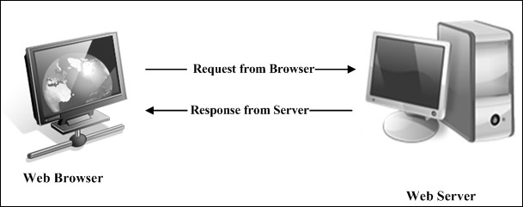
Sessions
2-3
Web browsers and Web servers have a stateless interaction and do not maintain track of user sessions
HTTP protocol
 Enables Web browsers to communicate with Web servers
 Has no methods or functions to maintain the status of a particular user

Slide 4
Sessions
Web sites that cannot depend on HTTP or Web servers for complex user interaction need session tracking
Refers to the total time the user accesses information on a particular Web site before exiting the Web site
Manages data for a particular user in a specific session
Enable distinguishing user specific information for the entire duration of the session

Slide 5
Importance of a Session
Consider an example, in a particular Web site, the user has to first register and then log on to access any information
For such authentication procedures, the state of the user has to be
maintained across the Web site
Web sites traditionally use GET and POST methods to pass user information from one script to another
When these methods are used, PHP assigns user information variables in the following format:
$name = $_GET['name'];
In the code, the variable $name stores the value that the script retrieves from
the HTML form
This process of transferring user information is time consuming and not essential for large Web sites

Slide 6
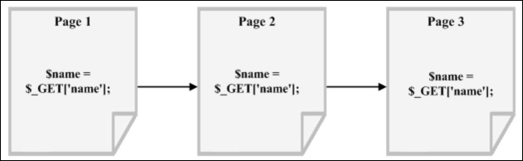
Importance of a Session
The code to be used across all the Web pages of the Web site is as follows:

Slide 7
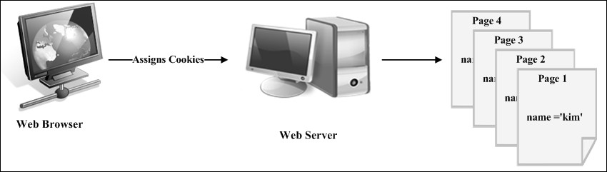
Importance of a Session
Consider a scenario, where it is required to store and retrieve information for 20 or more users across 10 different pages
Due to this disadvantage of using the GET and POST methods, Web developers prefer using cookies
Figure displays the assignment of cookies by the Web server to the browser

Slide 8
Importance of a Session
Cookies enable to store data into a variable and access it across all the pages of the Web site
Cookies are prone to security risks because the user information is saved at the client-end
The risks involved are greater when users access Web sites from a public computer or a shared computer

Slide 9
Importance of a Session
 Size of the cookie:
 The amount of information stored in the cookie determines the size of the cookie
 The size of the cookie determines the size of the Web page and increase in file size of the Web page results in poor performance
 Cookies disabled:
 Web sites store cookies on the hard disk of the client as a result the performance of computers reduces
 To improve the performance of such computers, users disable cookies making the assignment of cookies pointless

Slide 10
Importance of a Session
Sessions play an important role in such situations
Sessions eliminate deletion and assignment of new cookies to
the same user
The size of a cookie does not affect the performance of a Web site
Both the Web server and Web browser benefit because statistical information in the server database is accurate

Slide 11
Importance of a Session
Table explains the difference between cookies and sessions
Cookies | Sessions
Stores user information on the client system (Web Browser) | Stores user information on the Web server
Available even after the user exits the Web browser | Destroyed when the user exits the Web browser
Users can disable cookies | Users cannot disable sessions
Have size limits | Do not have size limits

Slide 12
Working with Sessions
Session commences when a user accesses a session-enabled Web site
Web server assigns a unique session ID to each user when the user starts a session
The scripts store and access user information through the session ID depending on the following two situations:
 Cookies enabled:
 Web server allots a session ID to the Web browser through a cookie, using
the setcookie()function
 Cookies enable transfer of user information between the browser and the server
 PHP stores session IDs in cookies

Slide 13
Working with Sessions
 Cookies disabled:
 Web server allots a session ID to the browser using the Uniform Resource
Locator (URL)
 The URL transfers user information from the browser to the server
 PHP stores the session variables in a file and names the file based on the session ID
While using a session, PHP stores all the user information in a file on the Web server
The file includes a session ID that is related the user's session variable
Each session ID identifies a different user and relates to a file that belongs to that user
PHP destroys the session file once the user exits the Web site

Slide 14
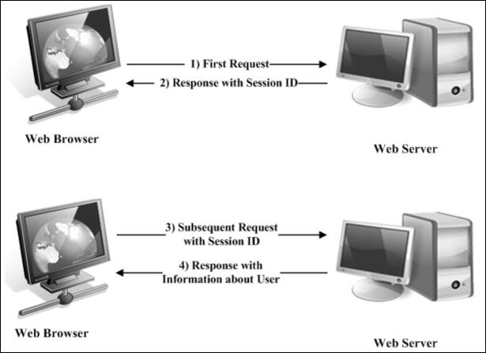
Working with Sessions

Slide 15
Working with Sessions
PHP works with sessions in the following sequence:
 User accesses a session-enabled Web site which checks the user identity
 If the user is a new visitor, the Web site allocates a unique session ID to the user. The Web site saves a cookie containing the session ID on the Web browser
 The Web browser records the cookie that holds the session ID. The browser uses the same cookie to retrieve the session ID and record all the session-related information
 The session file is destroyed from the Web server, when the user exists from the Web site

Slide 16
Life cycle of a Session
There are three stages in the life cycle of a session based on the communication between the Web browser and the Web server
They are as follows:
 Starting the session
 Registering the session variable
 Ending the session

Slide 17
Starting the Session
A session starts when a user logs on to the Web site
The session_start()function enables to start a session
The process of starting a session is also called as initializing a session
The session file is created in the /tmp directory
PHP assigns a name to this file based on the unique session identifier value generated by the PHP engine
The session identifier is also known as the session ID
The session ID is a hexadecimal string of 32 digits

Slide 18
Starting the Session
2-4
The file naming convention for the session file is as follows:
sess_<32_digit_hexadecimal_value>
The session file name is always preceded by sess_ and is followed by a random 32 digit hexadecimal value
The Web server passes the session ID as a response to the browser
The response sets up a session cookie in the browser with the name
PHPSESSID and the value of the identifier
The session_start()function must be specified on the top of every Web page or before the start of the actual coding
If the session is valid and existing, it activates the frozen variables of the session
If the session is invalid or non existing, it creates a session ID for the new
session

Slide 19
Starting the Session
3-4
The session_start()function is as follows:
Syntax
session_start();
To start a session, perform the following steps:
  Open a new file in gedit text editor
  Enter the following code:
Snippet
<?php
// initializing a session session_start();
/* The session_id() function displays the session id
that PHP allots to
a user. */
echo "The Session id is " .session_id(). ".<br>";
?>

Slide 20
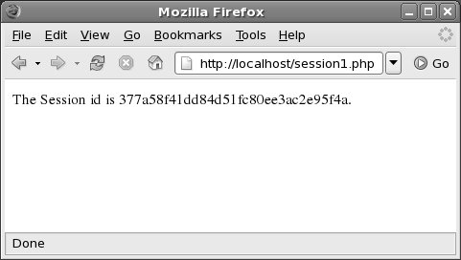
Starting the Session
Save the script as session1.php in the
/usr/local/apache2/htdocs/ directory.
Open the Mozilla Firefox Web browser.
Enter http://localhost/session1.php in the Address bar and press Enter.
The following output is displayed:

Slide 21
Registering the Session Variable
Variables in a session file contain user specific information
Session library enables creation, serialization, and storage of session
data
There are three methods to set a session variable, which are as follows:
 $_SESSION[]- recommended for PHP 4.1.0
 $HTTP_SESSION_VARS[]- recommended for PHP 4.0.6 or less
 session_register()- not recommended as it has been deprecated
Session variables can be of any data type such as integer, string, Boolean, or object
PHP stores the session variables in a session file by serializing the
values
PHP automatically handles the process of serializing the session variables

Slide 22
Registering the Session Variable
Steps to register the value of a session variable are as follows:
  Open a new file in gedit text editor
  Enter the following code:
Snippet
<?php
session_start();
$_SESSION['myname']= "Jessica";
?>
<HTML>
<HEAD> <TITLE> Session </TITLE></HEAD>
<BODY>
<A HREF = "mypage.php"> Homepage of MyPage.com </A>
</BODY>
</HTML>

Slide 23
Registering the Session Variable
3. Save the file as sessionstart.php in the
/usr/local/apache2/htdocs/directory
To display the value of the session variable, perform the following steps:
  Open a new file in gedit text editor.
  Enter the following code:
Snippet
<?php
session_start();
$myname = $_SESSION['myname'];
?>
<HTML>
<HEAD> <TITLE> Homepage </TITLE></HEAD>
<BODY>
Welcome <?php echo $myname ?> to MyPage.com <br>
</BODY>
</HTML>

Slide 24
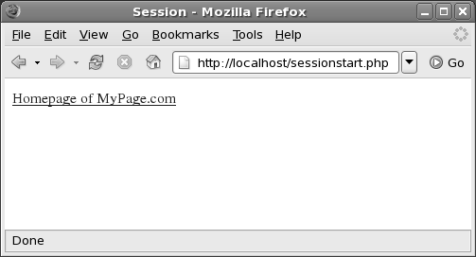
Registering the Session Variable
Save the file as mypage.php in the
/usr/local/apache2/htdocs/directory
Open the Mozilla Firefox Web browser
Enter http://localhost/sessionstart.php in the Address bar and press Enter
The following output is displayed:

Slide 25
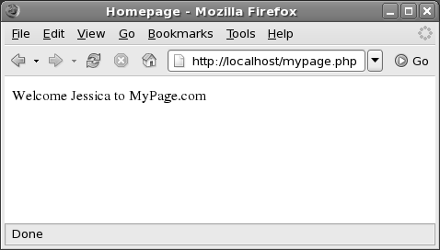
Registering the Session Variable
6. Click Homepage of MyPage.com
The Homepage page appears with the message,
Welcome Jessica to MyPage.com

Slide 26
Ending the Session
When the user logs out of the Web site, the PHP script executes the session_destroy()function
When the session file is deleted, the $PHPSESID cookie is not removed from the Web browser
The syntax for the session_destroy()function is as follows:
Syntax
session_destroy();

Slide 27
Ending the Session
PHP uses the following configuration directives when a session ends:
 gc_maxlifetime():
 Enables PHP to determine the time to wait before ending a session and the process of cleaning up is called as garbage collection
 gc_probability():
 Enables PHP to determine with what probability the garbage collection routine must be invoked

Slide 28
Ending the Session
To destroy a session, perform the following steps:
  Open a new file in gedit text editor
  Enter the following code:
Snippet
<?php
session_start();
$myname = $_SESSION['myname'];
// The session_unset() function unregisters a session variable.
session_unset(); session_destroy();
echo "Session destroyed!";

Slide 29
Ending the Session
?>
<HTML>
<HEAD> <TITLE> Session </TITLE></HEAD>
<BODY>
<br>
<A HREF = "mypage.php"> Homepage of MyPage.com </A>
</BODY>
</HTML>
Save the file as sessiondestroy.php in the
/usr/local/apache2/htdocs/directory
Open the Mozilla Firefox Web browser

Slide 30
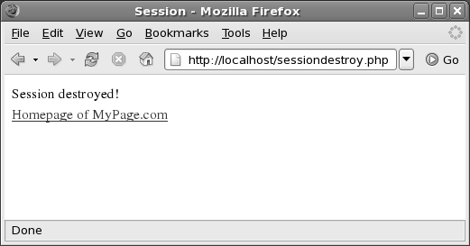
Ending the Session
5. Enter http://localhost/sessiondestroy.php in the Address bar and press Enter
The following output is displayed:

Slide 31
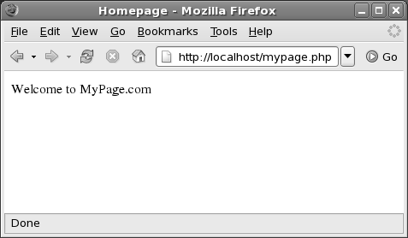
Ending the Session
6. To view the execution of the session_destroy()function, click the Homepage of MyPage.com hyperlink
The following output is displayed:
The name Jessica does not appear in the message because the variable has been cleared.

Slide 32
Working with the php.ini File
A Web server can contain multiple php.ini files
Create a php.ini file if it does not exist on the Web server
The complete source code must be downloaded to create a new
php.ini file
PHP interpreter works according to the instructions included in the
php.ini file
The Web server searches sequentially for the php.ini file in the following locations:
 Directory where the PHP script was called
 Root of the Web directory
 Directory containing the default.ini file on the Web server

Slide 33
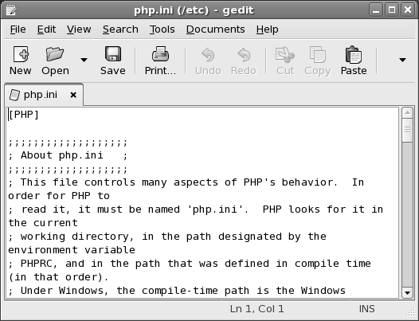
Working with the php.ini File
Figure displays the PHP configuration file
The php.ini file contains directive listed in the directive
= value format.
You can use a semicolon to add a comment to the file.

Slide 34
Working with the php.ini File
Table lists the categories in the php.ini file
Categories | Options
Language Options | Enable PHP scripting language engine under Apache
 | Allow ASP style tags
 | Enforce year 2000 compliance
Safe Mode | Perform a UID compare check when opening files
 | Allow executables under specific directories to be executed via exec family
 | Allow user set environment variables that begin with PHP prefix
Font Colors | Indicate the colors that PHP uses for highlighting syntax
Misc | Indicate whether or not PHP discloses the fact that it is installed on the server
Resource Limits | Indicate the maximum time for script execution
 | Indicate the maximum time for parsing request data
 | Indicate the maximum amount of memory a script requires
Data Handling | Control list of separators used in PHP generated URLs to separate arguments
 | Describe the order in which PHP registers Get, Post, Cookie, Environment and built-in variables
Path and Directories | Specifies the name of the directory under which PHP opens the script
 | Specifies the name of the directory under which the loadable extensions exist

Slide 35
Working with the php.ini File
Categories | Options
Error handling and logging | Report all errors and warnings
 | Report fatal compile time errors
 | Report fatal run-time errors
 | Report non-fatal error
 | Report fatal errors that occur during initial startup of PHP
 | Report user generated errors, warnings, and messages
Magic Quotes | Set magic quotes for incoming Get, Post, Cookie data
 | Use Sybase style magic quotes
 | Automatically adds file before or after any PHP document
File Uploads | Indicate whether or not to allow HTTP file uploads
 | Indicate temporary directory for HTTP uploaded files
 | Indicate the maximum allowed size for upload files
Session | Store and retrieve data
 | Indicate whether or not cookies should be used
 | Initializes session on request startup
 | Serializes data

Slide 36
Working with the php.ini File
Session category of the php.ini file include options, which are as follows:
 session.save_handler - specifies how PHP stores and retrieves session variables
 Either of the following values can be used for this option:
 files: indicates the use of the session files
 mm: stores and retrieves data from a shared memory
 user: stores and retrieves variables with custom defined handlers

Slide 37
Working with the php.ini File
 session.save_path - specifies the name of the directory where the session files will be stored
 session.use_cookies - indicates whether PHP must send a session ID to the Web browser through a cookie. The value to enable a cookie to store a session ID is 1
 session.use_only_cookies - indicates whether the modules can use only cookies for storing session IDs. By default, this option is disabled
 session.cookie_lifetime - specifies the lifetime of
the cookie and the value is specified in seconds

Slide 38
Working with the php.ini File
 session.name - manages the cookie name and form attributes such as GET and POST that holds the session ID. By default, the value of this option is PHPSESSID
 session.auto_start - enables sessions to automatically initialize if the session ID is not found in the browser request
 session.cookie_secure - specifies whether the cookies must be sent over secured connections. By default, the cookies are not sent through secured connections

Slide 39
Working with the php.ini File
Other settings can also be modified in the php.ini file, such as:
 register_globals - controls the functioning of server, forms, and
environment variables
If this option is disabled, variables can be retrieved using the GET or POST
methods as follows:
$_POST['$variable_name'];
$_GET['$variable_name'];
If register_globals is enabled, the variable can be directly accessed using the variable name as follows:
$storeValue = $variable_name;
$variable_name is the name of the variable that contains the session data of another Web page
The variable $storeValue stores the information included in the variable
variable_name

Slide 40
Working with the php.ini File
 upload_tmp_dir - sets the location of the temporary file that is uploaded with the HTML form
 display_errors and display_startup_errors - enables PHP to display errors on the Web browser
 log_errors and error_log - enables PHP to display error logs

Slide 41
Summary
Cookies provide the functionality of storing temporary user information on the local computer
Sessions enable PHP to store user information on the Web server
HTTP is considered as a stateless protocol that enables Web browsers to communicate with the Web servers
Session refers to the total time a user accesses information on a particular Web site before exiting the Web site
A PHP script can access the session ID when the Web user enables or disables cookies
The three stages in the life cycle of a session are: starting a session, registering a session variable, and ending a session

