Slide 1
MySQL

Slide 2
What is MySQL ?
MySQL is a relational database management system
MySQL is open-source
MySQL is free
MySQL is ideal for both small and large applications
MySQL is very fast, reliable, scalable, and easy to use
MySQL is cross-platform

Slide 3
What is SQL?
SQL is the standard language for dealing with Relational Databases.
SQL is used to insert, search, update, and delete database records.
SQL works by understanding and analyzing data of virtually any size, from small datasets to large stacks.
It's a very powerful tool that enables you to perform many functions at high efficiency and speed

Slide 4
Features of SQL
SQL will help you to communicate with the database by commands. Here are some of the top features of SQL Database:
It enables users to extract data from the relationship database.
It enables users to set up databases and tables.
It can be used to update, insert, delete and edit databases and tables.
It provides security and allows you to specify permissions.
Allows people to process information in new ways.

Slide 5
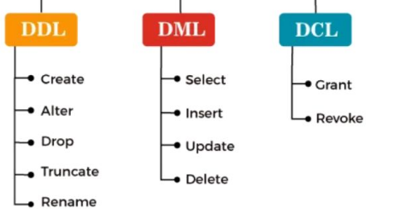
Types of sql commands

Slide 6
Data Definition Language (DDL)
CREATE :
  Create the database or its objects using the CREATE command (like table, index, function, views, store procedure, and triggers).
DROP :
  Use the DROP command to remove objects from the database.
ALTER:
  This is used to change the database's structure.
TRUNCATE:
  is one of the most important DDL commands in SQL, TRUNCATE eliminates all records from a table, as well as any spaces set aside for the records.
COMMENT:
  This is employed to include comments in the data dictionary.

Slide 7
ALTER COMMAND
Add column in a table
Changing data type of a column
Change column Name
Adding constraints to a column
Changing column position
Delete column
Renaming Tables

Slide 8
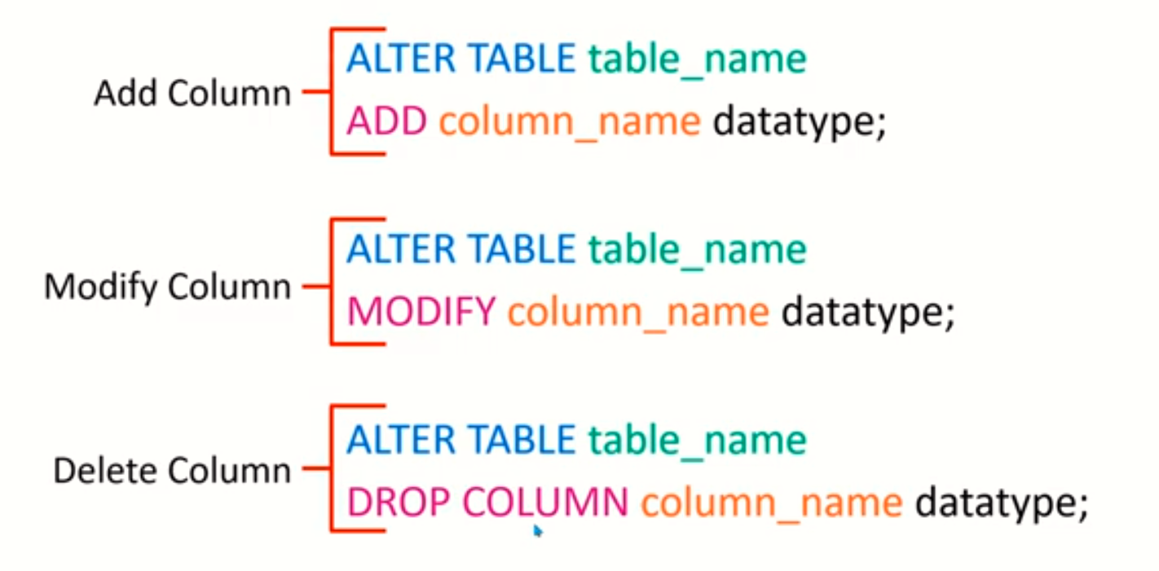
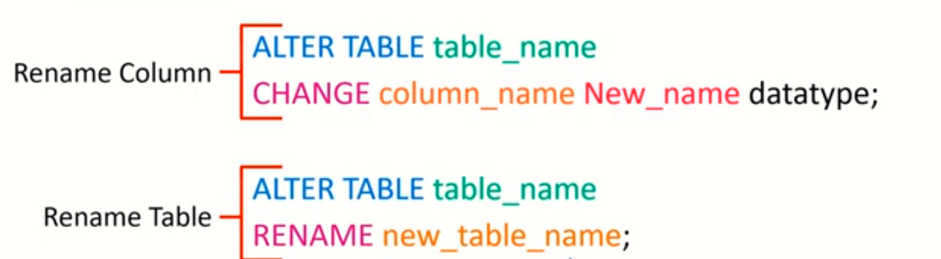

Slide 9
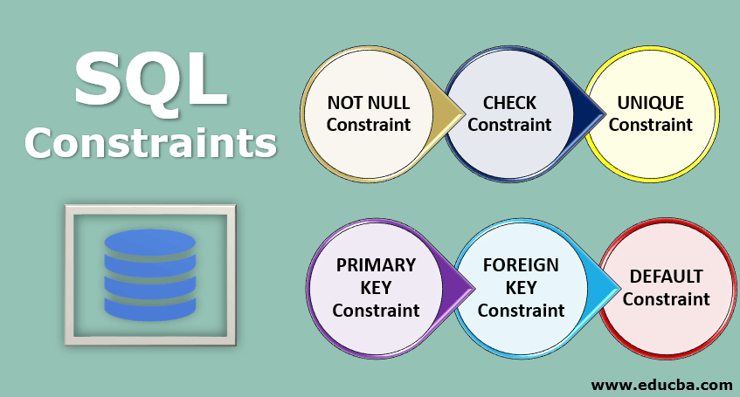
SQL CONSTRAINTS
SQL constraints are used to specify rules for the data in a table.
Constraints are used to limit the type of data that can go into a table. This ensures the accuracy and reliability of the data in the table. If there is any violation between the constraint and the data action, the action is aborted.

Slide 10
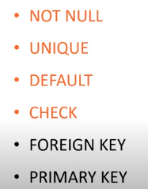
List Of Constraints in Mysql
id | Name | age | gender | city
1 | Hamna | 17 | Female | karachi
2 | Nimra | 19 | Female | Karachi
 | sameer | 21 |  | karachi
Not Null
Default ‘Karachi’
Not Null
Check(age>=18)
Unique

Slide 11
Create Table with constraints Syntax
Create Table TableName(
id int NOT NULL UNIQUE,
Name varchar(50) NOT NULL,
age INT NOT NULL CHECK(age>=18),
gender VARCHAR(10) NOT NULL,
phone VARCHAR(10) NOT NULL UNIQUE,
city VARCHAR(10) NOT NULL DEFAULT ‘Karachi’
);

Slide 13
Data Manipulation Language (DML)
SELECT:
  This command is used to retrieve rows from a table. SELECT is the most widely used DML command in SQL.
UPDATE:
  This command modifies data of one or more records.
INSERT:
  This command adds one or more records to a database table.
DELETE:
  This command removes one or more records from a table according to specified conditions

Slide 14
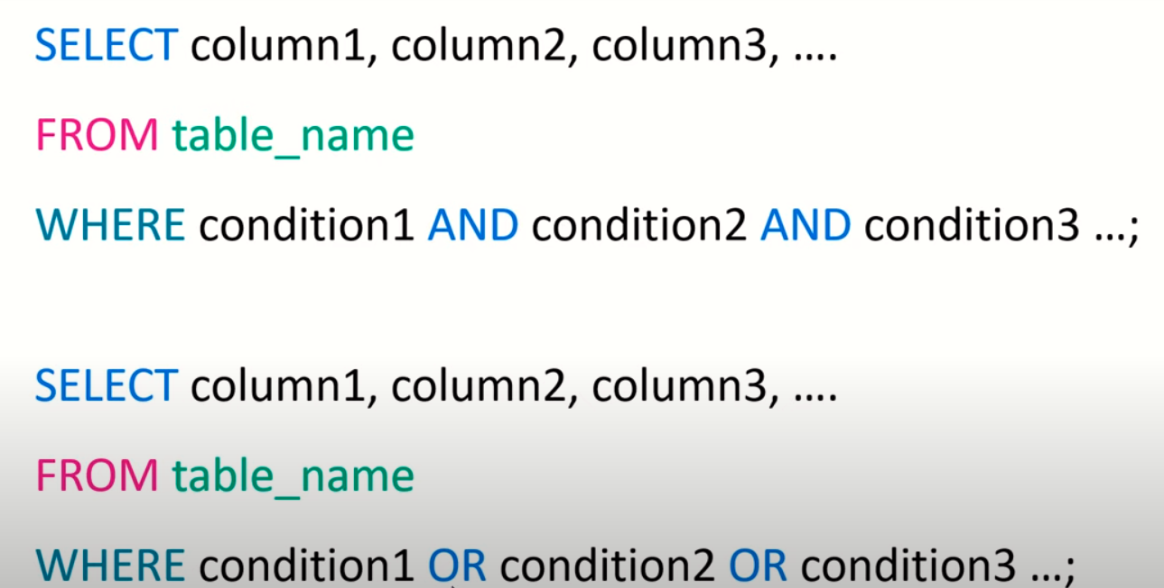
AND, OR, NOT Commands

Slide 15
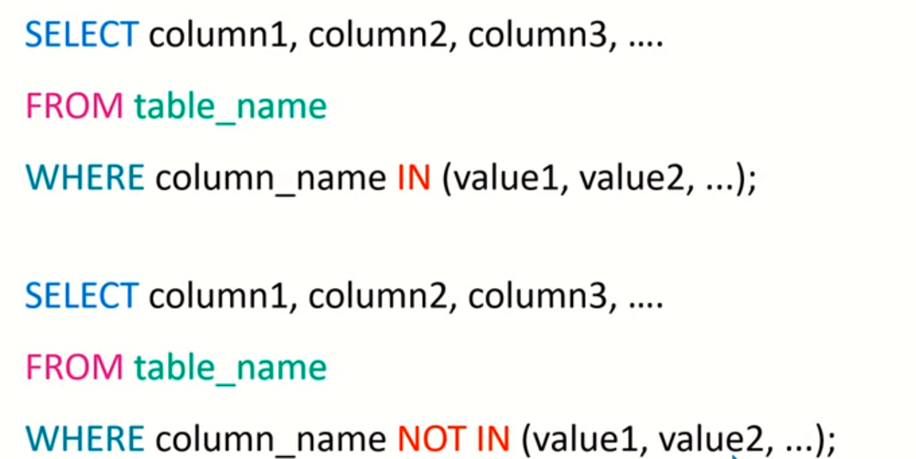
IN & NOT IN Commands

Slide 16
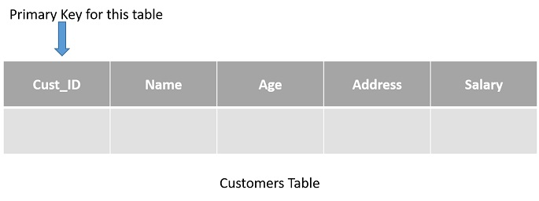
PRIMARY KEY Constraint

Slide 17
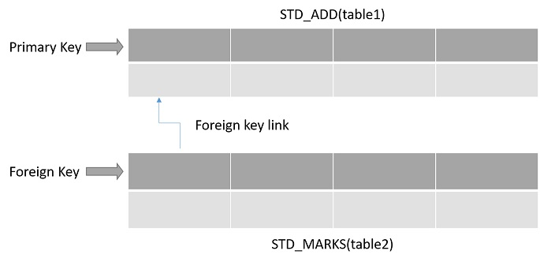
FOREIGN KEY Constraint

Slide 18
Joins in MySQL
Inner Join
Left Join
Right Join
Cross Join

Slide 19
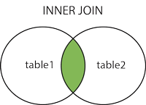
SQL INNER JOIN
The INNER JOIN keyword selects records that have matching values in both tables.
INNER JOIN Syntax
SELECT column_name(s)
FROM table1
INNER JOIN table2
ON table1.column_name = table2.column_name;

Slide 20
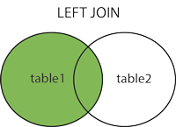
SQL LEFT JOIN
The LEFT JOIN keyword returns all records from the left table (table1), and the matching records from the right table (table2). The result is 0 records from the right side, if there is no match.
LEFT JOIN Syntax
SELECT column_name(s)
FROM table1
LEFT JOIN table2
ON table1.column_name = table2.column_name;

Slide 21
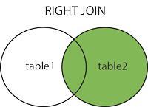
SQL RIGHT JOIN
The RIGHT JOIN keyword returns all records from the right table (table2), and the matching records from the left table (table1). The result is 0 records from the left side, if there is no match.
RIGHT JOIN Syntax
SELECT column_name(s)
FROM table1
RIGHT JOIN table2
ON table1.column_name = table2.column_name;

Slide 22
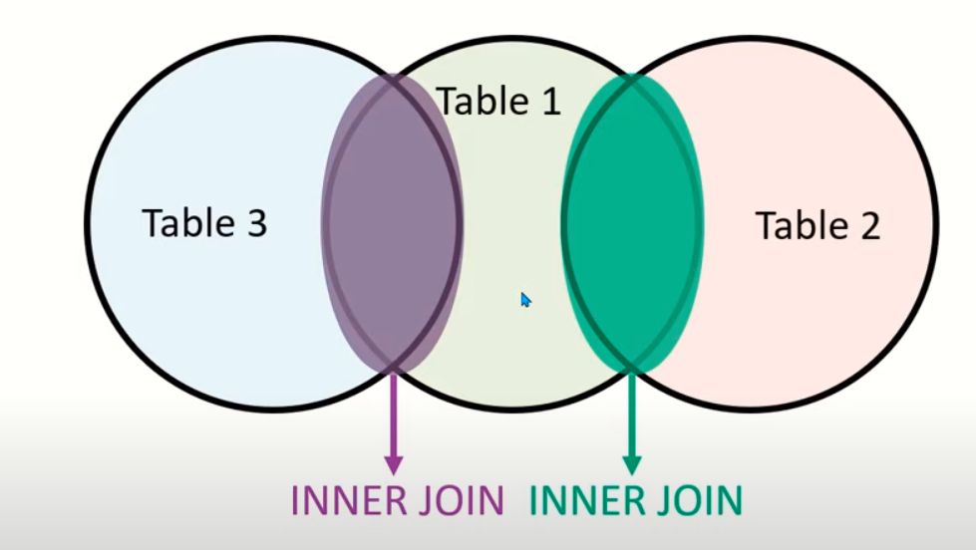
Multiple Tables JOIN
For each new table an extra JOIN condition is added.
Multiple Tables Join Syntax
SELECT column-names
FROM table-name1
JOIN table-name2 ON column-name1 = column-name2
JOIN table-name3 ON column-name3 = column-name4
JOIN table-name4 ON column-name5 = column-name6
...
WHERE condition

Slide 23
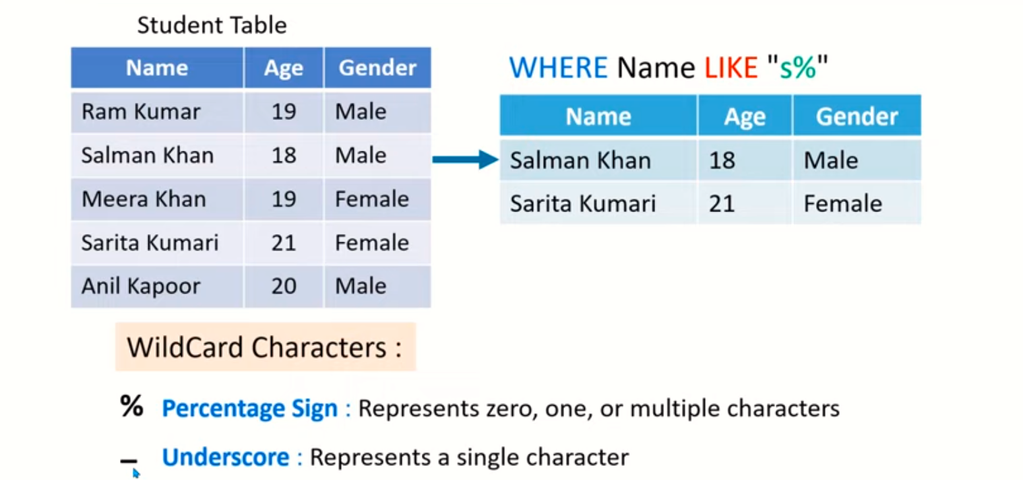
LIKE COMMAND

Slide 24
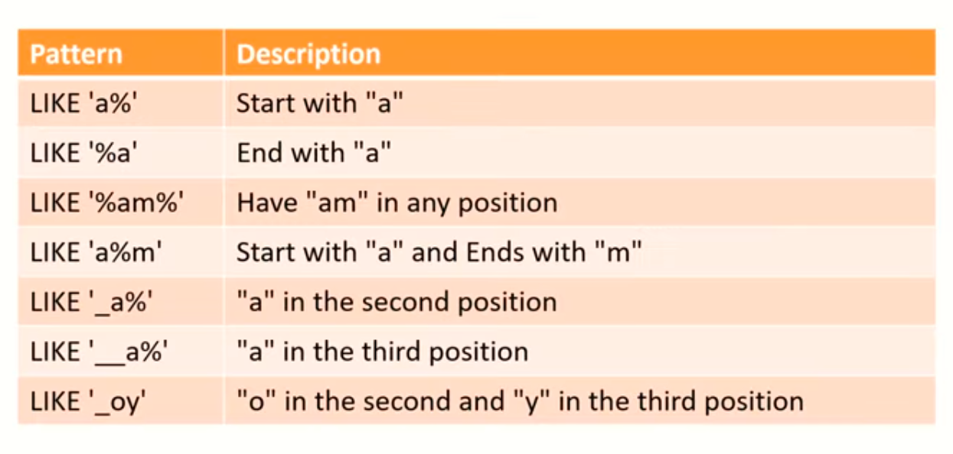

Slide 25
SQL LIMIT and OFFSET clause
To limit the number of rows returned by a select statement, you use the LIMIT and OFFSET clauses.
The following shows the syntax of LIMIT & OFFSET clauses:
The LIMIT row_count determines the number of rows (row_count) returned by the query.
The OFFSET offset clause skips the offset rows before beginning to return the rows.
Limit & Offset Syntax
SELECT
column_list
FROM
table1
ORDER BY column_list
LIMIT row_count OFFSET offset;

