Slide 1
Evolution of Version Control Systems (VCS)
Version Control Git

Slide 2

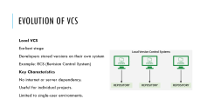
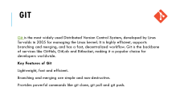
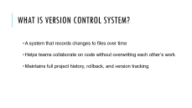
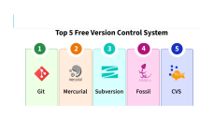

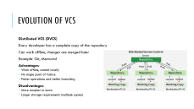
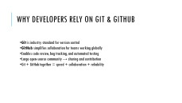
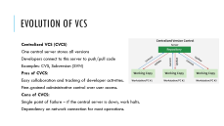
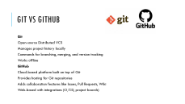

Slide 3
What is Version Control System?
  A system that records changes to files over time
  Helps teams collaborate on code without overwriting each other’s work
  Maintains full project history, rollback, and version tracking

Slide 4
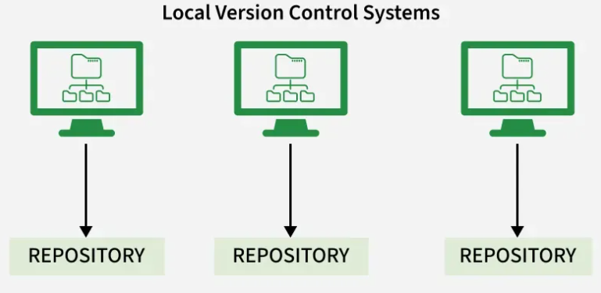
Evolution of VCS
Local VCS
Earliest stage
Developers stored versions on their own system
Example: RCS (Revision Control System)
Key Characteristics
No internet or server dependency.
Useful for individual projects.
Limited to single-user environments.

Slide 5
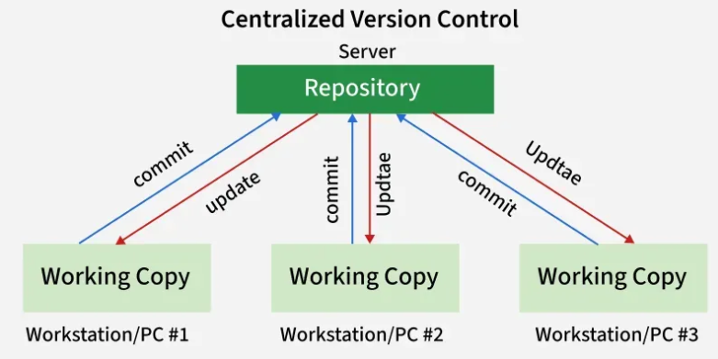
Evolution of VCS
Centralized VCS (CVCS)
One central server stores all versions
Developers connect to this server to push/pull code
Examples: CVS, Subversion (SVN)
Pros of CVCS:
Easy collaboration and tracking of developer activities.
Fine-grained administrative control over user access.
Cons of CVCS:
Single point of failure – if the central server is down, work halts.
Dependency on network connection for most operations.

Slide 6
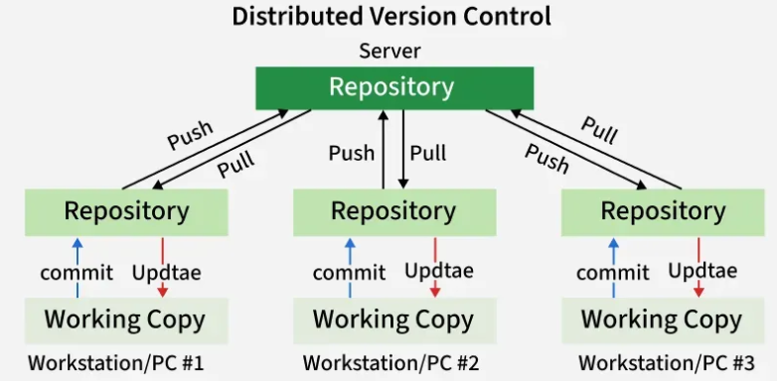
Evolution of VCS
Distributed VCS (DVCS)
Every developer has a complete copy of the repository
Can work offline, changes are merged later
Example: Git, Mercurial
Advantages:
  Work offline, commit locally
  No single point of failure
  Faster operations and better branching
Disadvantages:
  More complex to learn
  Larger storage requirements (multiple copies)

Slide 7
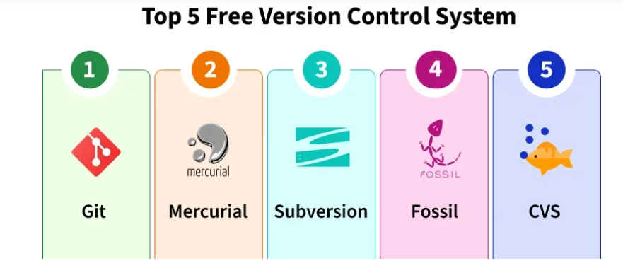

Slide 8

Git
Git is the most widely used Distributed Version Control System, developed by Linus Torvalds in 2005 for managing the Linux kernel. It is highly efficient, supports branching and merging, and has a fast, decentralized workflow. Git is the backbone of services like GitHub, GitLab and Bitbucket, making it a popular choice for developers worldwide.
Key Features of Git
Lightweight, fast and efficient.
Branching and merging are simple and non-destructive.
Provides powerful commands like git clone, git pull and git push.

Slide 9
Introduction to Github
GitHub is a web-based platform that uses Git, a version control system, to help developers manage and track changes in their code.
It allows multiple people to collaborate on a project, track revisions, and contribute to code from anywhere in the world.
GitHub offers both free and paid plans, catering to individuals and large organizations alike.

Slide 10
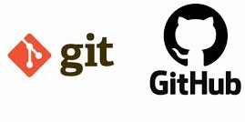
Git vs GitHub
Git
Open-source Distributed VCS
Manages project history locally
Commands for branching, merging, and version tracking
Works offline
GitHub
Cloud-based platform built on top of Git
Provides hosting for Git repositories
Adds collaboration features like Issues, Pull Requests, Wiki
Web-based with integrations (CI/CD, project boards)

Slide 11
Why Developers Rely on Git & GitHub
Git is industry standard for version control
GitHub simplifies collaboration for teams working globally
Enables code review, bug tracking, and automated testing
Large open-source community → sharing and contribution
Git + GitHub together = speed + collaboration + reliability

Slide 12
GitHub Key Features
Repositories
Project storage with code, documentation, and history
Issues
Track bugs, tasks, improvements
Assign labels and milestones
Pull Requests (PRs)
Propose changes to repository
Team members review and discuss before merging
Actions (CI/CD)
Automate builds, tests, and deployments
Collaboration Tools
Teams, contributors, access control
Project boards (like Trello style)

