Slide 1
Git Essentials and Commit Management
Version Control Git

Slide 2
Git File Lifecycle
When you add or modify files in Git, they pass through different stages:
Untracked
  New file created but not added to Git
  Git does not track it yet
  Example: touch notes.txt → initially untracked
Unmodified (Clean)
  File is already in Git and unchanged
  No action needed
Modified
  File content changed but not yet staged
  Example: Editing a file after last commit
Staged (Index)
  File changes marked for next commit
  Done with git add filename
Committed
  File changes saved in Git history permanently
  Done with git commit -m "message"

Slide 3
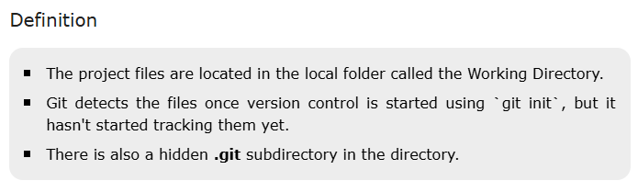
Working Directory
The Working Directory is where project's files are kept at the beginning of the Git lifecycle. It symbolizes the local setting in which we actively write, edit, and refine our code.

Slide 4
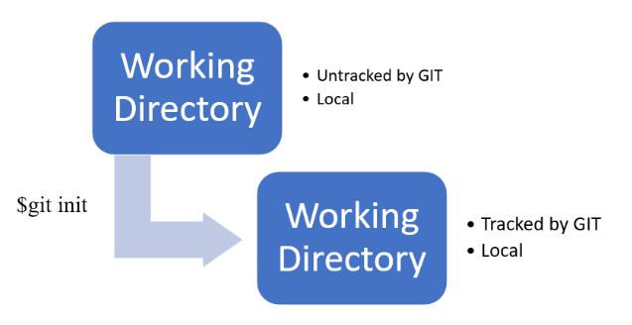
Tracked vs. Untracked Files
The Working Directory contains files that can be staged, edited, and untracked.
Files are initially untracked unless we decide to add them.
We can specify which files to track and which to ignore; for example, we might exclude generated or temporary files.

Slide 5
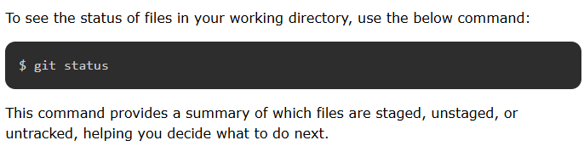
Management
This directory serves as a work space for editing and adding files.
Until they are specifically added to the staging area, changes made here have no effect on the version history.
We can control which changes are tracked by doing this.
Transition to Staging Area
Changes need to be staged using `git add` in order to be included in version history.
Files are not included in the commit history and are kept in the working directory until they are staged.

Slide 6
Staging Area
The staging area serves as a sandbox for grouping, adding, and arranging the files that need to be committed to Git in order to track their versions.
Definition
A crucial stage in the Git lifecycle is the Staging Area, where we get files ready for commits.
Between the Working Directory and the Git Directory, it serves as a buffer.
The files we want to include in the next commit are selected and organized here.

Slide 7
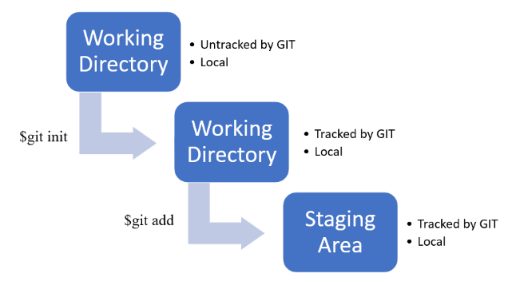
Adding Files
The git add command is used to move files from the Working Directory to the Staging Area.
The files' current state is copied to the staging area using this command.
We can exclude some files like temporary or dynamically generated files, by selecting which files to add.

Slide 8
Indexing
Indexing is the process of adding files to the staging area.
The snapshots of the files we plan to commit are kept in the staging area, commonly referred to as the index.
Management
Staging area manages changes included in the commit.
It ensures that only specific files that are relevant to previous versions of the project are tracked.

Slide 9
Git Directory
Git stores all version history, metadata, and configuration data internally in the Git Directory.
It includes configuration files, the index (staging area), the complete history of commits, and more.
Definition
Git keeps all of a repository's object database and metadata in the Git Directory.
It includes configuration files, the index (staging area), and the whole commit history.
Git needs this directory in order to oversee and monitor every aspect of version control.

Slide 10
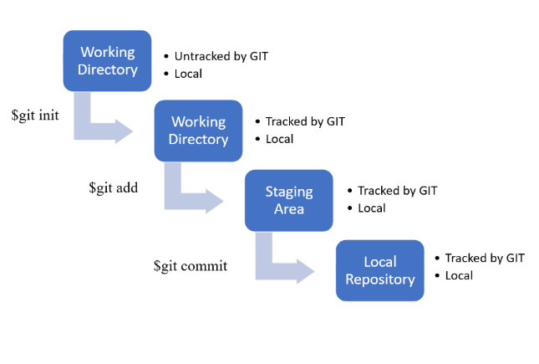
Storing Commit Data
The Git Directory stores the commit data, which includes snapshots of the staged files, commit messages, author information, and timestamps, when we use the git commit command.
All of the commit objects, which are essential for monitoring the project's version history, are stored in this directory.

Slide 11
Metadata
Along with the contents from each commit, the Git Directory also contains other crucial metadata, such as branch details, configuration settings, and change history.
This ensures that all project versions can be efficiently retrieved and managed by Git.
Role
Git's ability to manage versions, keep track of changes, and offer the features needed for version control all depend on the Git Directory.
It acts as the database for the repository, holding all the data required for history management and version tracking.

Slide 12
GitHub Integration in the Git Lifecycle
Git manages version control locally, but GitHub adds more stages for remote storage and collaboration.
GitHub fits into the Git lifecycle in the following ways:
Remote Repository
A remote repository is a version of your project hosted on a server or a cloud service like GitHub, GitLab, or BitBucket. It allows you to share your changes with others and collaborate on the project. It serves as a central repository for a web project.
It is possible for numerous users to view, access, and work on the project using the remote repository.

Slide 13
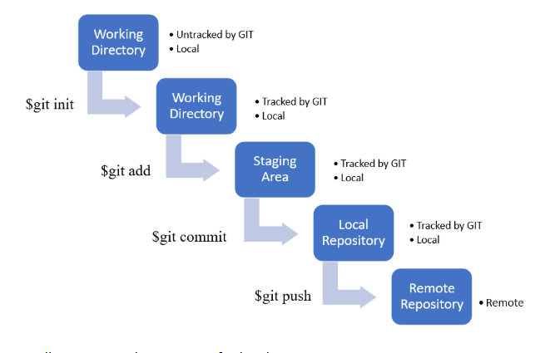

Slide 14
Pushing Changes
To upload your commits from your local repository to a remote repository, use the `git push` command:
$ git push
Pulling Changes
To update your local repository with changes from the remote repository, use the git pull command:
$ git pull origin main

Slide 15
Working with Branches
Branches are an essential feature of Git, allowing you to work on different features, fixes, or experiments in isolation. This section explores how branches fit into the Git lifecycle.
Creating a Branch
To create a new branch, use the `git branch` command:
$ git branch <branch-name>
This command creates a new branch but does not switch to it. To create and switch to a new branch simultaneously, use:
$ git checkout -b <branch-name>
Switching Branches
To switch between branches, use the `git checkout` command:
$ git checkout <branch-name>
Switching branches updates the files in your working directory to match the state of the branch you are switching to, allowing you to work on different tasks simultaneously.

Slide 16
Merging Branches
Merging is the process of combining changes from one branch into another. To merge changes, switch to the branch you want to merge into and use the `git merge` command:
$ git checkout main
$ git merge <branch-name>
This command incorporates changes from <branch-name> into the main branch. If there are conflicts, Git will notify you, and you'll need to resolve them manually.
Deleting Branches
Once a branch is no longer needed, you can delete it to keep your repository organized:
$ git branch -d <branch-name>
This command deletes the branch locally. If you want to delete a branch from a remote repository, use:
$ git push origin --delete <branch-name>

Slide 17
Best Practices for Managing the Git Lifecycle
Commit Often with Clear Messages - Make frequent, small commits with clear messages that describe the changes. This practice helps track progress, makes it easier to identify issues, and simplifies collaboration.
Use Branches Strategically - Utilize branches to isolate work on different features, bug fixes, or experiments. This allows you to work in parallel without interfering with the main codebase.
Regularly Sync with Remote Repositories - Keep your local repository in sync with the remote repository by regularly pulling changes and pushing your commits. This ensures everyone is working with the latest code and helps avoid conflicts.
Clean Up Unnecessary Branches - Regularly delete branches that are no longer needed to keep your repository tidy and prevent confusion.

Slide 18
Writing Meaningful Commit Messages
Good Practices:
Use present tense → “Add login validation” (not “Added”)
Be specific → “Fix null pointer error in login form”
Keep it concise (50 characters or less for title)
Add detailed description if needed (after a blank line)
Bad Commit Messages:
“fix”
“update”
“changes”
Good Commit Messages:
“Add password strength validation to signup form”
“Fix bug causing crash when uploading empty file”
“Update README with installation instructions”

