Slide 1
XML

Slide 2
XML eXtensible Markup Language
A markup language is a computer language that uses tags to define elements within a document.
It is called extensible because it has customized tags
Difference between HTML AND XML
HTML | XML
To structure or design a webpage | To exchange data or structure data
Uses predefined tags. | Uses user defined tags, does not have predefined tags.
Not Case Sensitive | Case Sensitive
No Concept of error generation | Well formed else error
Not Strict language | Strict language
Extension 🡪 .html | Extension🡪.xml

Slide 3
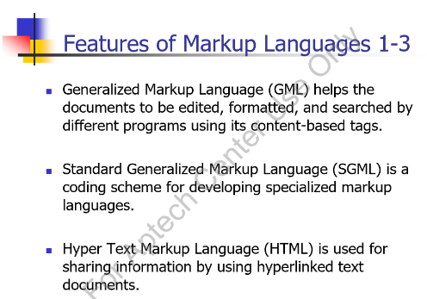
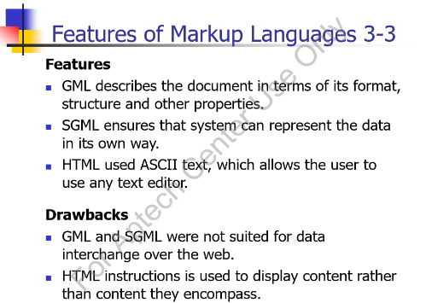

Slide 4
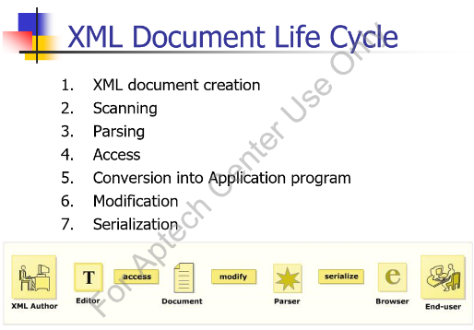
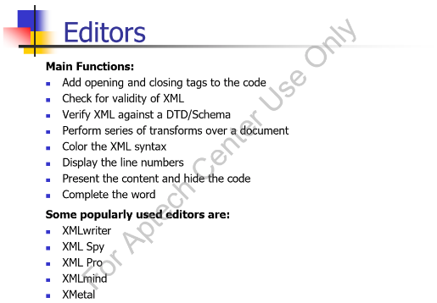

Slide 5
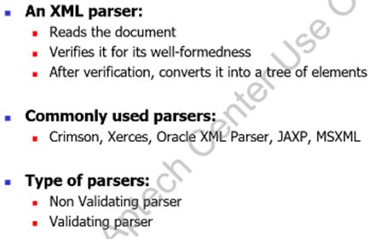
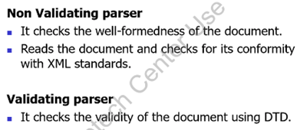
Easy data exchange
    One of the great things about XML is that it can allow easy sharing of data between different applications - even if these applications are written in different languages and reside on different platforms.
Self-describing data
    Provide an easy to use and standardized way to store self-describing data (self-describing data is data that describes both its content and its structure).

Slide 6
Syntax
XML Declaration
XML declaration statement is the first line of every XML document.
It simply states what version of XML you are using and the type of encoding you are using
Basic Structure
<root>
<child>
<subchild>.....</subchild>
</child>
</root>
Comments in XML
<!– this is comment section-->
<?xml version="1.0" encoding=“UTF-8"?>

Slide 7
Key Points
The XML specification was created by the World Wide Web Consortium (W3C), the body that sets standards for the web.
XML is a software- and hardware-independent tool for carrying information.
XML DTD or XML Schemas are used to define the XML document structure
XML Elements Must be Properly Nested
XML Documents Must Have a Root Element(only one)
XML Attribute Values Must be Quoted
All Elements Must have an Opening and Closing Tag
Well-formed of XML Document
Well-formed-ness refers to the standards that are to be followed by the XML documents. Well-formedness makes XML processors and browsers read XML documents. A document is well- formed, if it fulfills the following rules
XML tags should be valid
  Tags can begin with letter, an underscore or a colon.
  Tags can contain combination of letters, numbers, periods, colons, underscores, or hyphens.
  Tags should not contain whitespace.
  Tags should not start with reserved words like xml.
Notes:
XML Naming Rules
XML elements must follow these naming rules:
Names can contain letters, numbers, and other characters
Names cannot start with a number or punctuation character
Names can be started with Underscore _ character.
Names cannot start with the letters xml (or XML, or Xml, etc)
Names cannot contain space.

Slide 8
Key Terminologies
(Unicode) Character
An XML document is a string of characters. Almost every legal Unicode character may appear in an XML document.
Processor and Application
The processor analyzes the markup and passes structured information to an application. (parsing)
Markup and Content
All strings which constitute markup either begin with the character
< and end with a >. Strings of characters which are not markup are content.
Tag
A markup construct that begins with < and ends with >.
Element
A logical document component either begins with a start-tag and ends with a matching end-tag or consists only of an empty-element tag.
Attributes
Provide information that is not a part of the data.
<name Id= “123”> Shahzaib </name>

Slide 9
Attribute
Attributes provide extra information about elements.
Attributes are always placed inside the opening tag of an element.
<name id=“123" > hamza </name
Avoid Xml Attributes
Attributes cannot contain multiple values (element can)
Attribute cannot contain tree structure.
Attributes are not easily expandable.
  <Address City = “Khi” Street = “2A” />
Use Child Elements instead.
  <Address>
  <City></City>
  <Street></Street>
  </Address>

Slide 10
Entities
Sort of short code for a particular word that is to be repeated again and again. Created using & before the word and ; after the word
Some characters have a special meaning in XML, like the less than sign (<) that defines the start of an XML tag.
The following entities are predefined in XML:
  &amp; for & (almost always necessary)
  &lt; for < (almost always necessary)
  &gt; for > (not usually necessary)
  &quot; for " (necessary inside double quotes)
  &apos; for ' (necessary inside single quotes)

Slide 11
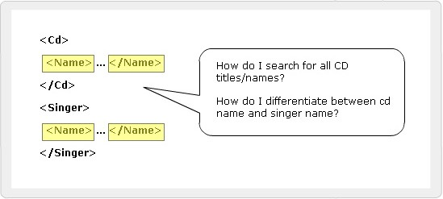
Namespaces
Duplicate Element Names
It allows developers to create their own elements
and attributes for their own projects.
Developer has to ensure the uniqueness of the element names and attributes in a document.
Name conflicts are inevitable from different developers.
It is difficult for the browser to distinguish a conflicting element.
Namespaces
Elements are distinguished by using namespaces.
A namespace is a collection of names.
Namespaces allow the browser to:
  Combine documents from different sources
  Identify the source of elements or attributes

Slide 12
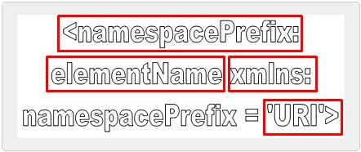
SYNTAX
EXAMPLE:
<S:Student xmlns:S=” http://www.abc.com”>
<S:First>John</S:First>
<S:Last>Dewey</S:Last>
<S:Title>Student</S:Title>
</S:Student>

Slide 13
SUMMARY
XML Namespaces
  Namespaces distinguish between elements and attributes with the same name from different XML applications.
  It is a collection of names that can be used as element names or attribute names in XML document.
  XML namespaces provide a globally unique name for a element or attribute to avoid name collisions.
Working with Namespaces syntax
  Namespaces are declared by an xmlns attribute whose
value is the URI of the namespace.
  If an attribute name has no prefix, it has no namespace.
  A default namespace is used by an element and its child elements if the element does not have a namespace prefix.

Slide 14


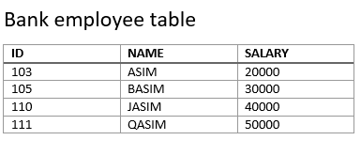
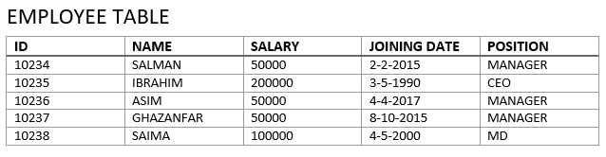

Slide 15
DTD Document Type Definition
A Document Type Definition (DTD) defines the legal building blocks of an XML document. It defines the document structure with a list of legal elements and attributes.
A DTD can be declared inline inside an XML document, or as an external reference.
USE OF DTD
With a DTD, each of your XML files can carry a description of its own format.
With a DTD, independent groups of people can agree to use a standard DTD for interchanging data.
Your application can use a standard DTD to verify that the data you receive from the outside world is valid.
You can also use a DTD to verify your own data.

Slide 16
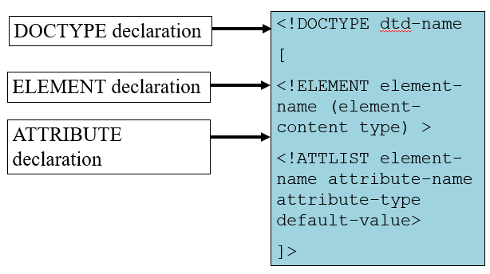
Structure of a DTD

Slide 17
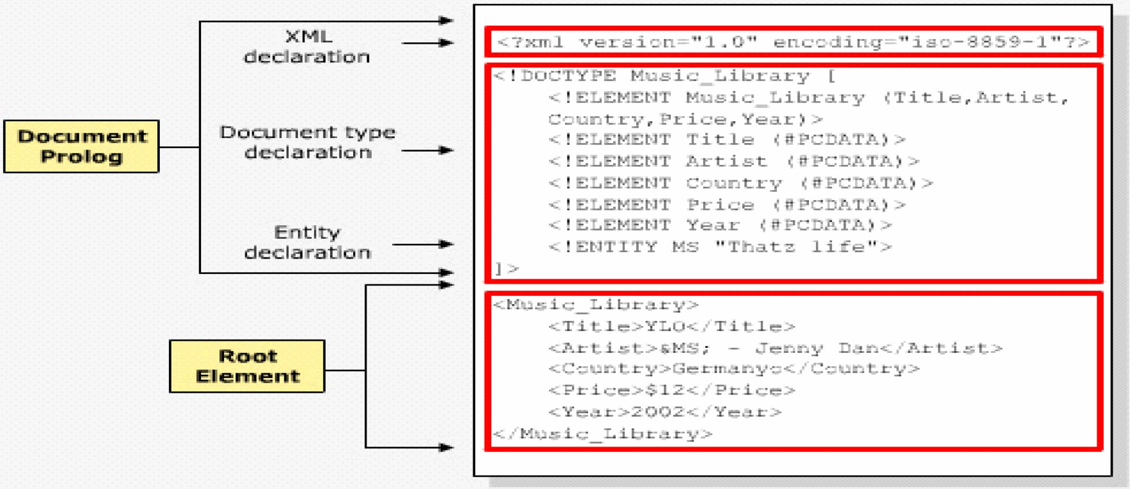
Internal DTD Declaration
If the DTD is declared inside the XML file, it should be wrapped in a DOCTYPE definition with the following syntax:
<!DOCTYPE root-element [element-declarations]>

Slide 18
ELEMENT IN DTD
<?xml version="1.0"?>
<!DOCTYPE note [
<!ELEMENT note (to,from,heading,body)>
<!ELEMENT to (#PCDATA)>
<!ELEMENT from (#PCDATA)>
<!ELEMENT heading (#PCDATA)>
<!ELEMENT body (#PCDATA)>
]>
<note>
<to>Tove</to>
<from>Jani</from>
<heading>Reminder</heading>
<body>Don't forget me this weekend</body>
</note>
!DOCTYPE note defines that the root element of this document is note
!ELEMENT note defines that the note element contains four elements: "to,from,heading,body"
!ELEMENT to defines the to element to be of type "#PCDATA"
!ELEMENT from defines the from element to be of type "#PCDATA"
!ELEMENT heading defines the heading element to be of type "#PCDATA"
!ELEMENT body defines the body element to be of type "#PCDATA"

Slide 19
PCDATA
PCDATA means parsed character data.
PCDATA is text that WILL be parsed by a parser. The text will be examined by the parser for entities and markup.
Tags inside the text will be treated as markup and entities will be expanded.
However, parsed character data should not contain any &, <, or > characters; these need to be represented by the &amp; &lt; and &gt; entities, respectively.
CDATA
CDATA means character data.
CDATA is text that will NOT be parsed by a parser. Tags inside the text will NOT be treated as markup and entities will not be expanded.

Slide 20
ATTRIBUTE IN DTD
Syntax
<!ATTLIST tag-name attribute-name type attribute-value>
Example
------In DTD--------------
<!ATTLIST name ID CDATA #REQUIRED
------In XML--------------
<name ID=“1234> hamza </name>
Attribute (Attribute-Default-Value)
Value
Explanation
#DEFAULT
The attribute has a default value.
#REQUIRED
The attribute value must be included in the element.
#IMPLIED
The attribute does not have to be included.
#FIXED
The attribute value is fixed.

Slide 21
ENTITY IN DTD
Entity Declaration
Entities that have their contents within the XML document are called internal entities.
Syntax
<!ENTITY entity-name "entity-value">
Example
------In DTD--------------
<!ENTITY writer “IQBAL">
<!ENTITY copyright "Copyright Aptech Ltd.">
------In XML--------------
<author>&writer;&copyright;</author>

Slide 22
External DTD Declaration
If the DTD is declared in an external file, it should be wrapped in a DOCTYPE definition with the following syntax:
<!DOCTYPE root-element SYSTEM "filename">
EXAMPLE
.XML FILE
<?xml version="1.0"?>
<!DOCTYPE note SYSTEM "note.dtd">
<note>
<to>Tove</to>
<from>Jani</from>
<heading>Reminder</heading>
<body>Don't forget me this weekend!</body>
</note>
.DTD FILE
<!ELEMENT note (to,from,heading,body)>
<!ELEMENT to (#PCDATA)>
<!ELEMENT from (#PCDATA)>
<!ELEMENT heading (#PCDATA)>
<!ELEMENT body (#PCDATA)>

Slide 23
Nodes Quantifiers
asterisk (*) - The element may appear zero or more times
question mark (?) - The element may appear zero or one time, only
plus sign (+) - The element appears at least once if not more times
DTD - XML Building Blocks
The Building Blocks of XML Documents
Elements
Attributes
Entities
PCDATA
CDATA

Slide 24
SCHEMA
It is an XML-based alternative to DTD.
An XML schema describes the structure of an XML document.
The XML Schema language is also referred to as XML Schema Definition (XSD).
An XML Schema:
defines elements that can appear in a document
defines attributes that can appear in a document
defines which elements are child elements
defines the order of child elements
defines the number of child elements
defines whether an element is empty or can include text
defines data types for elements and attributes
defines default and fixed values for elements and attributes

Slide 25
DTD V/S SCHEMA
XML Schemas are the Successors of DTDs
Main reasons:
DTDs do not have built-in datatypes.
DTDs do not support user-derived datatypes.
XML Schemas Support Data Types
One of the greatest strength of XML Schemas is the support for data types.
With support for data types:
It is easier to describe allowable document content
It is easier to validate the correctness of data
It is easier to work with data from a database
It is easier to define data facets (restrictions on data)
It is easier to define data patterns (data formats)
It is easier to convert data between different data types

Slide 26
SYNTAX
Defining a Simple type Element
The syntax for defining a simple element is:
<xs:element name="abc" type="xyz"/>
where abc is the name of the element and xyz is the data type of the element.
Data types
XML Schema has a lot of built-in data types. The most common types are:
    xs:string
    xs:decimal
    xs:integer
    xs:boolean
    xs:date
    xs:time
The <schema> Element
<?xml version="1.0"?>
<xs:schema>
...
...
</xs:schema>

Slide 27
Simple Example
XML elements:
  <name>huda</name>
  <age>36</age>
  <birthDate>1970-03-27</ birthDate >
Corresponding element definitions:
<xs:element name="name" type="xs:string"/>
<xs:element name="age" type="xs:integer"/>
<xs:element name=" birthDate " type="xs:date"/>

Slide 28
Values for Simple Elements
Simple elements may have a default value OR a fixed value specified.
Default:
A default value is automatically assigned to the element when no other value is specified.
<xs:element name="color" type="xs:string“ default="red"/>
Fixed
A fixed value is also automatically assigned to the element, and you cannot specify another value.
In the following example the fixed value is "red":
<xs:element name="color" type="xs:string" fixed="red"/>

Slide 29
Attributes
Defining a Attribute
The syntax for defining a attribute is:
<xs:attribute name="xxx" type="yyy"/>
where xxx is the name of the attribute and yyy specifies the data type of the attribute..
XML Attribute:
<lastname lang="EN">Smith</lastname>
Corresponding Attribute definitions:
<xs:attribute name="lang" type="xs:string"/>
ATTRIBUTES CAN BE DEFAULT OR FIXED AS WELL AS OPTIONAL AND REQUIRED
Optional and Required Attributes
Attributes are optional by default. To specify that the attribute is required, use the "use" attribute:
<xs:attribute name="lang" type="xs:string" use="required"/>

Slide 30
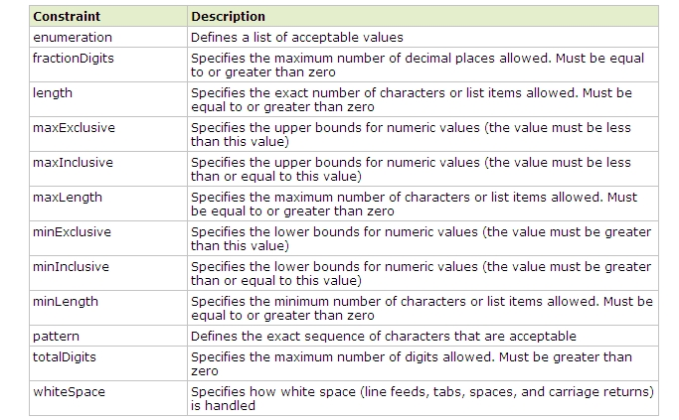
Restrictions for Datatypes

Slide 31
XSD Restrictions
XSD Restrictions/Facets
Restrictions are used to define acceptable values for XML elements or attributes. Restrictions on XML elements are called facets.
Restrictions on Values
<xs:element name="age">
<xs:simpleType>
<xs:restriction base="xs:integer">
<xs:minInclusive value="0"/>
<xs:maxInclusive value="120"/>
</xs:restriction>
</xs:simpleType>
</xs:element>
Notes:
When an XML element or attribute has a data type defined, it puts restrictions on the element's or attribute's content.
If an XML element is of type "xs:date" and contains a string like "Hello World", the element will not validate.
With XML Schemas, you can also add your own restrictions to your XML elements and attributes.

Slide 32
Restrictions on a Set of Values
The example below defines an element called "car" with a restriction. The only acceptable values are: Audi, Golf, BMW:
<xs:element name="car">
<xs:simpleType>
<xs:restriction base="xs:string">
<xs:enumeration value="Audi"/>
<xs:enumeration value="Golf"/>
<xs:enumeration value="BMW"/>
</xs:restriction>
</xs:simpleType>
</xs:element>

Slide 33
Examples
EXAMPLE 1:
<xs:element name="password">
<xs:simpleType>
<xs:restriction base="xs:string">
<xs:length value="8"/>
</xs:restriction>
</xs:simpleType>
</xs:element>
EXAMPLE 2:
<xs:element name="password">
<xs:simpleType>
<xs:restriction base="xs:string">
<xs:minLength value="5"/>
<xs:maxLength value="8"/>
</xs:restriction>
</xs:simpleType>
</xs:element>

Slide 34
Complex-type
Complex-type elements have attributes, child elements, or some combination of the two.
For example, the Name and HomePage elements below are both complex-type elements
<?xml version="1.0"?>
<Person>
<Name>
<FirstName>Mark</FirstName>
<LastName>Twain</LastName>
</Name>
<HomePage URL="http://www.marktwain.com"/>
</Person>
<xs:element name="ElementName">
<xs:complexType>
<!--Content Model Goes Here-->
</xs:complexType>
</xs:element>

Slide 35
There are four kinds of complex elements:
There are four kinds of complex elements:
empty elements
elements that contain only other elements
elements that contain only text
elements that contain both other elements and text
1.Empty Elements
XML
<product prodid="1345" />
XSD
<xs:element name="product">
<xs:complexType>
<xs:attribute name="prodid" type="xs:positiveInteger"/>
</xs:complexType>
</xs:element>
Notes:
<xs:element name="product">
<xs:complexType>
<xs:complexContent>
<xs:restriction base="xs:integer">
<xs:attribute name="prodid" type="xs:positiveInteger"/>
</xs:restriction>
</xs:complexContent>
</xs:complexType>
</xs:element>

Slide 36
2.Containing Elements Only
XML
<person>
<firstname>John</firstname>
<lastname>Smith</lastname>
</person>
XSD
<xs:element name="person">
<xs:complexType>
<xs:sequence>
<xs:element name="firstname" type="xs:string"/>
<xs:element name="lastname" type="xs:string"/>
</xs:sequence>
</xs:complexType>
</xs:element>
Note: <xs:sequence> tag means that the elements defined ("firstname" and "lastname") must appear in that order inside a "person" element.

Slide 37
3.Containing Text-Only
XML
<shoesize country="france">35</shoesize>
XSD
<xs:element name="shoesize">
<xs:complexType>
<xs:simpleContent>
<xs:extension base="xs:integer">
<xs:attribute name="country" type="xs:string" />
</xs:extension>
</xs:simpleContent>
</xs:complexType>
</xs:element>

Slide 38
4. Containing both other elements and text
XML
<letter>
Dear Mr.<name>John Smith</name>.
Your order <orderid>1032</orderid>
will be shipped on <shipdate>2001-07-13</shipdate>.
</letter>
XSD
<xs:element name="letter">
<xs:complexType mixed="true">
<xs:sequence>
<xs:element name="name" type="xs:string"/>
<xs:element name="orderid" type="xs:positiveInteger"/>
<xs:element name="shipdate" type="xs:date"/>
</xs:sequence>
</xs:complexType>
</xs:element>
Note: To enable character data to appear between the child-elements of "letter", the mixed attribute must be set to "true"

Slide 39
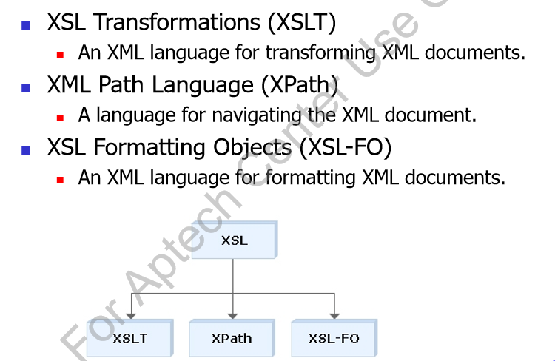
XSL
XSL extensible Stylesheet Language is a styling language for XML.
(Also XSLT extensible Stylesheet Language Transformations)
In the transformation process, XSLT uses XPath to define parts of the source document that should match one or more predefined templates. When a match is found, XSLT will transform the matching part of the source document into the result document.

Slide 40
Difference Between CSS and XSL
CSS | XSL
Stylesheet language to create a style For HTML and XML documents . | Stylesheet language to create a style for XML documents
Determines the visual appearance of a page , but does not alter the structure of the source document. | Provide a means of transforming XML documents.

Slide 41
Syntax
<xsl:stylesheet version="1.0"
xmlns:xsl="http://www.w3.org/1999/XSL/Transform">
<xsl:template match="/">
<html>
……
</html>
</xsl:template>
</xsl:stylesheet>

Slide 42
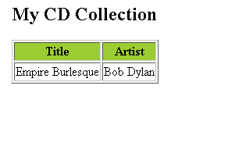
<xsl:value-of> Element
The <xsl:value-of> element can be used to extract the value of an XML element and add it to the output stream of the transformation:
<?xml version="1.0" encoding="ISO-8859-1"?>
<!-- Edited by XMLSpy® -->
<xsl:stylesheet version="1.0"
xmlns:xsl="http://www.w3.org/1999/XSL/Transform">
<xsl:template match="/">
<html>
<body>
<h2>My CD Collection</h2>
<table border="1">
<tr bgcolor="#9acd32">
<th>Title</th>
<th>Artist</th>
</tr>
<tr>
<td><xsl:value-of select="catalog/cd/title"/></td>
<td><xsl:value-of select="catalog/cd/artist"/> </td>
</tr>
</table>
</body>
</html>
</xsl:template>
</xsl:stylesheet>
The select attribute in the example above, contains an XPath expression. An XPath expression works like navigating a file system; a forward slash (/) selects subdirectories.

Slide 43
<xsl:for-each> Element:
The XSL <xsl:for-each> element can be used to select every XML element of a specified node-set:
<?xml version="1.0" encoding="ISO-8859-1"?>
<xsl:stylesheet version="1.0” xmlns:xsl="http://www.w3.org/1999/XSL/Transform">
<xsl:template match="/">
<html>
<body>
<h2>My CD Collection</h2>
<table border="1">
<tr bgcolor="#9acd32">
<th>Title</th>
<th>Artist</th>
</tr>
<xsl:for-each select="catalog/cd">
<tr>
<td><xsl:value-of select="title"/></td>
<td><xsl:value-of select="artist"/></td>
</tr>
</xsl:for-each>
</table>
</body>
</html>
</xsl:template>
</xsl:stylesheet>

Slide 44
XSLT <xsl:sort> Element
The <xsl:sort> element is used to sort the output.
<?xml version="1.0" encoding="ISO-8859-1"?>
<xsl:stylesheet version="1.0” xmlns:xsl="http://www.w3.org/1999/XSL/Transform">
<xsl:template match="/">
<html>
<body>
<h2>My CD Collection</h2>
<table border="1">
<tr bgcolor="#9acd32">
<th>Title</th>
<th>Artist</th>
</tr>
<xsl:for-each select="catalog/cd">
<xsl:sort select="artist"/>
<tr>
<td><xsl:value-of select="title"/></td>
<td><xsl:value-of select="artist"/></td>
</tr>
</xsl:for-each>
</table>
</body>
</html>
</xsl:template>
</xsl:stylesheet>

Slide 45
<xsl:if> Element
To put a conditional if test against the content of the XML file, add an <xsl:if> element to the XSL document.
XSLT <xsl:if> Element
To put a conditional if test against the content of the XML file, add an <xsl:if> element to the XSL document.
<xsl:if test="expression">
...some output if the expression is true...
</xsl:if>
Filtering the Output
We can also filter the output from the XML file by adding a criterion to the select attribute.
Legal filter operators are:
= (equal)
!= (not equal)
&lt; less than
&gt; greater than

Slide 46
<xsl:choose> element
is used in conjunction with <xsl:when> and <xsl:otherwise> to express multiple conditional tests.
<xsl:for-each select="catalog/cd">
<tr>
<td>
<xsl:value-of select="title"/>
</td>
<xsl:choose>
<xsl:when test="price &gt; 10">
<td bgcolor="#ff00ff">
<xsl:value-of select="artist"/>
</td>
</xsl:when>
<xsl:otherwise>
<td>
<xsl:value-of select="artist"/>
</td>
</xsl:otherwise>
</xsl:choose>
</tr>
</xsl:for-each>
XSLT <xsl:choose> Element
<xsl:choose>
<xsl:when test="expression">
... some output ...
</xsl:when>
<xsl:otherwise>
... some output ....
</xsl:otherwise>
</xsl:choose>

Slide 47
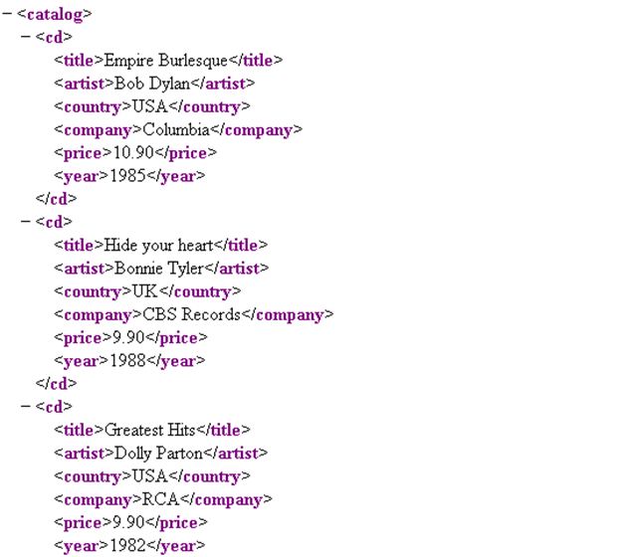
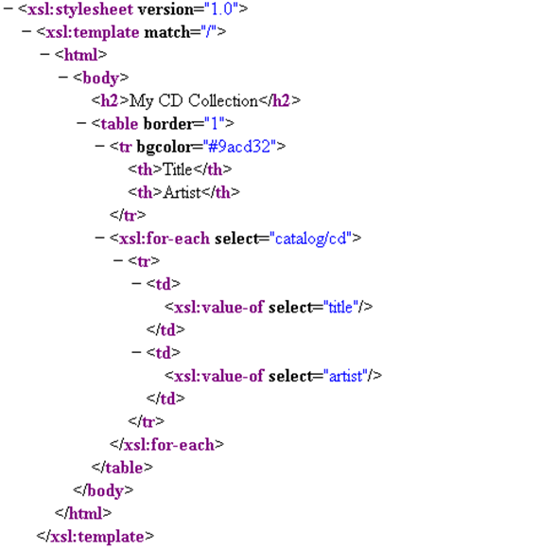
.xml
.xslt

Slide 48
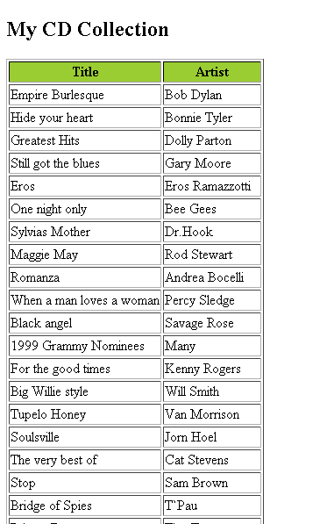
Output

Slide 49
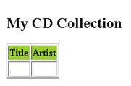
Cdcatalog.xml
Cdcatalog.xsl
<?xml version="1.0" encoding="ISO-8859-1"?>
<?xml-stylesheet type="text/xsl" href="cdcatalog.xsl"?>
<catalog>
<cd>
<title>Empire Burlesque</title>
<artist>Bob Dylan</artist>
<country>USA</country>
<company>Columbia</company>
<price>10.90</price>
<year>1985</year>
</cd>
.
.
.
</catalog>
<?xml version="1.0" encoding="ISO-8859-1"?>
<!-- Edited by XMLSpy® -->
<xsl:stylesheet version="1.0"
xmlns:xsl="http://www.w3.org/1999/XSL/Transform">
<xsl:template match="/">
<html>
<body>
<h2>My CD Collection</h2>
<table border="1">
<tr bgcolor="#9acd32">
<th>Title</th>
<th>Artist</th>
</tr>
<tr>
<td>.</td>
<td>.</td>
</tr>
</table>
</body>
</html>
</xsl:template>
</xsl:stylesheet>

