Slide 1
xml

Slide 2
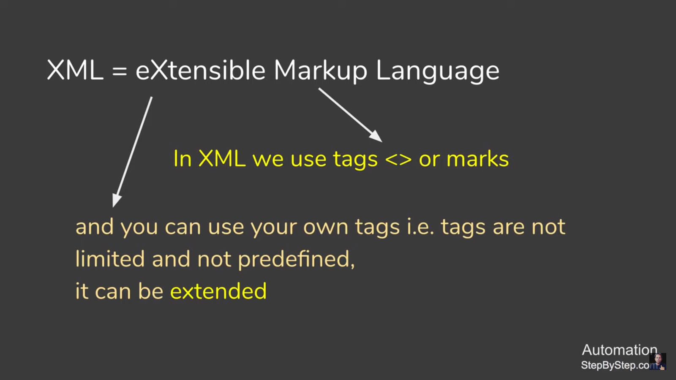
What is an XML?
XML stands for eXtensible Markup Language
XML is a markup language much like HTML
XML was designed to store and transport data
XML was designed to be self-descriptive
XML is a W3C Recommendation
XML uses a Document Type Definition (DTD) or an XML Schema to describe data

Slide 3
XML Markup
XML markup defines the physical and logical layout of the document.
XML markup divides a document into separate information containers called elements.
A document consists of one outermost element, called root element that contains all the other elements, plus some optional administrative information at the top, known as XML declaration

Slide 4
Difference btw html and xml
HTML | XML
HTML was designed to display data. | XML was designed to carry data.
HTML displays data and focuses on how data looks. | XML describes data and focuses on what data is.
HTML displays information. | XML describes information.

Slide 5
Parsers
An XML parser:
  Reads the document
  Verifies it for its well-formedness
  After verification, converts it into a tree of elements
Commonly used parsers:
  Crimson, Xerces, Oracle XML Parser, JAXP, MSXML
Type of parsers:
  Non Validating parser
  Validating parser

Slide 6
Parsers
Non Validating parser
It checks the well-formedness of the document.
Reads the document and checks for its conformity with XML standards.
Validating parser
It checks the validity of the document using DTD.

Slide 7
browsers
Web browsers can format XML data and display it to
the user.
Other programs like database, Musical Instrument Digital Interface (MIDI) program or a spreadsheet program may present XML data accordingly.
Commonly used web browsers:
  Netscape, Mozilla, Internet Explorer, Firefox, Opera

Slide 8
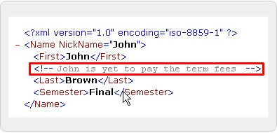
Comments
Used for the people to give information about the code
Usually made for the content

Slide 9
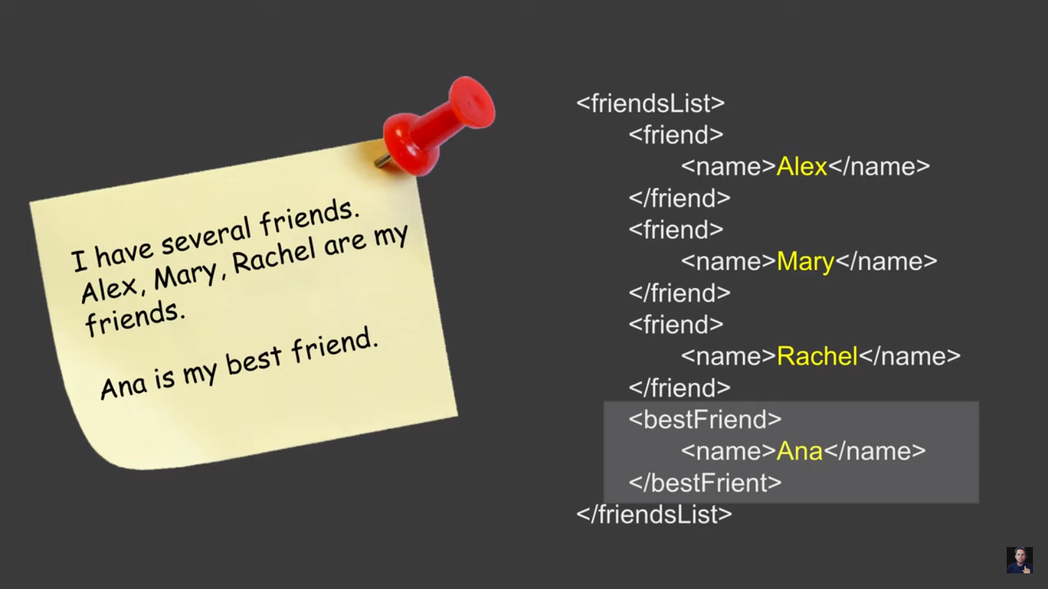
Example syntax

Slide 10
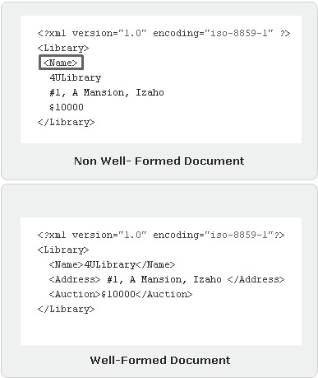
Structure of well and non well formed document

Slide 11
Tags, prolog and root elements
Code Snippet
<?xml version=”1.0” encoding=”iso-8859-1” ?>
- <FlowerPlanet>
<Name>Rose</Name>
<Price>$1</Price>
<Description>Red in color</Description>
<Number>700</Number>
</FlowerPlanet>
where,
<Name>, <Price>,<Description> and <Number> tags are
elements
<FlowerPlanet> and </FlowerPlanet> are the root elements

Slide 12
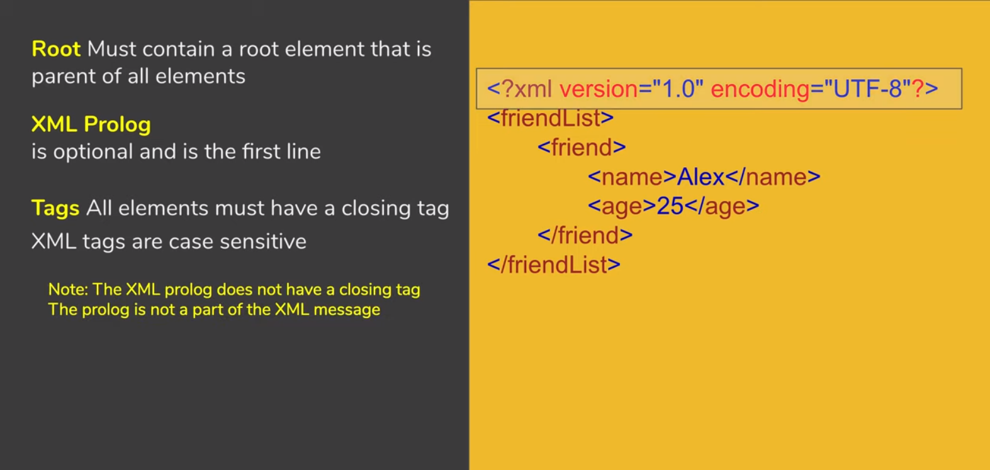
Tags, prolog and root elements
This is the XML optional preamble. version="1.0" means that this is the XML standard this file conforms to. encoding="utf-8" means that the file is encoded using the UTF-8 Unicode encoding

Slide 13
Xml Editors
The popularly used editors are:
  XMLwriter
  XML Spy
  XML Pro
  XMLmind
  XMetal

Slide 14
Creating an XML document
The steps to build an XML document are as follows:
Create an XML document in an editor
Save the XML document
Load the XML document in a browser

Slide 15
Task
Create an Employee File to store the following fields in XML.
  EMPNO,ENAME,DESIGNATION,SALARY AND DEPTNAME
Create Department file that contains the information of all the departments present in an organization.
  DeptNo, DeptName, Location

Slide 16
Print this student data in xml format
sid | fname | lname | Y_of_B
50 | David | Dave | 1984
23 | John | Jones | 1983
53 | John | Smith | 1983
55 | Mike | Green | 1985
54 | Ann | Webb | 1980
57 | Cathy | Brown | 1981
60 | Nick | Smith | 1979
62 | Sue | Moor | 1976
64 | George | Wolf | 1978
58 | Harry | Potter | 1983

Slide 17
Online xml code checker for movies
To check a xml code for movie visit :https://www.omdbapi.com/

Slide 18
attributes
Attributes provide extra information about elements.
Attributes are always placed inside the opening tag of an element.
<name id=“123" > hamza </name>
Avoid Xml Attributes
Attributes cannot contain multiple values (element can)
Attribute cannot contain tree structure.
Attributes are not easily expandable.
<Address City = “Khi” Street = “2A” />
Use Child Elements instead.
  <Address>
  <City></City>
  <Street></Street>
  </Address>

Slide 19
entities
Sort of short code for a particular word that is to be repeated again and again. Created using & before the word and ; after the word Some characters have a special meaning in XML, like the less than sign (<) that defines the start of an XML tag.
The following entities are predefined in XML:
  &amp; for & (almost always necessary)
  &lt; for < (almost always necessary)
  &gt; for > (not usually necessary)
  &quot; for " (necessary inside double quotes)
  &apos; for ' (necessary inside single quotes)

Slide 20
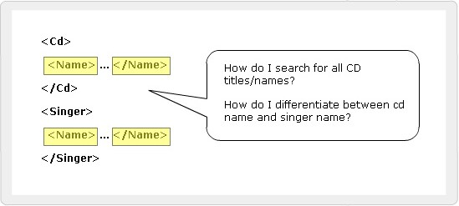
namespaces
Elements are distinguished by using namespaces.
A namespace is a collection of names.
Namespaces allow the browser to:
  Combine documents from different sources
  Identify the source of elements or attributes

Slide 21
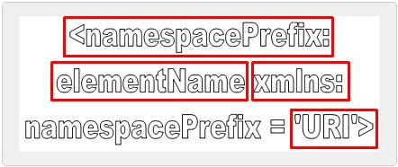
Namespaces SYNTAX
EXAMPLE:
<S:Student xmlns:S=” http://www.abc.com”>
<S:First>John</S:First>
<S:Last>Dewey</S:Last>
<S:Title>Student</S:Title>
</S:Student>

Slide 22
DTD DOCUMENT TYPE DEFINITION
A Document Type Definition (DTD) defines the legal building blocks of an XML document. It defines the document structure with a list of legal elements and attributes.
A DTD can be declared inline inside an XML document, or as an external reference.
USE OF DTD
With a DTD, each of your XML files can carry a description of its own format.
With a DTD, independent groups of people can agree to use a standard DTD for interchanging data.
Your application can use a standard DTD to verify that the data you receive from the outside world is valid.
You can also use a DTD to verify your own data.

Slide 23
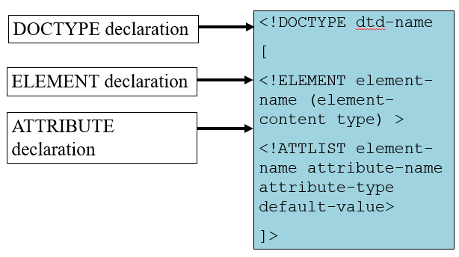
Structure of a DTD

Slide 24
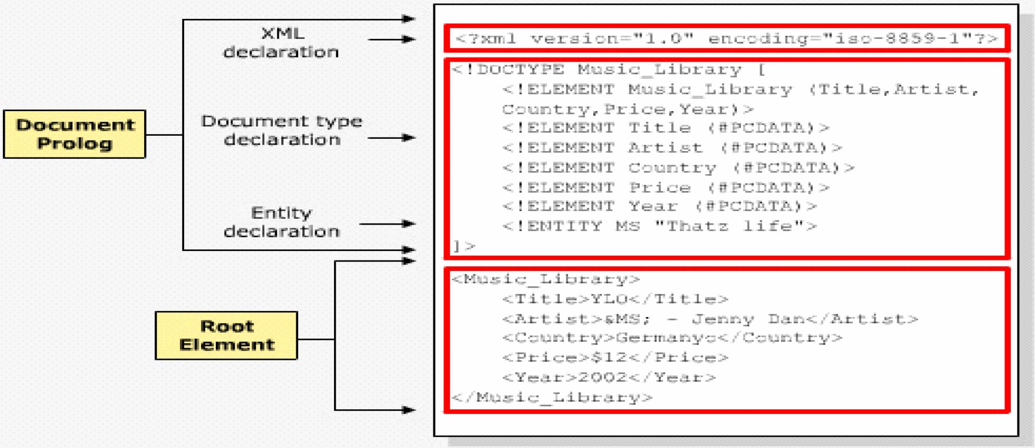
Internal DTD Declaration
If the DTD is declared inside the XML file, it should be wrapped in a DOCTYPE definition with the following syntax:
<!DOCTYPE root-element [element-declarations]>

Slide 25
ELEMENT IN DTD
<?xml version="1.0"?>
<!DOCTYPE note [
<!ELEMENT note (to,from,heading,body)>
<!ELEMENT to (#PCDATA)>
<!ELEMENT from (#PCDATA)>
<!ELEMENT heading (#PCDATA)>
<!ELEMENT body (#PCDATA)>
]>
<note>
<to>Tove</to>
<from>Jani</from>
<heading>Reminder</heading>
<body>Don't forget me this weekend</body>
</note>
!DOCTYPE note defines that the root element of this document is note
!ELEMENT note defines that the note element contains four elements: "to,from,heading,body"
!ELEMENT to defines the to element to be of type "#PCDATA"
!ELEMENT from defines the from element to be of type "#PCDATA"
!ELEMENT heading defines the heading element to be of type "#PCDATA"
!ELEMENT body defines the body element to be of type "#PCDATA"

Slide 26
PCDATA & CDATA
PCDATA
PCDATA means parsed character data.
PCDATA is text that WILL be parsed by a parser. The text will be examined by the parser for entities and markup.
Tags inside the text will be treated as markup and entities will be expanded.
However, parsed character data should not contain any &, <, or > characters; these need to be represented by the &amp; &lt; and &gt; entities, respectively.
CDATA
CDATA means character data.
CDATA is text that will NOT be parsed by a parser. Tags inside the text will NOT be treated as markup and entities will not be expanded.

Slide 27

ATTRIBUTE IN DTD
Syntax
<!ATTLIST tag-name attribute-name type attribute-value>
Example
------In DTD--------------
<!ATTLIST name ID CDATA #REQUIRED
------In XML--------------
<name ID=“1234> hamza </name>
Value
Explanation
#DEFAULT
The attribute has a default value.
#REQUIRED
The attribute value must be included in the element.
#IMPLIED
The attribute does not have to be included.
#FIXED
The attribute value is fixed.

Slide 28
ENTITY IN DTD
Entity Declaration
Entities that have their contents within the XML document are called internal entities.
Syntax
<!ENTITY entity-name "entity-value">
Example
------In DTD--------------
<!ENTITY writer “IQBAL">
<!ENTITY copyright "Copyright Aptech Ltd.">
------In XML--------------
<author>&writer;&copyright;</author>

Slide 29
External DTD Declaration
If the DTD is declared in an external file, it should be wrapped in a DOCTYPE definition with the following syntax:
<!DOCTYPE root-element SYSTEM "filename">
.XML FILE
<?xml version="1.0"?>
<!DOCTYPE note SYSTEM "note.dtd">
<note>
<to>Tove</to>
<from>Jani</from>
<heading>Reminder</heading>
<body>Don't forget me this weekend!</body>
</note>
.DTD FILE
<!ELEMENT note (to,from,heading,body)>
<!ELEMENT to (#PCDATA)>
<!ELEMENT from (#PCDATA)>
<!ELEMENT heading (#PCDATA)>
<!ELEMENT body (#PCDATA)>

Slide 30
Nodes Quantifiers
asterisk (*) - The element may appear zero or more times
question mark (?) - The element may appear zero or one time, only
plus sign (+) - The element appears at least once if not more times

Slide 31
SCHEMA
It is an XML-based alternative to DTD.
An XML schema describes the structure of an XML document.
The XML Schema language is also referred to as XML Schema Definition (XSD).
An XML Schema:
defines elements that can appear in a document
defines attributes that can appear in a document
defines which elements are child elements
defines the order of child elements
defines the number of child elements
defines whether an element is empty or can include text
defines data types for elements and attributes
defines default and fixed values for elements and attributes

Slide 32
DTD V/S SCHEMA
XML Schemas are the Successors of DTDs
Main reasons:
DTDs do not have built-in datatypes.
DTDs do not support user-derived datatypes.
XML Schemas Support Data Types
One of the greatest strength of XML Schemas is the support for data types.
With support for data types:
It is easier to describe allowable document content
It is easier to validate the correctness of data
It is easier to work with data from a database
It is easier to define data facets (restrictions on data)
It is easier to define data patterns (data formats)
It is easier to convert data between different data types

Slide 33
SYNTAX
Defining a Simple type Element
The syntax for defining a simple element is:
<xs:element name="abc" type="xyz"/>
where abc is the name of the element and xyz is the data type of the element.
Data types
XML Schema has a lot of built-in data types. The most common types are:
xs:string
xs:decimal
xs:integer
xs:boolean
xs:date
xs:time
The <schema> Element
<?xml version="1.0"?>
<xs:schema>
...
...
</xs:schema>

Slide 34
Simple Example
XML elements:
<name>huda</name>
<age>36</age>
<birthDate>1970-03-27</ birthDate >
Corresponding element definitions:
<xs:element name="name" type="xs:string"/>
<xs:element name="age" type="xs:integer"/>
<xs:element name=" birthDate " type="xs:date"/>

Slide 35
Values for Simple Elements
Simple elements may have a default value OR a fixed value specified.
Default:
A default value is automatically assigned to the element when no other value is specified.
<xs:element name="color" type="xs:string“ default="red"/>
Fixed
A fixed value is also automatically assigned to the element, and you cannot specify another value.
In the following example the fixed value is "red":
<xs:element name="color" type="xs:string" fixed="red"/>

Slide 36
Attributes
Defining a Attribute
The syntax for defining a attribute is:
<xs:attribute name="xxx" type="yyy"/>
where xxx is the name of the attribute and yyy specifies the data type of the attribute..
XML Attribute:
<lastname lang="EN">Smith</lastname>
Corresponding Attribute definitions:
<xs:attribute name="lang" type="xs:string"/>
ATTRIBUTES CAN BE DEFAULT OR FIXED AS WELL AS OPTIONAL AND REQUIRED
Optional and Required Attributes
Attributes are optional by default. To specify that the attribute is required, use the "use" attribute:
<xs:attribute name="lang" type="xs:string" use="required"/>

Slide 37
Complex-type
Complex-type elements have attributes, child elements, or some combination of the two.
For example, the Name and HomePage elements below are both complex-type elements
<?xml version="1.0"?>
<Person>
<Name>
<FirstName>Mark</FirstName>
<LastName>Twain</LastName>
</Name>
<HomePage URL="http://www.marktwain.com"/>
</Person>
<xs:element name="ElementName">
<xs:complexType>
<!--Content Model Goes Here-->
</xs:complexType>
</xs:element>

Slide 38
There are four kinds of complex elements
There are four kinds of complex elements:
empty elements
elements that contain only other elements
elements that contain only text
elements that contain both other elements and text

Slide 39
1.Empty Elements
XML
<product prodid="1345" />
XSD
<xs:element name="product">
<xs:complexType>
<xs:attribute name="prodid" type="xs:positiveInteger"/>
</xs:complexType>
</xs:element>

Slide 40
2.Containing Elements Only
XML
<person>
<firstname>John</firstname>
<lastname>Smith</lastname>
</person>
XSD
<xs:element name="person">
<xs:complexType>
<xs:sequence>
<xs:element name="firstname" type="xs:string"/>
<xs:element name="lastname" type="xs:string"/>
</xs:sequence>
</xs:complexType>
</xs:element>
Note: <xs:sequence> tag means that the elements defined ("firstname" and "lastname") must appear in that order inside a "person" element.

Slide 41
3.Containing Text-Only
XML
<shoesize country="france">35</shoesize>
XSD
<xs:element name="shoesize">
<xs:complexType>
<xs:simpleContent>
<xs:extension base="xs:integer">
<xs:attribute name="country" type="xs:string" />
</xs:extension>
</xs:simpleContent>
</xs:complexType>
</xs:element>

Slide 42
4. Containing both other elements and text
XML
<letter>
Dear Mr.<name>John Smith</name>.
Your order <orderid>1032</orderid>
will be shipped on <shipdate>2001-07-13</shipdate>.
</letter>
XSD
<xs:element name="letter">
<xs:complexType mixed="true">
<xs:sequence>
<xs:element name="name" type="xs:string"/>
<xs:element name="orderid" type="xs:positiveInteger"/>
<xs:element name="shipdate" type="xs:date"/>
</xs:sequence>
</xs:complexType>
</xs:element>
Note: To enable character data to appear between the child-elements of "letter", the mixed attribute must be set to "true"

Slide 43
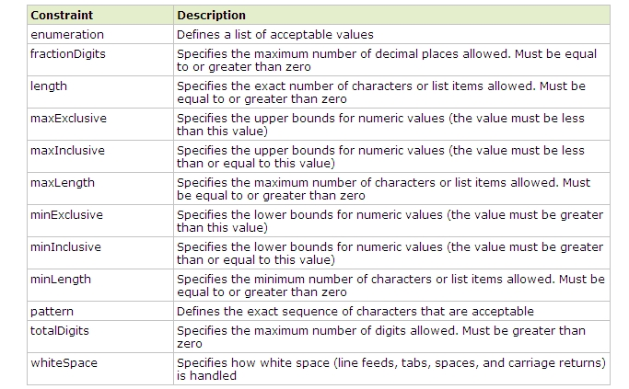
Restrictions for Datatypes

Slide 44
XSD Restrictions
XSD Restrictions/Facets
Restrictions are used to define acceptable values for XML elements or attributes. Restrictions on XML elements are called facets.
Restrictions on Values
<xs:element name="age">
<xs:simpleType>
<xs:restriction base="xs:integer">
<xs:minInclusive value="0"/>
<xs:maxInclusive value="120"/>
</xs:restriction>
</xs:simpleType>
</xs:element>

Slide 45
XSD Restrictions
Restrictions on a Set of Values
The example below defines an element called "car" with a restriction. The only acceptable values are: Audi, Golf, BMW:
<xs:element name="car">
<xs:simpleType>
<xs:restriction base="xs:string">
<xs:enumeration value="Audi"/>
<xs:enumeration value="Golf"/>
<xs:enumeration value="BMW"/>
</xs:restriction>
</xs:simpleType>
</xs:element>

Slide 46
XSD Restrictions
Examples
EXAMPLE 1:
<xs:element name="password">
<xs:simpleType>
<xs:restriction base="xs:string">
<xs:length value="8"/>
</xs:restriction>
</xs:simpleType>
</xs:element>
EXAMPLE 2:
<xs:element name="password">
<xs:simpleType>
<xs:restriction base="xs:string">
<xs:minLength value="5"/>
<xs:maxLength value="8"/>
</xs:restriction>
</xs:simpleType>
</xs:element>

Slide 47
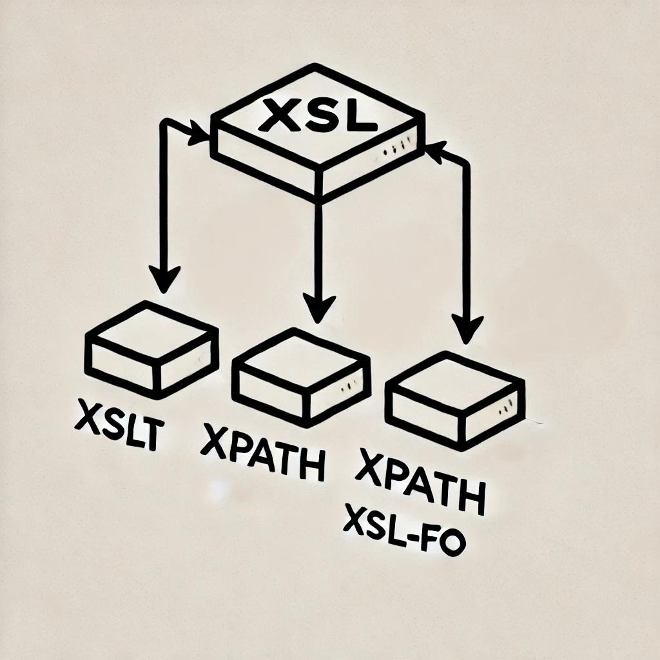
XSL
XSL extensible Stylesheet Language is a styling language for XML.
(Also XSLT extensible Stylesheet Language Transformations)
XSL Transformations (XSLT)
An XML language for transforming XML documents.
XML Path Language (XPath)
A language for navigating the XML document.
XSL Formatting Objects (XSL-FO)
An XML language for formatting XML documents.
In the transformation process, XSLT uses XPath to define parts of the source document that should match one or more predefined templates. When a match is found, XSLT will transform the matching part of the source document into the result document.

Slide 48
Difference Between CSS and XSL
CSS | XSL
Stylesheet language to create a style For HTML and XML documents . | Stylesheet language to create a style for XML documents
Determines the visual appearance of a page , but does not alter the structure of the source document. | Provide a means of transforming XML documents.

Slide 49
Syntax
<xsl:stylesheet version="1.0"
xmlns:xsl="http://www.w3.org/1999/XSL/Transform">
<xsl:template match="/">
<html>
……
</html>
</xsl:template>
</xsl:stylesheet>

Slide 50
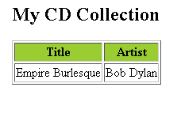
<xsl:value-of> Element
The <xsl:value-of> element can be used to extract the value of an XML element and add it to the output stream of the transformation:
<?xml version="1.0" encoding="ISO-8859-1"?>
<!-- Edited by XMLSpy® -->
<xsl:stylesheet version="1.0"
xmlns:xsl="http://www.w3.org/1999/XSL/Transform">
<xsl:template match="/">
<html>
<body>
<h2>My CD Collection</h2>
<table border="1">
<tr bgcolor="#9acd32">
<th>Title</th>
<th>Artist</th>
</tr>
<tr>
<td><xsl:value-of select="catalog/cd/title"/></td>
<td><xsl:value-of select="catalog/cd/artist"/> </td>
</tr>
</table>
</body>
</html>
</xsl:template>
</xsl:stylesheet>
The select attribute in the example above, contains an XPath expression. An XPath expression works like navigating a file system; a forward slash (/) selects subdirectories.

Slide 51
<xsl:for-each> Element:
The XSL <xsl:for-each> element can be used to select every XML element of a specified node-set:
<?xml version="1.0" encoding="ISO-8859-1"?>
<xsl:stylesheet version="1.0” xmlns:xsl="http://www.w3.org/1999/XSL/Transform">
<xsl:template match="/">
<html>
<body>
<h2>My CD Collection</h2>
<table border="1">
<tr bgcolor="#9acd32">
<th>Title</th>
<th>Artist</th>
</tr>
<xsl:for-each select="catalog/cd">
<tr>
<td><xsl:value-of select="title"/></td>
<td><xsl:value-of select="artist"/></td>
</tr>
</xsl:for-each>
</table>
</body>
</html>
</xsl:template>
</xsl:stylesheet>

Slide 52
<xsl:if> Element
To put a conditional if test against the content of the XML file, add an <xsl:if> element to the XSL document.
XSLT <xsl:if> Element
To put a conditional if test against the content of the XML file, add an <xsl:if> element to the XSL document.
<xsl:if test="expression">
...some output if the expression is true...
</xsl:if>
Filtering the Output
We can also filter the output from the XML file by adding a criterion to the select attribute.
Legal filter operators are:
= (equal)
!= (not equal)
&lt; less than
&gt; greater than

Slide 53
<xsl:choose> element
is used in conjunction with <xsl:when> and <xsl:otherwise> to express multiple conditional tests.
XSLT <xsl:choose> Element
<xsl:choose>
<xsl:when test="expression">
... some output ...
</xsl:when>
<xsl:otherwise>
... some output ....
</xsl:otherwise>
</xsl:choose>
<xsl:for-each select="catalog/cd">
<tr>
<td>
<xsl:value-of select="title"/>
</td>
<xsl:choose>
<xsl:when test="price &gt; 10">
<td bgcolor="#ff00ff">
<xsl:value-of select="artist"/>
</td>
</xsl:when>
<xsl:otherwise>
<td>
<xsl:value-of select="artist"/>
</td>
</xsl:otherwise>
</xsl:choose>
</tr>
</xsl:for-each>

Slide 54
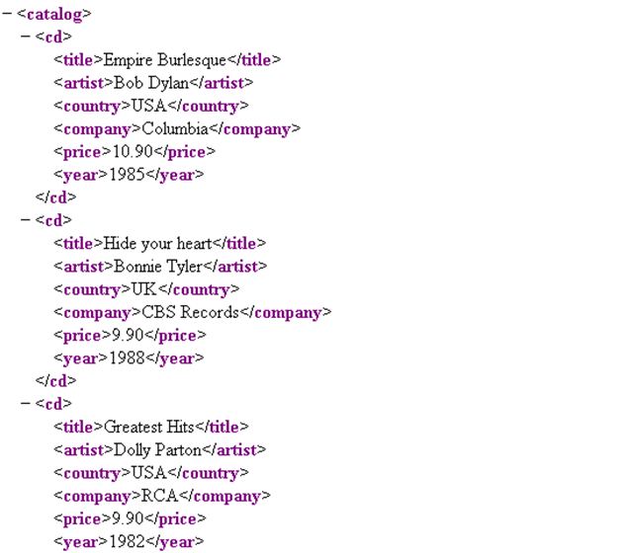
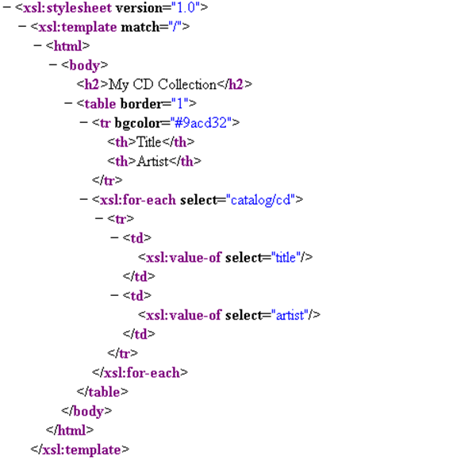
.xml
.xslt

Slide 55
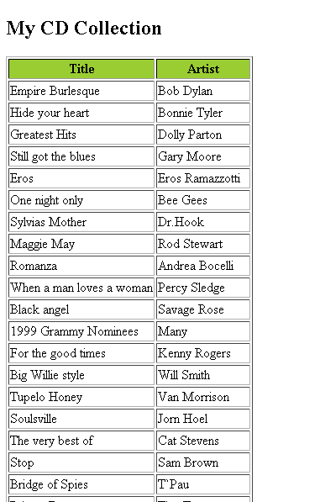
Output

Slide 56
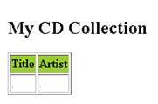
Cdcatalog.xml
Cdcatalog.xsl
<?xml version="1.0" encoding="ISO-8859-1"?>
<?xml-stylesheet type="text/xsl" href="cdcatalog.xsl"?>
<catalog>
<cd>
<title>Empire Burlesque</title>
<artist>Bob Dylan</artist>
<country>USA</country>
<company>Columbia</company>
<price>10.90</price>
<year>1985</year>
</cd>
.
.
.
</catalog>
<?xml version="1.0" encoding="ISO-8859-1"?>
<!-- Edited by XMLSpy® -->
<xsl:stylesheet version="1.0"
xmlns:xsl="http://www.w3.org/1999/XSL/Transform">
<xsl:template match="/">
<html>
<body>
<h2>My CD Collection</h2>
<table border="1">
<tr bgcolor="#9acd32">
<th>Title</th>
<th>Artist</th>
</tr>
<tr>
<td>.</td>
<td>.</td>
</tr>
</table>
</body>
</html>
</xsl:template>
</xsl:stylesheet>

