Slide 1
Introduction to JavaScript
Session 11

Slide 2
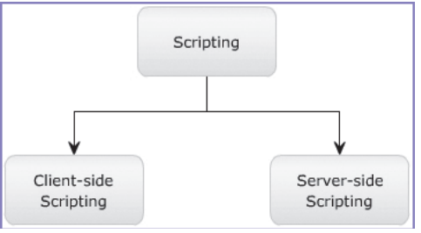
Scripting
Scripting refers to a series of commands that are executed immediately on occurrence of an event.
This event is an action generated by a user while interacting with a Web page.
Examples of events include button clicks, selecting a product from a menu, and so on.
There are two types of scripting languages.
Client-side Scripting Refers to a script being executed on the client’s machine by the browser. JavaScript
Server-side Scripting Refers to a script being executed on a Web server to generate dynamic HTML pages. Php .NET

Slide 3
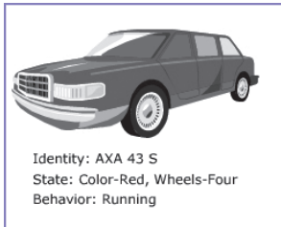
JavaScript
JavaScript is a scripting language that allows you to build dynamic Web pages by ensuring maximum user interactivity.
JavaScript language is an object-based language, which means that it provides objects for specifying functionalities.
In real life, an object is a visible entity such as a car .Which has some characteristics such as color, design, function.
Versions of JavaScript //self study from your book

Slide 4
JavaScript
Client-side JS
Server-side Js
A client-side JavaScript (CSJS) is executed by the browser on the user’s workstation.
A client-side script might contain instructions
Examples include displaying a welcome page with the username, displaying date and time, validating that the required user details are filled etc.
A server-side JavaScript (SSJS) is executed by the Web server when an HTML page is requested by a user.
The output of a server-side JavaScript is sent to the user and is displayed by the browser
A server-side JavaScript can interact with the database, fetch the required information specific to the user, and display it to the user.

Slide 5
Script Tag
The <script> tag defines a script for an HTML page to make them interactive.
The browser that supports scripts interprets and executes the script specified under the <script> tag when the page loads in the browser.
You can directly insert a JavaScript code under the <script> tag.
You can define multiple <script> tags either in the <head> or in the <body> elements of an HTML page.
In HTML5, the type attribute specifying the scripting language is no longer required as it is optional

Slide 6
Basic Syntax of JS
Basic Syntax of JS with html
<!DOCTYPE html>
<html lang="en">
<head>
<meta charset="UTF-8">
<meta http-equiv="X-UA-Compatible" content="IE=edge">
<meta name="viewport" content="width=device-width, initial-scale=1.0">
<title>Document</title>
<script>
document.write("Hello World");
</script>
</head>
<body>
</body>
</html>
<!DOCTYPE html>
<html lang="en">
<head>
<meta charset="UTF-8">
<meta http-equiv="X-UA-Compatible" content="IE=edge">
<meta name="viewport" content="width=device-width, initial-scale=1.0">
<title>Document</title>
<script>
document.write("<h1><i>Hello World</i></h1>");
</script>
</head>
<body>
</body>
</html>

Slide 7


Embedding JavaScript with HTML
Internal - by using <script>tag.
External - by using an external .js file
JavaScript allows you to display information using the methods of the document object.
document.write():Displays any type of data.
document.writeln():Displays any type of data and appends a new line character.
Note
It makes no sense to use writeln() in HTML.
Newline characters are ignored in HTML.

Slide 8
variables
A variable refers to a symbolic name that holds a value, which keeps changing.
For example, age of a student and salary of an employee can be treated as variables.
In JavaScript, a variable is a unique location in computer’s memory that stores a value and has a unique name.
The name of the variable is used to access and read the value stored in it.
A variable can store different types of data such as a character, a number, or a string.

Slide 9
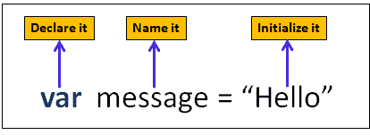
Types of variables
Var
Let
Const
Var Variable:
Variable defined with var keyword can be redeclared
Variables defined with var can be Reassigned.

Slide 10
Variables
Let
Const
Variables defined with let can not be redeclared.
Variables defined with let must be declared before use.
Variables defined with const cannot be Redeclared.
Variables defined with const cannot be Reassigned.

Slide 11
Declaring a variable
Declaring a variable refers to creating a variable by specifying the variable name.
For example, one can create a variable named to store the name of a student.
In JavaScript, the var keyword is used to create a variable by allocating memory to it.
a keyword is a reserved word that holds a special meaning.
the variable can be initialized at the time of creating the variable or later. initialization refers to the task of assigning a value to a variable.
once the variable is initialized, you can change the value of a variable as required.
variables allow keeping track of data during the execution of the script.
while referring to a variable, you are referring to the value of that variable

Slide 12
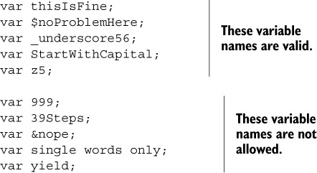
Variable Naming Rules
JavaScript is a case-sensitive language.
The variables X and x are treated as two different variables.
JavaScript consists of certain rules for naming a variable as follows:
cannot begin with a number and cannot contain any punctuation marks.
cannot contain any kind of special characters such as +, *, %, and so on.
must begin with a letter or underscore character.
can consist of digits, underscore, and alphabets.
cannot be a JavaScript keyword
cannot contain spaces.

Slide 13
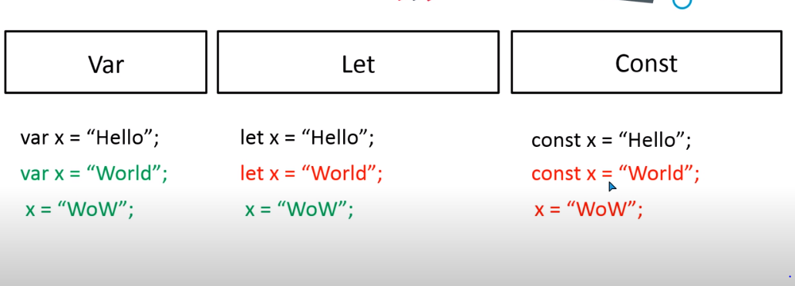
Difference between Variables

Slide 14
Example:1
Example:3
<script>
var studID;
var studName;
studID = 50;
studName = "David Fernando";
document.write(studID+studName);
</script>
<script>
var name=“FARIHA";
document.write(name);
</script>
Example:2
Example:4
<script>
var studID;
var studName;
studID = 50;
studName = "David Fernando";
document.write(studID +" " +studName);
</script>
<script>
var fname=“Fariha";
var lname=“Shafiq";
document.write("My name is:"+fname+lname);
</script>

Slide 15
Datatypes in Js
Data types in JavaScript are classified into two broad categories,
Primitive Data Types.
Composite Data Types.

Slide 16
PRIMITIVE DATA TYPES
A primitive data type contains a single value such as a number or a string.
A value that you can assign to variables
Primitive Data Type | Description
Boolean | Contains only two values namely, true or false
Null | Contains only one value namely, null. A variable of this value specifies that the variable has no value. This null value is a keyword and it is not the same as the value, zero
Number (Integer, float) | Contains positive and negative numbers and numbers with decimal point. Some of the valid examples include 6, 7.5, -8, 7.5e-3, and so on
String | Contains alphanumeric characters in single or double quotation marks. Single quotes are used to represent a string, which itself consists of quotation marks. A set of quotes without any characters within it is known as the null string

Slide 17
Datatypes in Js
COMPOSITE DATA TYPES :
A composite data type stores a collection of multiple related values, unlike primitive data types.
In JavaScript, all composite data types are treated as objects.
A composite data type can be either predefined or user-defined in JavaScript.
Composite Data Type | Description
Object | Refers to a collection of properties and functions. Properties specify the characteristics and functions determine the behavior of a JavaScript object
Functions | Refers to a collection of statements, which are instructions to achieve a specific task
Arrays | Refers to a collection of values stored in adjacent memory locations

Slide 18
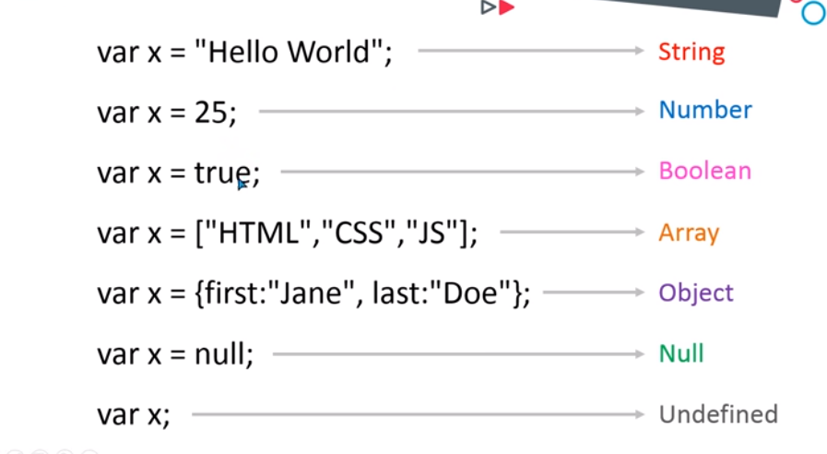
<script>
var x="Hello World";
var a=25;
var y=true;
document.write(x);
document.write("<br>");
document.write(typeof (x ) );
document.write("<br>");
document.write(a);
document.write("<br>");
document.write(typeof a);
document.write("<br>");
document.write(y);
document.write("<br>");
document.write(typeof y);
</script>
Different Datatypes with Examples

Slide 19
Comments
Single-line Comments: begin with two forward slashes (//).
// This statement declares a variable named num.
var num;
Multi-line Comments: begin with a forward slash followed by an asterisk (/*) and end with an asterisk followed by a forward slash (*/).
/* This line of code
declares a variable */
var num;

Slide 20
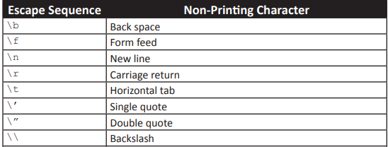
Escape Sequence
An escape sequence character is a special character that is preceded by a backslash (\).

Slide 21
Basic Operators
There are three main types of operators, which are as follows:
Unary operators - Operates on a single operand.
For example, the expression y = -x.
Binary operators - Operates on two operands.
For example, the expression sum = y + x.
Ternary operators - Operates on three operands.
For example, the expression age >= 18 ? “Eligible” : “Not Eligible”.

Slide 22
Operators and their Types
These six categories of operators are as follows:
Arithmetic operators
Relational operators
Logical operators
Assignment operators
Bitwise operators
Special operators

Slide 23
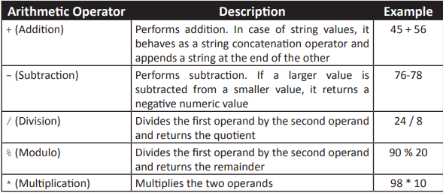
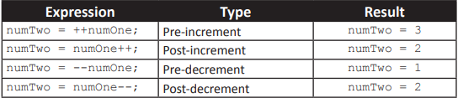
Arithmetic Operators
<script>
var num1 = 3;
var num2= 4;
document.write('Number after increment = ' + ++num1 +"<br>") ;
document.write('Number after decrement = ' + --num2);
</script>
<script>
var loanAmount = 34500;
var interest = 8;
var interestAmount, totalAmount;
interestAmount = loanAmount * (interest / 100);
totalAmount = loanAmount + interestAmount;
document.write("<B>Total amount to be paid ($):</B>"+ totalAmount);
</script>
Increment and Decrement Operators

Slide 24
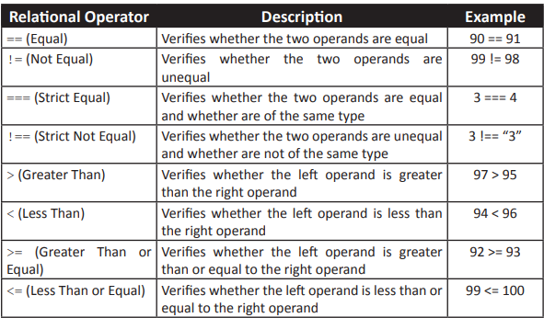
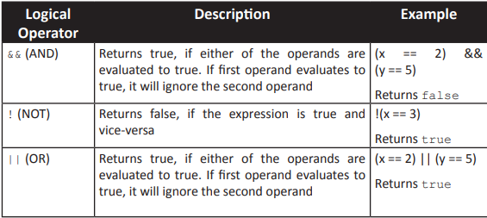
Relational Operator:
Relational operators are binary operators that make a comparison between two operands.
After making a comparison, they return a Boolean value namely, true or false.
Logical Operator:
Logical operators are binary operators that perform logical operations on two operands.
They belong to the category of relational operators, as they return a Boolean value.

Slide 25
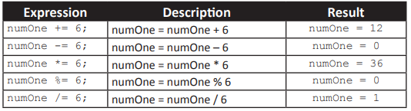
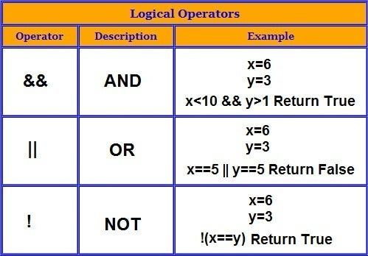
Assignment Operator:
Assignment operator assign the value of the right side operand to the operand on the left side by using the equal to operator (=).
Bitwise Operator: (logical operator)
Bitwise operators represent their operands in bits (zeros and ones) and perform operations on them.
They return standard decimal values.

Slide 26
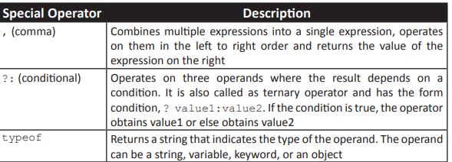
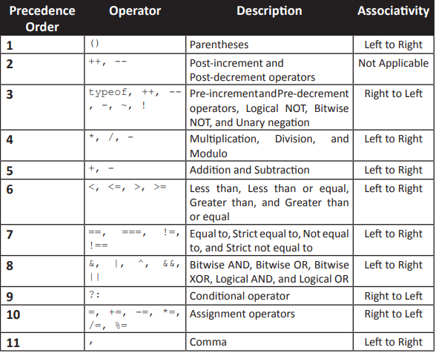
Special Operator:
There are some operators in JavaScript which do not belong to any of the categories of JavaScript operators.
Such operators are referred to as the special operators.
Operator Precedence:

Slide 27
Conditional Statement in JavaScript
Conditional statements are used to perform different actions based on different conditions.
In JavaScript we have the following conditional statements:
If statement
Else statement
Else if statement
Switch-case statement
Example:
An example of a condition is a password. Passwords are “if, then” logic statements: If a user enters the correct password, then they can access the program.

Slide 28
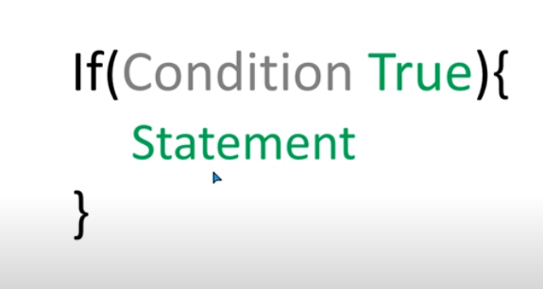
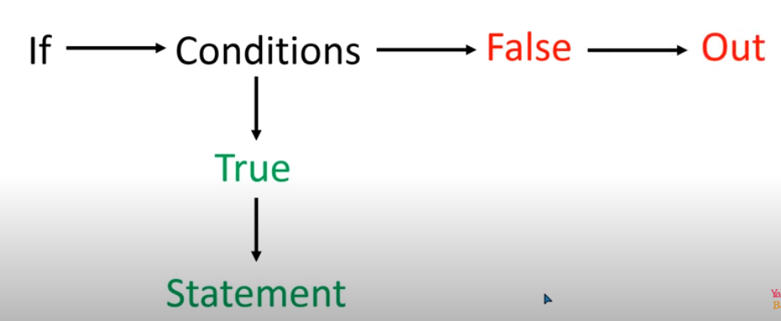
If Statement
Use if to specify a block of code to be executed, if a specified condition is true
Syntax:

Slide 29
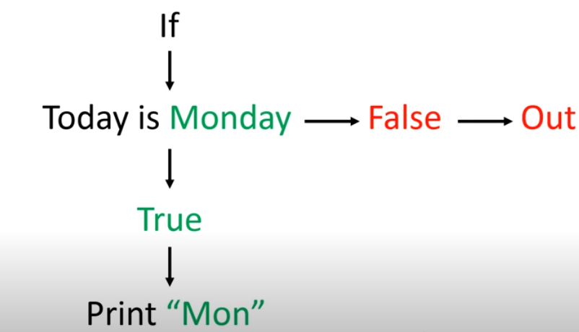
Example
<script>
var a=5;
if(a>=10)
{
document.write("A is greater");
}
</script>
Relational operator
<script>
var a="Monday";
if(a=="Monday")
{
document.write("Today is Monday");
}
</script>
<script>
var a=200;
var b=100;
if (a>b) {
document.write("A is greater than B");
}
</script>

Slide 30
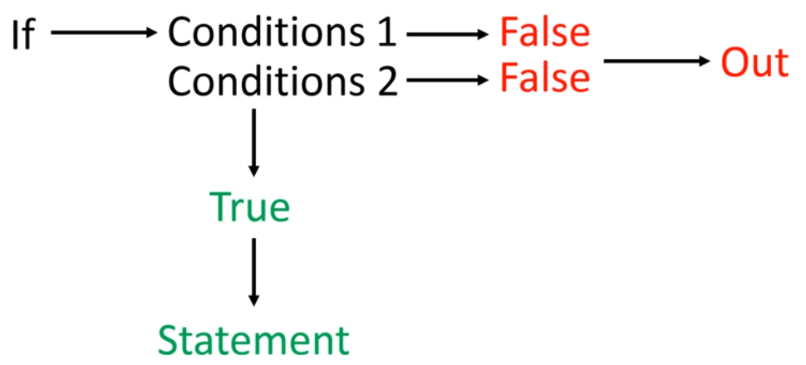
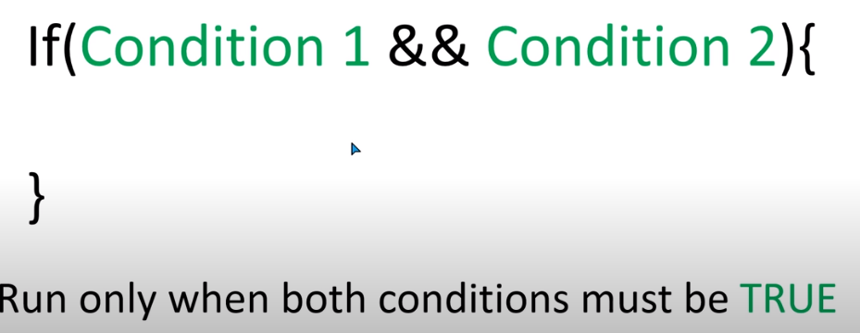
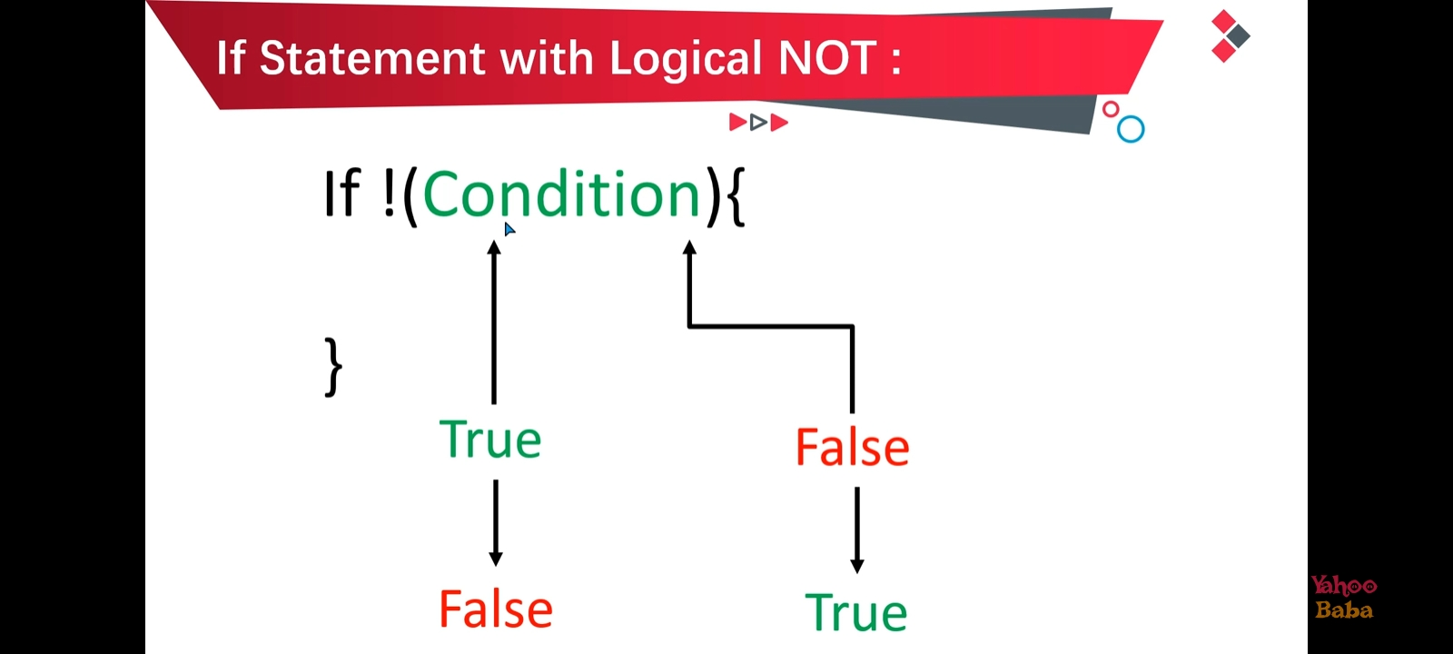
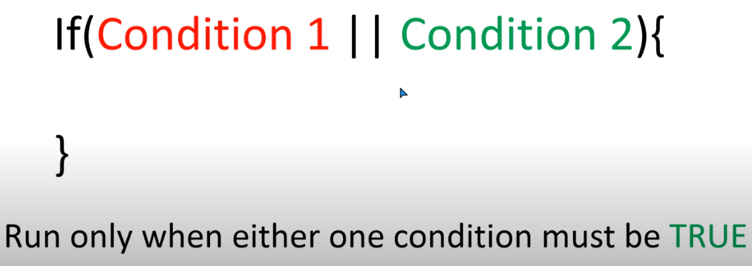
If Statement with Logical Operators

Slide 31
<script>
var age=22;
if (age >=18 && age<=21) {
document.write("You are eligible");
}
</script>
var a=10;
var b=15;
if (a>=10 || b<=20) {
document.write("Condition A is true");
}
<script>
var a=30;
document.write(!a>=12)
</script>

Slide 32
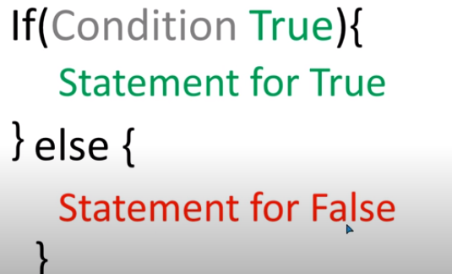
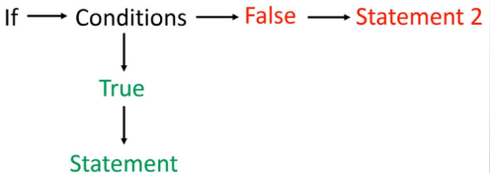
IF Else
Use else if to specify a new condition to test, if the first condition is false

Slide 33
Example
var x=15;
if (x>=30) {
document.write("X is greater");
}
else{
document.write("X is smaller");
}

Slide 34
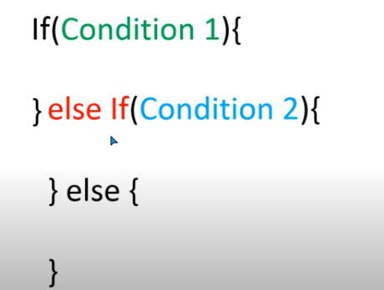
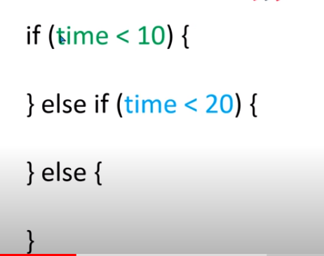
Else IF Statement

Slide 35
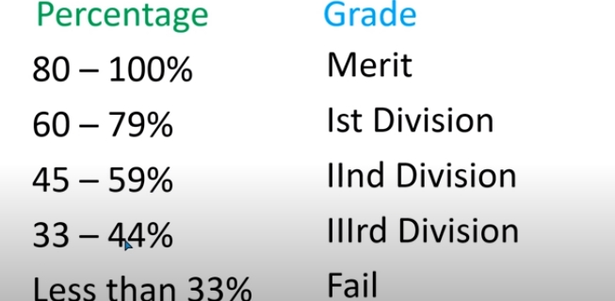
Example
var time=10;
if (time<10) {
document.write("Good Morning");
}
else if (time<20) {
document.write("Good Afternoon");
} else {
document.write("Incorrect time")
}
<script>
var per=45;
if(per>=80 && per<=100){
document.write("You are in Merit");
}else if(per>=60 && per<80){
document.write("You are in Ist Division.");
}else if(per>=45 && per<60){
document.write("You are in 2nd Division.");
}else if(per>=33 && per<45){
document.write("You are in 3rd Division.");
}else if(per<33){
document.write("You are Fail.");
}else{
document.write("Please Enter Valid Percentage.");
}
</script>

Slide 36
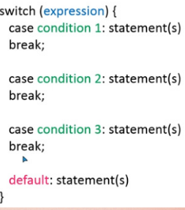
Switch Case

Slide 37
Example
<script>
var day = 7;
switch (day) {
case 1:
document.write("Today is Monday");
break;
case 2:
document.write("Today is Tuesday");
break;
case 3:
document.write("Today is Wednesday");
break;
case 4:
document.write("Today is Thursday");
break;
case 5:
document.write("Today is Friday");
break;
case 6:
document.write("Today is Saturday");
break;
case 7:
document.write("Today is Sunday");
break;
default:
document.write("Enter the valid Week day");
}
</script>

Slide 38
Alert()
Description
The alert() method displays an alert box with a message and an OK button.
The alert() method is used when you want information to come through to the user.
<script>
alert("Hello World");
</script>
a=10;
b=20;
if (a<b) {
alert("A is greater");
} else {
alert("B is greater");
}

Slide 39
Confirm()
Description
The confirm() method displays a dialog box with a message, an OK button, and a Cancel button.
The confirm() method returns true if the user clicked "OK", otherwise false.
<script>
confirm("Do you like to study Computer Science?")
</script>
<script>
var a= confirm("Do you like to study Computer Science?")
if (a) {
alert("Good to know that");
} else {
alert("Sorry to hear that :(");
}
</script>

Slide 40
Prompt()
Description
The prompt() method displays a dialog box that prompts the user for input.
The prompt() method returns the input value if the user clicks "OK", otherwise it returns null.
<script>
var a=prompt("Enter your name");
if (a) {
document.write("My nameis:"+a);
}
</script>

Slide 41
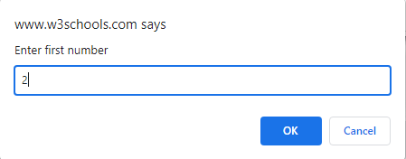
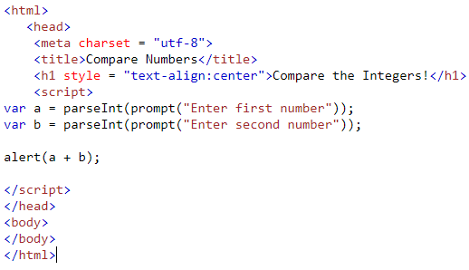

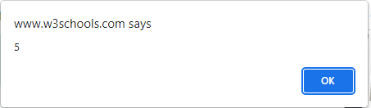
Task to print sum of 2 integer from user input

Slide 42
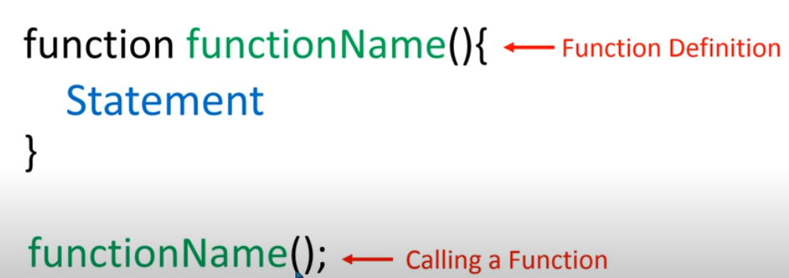
Function
A JavaScript function is defined with the function keyword, followed by a name, followed by parentheses ().
Function names can contain letters, digits, underscores, and dollar signs (same rules as variables).
The parentheses may include parameter names separated by commas:
(parameter1, parameter2, ...)
The code to be executed, by the function, is placed inside curly brackets: {}

Slide 43
<script>
function hello() {
alert("HI Welcome to my page");
}
hello();
document.write("<h1>Good Evening</h1>");
</script>

Slide 44
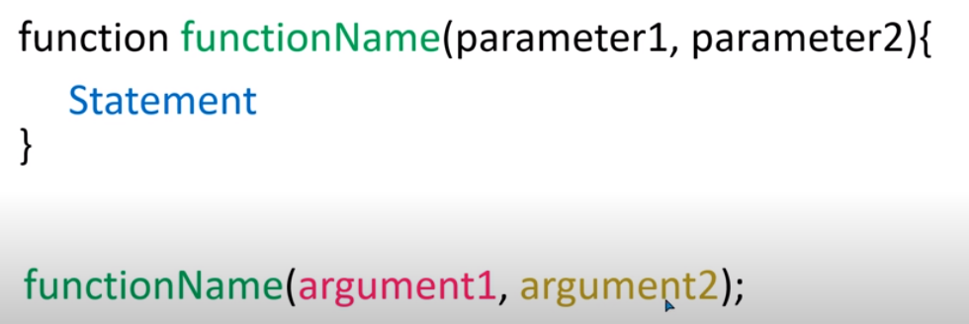
Function with parameters
Function parameters are listed inside the parentheses () in the function definition.

Slide 45
<script>
function name(fname,lname) {
document.write("Hello" +" " +fname + " " +lname);
}
name(“Fariha","Shafiq")
</script>
<script>
function name(a,b) {
alert("The sum is:" +(a+b));
}
name(10,20);
</script>

Slide 46
Function with return value
<script>
function fullname(fname,lname) {
var a= fname+ " "+lname;
return a;
}
var fn=fullname(“Fariha",“Shafiq");
document.write(fn);
</script>
Return statement function ko value return karti hai
Aur function ko assign hojati hai
<script>
function add(a, b) {
return a + b;
}
var sum = add(2, 3);
console.log(sum);
</script>

Slide 47
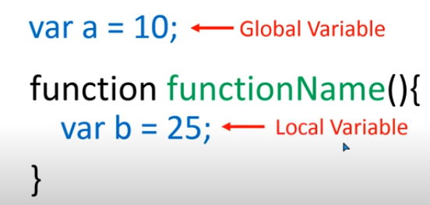
Global Vs Local variable
var a="Fariha";
function hello() {
document.write(a+"<br> <br> <br> <br>");
}
hello();
document.write(a);
function hello() {
var a=“Fariha";
document.write(a+"<br> <br> <br> <br>");
}
hello();
document.write(a);

Slide 48
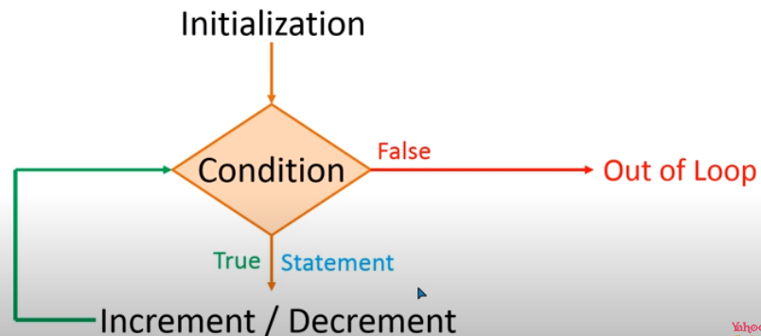
Loop
While loop
Do/while loop
For loop

Slide 49
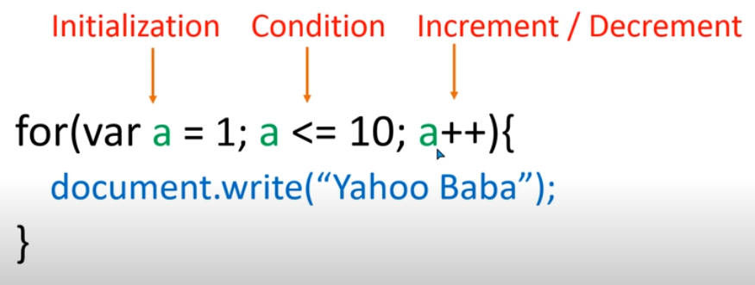
For Loop
<script>
for(var a=1; a<=10; a++) {
document.write("Print me <br>");
}
</script>

Slide 50
While/Do while loop
<script>
var a=1;
while (a<=10) {
document.write(“Fariha <br>");
a++;
}
</script>
<script>
var a=10;
while (a>=1) {
document.write(a+":Fariha <br>");
a=a-1;
}
</script>
var a=1;
do {
document.write(a+": Hello world <br>");
a++;
} while (a<=10);
var a=1;
while (a<=20) {
document.write(“Fariha <br>");
a=a+1;
}

Slide 51
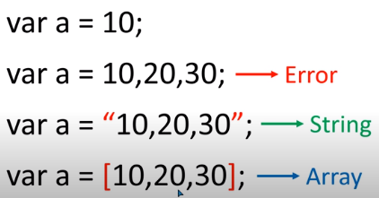

Arrays
An array is a collection of values stored in adjacent memory locations.
These array values are referenced using a common array name.
These values that are also referred to as elements and can be accessed by using subscript or index numbers.
The subscript number determines the position of an element in an array list. JavaScript supports two types of arrays that are as follows:
Single-dimensional array
Multi-dimensional array

Slide 52
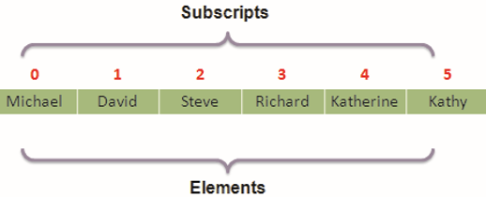
Single dimensional array
In a single-dimensional array, the elements are stored in a single row in the allocated memory.
<script>
var a=[10,“mifra",70,90];
document.write(a);
document.write("<br>")
document.write("The value on index 1 is:"+a[1]);
</script>

Slide 53
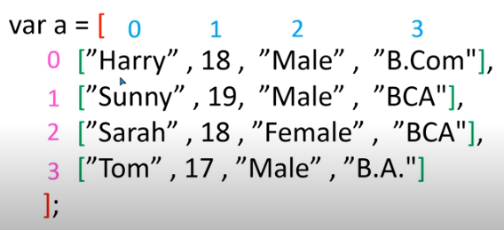
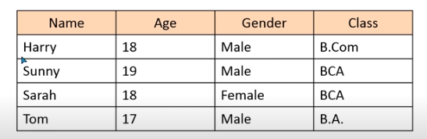
Multi dimensional array
A multi-dimensional array stores a combination of values of a single type in two or more dimensions. These dimensions are represented as rows and columns similar to those of a Microsoft Excel sheet. A two-dimensional array is an example of the multi-dimensional array.

Slide 54
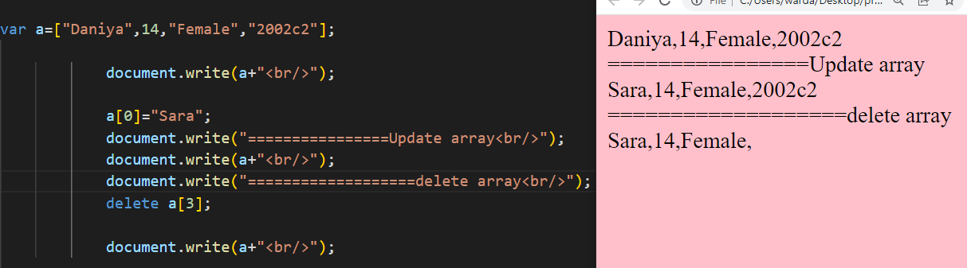
Update and delete array

Slide 55
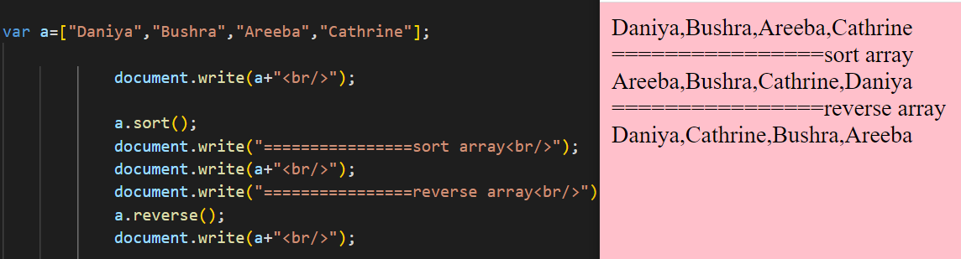
Sort and reverse array

