Slide 1
Organize Your Schema Using Standard Rules
“DATABASE NORMALIZATION”
Facilitator: Jaweria Ejaz

Slide 2
What is Normalization?
Primarily a tool to validate and improve a logical design so that it satisfies certain constraints that avoid unnecessary duplication of data.
The process of decomposing relations with anomalies to produce smaller, well-structured relations.
Normalization is a database design technique that reduces data redundancy and eliminates undesirable characteristics like Insertion, Update and Deletion Anomalies.

Slide 3
Why We Need Normalization?
A relation that contains minimal data redundancy and allows users to insert, delete, and update rows without causing data inconsistencies
The Goal of normalization is to avoid anomalies.

Slide 4
What are Anomalies?
  A database anomaly is an inconsistency in the data resulting from an operation like an update, insertion, or deletion.
  Insertion Anomaly–adding new rows forces user to create duplicate data
  Deletion Anomaly–deleting rows may cause a loss of data that would be needed for other future rows
  Modification Anomaly–changing data in a row forces changes to other rows because of duplication

Slide 5
Example 0f Duplications and Anomaly
  Row level Duplicity we make a primary key in the table:
Student_Id | Student Name | Student Age
1 | Sana | 10
2 | Laiba | 20
1 | Sana | 10
3 | Fariha | 15
Primary key is the unique key which can not be duplicate and always be not null.

Slide 6
Example 0f Duplications and Anomaly
Primary Key will avoid row level Duplicity
  Now the important part is the column level duplicacy
Student_Id | Student_Name | Course_Id | Course_Name | Instructor_Id | Instructor_Name | Salary
1 | Sana | C1 | HCI | I1 | Ms. Sara | 40,000
2 | Laiba | C2 | IS | I2 | Ms. Aliya | 30,000
3 | Fariha | C1 | HCI | I1 | Ms. Sara | 40,000
4 | Jawad | C3 | CN | I3 | Ms. Aneeqa | 50,000
5 | Danish | C2 | IS | I2 | Ms. Aliya | 30,000
Column Level Duplicity

Slide 7
Example 0f Duplications and Anomaly
  Column level duplicity occur insertion, deletion and updation Anomaly
  INSERTION:
Primary Key
Student_Id | Student_Name | Course_Id | Course_Name | Instructor_Id | Instructor_Name | Salary
1 | Sana | C1 | HCI | I1 | Ms. Sara | 40,000
2 | Laiba | C2 | IS | I2 | Ms. Aliya | 30,000
3 | Fariha | C1 | HCI | I1 | Ms. Sara | 40,000
4 | Jawad | C3 | CN | I3 | Ms. Aneeqa | 50,000
5 | Danish | C2 | IS | I2 | Ms. Aliya | 30,000
 |  | C10 | BMW | I4 | Sr. Ahsan | 75,000
Insertion anomaly occur

Slide 8
Example 0f Duplications and Anomaly
  Column level duplicity occur insertion, deletion and updation Anomaly
  DELETION:
  DELETE From table_name; where Student_Id=1
Primary Key
Student_Id | Student_Name | Course_Id | Course_Name | Instructor_Id | Instructor_Name | Salary
1 | Sana | C1 | HCI | I1 | Ms. Sara | 40,000
2 | Laiba | C2 | IS | I2 | Ms. Aliya | 30,000
3 | Fariha | C1 | HCI | I1 | Ms. Sara | 40,000
4 | Jawad | C3 | CN | I3 | Ms. Aneeqa | 50,000
5 | Danish | C2 | IS | I2 | Ms. Aliya | 30,000
Deletion anomaly occur

Slide 9
Example 0f Duplications and Anomaly
  Column level duplicity occur insertion, deletion and updation Anomaly
  Updation Anomaly:
  Update From table_name; Set Salary= 70,000 where Instructor_Id= I2
Primary Key
Student_Id | Student_Name | Course_Id | Course_Name | Instructor_Id | Instructor_Name | Salary
1 | Sana | C1 | HCI | I1 | Ms. Sara | 40,000
2 | Laiba | C2 | IS | I2 | Ms. Aliya | 30,000
3 | Fariha | C1 | HCI | I1 | Ms. Sara | 40,000
4 | Jawad | C3 | CN | I3 | Ms. Aneeqa | 50,000
5 | Danish | C2 | IS | I2 | Ms. Aliya | 30,000
Updation anomaly occur

Slide 10
Why Anomalies Exist
Because there are two themes (entity types) in this one relation. This results in data duplication and an unnecessary dependency between the entities.

Slide 11
Things To Know Before Starting Normalization
What is a database?
What are correct entities/relations?
What is a primary key?

Slide 12
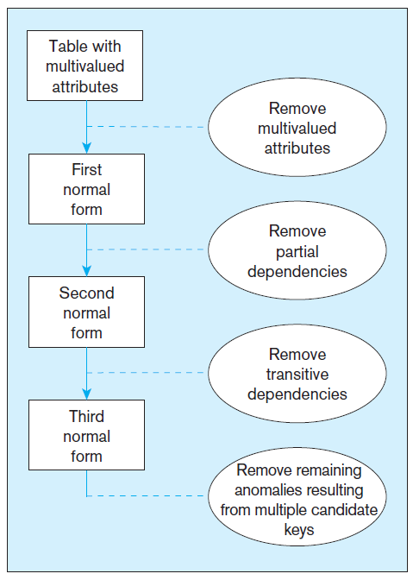
Steps of Normalization
3rd normal form is generally considered to be sufficient, although higher degrees of normalization are possible.

Slide 13
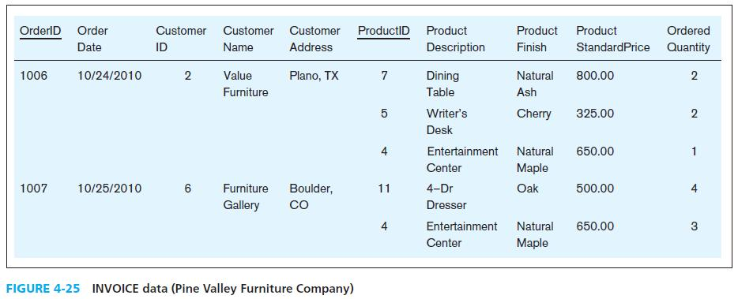
1st Normal Form
No multivalued attributes
Every attribute value is atomic

Slide 14
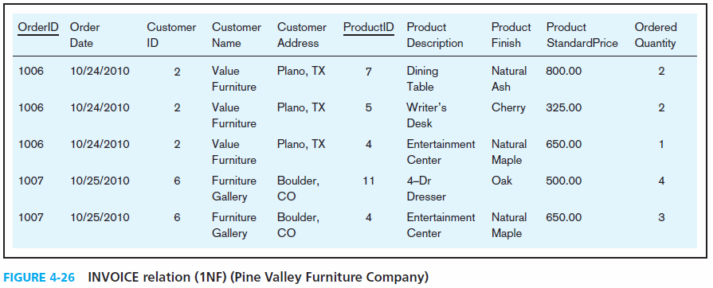
1st Normal Form
No multivalued attributes
Every attribute value is atomic

Slide 15
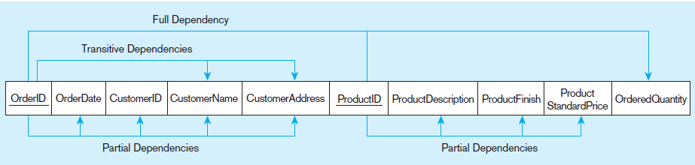
2nd Normal Form
Every non-key attribute must be defined by the entire key, not by only part of the key
No partial functional dependencies
OrderID ➔ OrderDate, CustomerID, CustomerName, CustomerAddress
ProductID ➔ ProductDescription, ProductFinish, ProductStandardPrice
OrderID, ProductID ➔ OrderQuantity

Slide 16
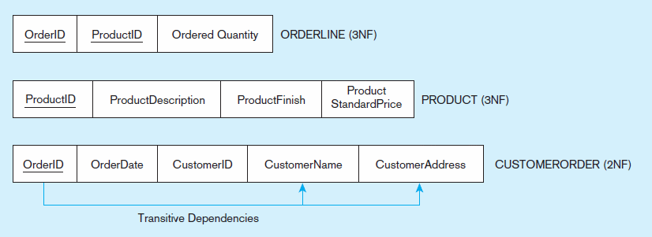
2nd Normal Form
Every non-key attribute must be defined by the entire key, not by only part of the key
No partial functional dependencies

Slide 17
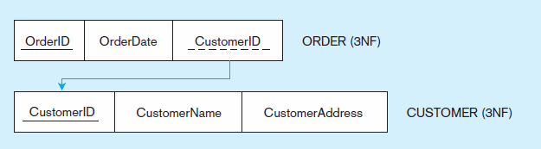
3RD Normal Form
No transitive dependencies (functional dependencies on non-primary-key attribute

Slide 18
Thank You

