Slide 1
PHP
PHP: Hypertext Preprocessor

Slide 2
Server-side Technologies
Server-side technologies are the software components and frameworks that run on the server-side of web applications.
These technologies handle the processing and logic behind the scenes, interacting with databases, managing user sessions, and generating dynamic content to be sent to the client's web browser.

Slide 3
What is PHP?
PHP stands for PHP: Hypertext Preprocessor
PHP is a widely-used, open source scripting language
PHP scripts are executed on the server
PHP is free to download and use
Current version of php is 8.3

Slide 4
What is a PHP File?
PHP files can contain text, HTML, JavaScript code, and PHP code
PHP code are executed on the server, and the result is returned to the browser as plain HTML
PHP files have a default file extension of ".php"

Slide 5
What Can PHP Do?
PHP can generate dynamic page content
PHP can create, open, read, write, and close files on the server
PHP can collect form data
PHP can send and receive cookies
PHP can add, delete, modify data in your database
PHP can restrict users to access some pages on your website
PHP can encrypt data

Slide 6
Why PHP?
PHP runs on different platforms (Windows, Linux, Unix, Mac OS X, etc.)
PHP is compatible with almost all servers used today (Apache, IIS, etc.)
PHP has support for a wide range of databases
PHP is free. Download it from the official PHP resource: www.php.net
PHP is easy to learn and runs efficiently on the server side

Slide 7
Basic PHP Syntax
A PHP script can be placed anywhere in the document. A PHP script starts with <?php and ends with ?>:
<?php
// PHP code goes here
?>
The default file extension for PHP files is ".php".

Slide 8
Comments in PHP
 <html>
<body>
<?php
//This is a PHP comment line
/*This is a PHP comment block*/
?>
</body>
</html>

Slide 9
Data Types
PHP supports the following data types:
  String : $x = "Hello world!";
  Integer : $x = 5985;
  Float (floating point numbers - also called double) : $x = 10.365;
  Boolean : $x = true; $y = false;
  Array : $cars = array("Volvo","BMW","Toyota");
  Object : $herbie = new Car();
  NULL : $x = null;
  Resource : is not an actual data type .A common example of using the resource data type is a database call.

Slide 10
PHP Variables
Variable can have short names (like x and y) or more descriptive names (age, carname, totalvolume).
Rules for PHP variables:
  A variable starts with the $ sign, followed by the name of the variable
  A variable name must begin with a letter or the
underscore character
  A variable name can only contain alpha-numeric characters and underscores (A-z, 0-9, and _ )
  A variable name should not contain spaces
  Variable names are case sensitive ($y and $Y are two different variables)

Slide 11
Creating (Declaring) PHP Variables
PHP has no command for declaring a variable.
A variable is created the moment you first assign a value to it:
$txt="Hello world!";
$x=5;
After the execution of the statements above, the variable txt will hold the value Hello world!, and the variable xwill hold the value 5.
Note: When you assign a text value to a variable, put quotes around the value.

Slide 12
PHP echo and print Statements
In PHP there is two basic ways to get output: echo and print.
There are some differences between echo and print:
  echo - can output one or more strings
  print - can only output one string, and returns always 1
Tip: echo is marginally faster compared to print as echo does not return any value.
<?php
echo "<h2>PHP is fun!</h2>";
echo "Hello world!<br>";
echo "This", " string", " was", " made", " with multiple parameters.";
?>

Slide 13
Php Operators

Slide 14
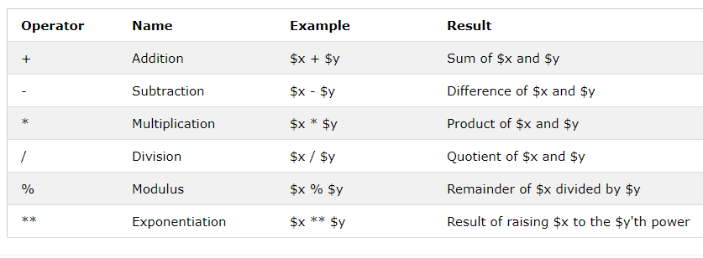
PHP Arithmetic Operators
The PHP arithmetic operators are used with numeric values to perform common arithmetical operations, such as addition, subtraction, multiplication etc.

Slide 15
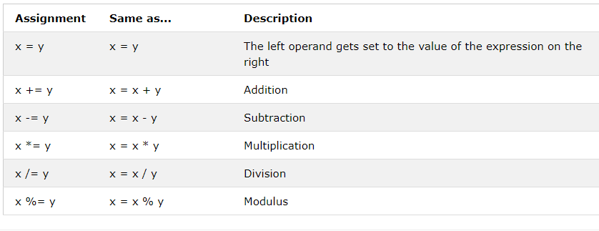
PHP Assignment Operators
The PHP assignment operators are used with numeric values to write a value to a variable.

Slide 16
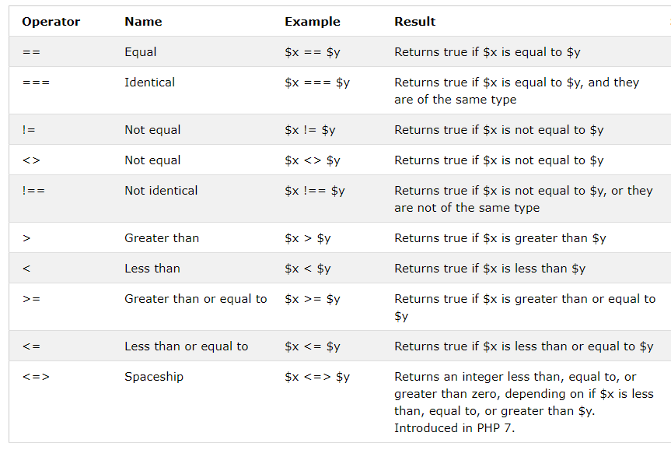
PHP Comparison Operators
The PHP comparison operators are used to compare two values (number or string):

Slide 17
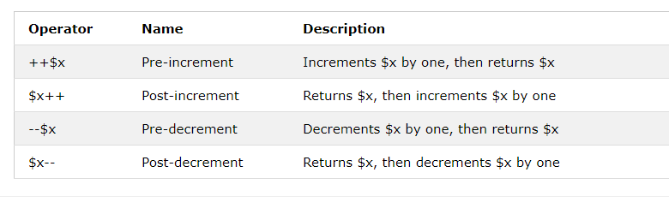
PHP Increment / Decrement Operators
The PHP increment operators are used to increment a variable's value.
The PHP decrement operators are used to decrement a variable's value.

Slide 18
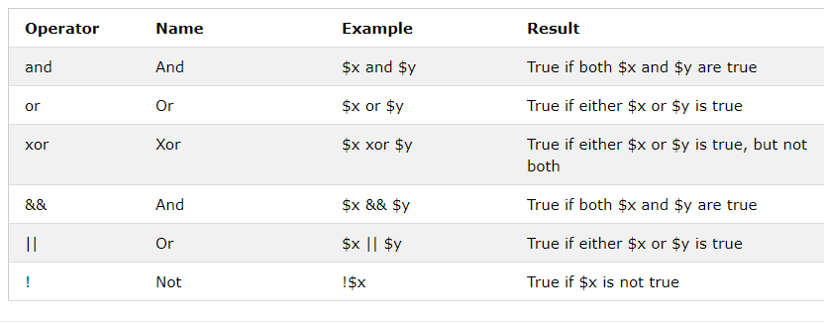
PHP Logical Operators
The PHP logical operators are used to combine conditional statements.

Slide 19
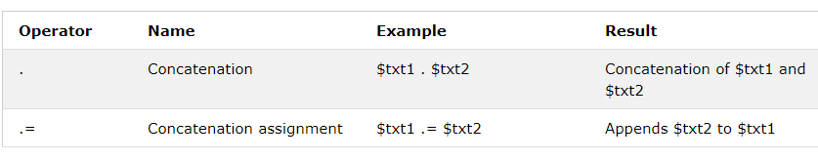
PHP String Operators
PHP has two operators that are specially designed for strings.
$text = “hello”;
$text .= $text;

Slide 20
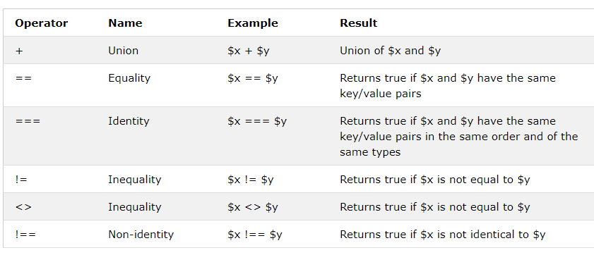
PHP Array Operators
The PHP array operators are used to compare arrays.

Slide 21
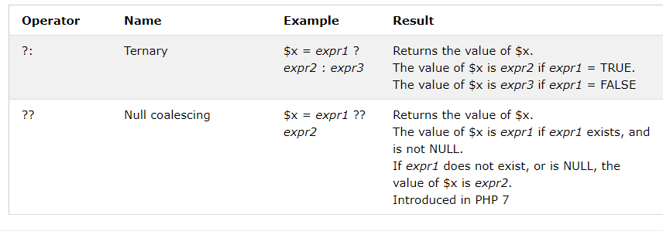
PHP Conditional Assignment Operators
The PHP conditional assignment operators are used to set a value depending on conditions:

Slide 22
PHP Arrays
 An array stores multiple values in one single variable:
Example
<?php
$cars = array("Volvo","BMW","Toyota");
echo "I like " . $cars[0] . ", " . $cars[1] . " and " .
$cars[2] . ".";
?>

Slide 23
Create an Array in PHP
In PHP, the array() function is used to create an array:
Example :
$cars = array("Volvo","BMW","Toyota");
In PHP, there are three types of arrays:
  Indexed arrays - Arrays with numeric index
  Associative arrays - Arrays with named keys
  Multidimensional arrays - Arrays containing one or more
arrays

Slide 24
PHP Indexed Arrays
There are two ways to create indexed arrays:
  The index can be assigned automatically (index always starts at 0):
  $cars=array("Volvo","BMW","Toyota");
OR
  The index can be assigned manually:
$cars[0]="Volvo";
$cars[1]="BMW";
$cars[2]="Toyota";

Slide 25
PHP Associative Arrays
Associative arrays are arrays that use named keys that you assign to them.
There are two ways to create an associative array:
 $age=array("Peter"=>"35","Ben"=>"37","Joe"=>"43 ");
OR
 $age['Peter']="35";
$age['Ben']="37";
$age['Joe']="43";
$person = array(“Name”=>“Surayya”, “role”=>”Teacher”)

Slide 26
PHP Associative Arrays
 Example
<?php
$age=array("Peter"=>"35","Ben"=>"37","Joe"=>"43"); echo "Peter is " . $age['Peter'] . " years old.";
?>
// Output : Peter is 35 years old.
Echo “Name of person is $person[‘Name’]”

Slide 27
PHP Multidimensional Arrays
An array can also contain another array as a value, which in turn can hold other arrays as well. In such a way we can create two- or three-dimensional arrays:
Example
<?php
// A two-dimensional array:
$cars = array (
array("Volvo",100,96),
array("BMW",60,59),
array("Toyota",110,100)
);
$student = array(array(“Rabia”,”3.0”),array(“Umaima”,”3.5”),array(“Aleeza”,”3.6”))
?>

Slide 28
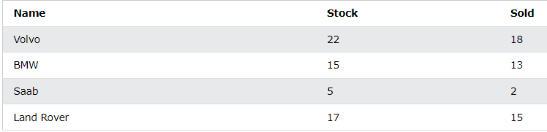
PHP Multidimensional Arrays

Slide 29
Decision Making
In PHP, decision-making statements are used to control the flow of execution based on certain conditions.
if Statement: The if statement is used to execute a block of code if a specified condition is true.
if-else Statement: The if-else statement is used to execute one block of code if the condition is true and another block of code if the condition is false.
if-elseif-else Statement: The if-elseif-else statement allows you to check multiple conditions and execute different blocks of code based on the conditions.
Switch Statement: The switch statement is used to perform different actions based on different values of a variable. It provides a concise way to handle multiple conditions.

Slide 30
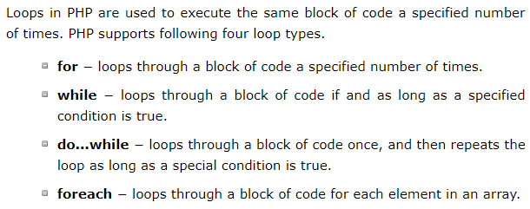
Loops

Slide 31
User Defined Functions
Besides the built-in PHP functions, we can create our own functions.
A function is a block of statements that can be used repeatedly in a program.
A function will not execute immediately when a page loads.
A function will be executed by a call to the function.
function functionName() {
code to be executed;
}

Slide 32
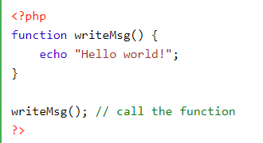
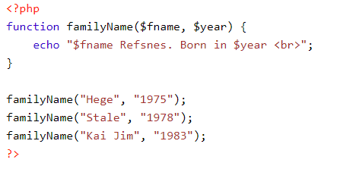
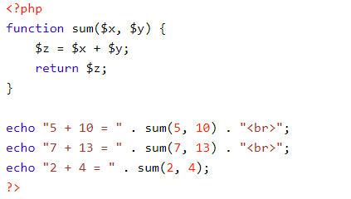
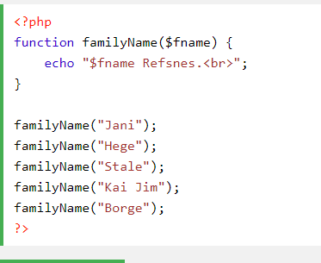

Slide 33
Using PHP for database connectivity

Slide 34
Outline
MySQL basics
Database terms review
MySQLi functions
CRUD operations

Slide 35
Introduction
MySQL is the most popular database management system for web servers.
Developed in the mid-1990s, it’s now a mature technology that powers many of today’s most-visited Internet destinations
One reason for its success must be the fact that, like PHP, it’s free to use. But it’s also extremely powerful and exceptionally fast—it can run on even the most basic of hardware, and it hardly puts a dent in system resources.

Slide 36
MySQL Basics
A database is a structured collection of records or data stored in a computer system and organized in such a way that it can be quickly searched and information can be rapidly retrieved.
The SQL in MySQL stands for Structured Query Language.
  This language is loosely based on English and also used in other databases such as Oracle and Microsoft SQL Server
A MySQL database contains one or more tables, each of which contains records or rows. Within these rows are various columns or fields that contain the data itself.

Slide 37
Database Terms Review
Database
  The overall container for a collection of MySQL data
Table
  A subcontainer within a database that stores the actual data
Row
  A single record within a table, which may contain several fields
Column
  The name of a field within a row
Query
  A question or a request for specific information

Slide 38
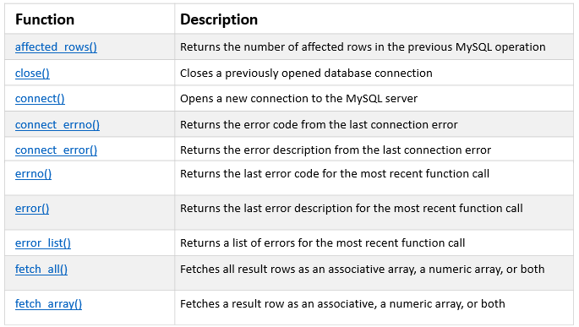
MySQLi Functions
The MySQLi functions allows to access MySQL database servers. Following are the commonly used functions

Slide 39
Accessing MySQL
There are three main ways in which you can interact with MySQL:
  using a command line,
  via a web interface such as phpMyAdmin,
  and through a programming language like PHP.

Slide 40
The Process for Connecting MySQL via PHP
Connect to MySQL and select the database to use.
Build a query string.
Perform the query.
Retrieve the results and output them to a web page.
Repeat steps 2 to 4 until all desired data has been retrieved.
Disconnect from MySQL.

Slide 41
A Connection File
Most websites developed with PHP contain multiple program files that will require access to MySQL
Connect.php
  <?php
  $hostname = 'localhost';
  $database = 'publications';
  $username = 'username';
  $password = 'password';
  // Create connection
  $conn = mysqli_connect($hostname, $username, $password);
  // Check connection
  if (!$conn) {
  die("Connection failed: " . mysqli_connect_error());
  }
  echo "Connected successfully";
  ?>

Slide 42
PHP Create a MySQL Database
The query() / mysqli_query() function performs a query against a database.
// Create database
$sql = "CREATE DATABASE myDB";
if (mysqli_query($conn, $sql)) {
echo "Database created successfully";
} else {
echo "Error creating database: " . mysqli_error($conn);
}
mysqli_close($conn);
?>

Slide 43
PHP Create MySQL Tables
The CREATE TABLE statement is used to create a table in MySQL.
CREATE TABLE MyGuests (
id INT(6) UNSIGNED AUTO_INCREMENT PRIMARY KEY,
firstname VARCHAR(30) NOT NULL,
lastname VARCHAR(30) NOT NULL,
email VARCHAR(50),
reg_date TIMESTAMP
)

Slide 44
PHP Create MySQL Tables (cont.)
<?php
$servername = "localhost";
$username = "username";
$password = "password";
$dbname = "myDB";
// Create connection
$conn = mysqli_connect($servername, $username, $password, $dbname);
// Check connection
if (!$conn) {
die("Connection failed: " . mysqli_connect_error());
}

Slide 45
PHP Create MySQL Tables (cont.)
// sql to create table
$sql = "CREATE TABLE MyGuests (
id INT(6) UNSIGNED AUTO_INCREMENT PRIMARY KEY,
firstname VARCHAR(30) NOT NULL,
lastname VARCHAR(30) NOT NULL,
email VARCHAR(50),
reg_date TIMESTAMP
)";

Slide 46
PHP Create MySQL Tables (cont.)
if (mysqli_query($conn, $sql)) {
echo "Table MyGuests created successfully";
} else {
echo "Error creating table: " . mysqli_error($conn);
}
mysqli_close($conn);
?>

Slide 47
PHP Insert Data Into MySQL
The INSERT INTO statement is used to add new records to a MySQL table:
INSERT INTO table_name (column1, column2, column3,...)
VALUES (value1, value2, value3,...)
Note: If a column is AUTO_INCREMENT (like the "id" column) or TIMESTAMP (like the "reg_date" column), it is no need to be specified in the SQL query; MySQL will automatically add the value.

Slide 48
PHP Insert Data Into MySQL
Example (MySQLi Procedural)
$sql = "INSERT INTO MyGuests (firstname, lastname, email)
VALUES ('John', 'Doe', 'john@example.com')";
if (mysqli_query($conn, $sql)) {
echo "New record created successfully";
} else {
echo "Error: " . $sql . "<br>" . mysqli_error($conn);
}
mysqli_close($conn);
?>

Slide 49
PHP Get ID of Last Inserted Record
Example (MySQLi Procedural)
…
if (mysqli_query($conn, $sql)) {
$last_id = mysqli_insert_id($conn);
echo “Successfully. Last inserted ID is: " . $last_id;
} else {
echo "Error: " . $sql. "<br>" . mysqli_error($conn);
}
…

Slide 50
PHP Select Data From MySQL
Select Data From a MySQL Database
The SELECT statement is used to select data from one or more tables:
SELECT column_name(s) FROM table_name
or we can use the * character to select ALL columns from a table:
SELECT * FROM table_name

Slide 51
PHP Select Data From MySQL (cont.)
…
$sql = "SELECT id, firstname, lastname FROM MyGuests";
$result = mysqli_query($conn, $sql);
if (mysqli_num_rows($result) > 0) {
// output data of each row
while($row = mysqli_fetch_assoc($result)) {
echo "id: " . $row["id"]. " - Name: " . $row["firstname"]. " " . $row["lastname"]. "<br>";
}
} else {
echo "0 results";
}
…

Slide 52
PHP Delete Data From MySQL
Delete Data From a MySQL Table Using MySQLi
DELETE FROM table_name
WHERE some_column = some_value
Example (MySQLi Procedural)
…
$sql = "DELETE FROM MyGuests WHERE id=3";
if (mysqli_query($conn, $sql)) {
echo "Record deleted successfully";
} else {
echo "Error deleting record: " . mysqli_error($conn);
}
…

Slide 53
PHP Update Data in MySQL
Update Data In a MySQL Table Using MySQLi
UPDATE table_name
SET column1=value, column2=value2,...
WHERE some_column=some_value
Example (MySQLi Procedural)
…
$sql = "UPDATE MyGuests SET lastname='Doe' WHERE id=2";
if (mysqli_query($conn, $sql)) {
echo "Record updated successfully";
} else {
echo "Error updating record: " . mysqli_error($conn);
}
…

Slide 54
PHP Limit Data Selections From MySQL
Limit Data Selections From a MySQL Database
MySQL provides a LIMIT clause that is used to specify the number of records to return.
$sql = "SELECT * FROM Orders LIMIT 30";
What if we want to select records 16 - 25 (inclusive)?
$sql = "SELECT * FROM Orders LIMIT 10 OFFSET 15";
or
$sql = "SELECT * FROM Orders LIMIT 15, 10";

Slide 55
MySQL Prepared statements with examples

Slide 56
Prepared Statements
A prepared statement (also known as parameterized statement) is simply a SQL query template containing placeholder instead of the actual parameter values. These placeholders will be replaced by the actual values at the time of execution of the statement.
MySQLi supports the use of anonymous positional placeholder (?), as shown below:
INSERT INTO MyGuests (first_name, last_name, email) VALUES (?, ?, ?);

Slide 57
Prepared Statements (Cont.)
The prepared statement execution consists of two stages: prepare and execute.
  Prepare — At the prepare stage a SQL statement template is created and sent to the database server. The server parses the statement template, performs a syntax check and query optimization, and stores it for later use.
  Execute — During execute the parameter values are sent to the server. The server creates a statement from the statement template and these values to execute it.
Prepared statements are very useful, particularly in situations when you execute a particular statement multiple times with different values, for example, a series of INSERT statements. The following section describes some of the major benefits of using it.

Slide 58
Advantages of Using Prepared Statements
A prepared statement can execute the same statement repeatedly with high efficiency, because the statement is parsed only once again, while it can be executed multiple times.
It also minimize bandwidth usage, since upon every execution only the placeholder values need to be transmitted to the database server instead of the complete SQL statement.
Prepared statements also provide strong protection against SQL injection, because parameter values are not embedded directly inside the SQL query string.
  The parameter values are sent to the database server separately from the query using a different protocol and thus cannot interfere with it.
  The server uses these values directly at the point of execution, after the statement template is parsed.
  That's why the prepared statements are less error-prone, and thus considered as one of the most critical element in database security.

Slide 59
Example
<?php
$servername = "localhost";
$username = "username";
$password = "password";
$dbname = "myDB";
// Create connection
$conn = new mysqli($servername, $username, $password, $dbname);
// Check connection
if ($conn->connect_error) {
die("Connection failed: " . $conn->connect_error);
}

Slide 60
Example (Cont.)
// prepare and bind
$stmt = $conn->prepare("INSERT INTO MyGuests (firstname, lastname, email) VALUES (?, ?, ?)");
$stmt->bind_param("sss", $firstname, $lastname, $email);
// set parameters and execute
$firstname = "John";
$lastname = "Doe";
$email = "john@example.com";
$stmt->execute();

Slide 61
Example (Cont.)
$firstname = "Mary";
$lastname = "Moe";
$email = "mary@example.com";
$stmt->execute();
$firstname = "Julie";
$lastname = "Dooley";
$email = "julie@example.com";
$stmt->execute();
echo "New records created successfully";
$stmt->close();
$conn->close();
?>

Slide 62
PHP form handling, input validation

Slide 63
Form Handling
The PHP $_GET and $_POST variables are used to process forms in PHP
Form elements in an HTML/PHP page will automatically be available to your PHP scripts.
GET when you want to retrieve data
POST when you want to send data

Slide 64
$_POST
The $_POST variable is an array of variable names and values sent by the HTTP POST method
The $_POST variable is used to collect values from a form with method="post“
Information sent from a form with the POST method is invisible to others and has no limits on the amount of information to send

Slide 65
Example - $_POST
Form.html
newpage.php
<html>
<body>
<form action="newpage.php" method="post">
Name: <input type="text" name="name">
Age: <input type="text" name="age">
<input type="submit">
</form>
</body>
</html>
<html>
<head>
<title>Grab form values</title>
</head>
<body>
Welcome <?php echo $_POST["name"];?>.<br/>
You are <?php echo $_POST["age"];?> years old
</body>
</html>

Slide 66
$_GET
The $_GET variable is an array of variable names and values sent by the HTTP GET method
The $_GET variable is used to collect values from a form with method="get"
Information sent from a form with the GET method is visible to everyone (it will be displayed in the browser's address bar) and it has limits on the amount of information to send.

Slide 67
Example - $_GET
Form.html
get.php
<html>
<body>
<form action="get.php" method="get">
Name: <input type="text" name="name">
Age: <input type="text" name="age">
<input type="submit">
</form>
</body>
</html>
<html>
<head>
<title>Grab form values</title>
</head>
<body>
Welcome <?php echo $_GET["name"];?>.<br/>
You are <?php echo $_GET["age"];?> years old
</body>
</html>

Slide 68
PHP MySQL
Insert
  INSERT INTO users(firstname, lastname, email, password, gender)
  VALUES ('$first_name','$last_name','$email','$password','$gender')";

Slide 69
PHP Session
A session is a way to store information (in variables) to be used across multiple pages.
When you work with an application, you open it, do some changes, and then you close it. This is much like a Session. The computer knows who you are. It knows when you start the application and when you end. But on the internet there is one problem: the web server does not know who you are or what you do, because the HTTP address doesn't maintain state.
Session variables solve this problem by storing user information to be used across multiple pages (e.g. username, favorite color, etc). By default, session variables last until the user closes the browser.
So; Session variables hold information about one single user, and are available to all pages in one application.

Slide 70
PHP Session
Unlike a cookie, the information is not stored on the users computer
You can store data using cookies but it has some security issues. Since cookies are stored on user's computer it is possible for an attacker to easily modify a cookie content to insert potentially harmful data in your application that might break your application.
Also every time the browser requests a URL to the server, all the cookie data for a website is automatically sent to the server within the request. It means if you have stored 5 cookies on user's system, each having 4KB in size, the browser needs to upload 20KB of data each time the user views a page, which can affect your site's performance.
You can solve both of these issues by using the Php session.

Slide 71
Start a PHP Session
A session is started with the session_start() function.
Session variables are set with the Php global variable: $_SESSION.
To begin a new session, simply call the Php session_start() function. It will create a new session and generate a unique session ID for the user.
<?php
// Starting session
session_start();
?>

Slide 72
Storing and Accessing Session Data
You can store all your session data as key-value pairs in the $_SESSION[] superglobal array. The stored data can be accessed during lifetime of a session.
Consider the following script, which creates a new session and registers two session variables.
<?php
// Starting session
session_start();
// Storing session data
$_SESSION["firstname"] = "Peter";
$_SESSION["lastname"] = "Parker";
?>

Slide 73
Storing and Accessing Session Data
To access the session data we set on our previous example from any other page on the same web domain — simply recreate the session by calling session_start() and then pass the corresponding key to the $_SESSION associative array.
    <?php
    // Starting session
    session_start();
    // Accessing session data
    echo 'Hi, ' . $_SESSION["firstname"] . ' ' . $_SESSION["lastname"];
    ?>
    Output
    Hi, Peter Parker

Slide 74
Destroy a PHP Session
If you want to remove certain session data, simply unset the corresponding key of the $_SESSION associative array, as shown in the following example:
<?php
// Starting session
session_start();
// Removing session data
if(isset($_SESSION["lastname"]))
{ unset($_SESSION["lastname"]); }
?>

Slide 75
Destroy a PHP Session
To destroy a session completely, simply call the session_destroy() function. This function does not need any argument and a single call destroys all the session data.
Before destroying a session with the session_destroy() function, you need to first recreate the session environment if it is not already there using the session_start() function, so that there is something to destroy.
<?php
// Starting session
session_start();
// Destroying session
session_destroy();
?>

Slide 76
PHP Cookie
A cookie is a small text file that lets you store a small amount of data (nearly 4KB) on the user's computer. They are typically used to keeping track of information such as username that the site can retrieve to personalize the page when user visit the website next time.
Each time the browser requests a page to the server, all the data in the cookie is automatically sent to the server within the request.
The setcookie() function is used to set a cookie in PHP. Make sure you call the setcookie() function before any output generated by your script otherwise cookie will not set. The basic syntax of this function can be given with:
setcookie(name, value, expire, path, domain, secure);

Slide 77
Parameter | Description
name | The name of the cookie.
value | The value of the cookie. Do not store sensitive information since this value is stored on the user's computer.
expires | The expiry date in UNIX timestamp format. After this time cookie will become inaccessible. The default value is 0.
path | Specify the path on the server for which the cookie will be available. If set to /, the cookie will be available within the entire domain.
domain | Specify the domain for which the cookie is available to e.g www.example.com.
secure | This field, if present, indicates that the cookie should be sent only if a secure HTTPS connection exists.

Slide 78
Php Cookie
If the expiration time of the cookie is set to 0, or omitted, the cookie will expire at the end of the session i.e. when the browser closes.
All the arguments except the name are optional. You may also replace an argument with an empty string ("") in order to skip that argument, however to skip the expire argument use a zero (0) instead, since it is an integer.
Here's an example that uses setcookie() function to create a cookie named username and assign the value value John Carter to it. It also specify that the cookie will expire after 30 days (30 days * 24 hours * 60 min * 60 sec).
  <?php
  // Setting a cookie
  setcookie("username", "John Carter", time()+30*24*60*60);
  ?>

Slide 79
Accessing Cookies Values
The Php $_COOKIE superglobal variable is used to retrieve a cookie value. It typically an associative array that contains a list of all the cookies values sent by the browser in the current request, keyed by cookie name. The individual cookie value can be accessed using standard array notation, for example to display the username cookie set in the previous example, you could use the following code.
  <?php
  // Accessing an individual cookie value
  echo $_COOKIE["username"];
  ?>

Slide 80
Accessing Cookies Values
It's a good practice to check whether a cookie is set or not before accessing its value. To do this you can use the Php isset() function, like this:
<?php
// Verifying whether a cookie is set or not
if(isset($_COOKIE["username"]))
{ echo "Hi " . $_COOKIE["username"]; }
else{ echo "Welcome Guest!"; }
?>
You can use the print_r() function like print_r($_COOKIE); to see the structure of this $_COOKIE associative array, like you with other arrays.

Slide 81
Removing Cookies
You should pass exactly the same path, domain, and other arguments that you have used when you first created the cookie in order to ensure that the correct cookie is deleted.
You can delete a cookie by calling the same setcookie() function with the cookie name and any value (such as an empty string) however this time you need the set the expiration date in the past, as shown in the example below:
  <?php
  // Deleting a cookie
  setcookie("username", "", time()-3600);
  ?>

