Slide 1
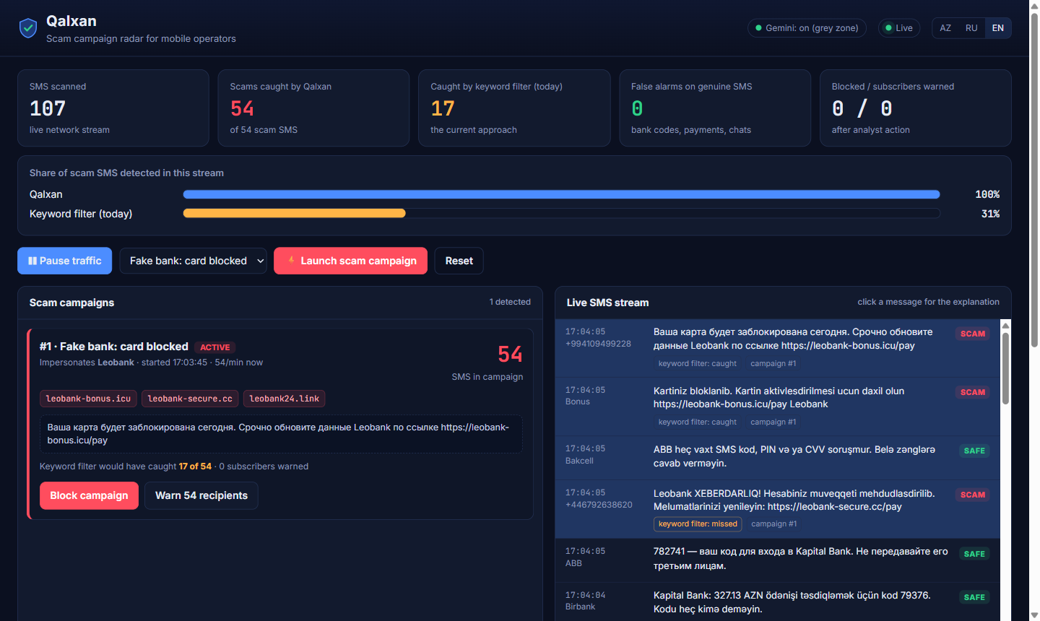
NEUROBRIDGE.SI BAKU 2026 · AI ENTERPRISE SOLUTIONS
Qalxan
Stops scam SMS campaigns before they reach your subscribers
Detects scam SMS in Azerbaijani, Russian and English, groups them into campaigns and lets the operator block them in one click.
Working prototype: 54 of 54 scam SMS caught live, keyword filter 17
Team La Furia Roja
Qalxan means «shield» in Azerbaijani
Notes:
Hello, we are team La Furia Roja. Qalxan means shield in Azerbaijani. It is a scam campaign radar for mobile operators: it detects scam SMS in Azerbaijani, Russian and English, groups them into campaigns and lets the anti-fraud team stop them in one click. On the right is our working prototype catching a fake-bank campaign live.

Slide 2
THE PROBLEM
Scam SMS reach thousands before anyone reacts
+994 70 8•• •• ••
30%
Kapital Bank: Kartınız bloklanıb. Bərpa üçün keçid edin: kapitalbank-az.online
+44 7•••• ••••
of scam SMS caught by today's keyword filters
Azerpost: 10.2 AZN gömrük rüsumu ödənilməyib: azerpost-gomruk.com
+994 55 •••
Blocklists updated by hand, hours to days late
Мама, это мой новый номер. Срочно нужно 300 AZN…
One swapped letter beats a keyword
WhatsApp
Tap.az: Alıcı ödəniş etdi. Kartı təsdiqləyin: tapaz-pay.top
Subscribers lose money, operators lose trust
Real scheme types officially warned about in Azerbaijan. Senders masked.
Notes:
These are real scheme types officially warned about in Azerbaijan by the Electronic Security Service, the Ministry of Internal Affairs and banks. Operators fight them with keyword blocklists updated by hand after complaints: hours to days of delay. Scammers swap one letter (ə to e, a Cyrillic a inside Kapital) and the filter is blind. In our test of documented schemes, keyword filtering caught 30%.

Slide 3
THE SOLUTION
Catch the campaign, not just the message
01
02
03
Detect
Group
Act
Understands the scheme in AZ / RU / EN, whatever the wording or letter swaps
Joins messages into campaigns: brand, domains, phones, speed
One click blocks the campaign and warns everyone who received it
Today
Hours to days, after subscribers complain
With Qalxan
Seconds from the first SMS
Notes:
Scammers send campaigns, not single messages. Qalxan reads every SMS like an analyst, catches the scheme whatever the wording, groups thousands of messages into a few campaigns and lets the operator block a campaign and warn everyone who already received it in one click.

Slide 4
OUR PRODUCT
Qalxan at a glance
Overview
An AI radar next to the operator's SMS firewall: it scores every message, explains why, and turns scam traffic into campaigns.
Mission
Make every scam campaign visible and stoppable within minutes, in the languages people here actually write in.
Who uses it
Anti-fraud analyst
web dashboard: campaigns, block, warn
Vision
One shield for every subscriber in the region: operators, banks and people sharing one live picture of scams.
Subscriber
Telegram bot: forward an SMS, get a verdict
Notes:
Overview, users, mission and vision. The primary user is the operator's anti-fraud analyst; subscribers use the Telegram bot.

Slide 5
FEATURES AND HOW IT WORKS
Our model decides, Gemini double-checks
Scam detection in AZ / RU / EN
survives letter swaps and rephrasing
SMS
network traffic or a subscriber report
Campaign grouping
brand, domains, phones, rate
Normalize + risk signals
undo letter swaps; spot fake links, code requests
One-click actions
block a campaign, warn recipients
Our model, trained by us
97.6% of messages, ~0.3 ms each
Gemini
2.4% grey zone
Explanations
why it is a scam, in 3 languages
Telegram bot
subscribers check any SMS
Campaign
dashboard · block · warn · explain
Notes:
Normalization undoes evasion tricks; rule signals add domain knowledge (impersonated brand, lookalike links, requests for code, card or ID, AnyDesk); our own model, character and word n-grams plus signals into logistic regression trained by us, decides 97.6% of messages in about 0.3 ms. Only the grey zone, 2.4%, goes to Gemini for a second opinion. If Gemini is unavailable, the model's verdict stands.

Slide 6
WORKING PROTOTYPE
Live: a scam campaign hits the network
1
Normal traffic
bank codes, payments, chats
2
The attack
60 scam SMS, 3 rotating fake domains
3
Seconds later
one campaign card: 54 / 54 caught, keyword filter 17
4
Analyst acts
block, then warn every recipient
Notes:
This is the real prototype: FastAPI backend, live dashboard, campaign actions, Telegram bot, running on a laptop. A fake-bank campaign enters the network; within seconds Qalxan shows one campaign card with the impersonated brand, domains and rate. It caught all 54 scam SMS that arrived; the keyword filter caught 17.

Slide 7
QUALITY TESTING
Tested against what operators use today
Test 1 · 70 SMS
real schemes documented by Azerbaijani authorities
Test 2 · 873 held-out SMS
with traps: real bank codes, payment alerts, fines
Test phrasings never appear in training · Gemini consulted for only 2.4% of messages
Notes:
Test 1: 70 SMS, 40 scams reconstructed from official warnings about real Azerbaijani campaigns plus 30 genuine-looking SMS. Keyword filter 30% caught with 13% false alarms; our first version 85% with 3.3%; final with Gemini 97.5% with zero false alarms. The final number is optimistic because it was measured on the same set that revealed the failures; 85% is the unbiased figure. Test 2: 873 held-out SMS, phrasings never in training, two scheme types only in the test: keyword filter 30.1%, classic ML 94.6% but 18.8% false alarms on bank SMS, Qalxan 96.1%, with Gemini 98.5%, zero false alarms.

Slide 8
QUALITY TESTING
What broke, and what we changed
Missed new schemes that ask for data, not a click: «tell us your card digits», «install AnyDesk»
Such requests now always get a Gemini second opinion
85% → 97.5%
Flagged a genuine Netflix payment alert as a fake link
Well-known merchant domains are trusted
3.3% → 0% false alarms
Still missed: an investment pitch with only a Telegram handle
Retrain on real reports during the pilot
Notes:
Version 1 missed every unseen scheme that asks for data instead of a click: tell us the 16 digits and the 3 on the back, install AnyDesk, send a passport photo. The model was confidently wrong, so Gemini was never asked. We added risk signals that always trigger a second opinion: 85% to 97.5%. It also flagged a genuine payment alert to NETFLIX.COM; merchants are now trusted: false alarms 3.3% to 0%. Still open: an investment pitch with only a Telegram handle, and code theft worded almost like a real OTP SMS.

Slide 9
MARKET SIZE
A global problem with a market that already pays
THE PROBLEM
MARKET
OUR START
$442B
~$3B
12.3M
lost to scams in one year; 23% of adults lost money
spent by operators on SMS firewalls every year
mobile lines in Azerbaijan across 3 operators
GASA & Feedzai, 2025
industry reports, 2024–25 ($2.7–3.6B)
GSMA Intelligence / DataReportal, 2026
Next markets: Central Asia, Türkiye and the GCC, with the same schemes and language mix
Notes:
The problem: consumers lost 442 billion dollars to scams in one year across 42 countries; 57% of adults met a scam and 23% lost money (Global Anti-Scam Alliance and Feedzai, 2025). The market: operators already spend about 3 billion dollars a year on SMS firewalls; estimates for 2024-25 range from 2.7 to 3.6 billion. Our beachhead: Azerbaijan, 12.3 million mobile connections at the end of 2025 across Azercell, Bakcell and Nar.

Slide 10
BUSINESS MODEL
The operator pays, brands join
1
2
3
Operator license
Brand protection
Scam Shield add-on
Annual on-premise license, priced by subscriber base, plus support
Banks and Azerpost pay for real-time alerts when their name is faked
Operator sells protection to subscribers; we share revenue
Unit economics
Near-zero cost per SMS: an LLM is needed for only 2.4% of traffic
Pricing
Set together with the first operator during the pilot
Notes:
The operator buys an annual on-premise license priced by subscriber base, plus setup and support; the buyer is the head of fraud or CTO. Banks, Azerpost and marketplaces subscribe to real-time impersonation alerts for faster takedowns. The operator can bundle protection into a tariff as a value-added service with revenue share. Unit economics: about 0.3 ms per SMS on CPU, no API cost for 97.6% of traffic. Pricing will be validated in the pilot.

Slide 11
PRODUCT MILESTONES
From prototype to the region
Oct 2026
Month 1
Months 2–3
Months 4–6
2027
DONE
PLANNED
PLANNED
PLANNED
PLANNED
Prototype, own model, 2 test sets
Pilot with one operator
Shadow mode on live traffic, retrain
Paid license, brand alerts
Central Asia, Türkiye, GCC; voice calls
Pilot success: time to block a campaign · scams caught vs blocklist · zero false alarms on bank SMS
Notes:
Done today: working prototype, our own model, two test sets, dashboard and Telegram bot. Month 1: pilot with one operator on subscriber-forwarded reports. Months 2-3: shadow mode on A2P traffic, retrain on real data, measure time-to-block. Months 4-6: paid license and brand protection feed. 2027: Central Asia, Türkiye, GCC and voice-call scam detection.

Slide 12
WHY THIS WORKS
Why Qalxan can win
Proven
30% → 97.5% vs today's keyword filter, zero false alarms on bank SMS
Private and cheap
runs on the operator's servers; 97.6% of traffic needs no API
Built for Azerbaijan
AZ / RU / EN, letter swaps, local brands and schemes
Actionable
one card per campaign; every verdict explained
Disclosure: own TF-IDF + logistic regression model trained at the hackathon · Gemini for grey-zone checks · Claude as coding assistant · synthetic and documented-scheme test data, no subscriber data · FastAPI, scikit-learn, aiogram
Notes:
Disclosure in full: our own TF-IDF and logistic regression model trained during the hackathon; Google Gemini flash-lite / flash for grey-zone second opinions; Claude used as a coding assistant; 2,714 synthetic SMS from our templates and a 70-SMS test reconstructed from official warnings; no real subscriber data; FastAPI, scikit-learn, google-genai, aiogram, matplotlib.

Slide 13
TEAM
Team La Furia Roja
Name Surname
Name Surname
Name Surname
Name Surname
Role
Role
Role
Role
What they built in Qalxan
What they built in Qalxan
What they built in Qalxan
What they built in Qalxan
Notes:
Team slide: replace names, roles and photos.

Slide 14
Thank you for your attention
Qalxan: one shield for every subscriber.
Team La Furia Roja · NeuroBridge.SI Baku 2026
Notes:
Thank you. We are happy to take questions and to show the live demo.

