Slide 1
MY AI & DATA SCIENCE PROJECT
Plant Disease
Classification
Using a CNN to classify pictures of plant leaves
Presented by: Farina Hamid | Saylani Mass IT Training
1 / 5

Slide 2
What is CNN?
CNN stands for Convolutional Neural Network.
1. Looks at the image
2. Learns patterns
3. Makes a prediction
It checks small parts of a picture.
It learns shapes, colours, and leaf marks.
It predicts which of the 15 categories the leaf may belong to.
In simple words: a CNN is an AI model that learns from images.

Slide 3
What is this project?
We made a model that looks at a plant-leaf photo and predicts which leaf category it belongs to.
1
Upload a leaf photo
2
AI checks the photo
3
See the result
Give the model a picture.
It looks for patterns in the leaf.
It predicts one of 15 categories.
It can classify 15 categories of pepper, potato and tomato leaves.
2 / 5

Slide 4
What did we do?
Five simple steps
1
Got the pictures
We used a dataset of plant-leaf photos.
2
Prepared them
We made every image the same size.
3
Built the CNN
We made an AI model to learn leaf patterns.
4
Trained it
We let it learn from the labeled pictures in Colab.
5
Tested it
We uploaded new pictures to see its predictions.
3 / 5

Slide 5
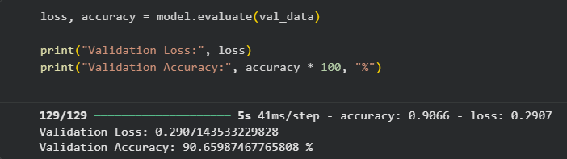
Our result
The model was tested on validation images in Google Colab.
90.66%
Validation accuracy
Validation loss: 0.2907
Actual output from my Colab notebook
This means the model predicted the correct category for about 91 out of every 100 validation images.
4 / 5

Slide 6
What did we learn?
We learned how to prepare images, train a CNN, and test its predictions.
The model predicts 15 plant-leaf categories.
It reached 90.66% validation accuracy.
The image checker is a first step and can be improved.
Thank you! Any questions?
5 / 5

