Slide 1

Farin Shaha
Nexthike IT Solution
Exploratory Data Analysis | Feature Engineering
Notes:
Introduce yourself and the project: Feature Extraction and Price Prediction for Mobile Phones. This presentation covers the EDA and feature engineering stage.

Slide 2




Project Goal: What Drives Phone Price?
Explore
Clean
Engineer
Prepare
Structure, types, quality
Fix text, outliers, duplicates
Create smarter features
Model-ready dataset
Takeaway Goal: find which phone features influence price and prepare clean data for prediction.
Notes:
A mobile retailer wants to price phones better. First we explore and clean the data, then create new features, and finally export a dataset ready for regression models.

Slide 3
Dataset Overview
541
Column | Type | Note
Model | Text | 187 unique phone names
Colour | Text | 275 marketing colour names
Memory | Number | Storage in GB
RAM | Number | RAM in GB
Battery_ | Number | Capacity in mAh
Rear / Front Camera | Text | Stored as "50MP"
AI Lens | 0 / 1 | AI camera flag
Mobile Height | Number | Height in cm
Processor_ | Text | Messy spellings
Prize | Number | Price (target)
phone listings
0
null values
123
processor spellings
Notes:
541 listings, no null values, but the data is inconsistent. Camera columns are text, processor has 123 spellings, and Model/Colour have too many unique values to encode directly.

Slide 4



Data Quality Issues: Before vs After
Camera stored as text
"50MP" cannot be plotted
Impossible height
41.94 cm phone = entry error
Fake processors
"Android", "Octa Core"
Takeaway No missing values, but inconsistent text hides the real information.
Notes:
The dataset has no nulls, so the quality problems are inconsistency: too many spellings, text numbers and one impossible height.

Slide 5

Cleaning Pipeline
1
2
3
4
5
Rename
Brand
Camera
Height
Duplicates
Clear column names, drop index
First word of model name
"50MP" becomes number 50
Fix values above 25 cm
Remove exact repeats
"50MP" → 50.0
41.94 cm → model median
Mediatek / MediaTek → MediaTek
Takeaway Five simple steps turn raw text into clean, numeric, consistent columns.
Notes:
Each step is one line of pandas. Examples at the bottom show the transformation: camera text to number, the 41.94 cm height replaced by the model median, and processor spellings merged.

Slide 6
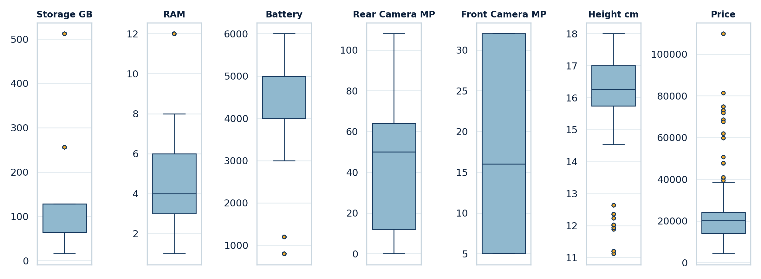
Outlier Detection (Box Plots)
Takeaway Only the 41.94 cm height was an error; premium and feature phones are real, so they were kept.
Notes:
Points beyond the whiskers are outliers. We checked each case: an outlier is only fixed when it is an error, not when it is a genuine premium phone or a basic feature phone.

Slide 7
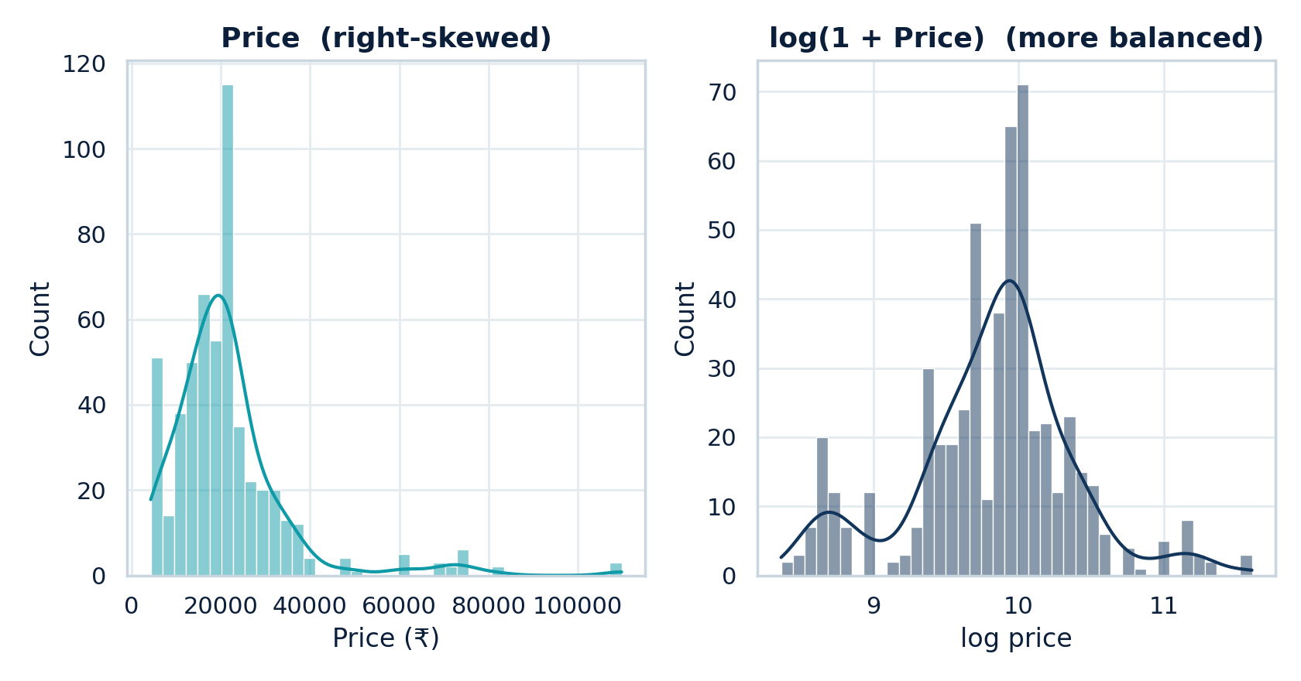
Price Distribution: Raw vs Log
Raw price
Right-skewed
Log price
Balanced
Takeaway A few premium phones stretch the price; log(Price) is the better target.
Notes:
The raw price has a long right tail because of premium phones. Taking log(1 + price) makes the shape much more balanced and is used as the modelling target.

Slide 8
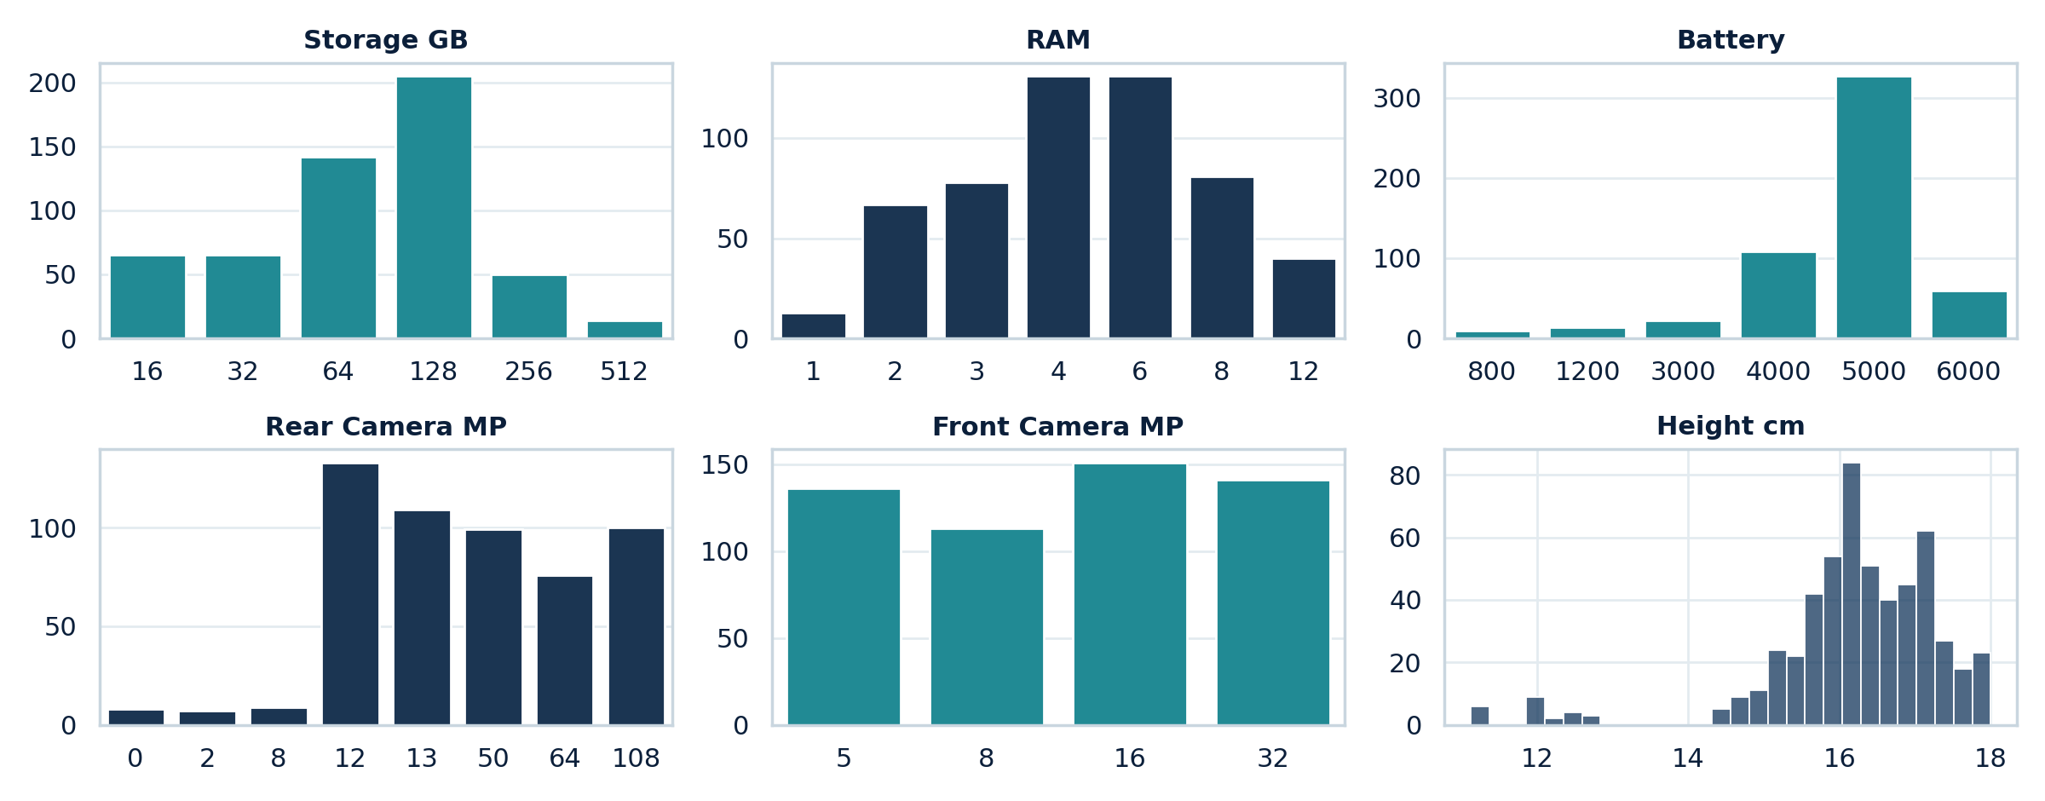
Distribution of Phone Specifications
Takeaway Listings cluster around common spec levels, with few high-end configurations.
Notes:
Histograms and count plots for storage, RAM, battery, rear camera, front camera and height.

Slide 9
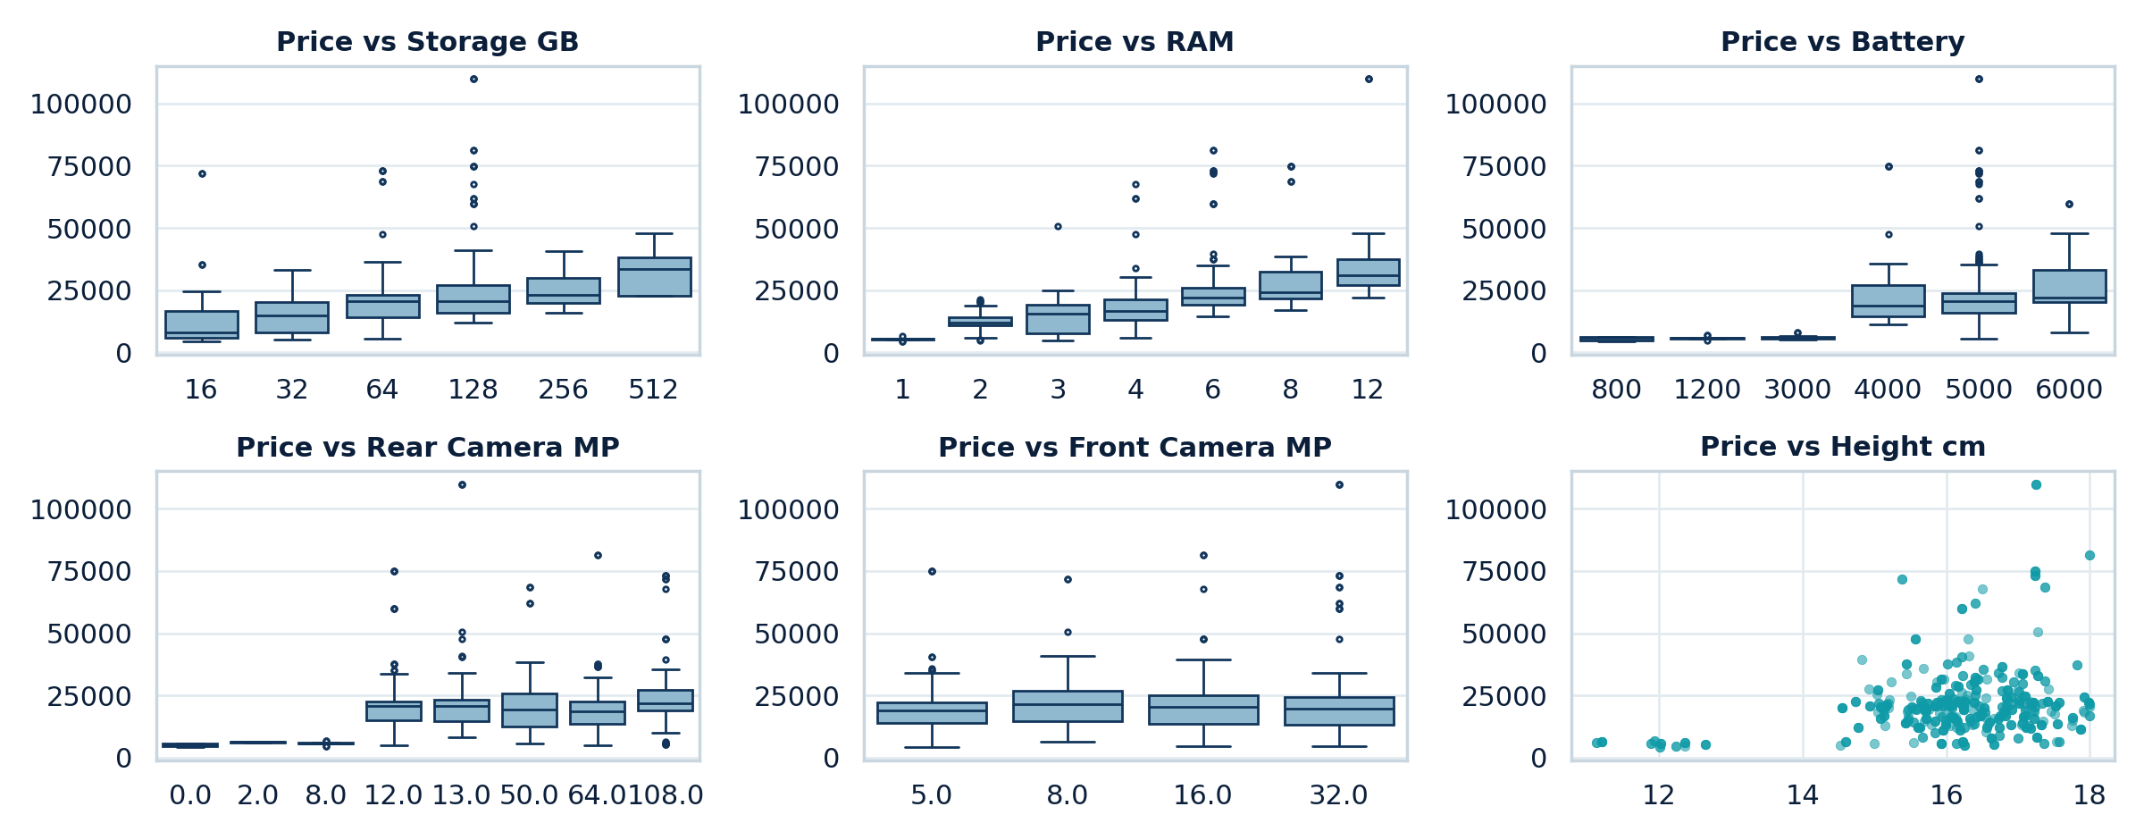
Price vs Specifications
Takeaway Higher RAM and storage tiers sit at higher price levels.
Notes:
Box plots are used for discrete specs like RAM and scatter plots for continuous ones like battery and camera.

Slide 10
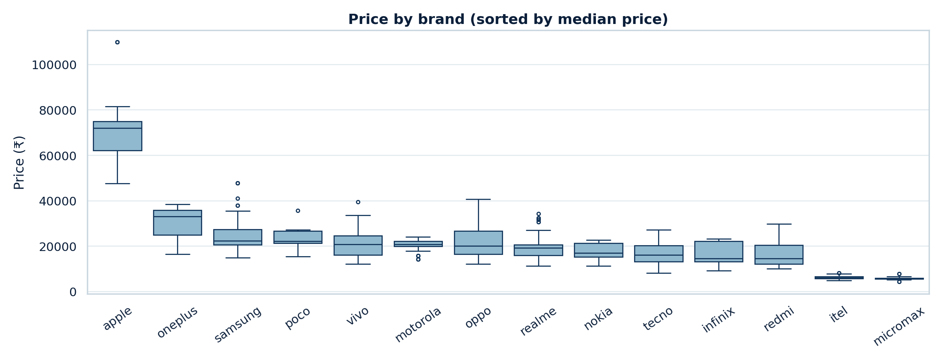
Price by Brand
Takeaway Brand shifts the price level, even for phones with similar specs.
Notes:
Brands are sorted by median price. Rare brands with fewer than five listings were merged into 'other'.

Slide 11
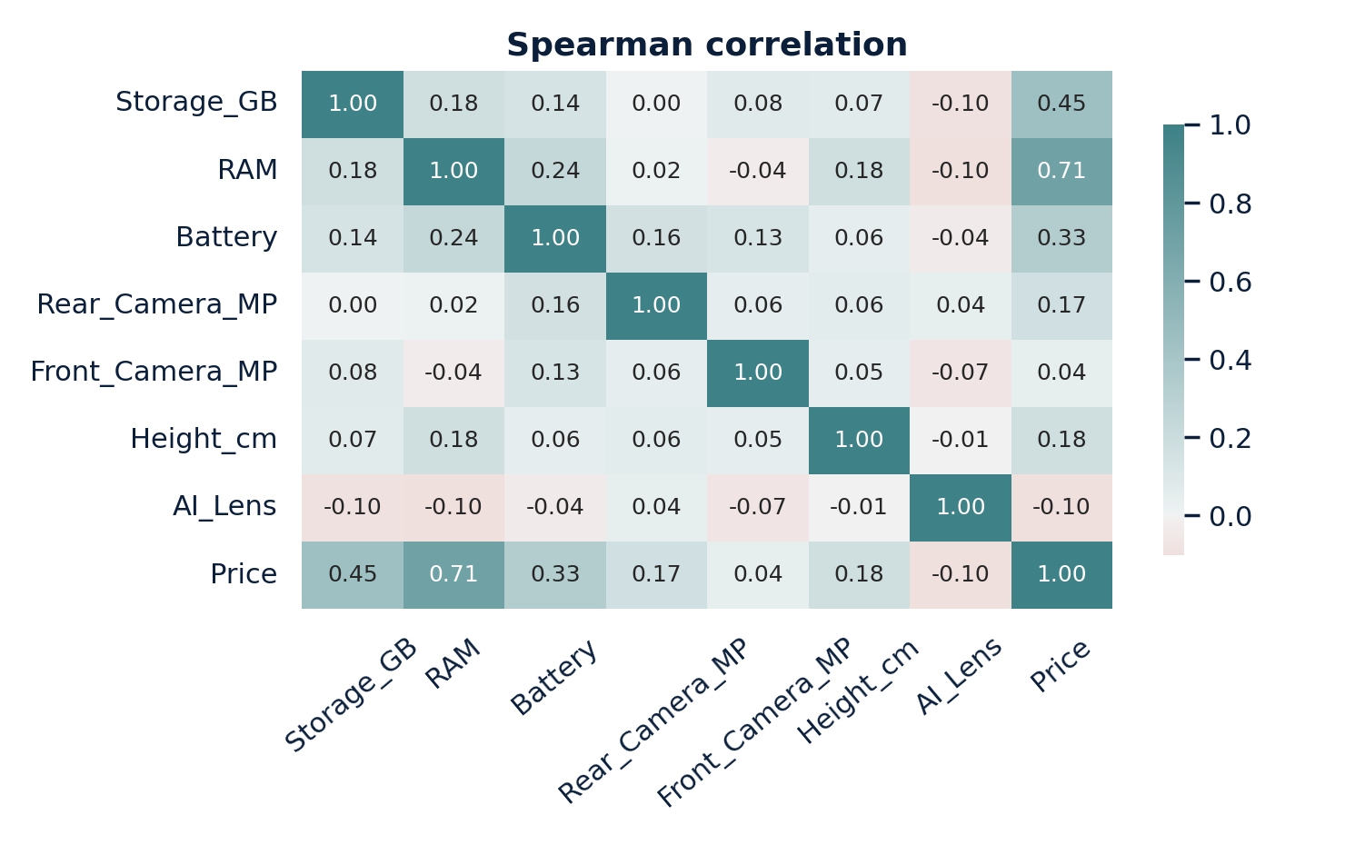
Correlation Heatmap
+1
Moves up with price
0
Little relation
-1
Moves opposite to price
Takeaway Check the Price row/column: darker cells mean a stronger link with price.
Notes:
Spearman correlation is used because it captures any steady increasing or decreasing relationship, not only straight lines. Look at the Price row to see which features matter most.

Slide 12
New Features Created
Feature | How it is built | Why
Brand | First word of model | Brand sets price level
Processor_Family | 123 spellings → 7 groups | Clean, low-cardinality
Colour_Family | 275 names → 10 groups | Avoids sparse columns
Is_5G, Is_Feature_Phone | Rule-based flags | Explicit phone type signals
Total_Camera_MP | Rear + Front MP | Combined camera strength
RAM_x_Storage, Battery_per_cm | Interaction and ratio | Combined spec effect
Spec_Score | Mean of scaled core specs | One number for strength
Storage / RAM / Battery Tier | Binned specs | Readable segments
Log_Price | log(1 + Price) | Modelling target
Notes:
These are the features we created. Categorical text was grouped, flags and ratios were added, and a spec score summarises the phone in one number.

Slide 13
Grouping Processor and Colour
123 → 7
processor spellings → chip families
275 → 10
colour names → colour families
Takeaway Grouping cuts hundreds of sparse values into a few meaningful categories.
Notes:
Hundreds of unique text values would create hundreds of sparse one-hot columns for only about 540 rows. Grouping keeps the information and removes the noise.

Slide 14
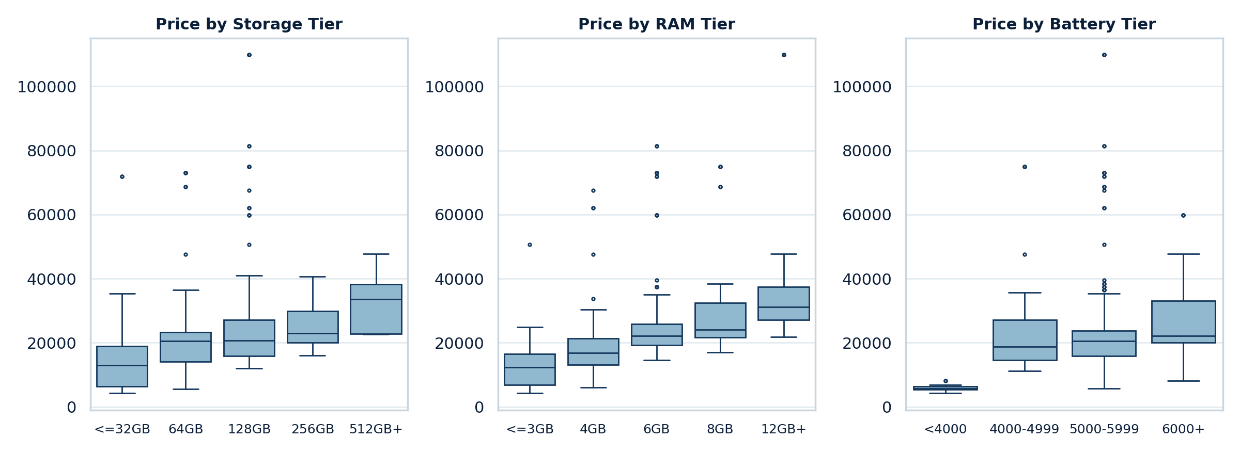
Tier Analysis: Storage, RAM, Battery
Takeaway Binning specs into tiers makes the price step from one level to the next easy to read.
Notes:
Tiers are for readable segment analysis. The model still uses the numeric versions of these specs.

Slide 15
Which Features Relate to Price?
Takeaway Two different methods are used so the ranking does not depend on one technique.
Notes:
Correlation shows steady relationships; mutual information also catches non-linear ones. Features that rank high in both are the most reliable price drivers.

Slide 16



Conclusion and Next Steps
Clean data
Log price
Specs + brand
Ready to model
Text, height and duplicates fixed
Skew reduced for modelling
Main signals for price
Two CSV files exported
Next: train and compare regression models (Linear, Ridge, Random Forest, Gradient Boosting) with a grouped train/test split by Model.
Notes:
Summarise: the data is clean, price is modelled on a log scale, RAM, storage and brand are the main signals, and the engineered dataset is exported. The next step is model building.

Slide 17
Thank You
Farin Shaha
Nexthike IT Solution
Notes:
Thank the audience and invite questions.

